Slide 1
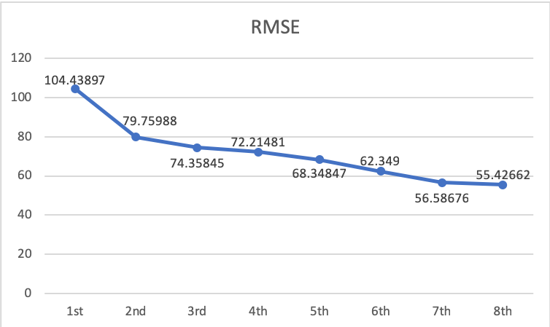
Data exploration (data type, validity of data)
Data Processing (remove n/a columns and convert categorical variables)
Modelling and Tweaking Parameters
Features:
RATING
LOCATION
AVAILABILITY
GUESTS
ROOM
HOST
Linear Regression
Tree Model

