Slide 1
Cucumberjs + protractor
E2E testing , October 2017

Slide 2
agenda
Protractor and cucumber
Protractor and bdd
Java script + es6
Helper functions in protractor(step definitions)
Protractor api
Page objects
Cucumber examples

Slide 3
Protractor and cucumber
an end-to-end testing framework built specifically for AngularJS
It allows you to create tests that interact with a browser like a real user would
One of the greatest features of Protractor is its ability to "be smart" about waiting for a page to load, limiting the amount of waits and sleeps you use in your suite.
Protractor is also incredibly flexible in that it allows you to incorporate different behavior-driven development (BDD) frameworks like Cucumber into your workflow.

Slide 4
Protractor and BDD
Out of the box, Protractor supports Jasmine. Jasmine allows you to write your specs based on the behavior of the application. This is great for unit tests, but may not be the preferred format for business-facing users.
What if your business team wants the ability to see a higher-level view of what your suite is testing against? This is where Cucumber comes in. Cucumber is another BDD framework that focuses more on features or stories.
Cucumber provides your team with living documentation, built right into your tests, so it is a great option for incorporating with your Protractor tests.

Slide 5
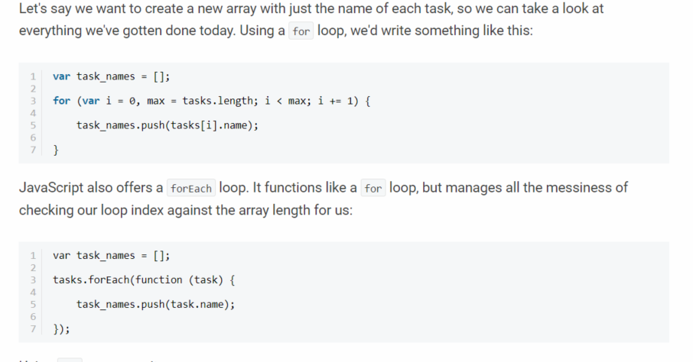
Java Script + es6
functional programming (forEach)
text
TEXT
text

Slide 6
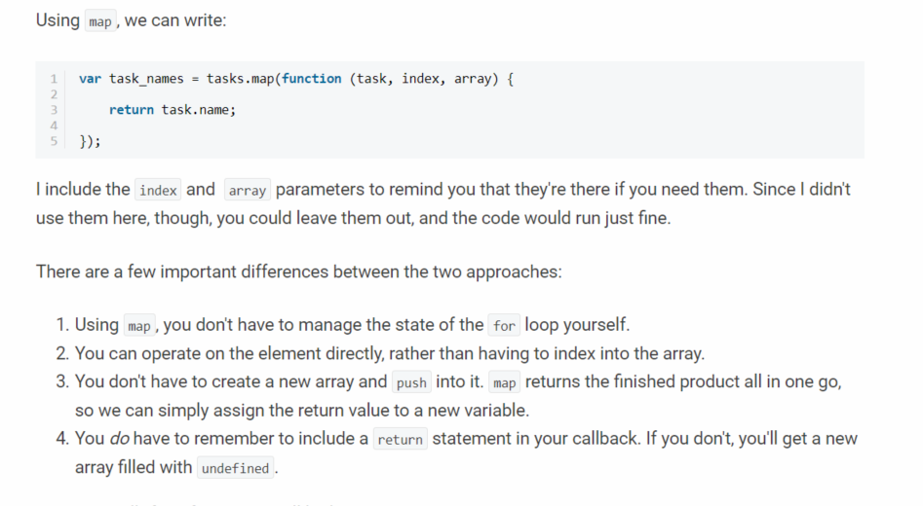
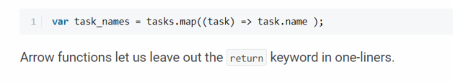
Java Script + es6
functional programming (map)
text
TEXT
text

Slide 7
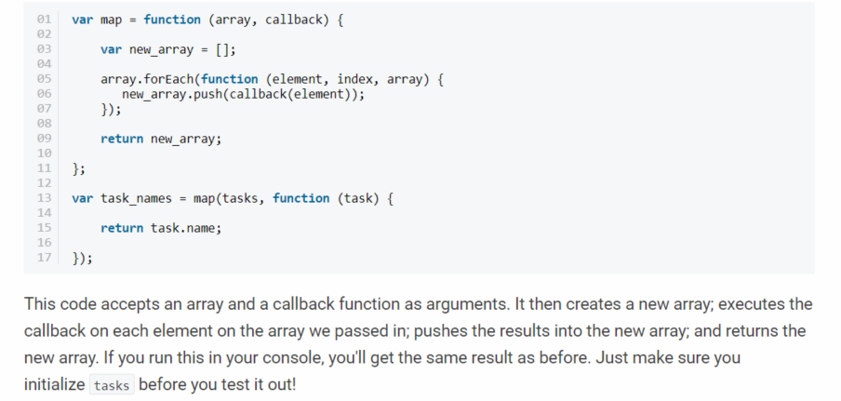
Java Script + es6
functional programming (map)
text
TEXT
text

Slide 8
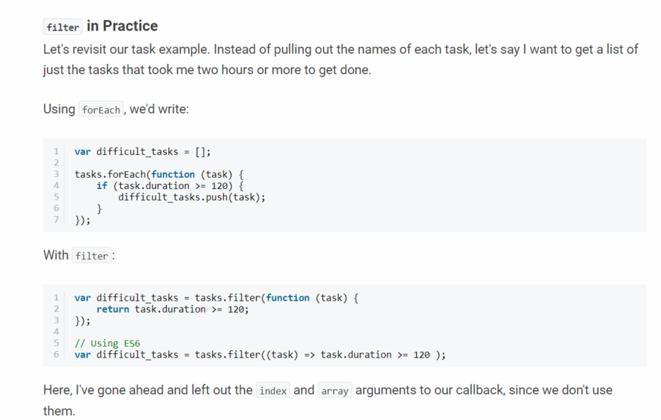
Java Script + es6
functional programming(filter)
text
TEXT
text

Slide 9
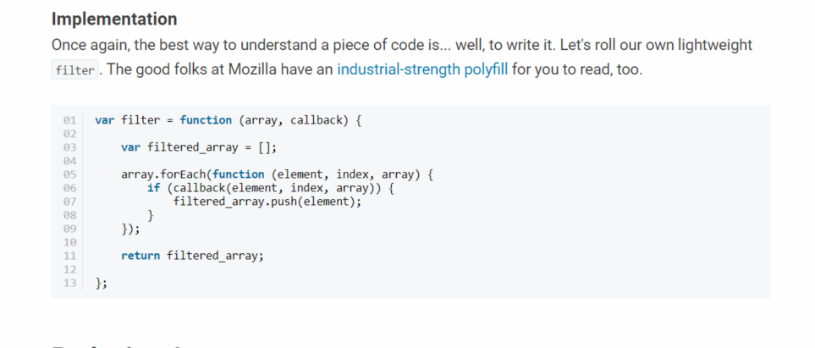
Java Script + es6
functional programming(filter)
text
TEXT
text

Slide 10
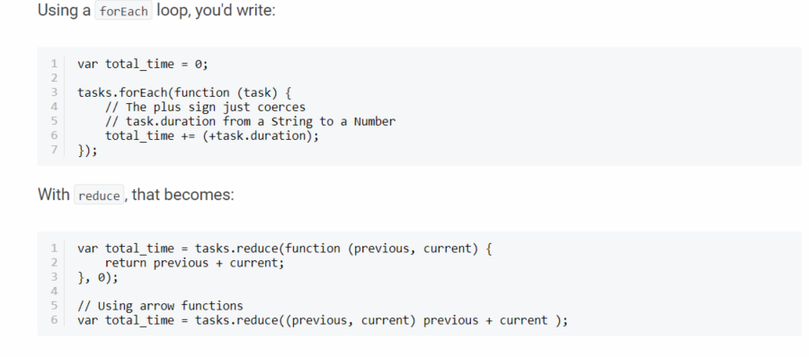
Java Script + es6
functional programming(reduce)
text
TEXT
text

Slide 11
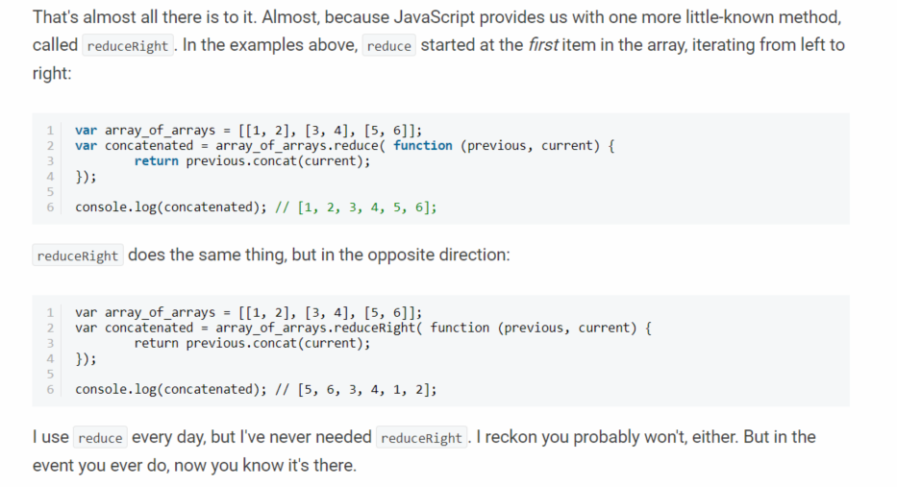
Java Script + es6
functional programming (reduce)
text
TEXT
text

Slide 12
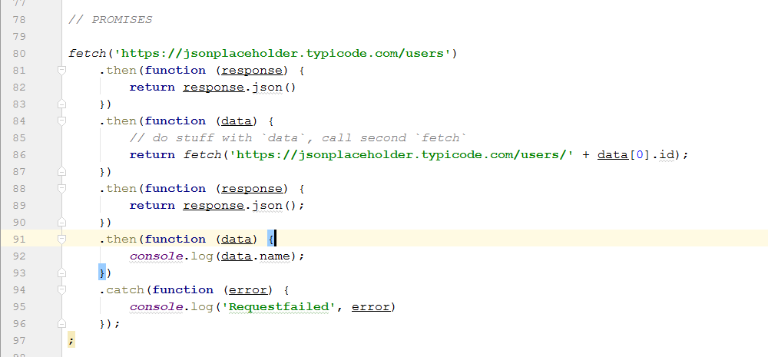
Java Script + es6
PROMISE
text
TEXT
text

Slide 13
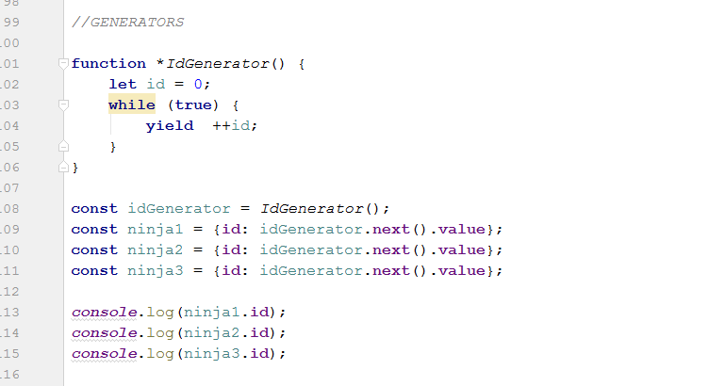
Java Script + es6
GENERATORS
Suspended start =>
Executing =>
Suspended yield =>
Executing =>
Completed. (Iterator.next())
text
TEXT
text

Slide 14
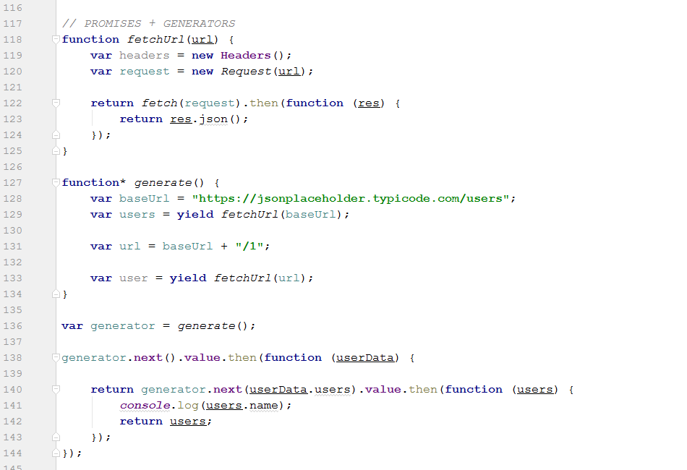
Java Script + es6
GENERATORS + PROMISE
text
TEXT
text

Slide 15
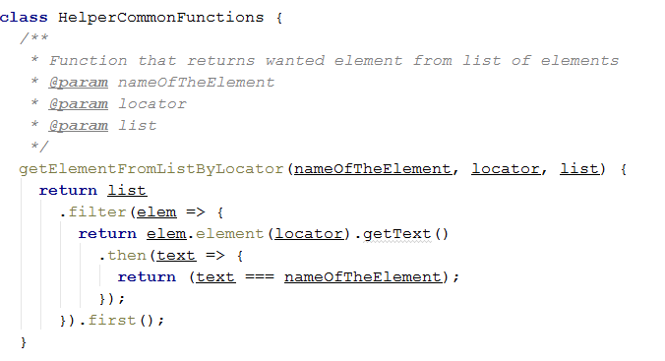
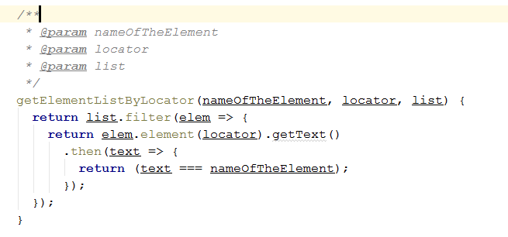
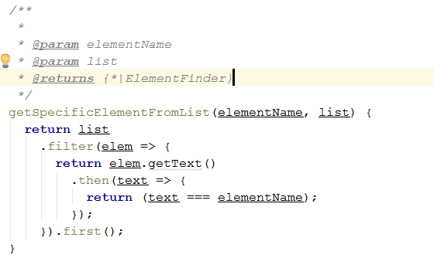
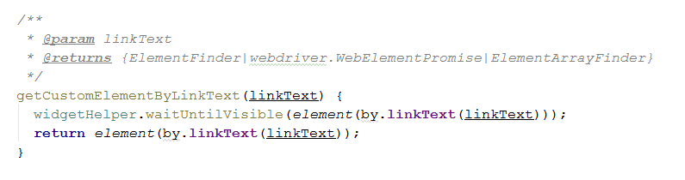
Some helper functions in protractor

Slide 16
Protractor Api
http://www.protractortest.org/#/api?view=webdriver.WebDriver.prototype.actions

Slide 17
Page objects – automation testing
Page Object is a Design Pattern which has become popular in test automation for enhancing test maintenance and reducing code duplication.
A page object is an object-oriented class that serves as an interface to a page of your AUT.
The tests then use the methods of this page object class whenever they need to interact with that
page of the UI.
The benefit is that if the UI changes for the page, the tests themselves don’t need to change,
only the code within the page object needs to change.
Subsequently all changes to support that new UI are located in one place.

Slide 18
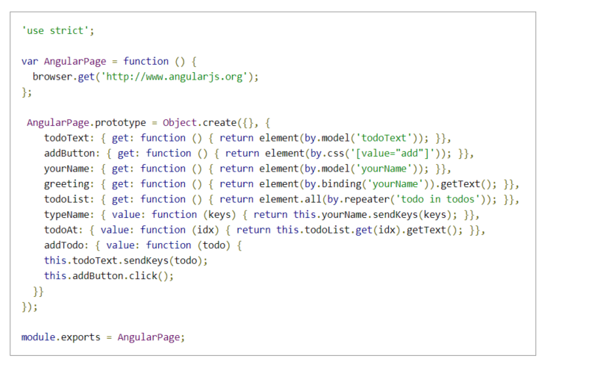
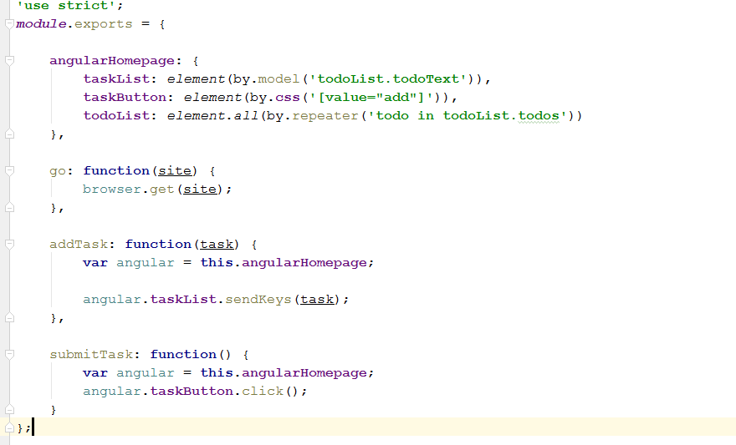
Page object Examples

Slide 19
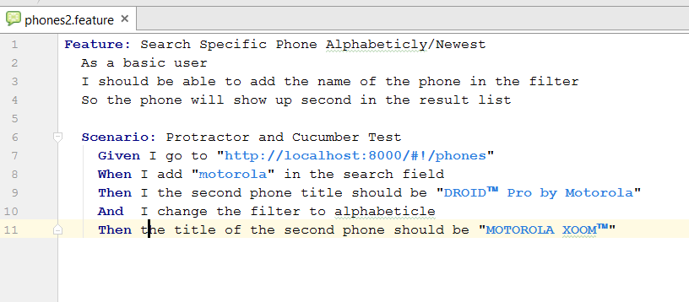
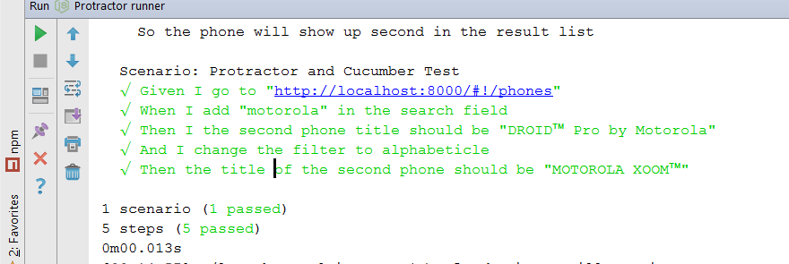
Cucumber feature files

Slide 20
Example
Lets see the practical work in action….

Slide 21
Sources
Protractor:
http://www.protractortest.org/#/
http://www.protractortest.org/#/api?view=webdriver.WebDriver.prototype.actions
https://www.thoughtworks.com/insights/blog/using-page-objects-overcome-protractors-shortcomings
Java Script:
https://code.tutsplus.com/tutorials/how-to-use-map-filter-reduce-in-javascript--cms-26209
Secrets of the JavaScript Ninja SECOND EDITION – Generators And Promises
https://www.sitepoint.com/asynchronous-apis-using-fetch-api-es6-generators/
CucumberJS + Protractor
https://semaphoreci.com/community/tutorials/getting-started-with-protractor-and-cucumber

Slide 22
THANK YOU
Hristina nastevska
Developer
Hristina.Nastevska@endava.com

