Slide 1

Is a Hotdog a Sandwich?
By: Christina, Abby, Cece

Slide 2
Motivation
Hotdogs are an extremely common food item, especially among young college undergrads
This has created the long lasting debate of “is a hotdog a sandwich?”
This question is known to cause large fights between family and friends
The goal of this project is to find the correct answer

Slide 3
Hypothesis
Less than half of full-time UVA undergraduate students believe that a hot dog is a sandwich.

Slide 4
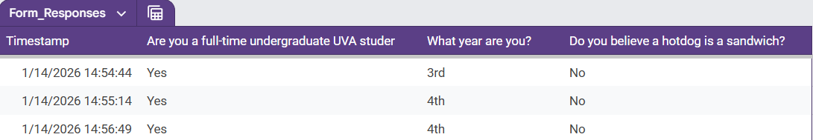
Data
Responses: 79
Columns: 4
  Timestamp (timestamp), Full-time Undergraduate UVA Student (binary), Year (ordinal), Hotdog a Sandwich Question (binary)
Yes (18), No (58)
Example from form:

Slide 5
Analysis Plan
Cleaning data
  Filtering to only full-time undergrad uva students
EDA
  Pie charts
  Bar graphs
Data analysis
  Chi squared analysis
Conclusions
  We have evidence to support the hypothesis.

Slide 6
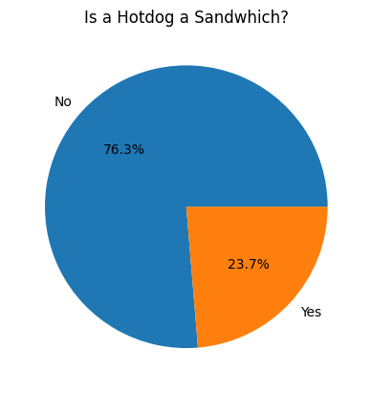
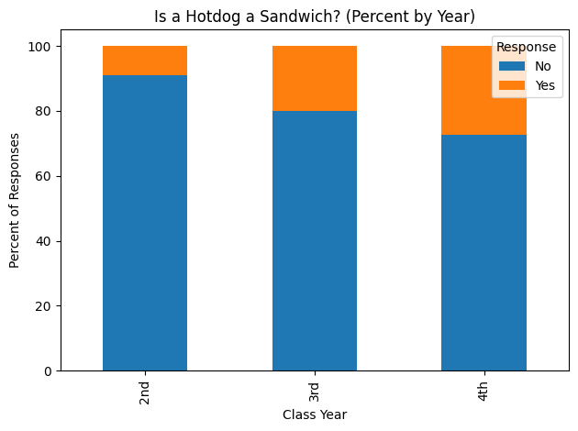
Results/findings
Our survey results show that 23.7% (less than half) of full time UVA undergraduate students responded they believe a hot dog is a sandwich.
A chi-squared test showed that there is no significant difference in response by year of student.

Slide 7
Limitations of Data
Limited questions
Missing 1st years response
Small sample size
  Uneven distribution of years

Slide 8
Next Steps
Explore other demographics for potential differences in answers to hotdog question
  major, school, in state vs. out of state vs. international, dietary restrictions, etc
Further statistical testing to strengthen findings

