Slide 1
MTurk/JavaScript Workshop
Christina Bejjani & Peter Whitehead
Notes:
(developed from Jiefeng Jiang’s materials)

Slide 2
Goals
Acquire basic programming skills for presenting stimuli and collecting responses using JavaScript.
Develop basic skills for running online subjects using Amazon mechanical turk (MTurk). Gain basic knowledge of MTurk.
We’ll go through the basic demographics and considerations of MTurk studies (Part I), JavaScript Tasks (Part II), a Basic Stroop Task Demo (Part III), Resources for Future Tasks (Part IV), and Your Turn to Post a Task (Part V).

Slide 3
Part I: Amazon Mechanical Turk (MTurk)

Slide 4
Introduction to Amazon Mechanical Turk
What is Mturk?
Who are those people on Mturk?
Why do you want to use Mturk?
How do you use Mturk to conduct behavioral studies?

Slide 5
What is Mturk?

Slide 6
“Based upon searches of the full article text, we find that in 2017, 24% of articles in Cognition, 29% of articles in Cognitive Psychology, 31% of articles in Cognitive Science, and 11% of articles in Journal of Experimental Psychology: Learning, Memory, and Cognition mention MTurk or another marketplace, all up from 5% or fewer five years ago.”
Stewart, Chandler, and Paolacci, 2017, TiCS
Notes:
http://www.cell.com/trends/cognitive-sciences/fulltext/S1364-6613(17)30131-6?rss=yes

Slide 7
MTurk is one of many crowdsourcing sites:
MTurk consists mostly of Americans and Indians.
Prolific and Clickworker have larger European populations.
Microworkers claims a large South-East Asian population.
CrowdWorks has a primarily Japanese population.
Stewart, Chandler, and Paolacci, 2017, TiCS

Slide 8
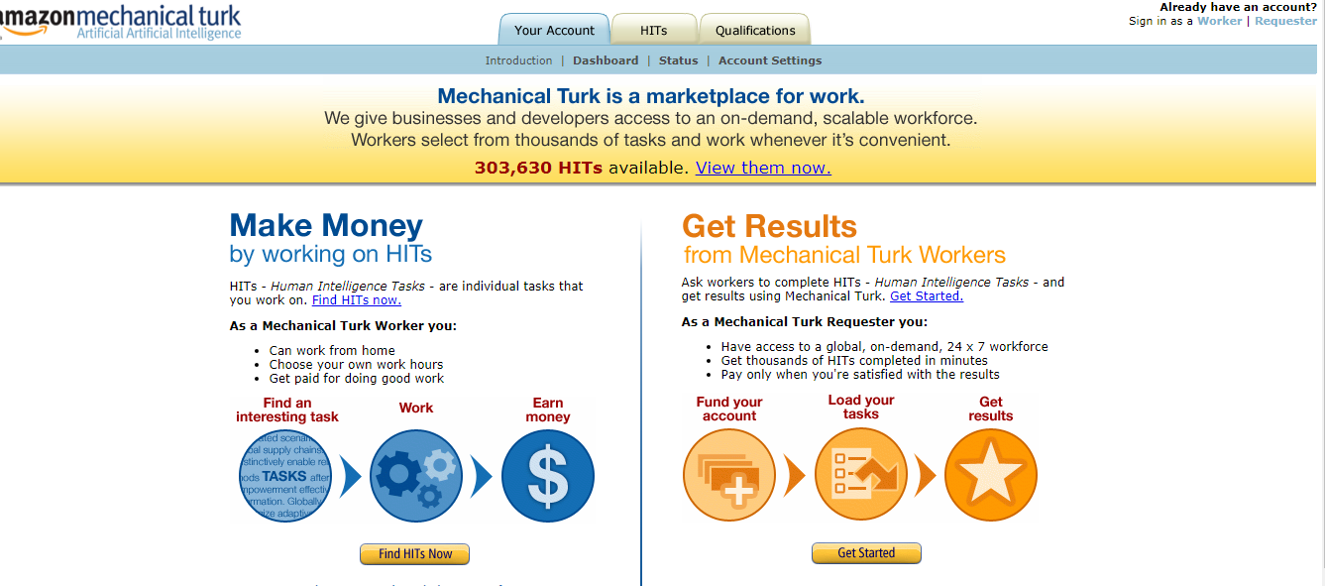
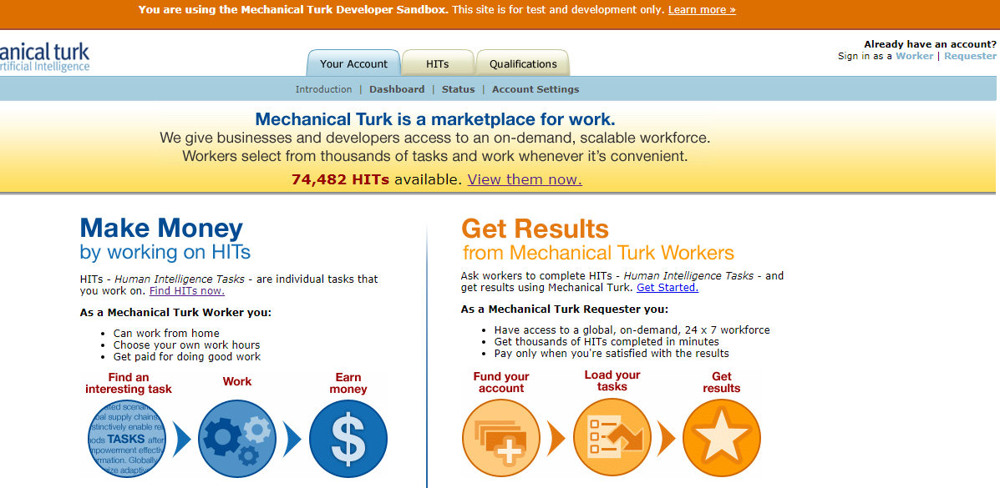
Sandbox vs. Regular MTurk
Two websites:
For running real subjects -> https://www.mturk.com/mturk/welcome
For piloting/debugging (sand box) -> https://workersandbox.mturk.com/mturk/welcome

Slide 9
Who are those people on Mturk?

Slide 10
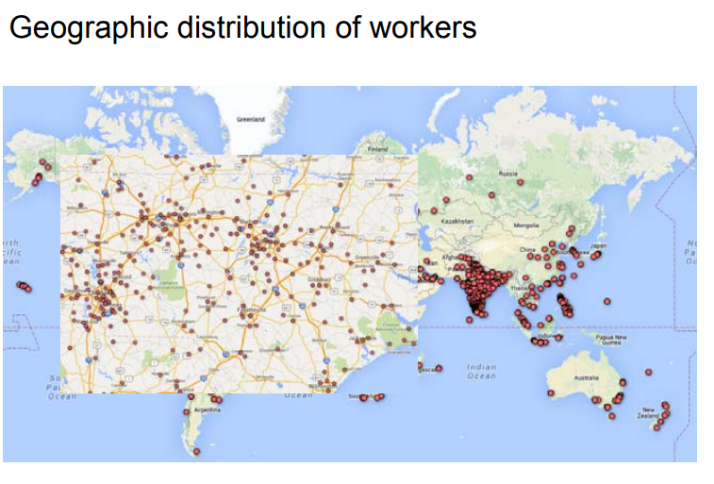
http://techlist.com/mturk/global-mturk-worker-map.php
Notes:
More spread out in the US, but it’s more concentrated in India

Slide 11
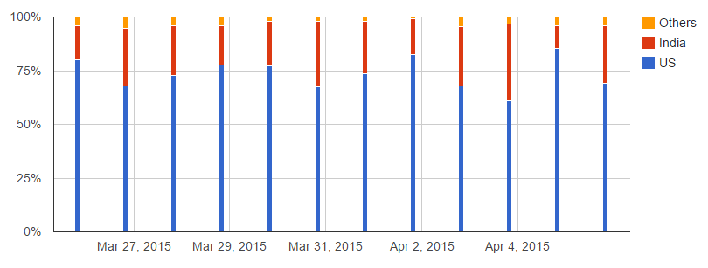
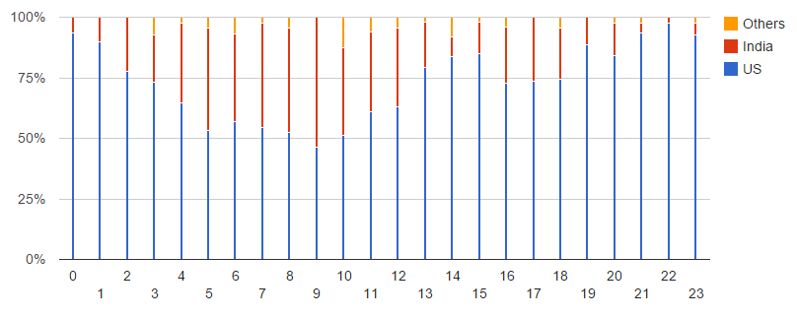
Worker Country of Origin
Worker Country of Origin Depending on Time of Day
Also see: http://demographics.mturk-tracker.com/
http://www.behind-the-enemy-lines.com/2015/04/demographics-of-mechanical-turk-now.html
Notes:
~80% of MTurkers are from US; 20% from India - this might have changed over the years (i.e., more Indian workers)
Demographics depends on time of day
Around 8-10am UTC (3am NYC time, 1.30pm India time) - much higher number of workers from India (~50%); goes down to 5% at 8-10pm UTC.

Slide 12
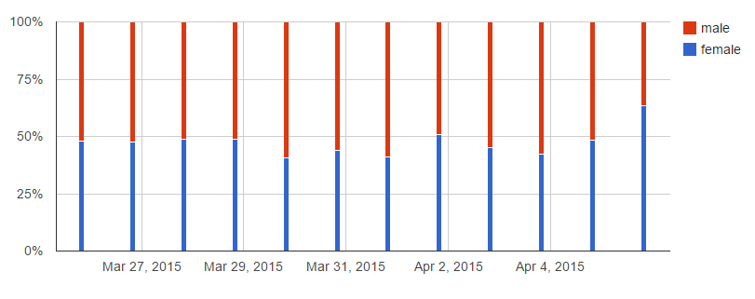
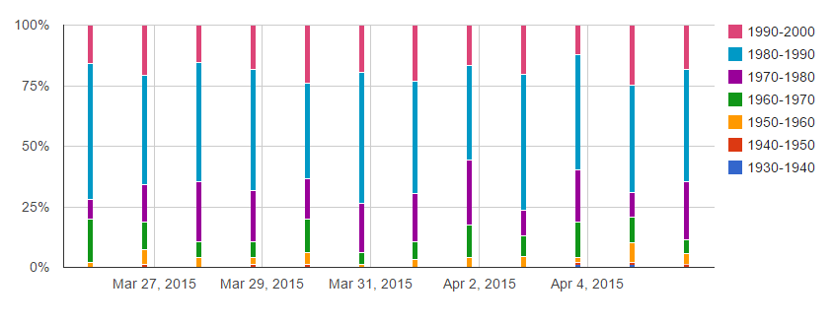
Worker Gender and
Year of Birth/Age
http://www.behind-the-enemy-lines.com/2015/04/demographics-of-mechanical-turk-now.html
Notes:
Gender roughly even regardless of time of day & hour
~50% are 30-year-olds;
~20% are 20-year-olds;
~20% are 40-year-olds.
Note that you do get the occasional 50+ year old on MTurk. You can exclude, but our lab doesn’t, typically.

Slide 13
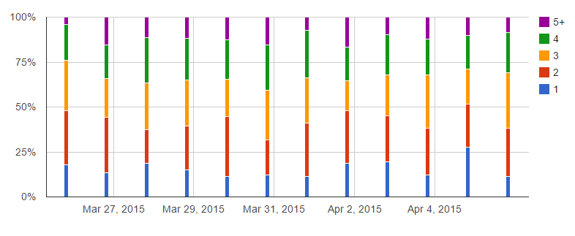
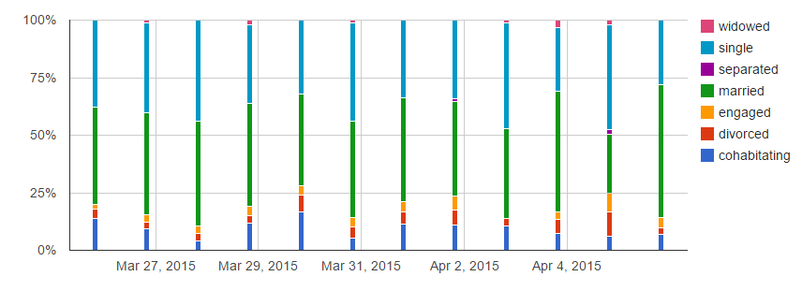
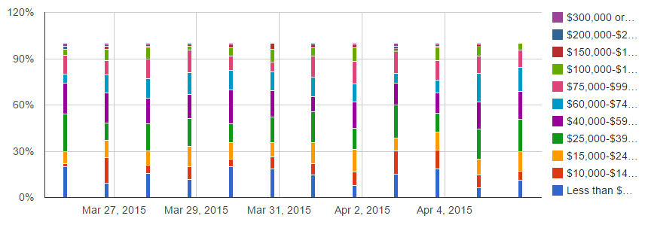
Worker marital status, number of people in household, and median income
http://www.behind-the-enemy-lines.com/2015/04/demographics-of-mechanical-turk-now.html
Notes:
NOTE THAT THERE IS A FIGURE BENEATH THE HOUSEHOLD ONE
~40% are single, ~40% are married, and ~10% are cohabitating.
~15% live alone; ~25% have a household size of 2 & ~25% have a household of 3. ~25% live in a household of 4, & ~10% have a household of 5+ members.
The median household income is ~$50K/year for US Turkers (on par with the median US household income). Indian workers have considerably lower household income, with most of them being around $10K/yr.

Slide 14
A Typical MTurk Worker, Summarized
Lives in the US or India
Is 20‐36 years old
Earns US $25,000‐60,000 a year (depending on where they live)
Matches the profile of a (procrastinating) graduate student/postdoc

Slide 15
Other Characteristics of MTurk Workers:
Demographics:
More diverse than college student samples but not representative of the US population as a whole (European- and Asian-Americans over-represented, while Hispanics and African-Americans under-represented)
Tend to be younger and more educated
Lower incomes and more likely to be unemployed or underemployed
Less religious and more liberal (than the population as a whole)
Psychologically:
Score higher on learning goal orientation & need for cognition
Report more social anxiety than both college students and the population as a whole
Are more introverted than both college students and the population as a whole
Less tolerant of physical and psychological discomfort than college students
More neurotic than other samples
Score higher on traits associated with autism spectrum disorders
Stewart, Chandler, and Paolacci, 2017, TiCS

Slide 16
Less studied characteristics:
“Research studies are usually available on a ‘first come first served’ basis... survey respondents will vary in characteristics such as personality, ethnicity, mobile phone use, and level of worker experience as a function of the time of day that a task is posted.”
“In particular, small samples tend to over-represent the savviest workers – who take advantage of software and online communities to quickly find available work.”
“Workers have self-organized into communities, and those workers tend to earn more.”
“Studies that are publicized on online forums (e.g., Reddit) may also return disproportionately young and male samples.”
“The workers who complete a survey early are also different from workers who complete later, leading samples to change across data collection.”
Stewart, Chandler, and Paolacci, 2017, TiCS
Notes:
Point: mturk is great, but there’s a lot of variability we don’t entirely understand, especially that which results from inadvertent study design. But some of this may not be things you can control, so you just have to be aware of these issues.

Slide 17
Some Other Design Considerations:
Crowdsourcing tasks tend to be shorter
Workers aren’t taking part while under exam conditions
1/3 report not being alone (e.g., emails I’ve received about children)
1/5 report watching TV
Doesn’t mean data doesn’t look like ‘in-person’ subjects
Workers need to be spoon-fed 100% understandable instructions
In-person subjects would be able to ask you questions; workers will not pause for this
Stewart, Chandler, and Paolacci, 2017, TiCS

Slide 18
Why do you want to use MTurk?

Slide 19
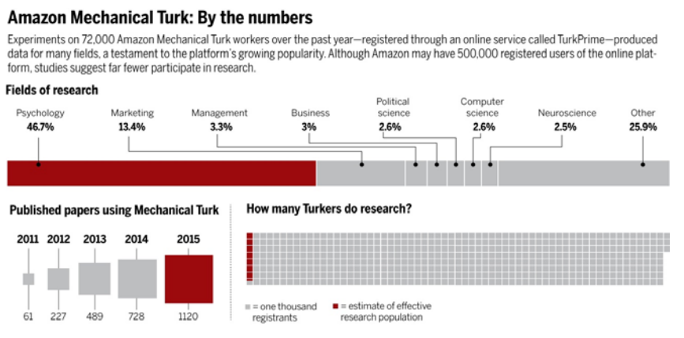
Our field is rapidly adapting
Notes:
http://science.sciencemag.org/content/352/6291/1263

Slide 20
Benefits versus Pitfalls, a Summary:
Cheap, fast data acquisition
Can simultaneously run multiple subjects
Subjects can participate at any time
More available subjects
Much larger and diverse than local subject pools
Easy for testing replicability and transparency
Tasks can be run on multiple platforms without modifying code
Uncontrolled testing environment
Sometimes uncontrolled internet issues and data collection (there are some issues with JS)
Duplicate data
Are they “real” humans?
Running MTurk can be stressful (hate mail, IRB, etc.)

Slide 21
Does MTurk yield reproducible results? Short answer: yes. But its longer relationship with the reproducibility crisis: unknown.
Notes:
Crump et al (2013, PLOS ONE) tested the reliability of Mturk data using Stroop, task switching, Flanker, Simon, Posner cuing, attentional blink, subliminal priming, and category learning tasks. Crowdsourced samples can be used along-side traditional university panel samples.

Slide 22
It is unclear what effect the ease and speed of running studies on crowdsourcing platforms will have on reproducibility.
More bad ideas being tested & greater false positives and file drawer effects?
More p-hacking?
But the ease of collecting data, resource costs, etc. may allow researchers to let go of less promising ideas
The time reduction should also reduce “data-peeking” p-hacking
Larger samples for greater power
Lowered investment to replicate a study
Stewart, Chandler, and Paolacci, 2017, TiCS

Slide 23
Things that may change in the future of MTurk (Ethics)
Is ‘Click here to continue’ good enough for informed consent? Do participants understand that they can withdraw from the study at any time?
Do participants have a way to request deletion of their data?
Payment -- a primarily ethical consideration
Data quality not usually sensitive to compensation level
Greater payment = quicker data collection & reduces data attrition
Could also act as incentive - spend longer on tasks with greater effort demands
Could, however, also attract most keen workers and crowd out the less experienced
Stewart, Chandler, and Paolacci, 2017, TiCS

Slide 24
Other Dangers
“The average laboratory samples from a population of about 7300 MTurk workers, with… overlap between the populations accessed by different laboratories. This creates the very real possibility of exhausting the pool of available workers for a particular line of research.”
No restrictions on # surveys to complete or how long to be in the pool
The median worker does 160 academic studies/month; half of the workers are replaced every seven months, but some remain in the pool for years
Workers don’t tend to share knowledge about expts w/ each other on forums or online discussion boards (except mturk features, like payment/experiences w/ the requester, etc.)
Worker experience can affect data/influence future behavior (practice effects); contaminating subject pools for other laboratories, etc.
Amazon sometimes randomly changes their policies (increased costs, etc.)
Stewart, Chandler, and Paolacci, 2017, TiCS

Slide 25
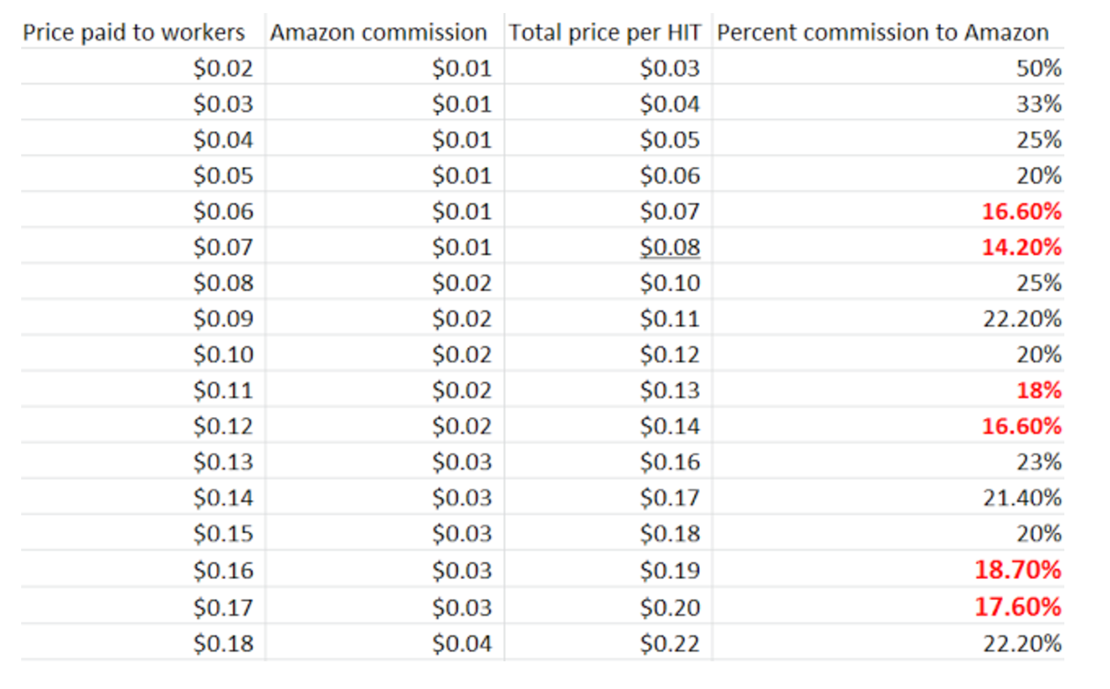
Cost of MTurk
Base pay for workers
The general consensus on MTurk boards is that $0.10-$0.20 per minute is reasonable
I.e. $6-$12 per hour
Heuristically most researchers pay ~$0.10 per minute or less (info gained from MTurk forums)
I try to usually pay ~$0.13 a minute, but might adjust depending on difficulty of task or what lab I’m running in ($0.11-$0.16)
Cost of using Mturk service = +20% service fee
Additional +20% if running batches of > 9 subjects
You can run multiple batches of 9 at the same time
Additional +5% if using Master workers
(i.e. high performing workers)

Slide 26
How do you use Mturk to conduct behavioral studies?

Slide 27
MTurk Terms
Approval/rejection: once a worker completes a HIT, a requester can choose whether to approve the HIT (and compensate the worker with the reward) or reject the HIT (and not compensate the worker).
Block: a requester can ‘block’ workers and disqualify them from any future task they post. Workers are banned from MTurk after an unspecified number of blocks. (We also block mturkers from doing our tasks via our JS, without specifically blocking them on mturk).
Command line tools: a set of instructions that can be input in Python to send instructions to MTurk via its application programming interface (API).
HIT approval ratio: the ratio between the number of approved tasks and the number of total tasks completed by a worker in her history. Until a worker completes 100 HITs, this is set at a 100% approval ratio on MTurk. (Why mturkers will argue with you, when you reject their HITs)
Human intelligence task (HIT): a task posted on MTurk by a requester for completion by a worker.
Qualifications: requirements that a requester sets for workers to be eligible to complete a given HIT. Some qualifications are assigned by Amazon and are available to all requesters. Requesters can also create their own qualifications. (e.g. “Master Worker”, “must live in USA”)
Requesters: people or companies who post HITs on MTurk for workers to complete.
Reward: the compensation promised to workers who successfully complete a HIT.
Turkopticon: a website where workers rate requesters based on several criteria. (You will receive bad reviews and hate mail no matter what you do.)
TurkPrime: one among the websites that augments or automates the use of several MTurk features.
Worker file: a comma-separated values (CSV) file downloadable by the requester with a list of all workers who have completed at least one task for the requester.
Workers: people who subscribe to MTurk to complete HITs in exchange for compensation.
Stewart, Chandler, and Paolacci, 2017, TiCS

Slide 28
Reporting Recommendations (from MTurk)
Qualifications required to take the HIT: country of residence, minimum HIT approval ratio or number of previously completed HITs, and any other custom qualifications. All of this can affect data quality.
Properties of the HIT preview which affect which workers take the HIT: reward offered, any bonus pay, and stated duration... the study begins with the decision to accept a HIT... a copy of the HIT title and text description should be included.
The actual duration of the HIT (perhaps median or range) and actual bonus pay.
Time of day and date for batches of HITs posted. Worker characteristics vary dynamically across time.
Stewart, Chandler, and Paolacci, 2017, TiCS
Notes:
Important things to consider when designing an mturk study + things that we may have to report more in the future re: mturk tasks (studies vary dramatically in what is reported)

Slide 29
Reporting Recommendations (for Us)
Whether workers were prevented from repeating different studies in the same package of studies. Most traditional subject pools prevent repeated participation by default. MTurk does not.
Attrition rates (because many people can preview the study before accepting the HIT). Attrition rates for MTurk studies are often assumed to be zero, but are usually higher.
IP addresses, for identifying (reasonably rare) cases of multiple submissions and cases where responses may not have been independent (e.g., two respondents in the same room).
Browser agent strings, which contain information about the platform and browser used to complete the study.
Demographics: because samples are not selected randomly by MTurk, the demographics of previous studies on the platform may not be appropriate.
Whether participants discovered the experiment on a site outside MTurk, and the URL where they found it, such that participant discussions about the experiment can be monitored
Stewart, Chandler, and Paolacci, 2017, TiCS
Notes:
https://www.turkprime.com/Home/Pricing; https://requester.mturk.com/pricing
Can measure completion rate with turk prime: http://blog.turkprime.com/2015/03/determining-completion-rate-and-dropout.html
Ip addresses can be measured if you have qualtrics at the end - but their suggestion is extreme
We do exclude participants from doing more than one study
Browser agent - it’s recommended you make sure your task works in multiple browsers
#6 is less relevant to our lab, but if you need a special population of mturkers, this could be relevant.

Slide 30
Practical MTurk Tips
Create a separate email account
This will let you manage the hate/help emails without getting bombarded by them
Also, make sure that your requester name is an alias, unless you want mturkers to look you up
Always test task extensively prior to posting
Bad reviews stay with you forever, including if you have a coding error
Mturkers will use any coding malfunction to argue for compensation, even when the issue might be their own, through their internet connection
Always state explicitly what you expect of workers for payment
Must finish the HIT within the HIT time, must not have already done the task, must get above a certain accuracy threshold, must finish all portions of the task, etc. etc.
If a person who you’ve rejected their submission emails your PI or threatens to inform the IRB, just pay them and move on.

Slide 31
Practical MTurk Tips, II
Always give mturk workers a cumulative feedback score, especially if you have an accuracy threshold payment requirement (these are not popular)
They also like to know how they’re doing in the task
The efficacy of responding to email is up for debate.
Never put something in writing you might later regret
Do you want to spend the time?
Make instructions easy to understand and make mturkers read the instructions bullet point by bullet point
If there’s something subtle in there, they may not notice it
Try to think of every possible way people could misunderstand your instructions
Try to think of every way people could try and not do your task (i.e. button-mashers)
Run tasks by random undergrads in lab or non-science friends

Slide 32
Adding MTurk to Your IRB
In ‘subject selection’: “Amazon Mechanical Turk subjects can view the entire consent form and eligibility requirements before accepting the study (ie. accepting the “HIT”), as it is posted on the initial page for the study in MTurk. Other than posting the experiments to these websites, we will not utilize other recruitment methods or recruitment materials.”
In ‘compensation’: “MTurk Workers: MTurk workers will be compensated based on average payment rates for HITs. Workers will be paid pro-rated at $3-10 per hour. Workers will not be paid if they fail to follow directions or do not complete the HIT assignment in the time allotted. This is outlined for the subjects in the consent form, and is a standard practice on MTurk.”
In ‘informed consent’: “Please see attached informed consent forms (Appendix 1-3). For MTurk participants we request a waiver of the requirement to document informed consent. We will be providing all of the elements of consent that potential participants would need to make an informed decision about whether to participate in the research at the beginning of the survey.”
*IRB can be inconsistent on the issue of the consent/eligibility forms. Check with your particular IRB handler.

Slide 33
Anonymized Example Consent Form
*Due to the self guided and unsupervised nature in which MTurk participants complete the task, the time stated as an estimation of completion differs from the SONA consent forms in order to account for individual choices MTurk subjects might make during the task (i.e. taking longer breaks between blocks of trials than subjects from SONA tested in lab). Additionally, MTurk participants receive this consent form before they accept the study (ie. accept the “HIT”).
About the Study: This MTurk task is research being conducted by the XX Lab in the Center for XX and XX. The purpose of this study is to find out more about how XX and XX affect each other. Expect to spend XXX [adjust according to specific experiment] to complete this study. If you choose to take part in this study, you will be completing a task that involves identifying whether an image or type of word appears in a specific location on the computer screen. The images and words will appear in brisk succession and we ask that you identify their location as quickly and accurately as you are able to. We will also ask you common demographic questions about yourself.
Voluntariness: This study is completely voluntary and you can withdraw from this study at any time by closing your Internet browser window.
Compensation: You will receive $XX [adjust according to specific experiment] for your participation. We will screen your responses prior to compensation. If you do not complete the task, or we feel that you completed it to an unsatisfactory standard (ie. you do not follow the instructions), you will not be compensated.
How Confidentiality Will Be Maintained: Amazon Mechanical Turk will provide us, the researchers, only with your responses. We will not have access to your personal information.
Risks/Benefits: There are no expected risks or benefits to you for participating in this research study.
Contact Information: If you have any questions at this time or during the experiment, please feel free to ask. If questions arise after the experiment, you may contact the primary investigator, X (X@X.edu or X-X-X). You may also contact Human Subjects Protection at X for questions about your rights as a research subject.
Please click to indicate your consent to participate in the study
Options: I have read the above consent form and agree to participate in the study.
I do not agree to participate in the study. (Selection of this option will exit the participant from the survey.)
Notes:
Anonymized aspects of this consent form

Slide 34
Software needed for running Mturk tasks
Text editor (e.g., Notepad++, Atom) for programming
Webspace for hosting task files
Your Duke web space (https://oit.duke.edu/voicevideoweb/web/tools/personal.php)
Dropbox with public folder enabled (now costs $100 a year) - aka no longer works
Could use Github, technically
Two Mturk accounts using different Amazon usernames: one requester account for running subjects, and one worker account for testing and trouble-shooting (sandbox)
A web browser (e.g., Chrome)

Slide 35
Part 2: JavaScript Tasks

Slide 36
Additional Resources
https://www.codeschool.com/search?utf8=%E2%9C%93&query=javascript
https://www.w3schools.com/js/
https://www.coursera.org/learn/duke-programming-web/home/welcome; https://www.coursera.org/learn/javascript/home/welcome
https://www.codecademy.com/learn/introduction-to-javascript
http://try.jquery.com/
If you have no coding experience whatsoever, take some courses on other languages (for the basic logic):
https://www.coursera.org/learn/matlab (this was helpful)
https://www.coursera.org/learn/julia-programming (John Pearson likes Julia)
https://www.coursera.org/learn/r-programming
https://www.coursera.org/learn/python

Slide 37
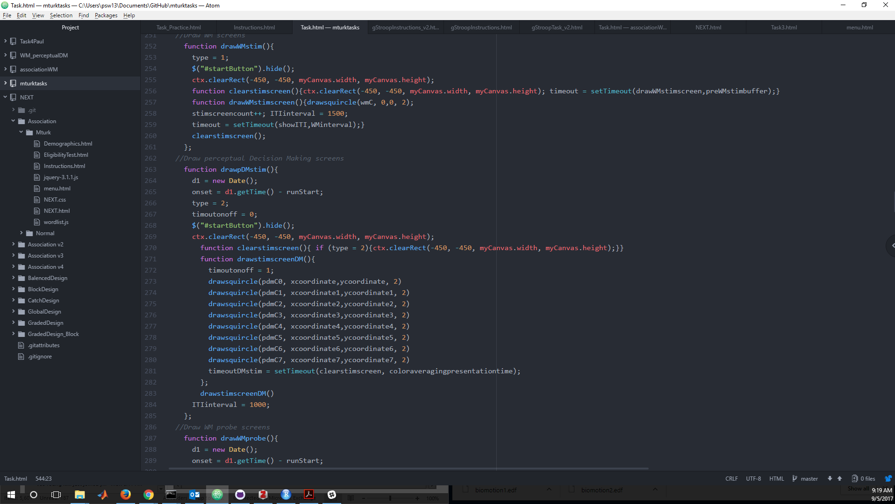
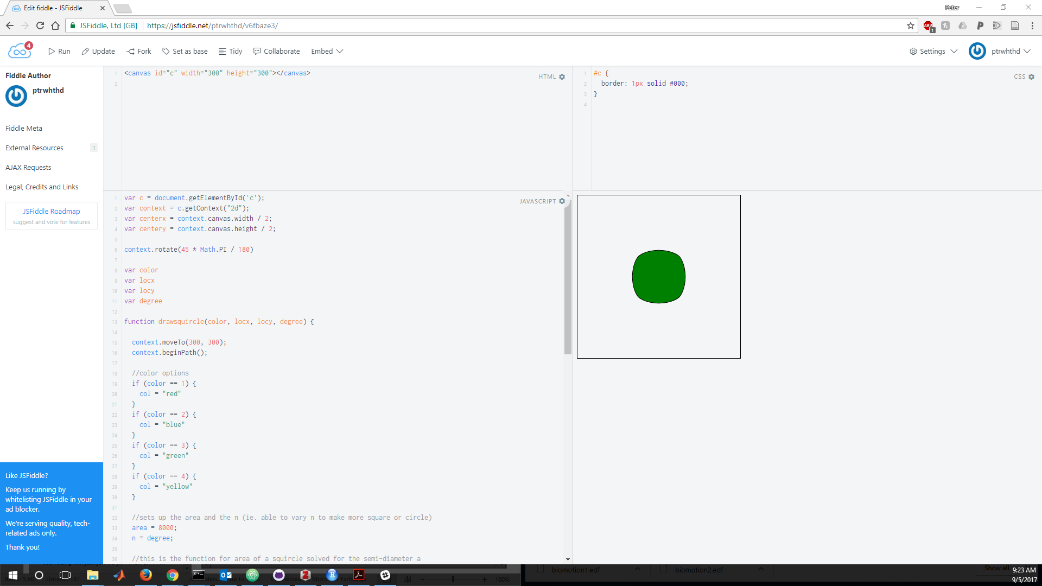
Setting things up
Atom or Notepad++ for writing javascript
Automatic color coding of different types of variables
Good auto indenting and organization of code
Good organization for projects
https://stackexchange.com/ and https://stackoverflow.com/ are your friends
Forums with really good info for a multitude of questions
Also can ask questions and get pretty quick replies
https://jsfiddle.net/ is useful if you just want to mess around with some javascript code or mess with other people’s (people post some code there too)

Slide 38
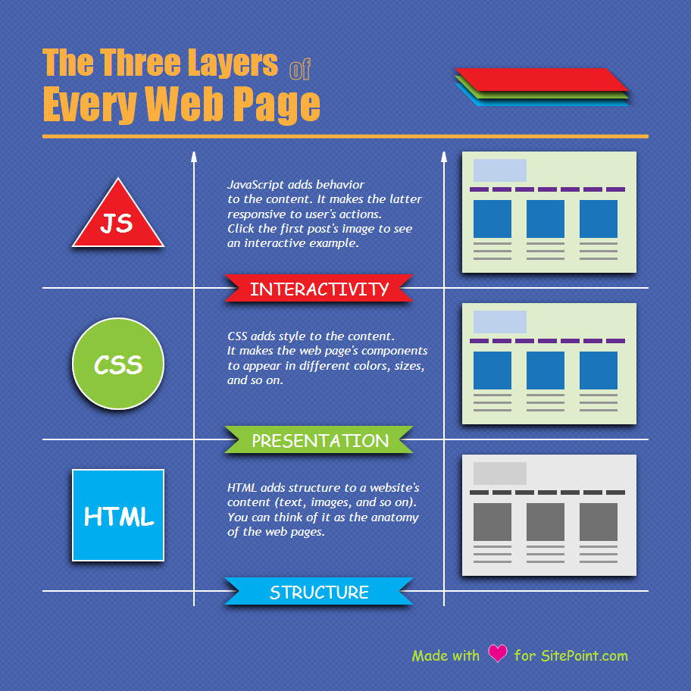
What’s in a task?
HTML pages, CSS pages, javascript file
Things that make your html interactive
Usually use JQuery library, but there are many more. Explore!
Normally don’t try to edit the JQuery libraries
CSS
This is the ‘style sheet’
Defines...
background color
size of window for html
border
font/text alignment
You can use it for advanced purposes, but that isn’t necessary
HTML
This is the ‘meat’ of the experiment/task
Its brings the above together
Confusing:
You will write javascript in your html page
A lot of the ‘javascript’ you write is JQuery (or library) specific

Slide 39
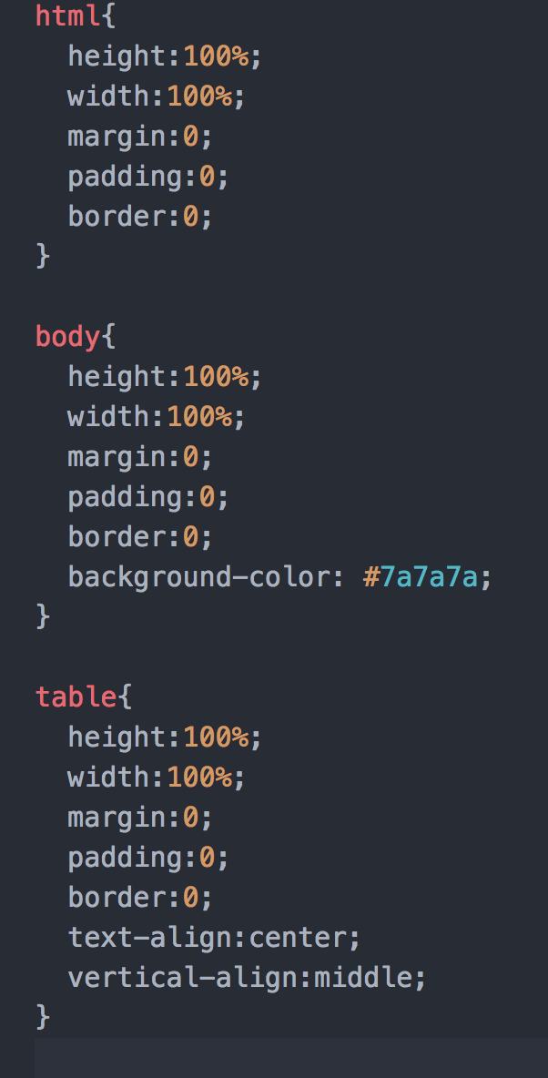
CSS file
Normally don’t do to much with the style sheet except change the background color of the experiment.
-under body{
background-color: “white”
}
You can use the CSS to better define stylistic/’looks’ aspects to your task.

Slide 40
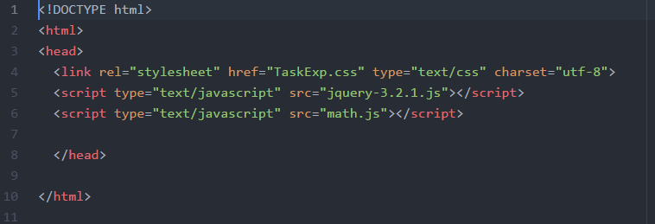
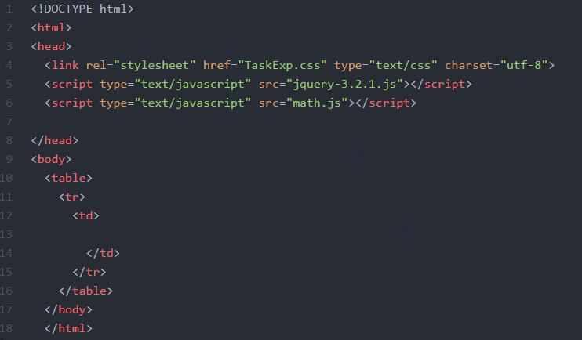
HTML file
Line 1 defines what kind of document type
Line 2 starts the html & Line 10 ends the html
Line 3 starts the header - this is where you put important information for the html page
L4 - links to your CSS sheet
L5 & 6 - link to the javascript libraries you need
Adding more things:
Lines 9-17 now adds structure for things to be displayed on the html page

Slide 41
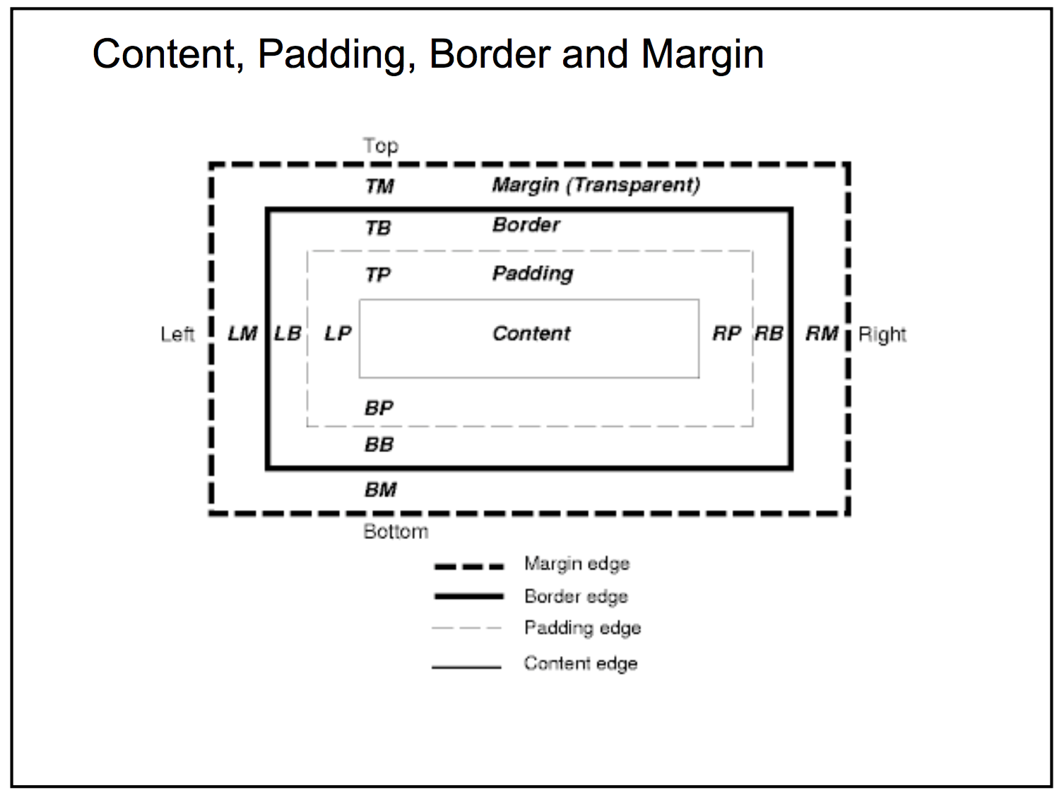
HTML file
Line 1 defines what kind of document type
Line 2 starts the html & Line 10 ends the html
Line 3 starts the header - this is where you put important information for the html page
L4 - links to your CSS sheet
L5 & 6 - link to the javascript libraries you need
Adding more things:
Lines 9-17 now adds structure for things to be displayed on the html page

Slide 42
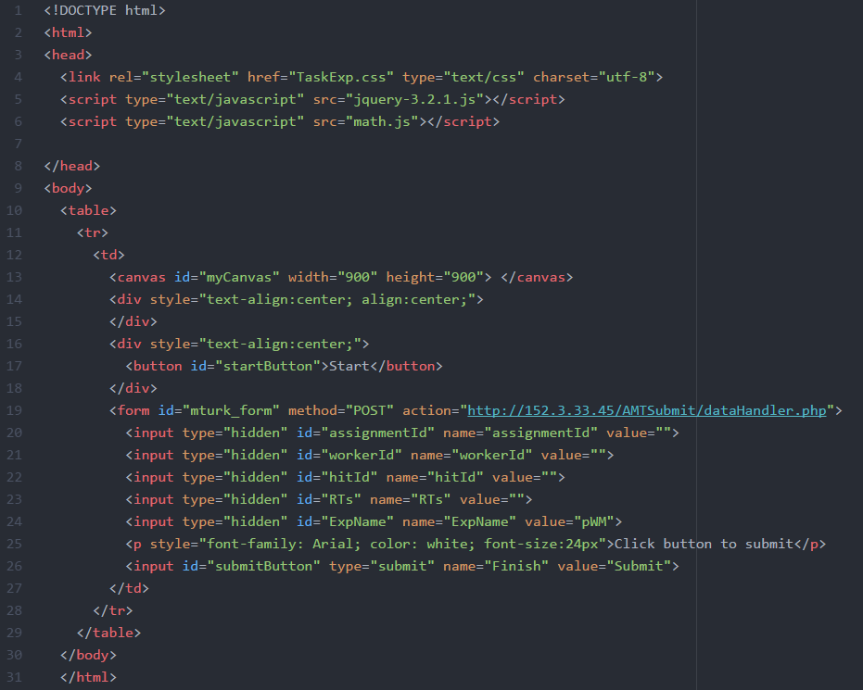
HTML file
In that structure (L9-30)...
L9-12 are the beginning ‘tags’ (they are nested)
L13
<canvas> is the size of the area you can present stimuli on.
i.e. draw the interactive/changing part people see
L14-18
<div> defines elements like text or buttons.
Here I use to to say I want to have everything center aligned by default and that I want a “Start” button
L19-26
<form> and <input> are how we actually post the data to our server
L27-30 are the end tags

Slide 43
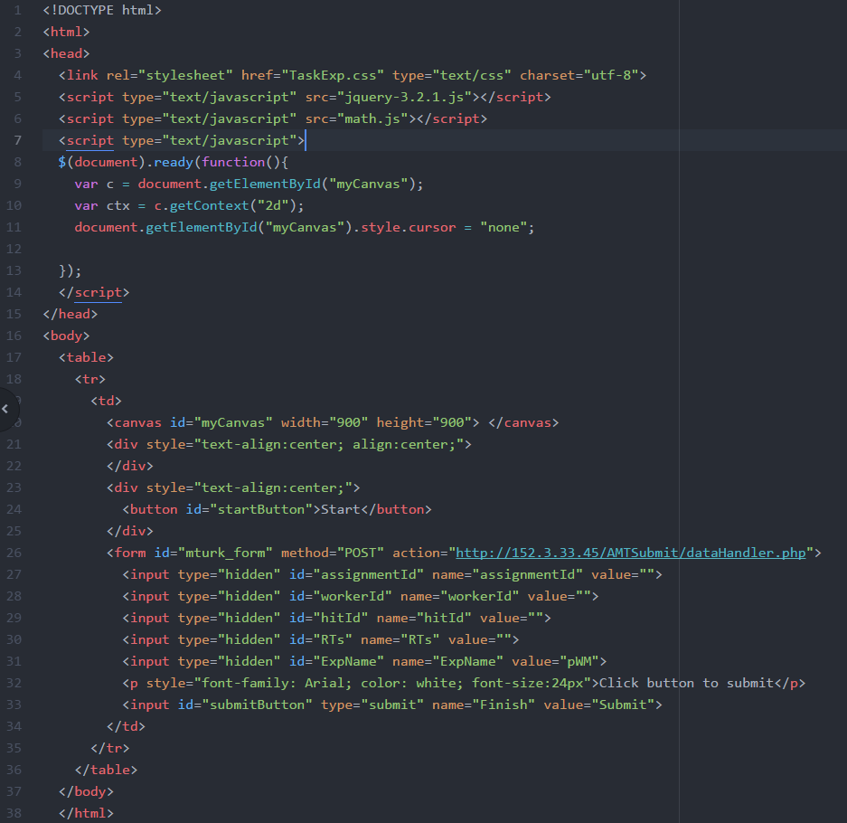
HTML file
Where the fun happens...
L7-L14 are where you will write a majority of your experiment script
L7 tells the html page you are going to start writing a script and that you will be using javascript
L14 ends that script
L8 starts the ‘document’
Document is the ‘owner’ of everything in the page. It ties all the previous defined javascript libraries together and everything else we have previously defined.
Ready says that once everything else is loaded, execute whatever is between the ().
Function () means that everything in the {-your javascript code-} will be executed
Now everything you write in L9-12 will be executed when the page loads.

Slide 44
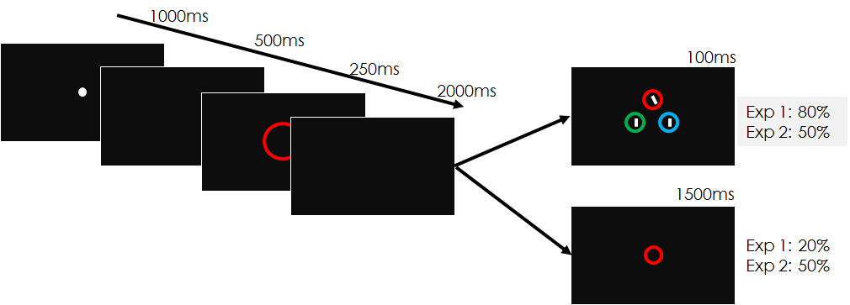
Javascript - good practices
To avoid as many timing issues in javascript, it’s important to follow good coding practices and organization in your script.
Think work ‘big picture’ to ‘small picture’
Below is an example ‘big picture’ layout for how your code should be set-up
Define global task variables
How many trials, how many blocks, maybe a trial matrix (i.e. how many congruent/incongruent trials)
Define experimental trial types
What screens are you going to want? A visual search screen, a working memory screen, just a stroop stimulus screen?
Define variable values for that trial
What color is the WM probe this trial? What colors in the visual search?
Run trial -> block sequence
This should call the previously created functions
Define trial variables, draw trial specific screens, advance trial, rinse and repeat
This outline has been more codified in python (http://sapir.psych.wisc.edu/wiki/index.php/Sample_Psychopy_Experiment)

Slide 45
Javascript basics (for tasks)
Vast majority of your task will be three different types of javascript features:
Functions, ‘If’ statements, ‘For’ statements
Functions:
function drawSTROOPscreen(){
ctx.font="bold 150px Arial";
ctx.fillStyle="green";
ctx.textBaseline="middle";
ctx.textAlign="center";
ctx.fillText(“RED”,(myCanvas.width)/2,(myCanvas.height)/2);
}
drawSTROOPscreen()

Slide 46
Javascript basics (for tasks)
Vast majority of your task will be three different types of javascript features:
Functions, ‘If’ statements, ‘For’ statements
Functions:
function drawSTROOPscreen(word){
ctx.font="bold 150px Arial";
ctx.fillStyle="green";
ctx.textBaseline="middle";
ctx.textAlign="center";
ctx.fillText(word,(myCanvas.width)/2,(myCanvas.height)/2);
}
If statements:
if (trialtype == 1){
drawSTROOPscreen(“RED”)
}
else if (trialtype == 2){
drawSTROOPscreen(“GREEN”)
}

Slide 47
Part III: a Basic Stroop Task Demo
Notes:
Peter will lead this

Slide 48
Our lab file organization
Typical Task File(s)
“Main Menu” File (links to all your task files; it’s how you control which tasks are run in time)
JavaScript Library (e.g., JQuery)
JS file that has your stimuli matrices (or you can program this into your regular html file)
All your stimuli images (a link to them, or include them in your folder)
Informed Consent file (or you may have to place it on MTurk HIT preview)
Instructions file (or can be put into task file)
The workshop demo on the basic Stroop task will also show you how we “bind” our data to HTML elements that are then recorded in data logs.

Slide 49
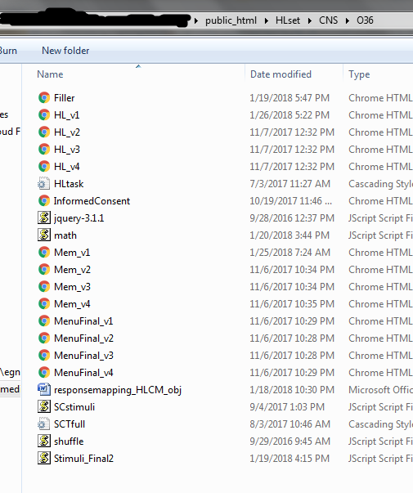
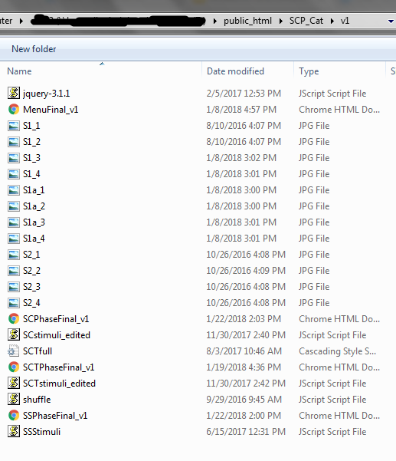

Slide 50
Part IV: Resources for your future work
Notes:
NOTE THAT THESE ARE BASED OFF HOW WE DO OUR JAVASCRIPT, WITH A MAIN MENU FILE LINKING THE TASK FILES
*some of this isn’t relevant if you don’t code tasks the way we do!

Slide 51
Practical JavaScript Tips, I
Debugging: in your coder or in the browser. In the browser, you debug in the Console. For Windows, you hit F12 for the Console. For Macs, you have to do view -> developer -> JavaScript Console.
From there, you can put a breakpoint on any part of your script. So, if you call your showITI function -> drawFixationCross -> drawStroop, you can stop it at any of these, and see where exactly your script is freaking out.
You can also do console.log(variablename); if you want to know whether your variable was defined correctly, has the right # of stimuli, etc.
Things that are absolutely necessary:
Gup fxn that will ‘break down’ mturk worker, hit, and assignment IDs (get this from us)
Document.ready function (“loading the DOM”)
CSS/HTML/a JavaScript library
If it involves images, a loadImage fxn
The code to submit to the lab server or mturk
Code to end a block, code to end a run

Slide 52
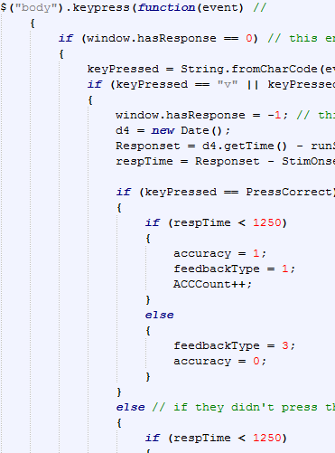
Practical JavaScript Tips, II
If you have many images to load, call your image loader function in the background. JavaScript does not like the If/Else statement for image loading when you have a lot of them to load.
Fixed length vs. response-sensitive trials:
In a fixed length style JS, you would need to put the body.keypress fxn outside of any function, and you would never clear a timeout or have a timeouthandle. SetTimeout helps.
In a response-sensitive trial, you could put the body.keypress fxn inside a function (like the showITI), and you would use things like timeouthandle = setTimeout(fxn, ms), & clear the timeout once the sub has pressed a button

Slide 53
Specific Functions and/or Coding Methods that You Can Use

Slide 54
Excluding Workers & Eligibility Testing
Jiefeng’s Eligibility Test
This matches worker ID to the files within the Experiment Name folder that you specify.
Manually Exclude Subjects (in your Main Menu)
Ask us for the code for any of these and how to work these (too complicated to post in one slide)

Slide 55
Recording Demographics
Demographics.html file
Easy JS based task
Demographics_link.html file:
This links directly to your Google Drive form that you are responsible for keeping up with (any other methods - you have to input your worker info into this spreadsheet)
i-Frames
These can be used with Qualtrics, for demographics and post-test info; change your end message to give subjects a code to put into a blank below the i-frame.
Ask us for the code to any of these; each one is too complicated to post in a slide here, particularly the i-frame set-up.

Slide 56
Submitting Data Links
Mturk: <form id="mturk_form" method="POST" action="https://www.mturk.com/mturk/externalSubmit">
Sandbox: <form id="mturk_form" method="POST" action="http://workersandbox.mturk.com/mturk/externalSubmit">
Our lab server: <form id="mturk_form" method="POST" action="http://152.3.33.45/AMTSubmit/dataHandler.php">
If you’re not submitting data to our lab, you can submit to mturk, at which point your data will be included in your batch CSV file. (Batch CSV is the MTurk list of participants, gives you information on how long they took to complete the HIT, etc.)
Data submission/collection can be very specific to the way that your lab has set things up. If you want to know how each of us has set things up, please ask later, since it will be pretty complicated.

Slide 57
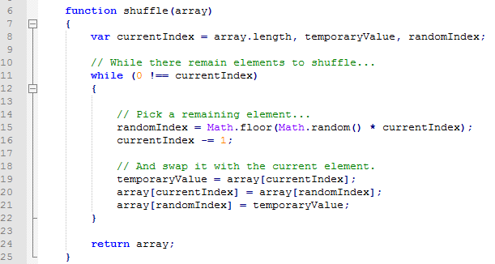
Shuffle Your Variables Function

Slide 58
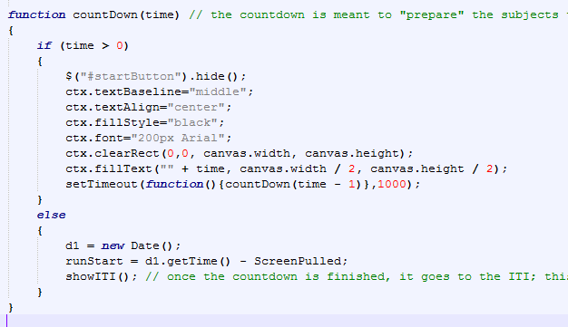
Start Your Task with a Countdown Timer

Slide 59
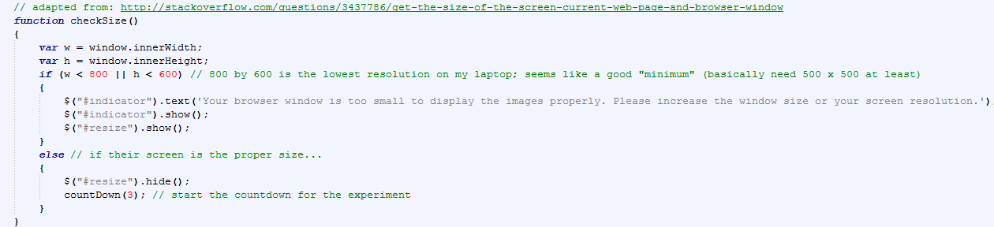
Make Sure MTurkers Don’t Minimize the Browser

Slide 60
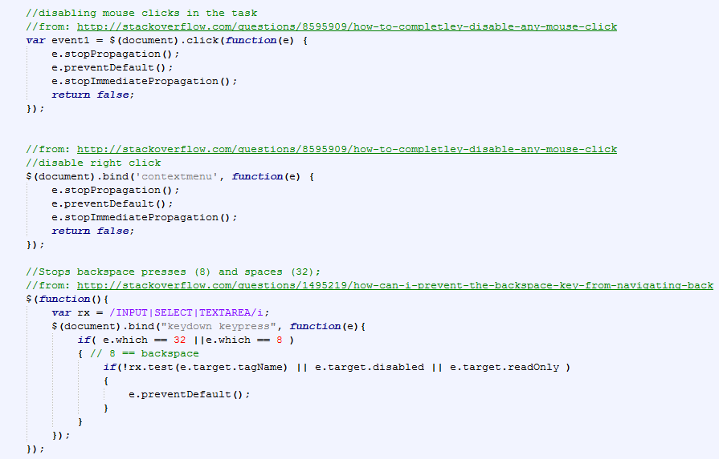
Prevent Certain Clicks or Keypresses

Slide 61
What should the final product look like?
https://elabtasks.github.io/mturktasks/Task.html (currently a perceptual decision making task crossed with a working memory task)
https://github.com/pswhitehead you can find another perceptual decision making task, as well as an AXCPT task (hidden are various stroop-like and visual search-WM type tasks; feel free to ask me via email for access if you like)
https://github.com/christinabejjani (many tasks--the most recent is sc_learn; ask to know for more details)
Ask us for any of our scripts - we are happy to share more resources!
Notes:
If you pull up any html, you can also look at the JS script from the Console. “Sources” will list the exact script source; to navigate the main menu, type updateMainMenu(#) into the Console <- insert a number there. This will take you through to the next “phase” of a study for our studies. You can click the start buttons for any of the tasks, and they’ll pop up with the exact codes for you to grab.
Ask either of us if you want other scripts

Slide 62
How can you tell if a worker has done something wrong?
This is likely to depend on your particular script
If you have an accuracy requirement, you can write an analysis script to look through your data and see what accuracy they got on the task
If it’s a simple “face ratings” - like task, you can include an attention check (e.g., ‘what’s the color of this rectangle) and check the accuracy on those trials; however, these may not be effective
Come see us to brainstorm ideas for your particular script

Slide 63
Part V: Now it’s your turn!

Slide 64
Ready to start posting a task?

Slide 65
Project Study Descriptors
Project Name – This is the name of your project that is not visible to Workers. It will be visible on the dashboard, and will allow you to easily differentiate between multiple HITs with the same name.
Title – This is the name of your HIT as it will appear to Workers on Mechanical Turk. (This is what they will refer to your HIT by in reviews)
Description – A brief description of the Hit as it will appear to Workers on Mechanical Turk. (e.g. “Your task is to make judgements about color words.” Not very exciting, but not giving away too much either?)
Keywords – Including keywords will make it easier for Workers to find your HIT.
Workers payment per survey – How much each participant will be paid per HIT. (IRBs: $3-7 per hour).
Number of assignments per HIT – The total number of participants that you want to take your HIT. (Do not exceed 9! Each batch must be less than or equal to 9 assignments, else the fee Amazon takes for running a batch increases.)
Time allotted per assignment – This is the maximum amount of time that a worker can spend on a HIT. If a worker does not submit a HIT within the time allotted per assignment they cannot complete the HIT and cannot get paid. Note that participants differ as to how fast they work. You should thus provide workers with ample time to complete their HIT. However do not make the time allotted per assignment overly long, since this will deter workers from taking your HIT, as they will assume that the HIT will take a long time.
HIT expired in – The HIT will expire and will no longer be visible to workers after this time. (Default is 7 days).
Auto pay workers in – Time after which all Workers will be automatically approved. (Default is 3 days).
Worker Requirements Tab - usually not relevant for us; we don’t typically use “Master Workers” or any other qualifications, as these cost extra money and we usually do not make hypotheses as to why we only need USA workers, for example.

Slide 66
First, you need money; go to My Account & purchase prepaid HITs with the p-card of your choice. Make sure to keep receipts.
Then, go to “Create” -> “New Project” -> Survey Link -> Create Project
Ours are Survey Links, because we post (Main Menu) links to our JavaScript-based task
Some other labs post qualtrics links here as well
Not actually certain about the other project types
Once you fill out all the other project study type details, then your project will appear under the Create tab. Now you have to hit “Publish Batch” to actually have a batch of your HIT go live.
Sandbox is organized in the *exact* same way as regular Mturk. However, money does not matter there (it’s fake, since it’s a developer site).

Slide 67
You will get bad reviews / hate mail...
Quite frankly, sometimes mTurkers lie about your task in reviews. There is nothing you can do about that. Don’t sweat the bad reviews/hate mail.
“Wow, this is the most insanely horrible hit I've seen in a long long time. $3 for close to an hour of NO LOGIC button mashing… AVOID.”
“This is a big fat joke... They just want free data.”
“Sketchy requester… Just a straight up scam. Glad I warned everyone in the forums and Reddit to avoid this garbage.”
“It's pretty much a Hell on Earth HIT.”
“I wish I had read your TO reviews before wasting so much time on this junk!”
“You must be fun at parties.”
“I wouldn't do this HIT again or work on his future HITS for double the rate.”

