Slide 1
PSY102: Introduction to Cognitive Psychology
Day 9 (05/28/19): Language

Slide 2
Today’s Goals & Agenda
LO1: Continue to build a supportive classroom culture & discuss science communication
Handouts on Science Communication Elevator pitches
Determine components as a class for rubric on SciComm pitch
LO2: Define, identify, and apply previous constructs that we have discussed in class
Quiz on material covered since last quiz: multiple choice and short answer
LO3: Describe the basic fundamental principles of language
Discuss real-world implications of language interventions, language theories, and development (e.g., this) as another subarea in psychology that interacts with cognitive psychology
Discuss Goldstein chapter 11 on language as well as recent language research from the SciAm article
LO4: Summarize and critically analyze academic journal articles
With the language research as our background, we can now discuss the methodology used to infer cognition, language development, etc.

Slide 3
Course Changes
Added more review days
Changed some of the order of topics
Followed suggestions on textbook
Syllabus now has suggested textbook readings if you want to follow a textbook
Have done a couple of textbook chapters, with + without academic readings

Slide 4
SciComm Elevator Pitches
Continue to build a supportive classroom culture & discuss science communication

Slide 5
SciComm Pitches
Read the handout given to you; make notes on what you think (~4 min)
Turn to the person next to you and discuss what you think constitutes a good Elevator pitch (~4 min)
Come together as a class to generate a rubric of guidelines for your SciComm pitch assignment (~4 min)

Slide 6
Language
Describe the basic fundamental principles of language
Summarize & critically analyze academic journal articles

Slide 7
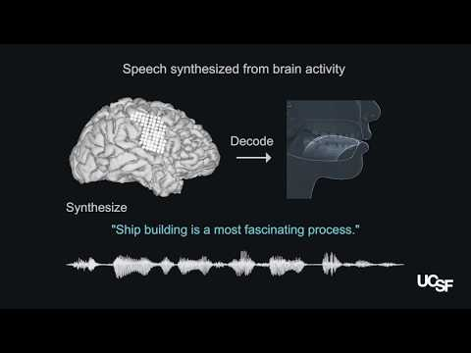
What are the stakes in language research?
https://www.npr.org/sections/health-shots/2019/04/24/716790281/decoded-brain-signals-could-give-voiceless-people-a-way-to-talk
Notes:
https://www.youtube.com/watch?v=kbX9FLJ6WKw
Epilepsy patients: patients with intact speech who had electrodes temporarily implanted in their brains to map the source of their seizures in preparation for neurosurgery

Slide 8
Predict a Baby’s First Word
https://www.jove.com/video/58445/a-view-their-own-capturing-egocentric-view-infants-toddlers-with-head
~1 minute in
Previous research on helping folks with strokes, trauma, neurological disorders… what about developmental disorders? Early language as a predictor of academic achievement? Language delays?
Notes:
https://www.theatlantic.com/education/archive/2016/12/how-to-predict-a-babys-first-word/510146/
Drawing on theories of statistical learning, IU researcher Linda Smith and colleagues found that the number of times an object enters an infant’s field of vision "tips the scales" in favor of associating certain words with certain objects.
The research appears in the journal of the Royal Society Philosophical Transactions B in a special issue on statistical learning.

Slide 9
Language
Two components:
Hierarchical
Governed by rules
Notes:
Language generally….
•System of communication using sounds or symbols
•Express feelings, thoughts, ideas, and experiences
•Hierarchical system
–Components that can be combined to form larger units
•Governed by rules
–Specific ways components can be arranged

Slide 10
Language Is Universal
Deaf children invent sign language
All humans with normal capacities develop a language and learn to follow its complex rules
Language is universal across cultures
Language development is similar across cultures
Languages are “unique but the same”
Different words, sounds, and rules
All have nouns, verbs, negatives, questions, past/present tense
Notes:
-deaf children: if no one speaks or uses sign language, they will invent their own sign language
-more than 5k different languages
-children begin babbling ~7 months, a few meaningful words by 1st bday, multiword utterances ~age 2

Slide 11
Early Perspectives on Language
B.F. Skinner (1957), Verbal Behavior
Language learned through reinforcement
Noam Chomsky (1957), Syntactic Structures
Human language: in the genes
Underlying basis of all language is similar
Children produce sentences they have never heard and that have never been reinforced
“I hate you, Mommy!”
Notes:
If language is so universal, should be coded in our genes
Studying language = studying the mind; behaviorist perspective is TERRIBLE (scathing review of Skinner et al.)

Slide 12
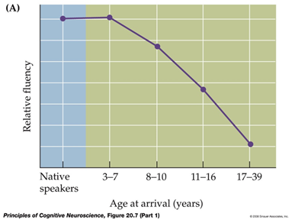
Psycholinguistics
How do humans acquire and process language?
Comprehension
Speech production
Representation
Acquisition
Notes:
-how do people understand spoken & written language? Process sounds, understand words, have conversations w/ each other, etc.
-how do people produce language? Physical + mental processes involved
-How is language represented in the mind and brain? E.g., segmentation, connecting parts of stories, etc.
-How do people learn language? I.e., the focus of the 2 papers read for today
Children nevertheless retain a high ability for learning languages: if a child acquires a 2nd language (‘L2’) by the age of 7, their adult performance is indistinguishable from a native speaker. The critical period during which language acquisition is particularly efficient lasts approximately until age 10, and declines steadily thereafter.

Slide 13
Key Terms
Lexicon
E.g., Atlantic coverage of PNAS study
Phonemes
“C”[k] + “A”[æ] + “T”[t]
Cat -> Mat; Cat -> Cot; Cat -> Cap
Morphemes
Truck: 1 morpheme
Bedroom: 2 morphemes
Notes:
•Lexicon: all words a person understands
•Phonemes: shortest segments of speech that, if changed, changes the meaning of the word
•Morphemes: smallest units of language that has meaning or grammatical function

Slide 14
Perceiving Phonemes, Words, and Letters
Phonemic restoration effect
Cough, white noise, etc. in the middle of hearing a sentence -- can you fill in the missing phoneme based on context & the portion of a word you heard?
Top-down processing
Notes:
Usually we’ll notice the white noise or cough but still report the sentence as though there was no interruption (i.e., our knowledge based on context)
Probably more difficult when just learning a language

Slide 15
Perceiving Phonemes, Words, and Letters
Difficult to perceive isolated words
Context helps; “Did you” “Didja” “Dijioo”
Speech Segmentation
Breaking a stream of sounds into words
Context, Meaning, Sound & Syntactic rules, Statistical learning
“I scream, you scream, we all scream for ice cream”
Notes:
“Did you” “Didja” “Dijoo”
-speech segmentation: our ability to perceive individual words even though there are no pauses between words in sound
-some sounds are more likely to follow one another within a word

Slide 16
Perceiving Phonemes, Words, and Letters
Word superiority effect:
Letters easier to recognize when in a word
Again, context matters
FORK, K, RFOK
Word, letter, nonword conditions
Compare how quickly people identify one of the letters that was originally presented

Slide 17
Understanding Words
Word frequency effect:
Respond faster to high frequency words
Lexical decision task
Lexical Ambiguity
Words have > 1 meaning
Context matters (meaning dominance)
River bank
First National bank
You can bank on it
Notes:
•Meaning dominance – The fact that some words are used more frequently than others

Slide 18
Demo: Lexical Decision Task
Say “yes” aloud whenever you encounter a word
Raise your hand when you’ve gone through the entire list
Ready?

Slide 19
List 1
Gambastya, revery, voitle, chard, wefe, cratily, decoy, puldow, faflot, oriole, voluble, boovle, chalt, awry, signet, trave, crock, cryptic, ewe, himpola

Slide 20
Demo: Lexical Decision Task
Say “yes” aloud whenever you encounter a word
Raise your hand when you’ve gone through the entire list
Ready?

Slide 21
List 2
Mulvow, governor, bless, tuglety, gare, relief, ruftily, history, pindle, develop, grdot, norve, busy, effort, garvola, match, sard, pleasant, coin, maisle

Slide 22
Demo Debriefing
Were there some words that were easier to say “yes” to?
Think back to “perception”
Notes:
Governor, history vs. ewe, voluble
2nd list should have been easier - has a lot more high frequency words than List 1
Statistical regularities even in our language

Slide 23
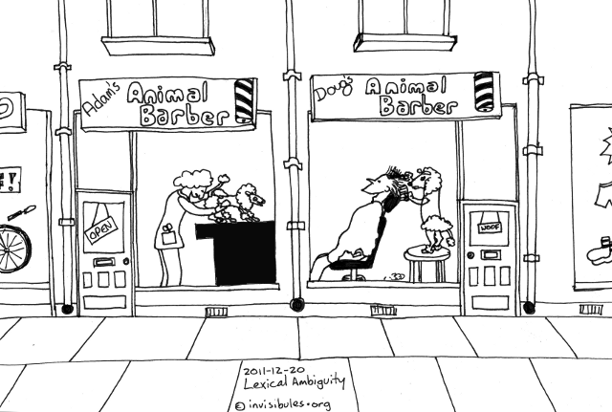

Semantic Ambiguity
https://www.youtube.com/watch?v=uRj1RWvIVI8

Slide 24
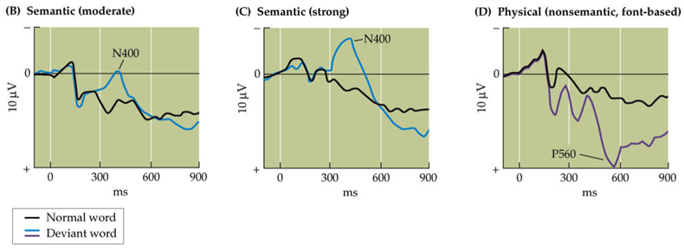
Understanding Sentences
Semantics & Syntax: different mechanisms (N400 - semantics vs. P600 - syntax)
“It was his first day at work.” (black)
“He spread the warm bread with socks.” (blue)
“She put on her high heeled SHOES.” (purple)
Notes:
•Semantics: meanings of words and sentences
•Syntax: rules for combining words into sentences
–
Figure from Principles of Cognitive Neuroscience 2nd edition textbook, Purves et al.
Remember to mention - is up here and + is down because sometimes weird ERP conventions
Noninvasive imaging studies of language have confirmed that the brain cares a lot about context in processing word stimuli. One well-described signature of contextual language processing is the N400 ERP component, a negative-going potential ~400ms after processing a contextually incongruous word (with respect to the preceding sentence context).
The N400 amplitude seems to track the degree of semantic incongruency of a word from the preceding context, but it is not modulated by non-semantic (e.g. physical) changes in the presentation of verbal material.

Slide 25
Understanding Sentences
Broca’s Area (Frontal lobe)
“Alright… Uh…. stroke and un….. I….”
Wernicke’s Area (Temporal Lobe)
“It just suddenly had a feffort and all the feffort had gone with it…”
Semantics & syntax are processed differently in the brain (ERP) & by different brain regions
Notes:
Broca’s area:
-language production in the frontal lobe
-syntax (the structure of sentences)
-sometimes have difficulty understanding some types of sentences too
Wernicke’s area:
-language comprehension in the temporal lobe
-semantics (understanding meaning)
-unable to understand speech and writing

Slide 26
Understanding Sentences
Garden Path sentences
“The old man the boat.”
Temporal ambiguity
“The horse raced past the barn fell.”
Ambiguity can be caused & resolved with semantics, information via content in a scene, expectations and experience.
Notes:
•Garden path sentences
–Sentences that begin by appearing to mean one thing, but then end up meaning something else
•Temporary ambiguity
–When the initial words are ambiguous, but the meaning is made clear by the end of the sentence
The horse that was raced past the barn fell

Slide 27
How do you group words in a sentence into phrases?
Syntax-first
Grammar structure determines parsing
New word is part of current phrase
Interaction of Syntax & Semantics
“The spy saw the man with the binoculars” vs “The bird saw the man with the binoculars”
Eye movements when revision necessary

Slide 28
Understanding Text & Stories
“William Shakespeare wrote Hamlet while sitting at his desk…”
Inferring meaning beyond the sentence, via past experience
Simulating characteristics of images & actions within a story to match situations described
Motor cortex activated by action words (simulation)
We predict what words would fit with a story (substitution of one word)
Notes:
•Coherence: representation of the text in one’s mind so that information from one part of the text can be related to information in another part of the text
•Inference: readers create information during reading not explicitly stated in the text
–Anaphoric: connecting objects/people
–Instrumental: tools or methods
–Causal: events in one clause caused by events in previous sentence
•Situation model: mental representation of what a text is about
–Represent events as if experiencing the situation
–Point of view of protagonist
•Physiology of simulations
–Approximately the same areas of the cortex are activated by actual movements and by reading related action words
–The activation is more extensive for actual movements

Slide 29
How do we converse?
Construct sentences with
Old/given information
New information
New then becomes given/old
Pretty standard in “science writing” recommendations
We also produce speech to achieve common ground and prime each other to recognize certain grammatical structures
Notes:
•Given-new contract: speaker constructs sentences so they include
–Given information
–New information
–New can then become given information
•Syntactic coordination
–Using similar grammatical constructions
•Syntactic priming
–Production of a specific grammatical construction by one person increases chances other person will use that construction
–Reduces computational load in conversation
–
•

Slide 30
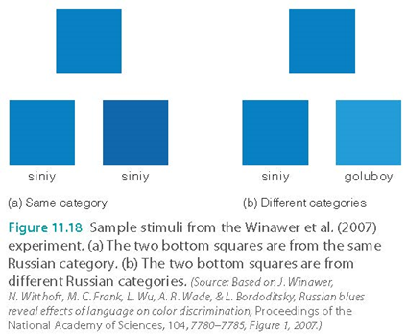
Can language influence thought & perception?
Notes:
•Sapir-Whorf hypothesis: language influences thought
–Two cultures had differences in how participants responded to blue squares based on how they were categorized
•Differences in the way names were assigned to colors affect the ability to tell the difference between colors

Slide 31
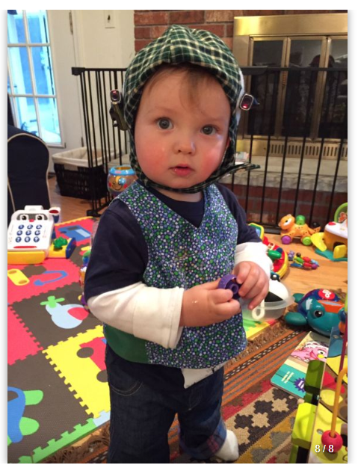
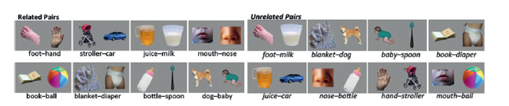
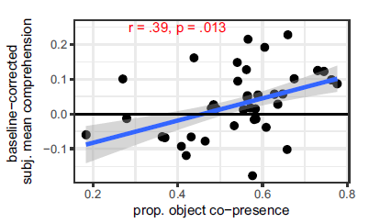
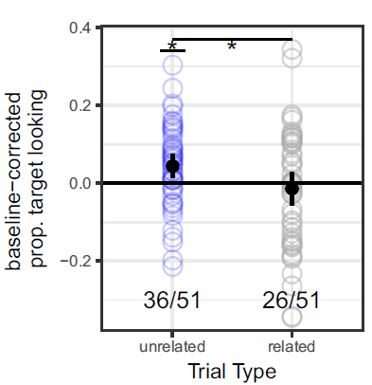
Bergelson & Aislin (2017)
https://bergelsonlab.com/bergelson-personal-page.html
Notes:
Credit: https://bergelsonlab.com/media.html
For typical eye-tracking: https://www.smashingmagazine.com/2019/03/biometrics-neuro-measurements-user-testing/
-two main points are in the two figures

Slide 32
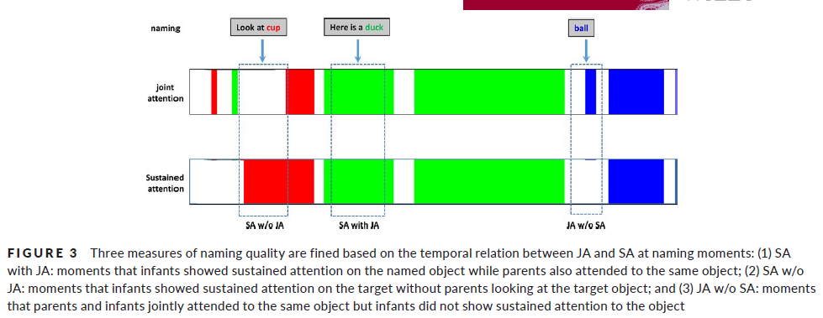
Yu et al. (2019)
Notes:
-sustained attention, joint attention

Slide 33
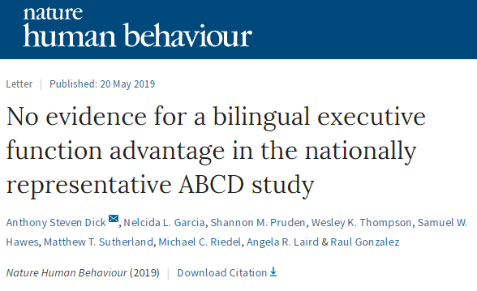
What about Bilinguals?
A contrast to the Hayakawa & Marian (2019) SciAm article – long-term validity?
Notes:
Nature Human Behaviour article: https://t.co/faoYXcJFJX
Ed yong piece on billingual advantage, 3 years ago: https://www.theatlantic.com/science/archive/2016/02/the-battle-over-bilingualism/462114/

Slide 34
SciComm & Ambiguity
Use the next 5 minutes to:
Review a news website of your choice
Look for any headlines, advertisements, or writings that contain unintended ambiguity or imprecision
What are possible interpretations of the writing?

Slide 35
Quiz #2
Define, identify, and apply previous constructs that we have discussed in class

Slide 36
Today’s Goals & Agenda
LO1: Continue to build a supportive classroom culture & discuss science communication
Handouts on Science Communication Elevator pitches
Determine components as a class for rubric on SciComm pitch
LO2: Define, identify, and apply previous constructs that we have discussed in class
Quiz on material covered since last quiz: multiple choice and short answer
LO3: Describe the basic fundamental principles of language
Discuss real-world implications of language interventions, language theories, and development (e.g., this) as another subarea in psychology that interacts with cognitive psychology
Discuss Goldstein chapter 11 on language as well as recent language research from the SciAm article
LO4: Summarize and critically analyze academic journal articles
With the language research as our background, we can now discuss the methodology used to infer cognition, language development, etc.

Slide 37
Tomorrow’s Work
Readings:
Kable et al. (2017) - many details that may not feel as relevant or may be tough (modeling); extract what you can
Yin et al. (2019) (duke)
Noe (2017) & Duong (2019) - SciComm
Assignments:
SciComm (written) pitch by 8 a.m. to me
On an article you have not already covered

Slide 38
Participation + Minute Paper
https://tinyurl.com/PSY102Participation
https://tinyurl.com/PSY102MinutePaperMay28

Slide 39
Practice Quiz Items
Optional: Test Your Knowledge

Slide 40
General Questions
Compare & Contrast Skinner vs. Chomsky points of views on how language is learned
If given a paragraph, could you identify the different behavioral effects that we’ve discussed? What about examples of how context can affect our perception of language?
What are different ways that researchers can measure these behavioral effects?
How would you identify the difference between a syntax-first and interactionist perspective on parsing language?
What are some ways that you can apply what we’ve discussed today to SciComm?

Slide 41
The word “bad” has ___ phoneme(s).
One
Two
Three
Four
Notes:
Answer below in notes
three

Slide 42
“Kitchen tables” consists of ___ morphemes.
Two
Three
Four
Five
Notes:
Answer below
three

Slide 43
You are conducting a study on how fluency influences the phonemic restoration effect. You study two groups of non-native English speakers, one with a year of English classes and the other with 10 years. All of your stimuli are in English. Who would you expect to show the greatest phonemic restoration effect?
The group with one year of English instruction
The group with 10 years of English instruction
The two groups would show equal phonemic restoration effects
Neither group would show an effect because they are non-native English speakers
Notes:
Answer below
10 years experience

