Slide 1
PSY102: Introduction to Cognitive Psychology
Day 7 (05/23/19): Emotion II

Slide 2
Today’s Goals & Agenda
LO1: Apply principles of good science communication
Compare & contrast the CNN and NPR reporting of the two academic papers: did they follow the principles we've discussed?
LO2: Describe the basic fundamental principles of emotion & emotion regulation research
Compare & contrast different theories of emotion, such as: James-Lange and Cannon-Bard theories, constructionist and discrete emotion hypothesis
LO3: Summarize and critically analyze academic journal articles
Compare & contrast the two constructionist articles we have read to the Kragel paper
Apply the d'Arbeloff paper to discussion on the Gross reappraisal theory of emotion regulation

Slide 3
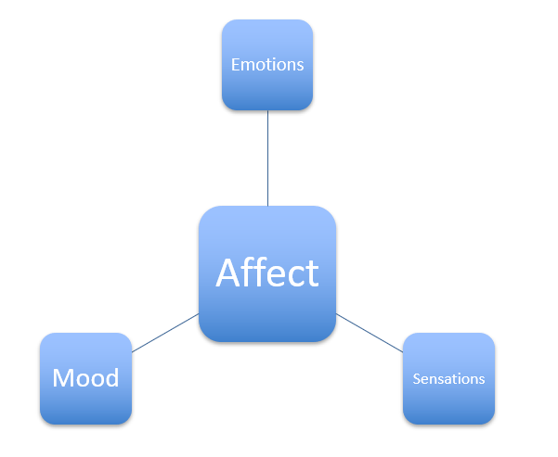
What are emotions?
States that feel a certain way (qualia)
States that motivate you to do something, particularly something of evolutionary/functional significance
States that have associated physiological patterns
States that signal to conspecifics (facial expressions)
Notes:
3 components that can be studied independently: Behavior (motor output: e.g., approach or avoidance), physiology (e.g., autonomic nervous system activity), and feelings (subjective, conscious experience associated with the emotional state).
Confused about terminology?
Emotions are typically triggered by a particular event and are short-lived (seconds to minutes). Emotional states that endure for longer periods and often have no clear antecedent are called moods (cf. ‘mood disorders’).
Affect is technically the same as emotion, but it is most commonly used to describe outward expression of emotion (like facial expressions, gestures).
Temperament refers to someone’s stable disposition (a ‘personality trait’) to experience and react to events in certain ways (e.g. ‘he’s choleric’).
Motivation describes an urge to ‘reduce drives’, e.g. one is motivated to eat in order to reduce hunger (a ‘drive’). However, motives can also be more lofty and very long-term, such as the motive to graduate with honors.
(All of these concepts have some overlap, and each of them may interact with each other and influence emotional responses.)

Slide 4
What are emotions?
“Emotion refers to a collection of psychological states that include subjective experience, expressive behavior (e.g., facial, bodily, verbal), and peripheral physiological responses (e.g., heart rate, respiration).”
- Gross & Barrett, 2011
Quick onset/duration (“minutes and seconds, not hours and days”)

Slide 5
What are emotions?
It’s very hard to define what an emotion is
Subjective experience (qualia)
Physiological state
Behavioral predisposition (likely to do something)
Functional significance (it’s probably there to accomplish Goal X)
There are problems with trying to define what an emotion is by any of these criteria

Slide 6
What makes us have an emotion at a given moment?
James-Lange theory of emotion
A stimulus is perceived
Physiological changes occur
Feeling those physiological changes IS the emotion
“What kind of an emotion of fear would be left, if the feelings neither of quickened heartbeats nor of shallow breathing, nor of trembling lips nor of weakened limbs, neither of goose-flesh nor of visceral stirrings, were present, it is quite impossible to think.” –William James
Notes:
we are fearful as a consequence of the bodily changes associated with an emotion, not the other way around. The emotion is a result of the brain interpreting the feedback from changes in bodily states.
(similar to somatic marker theory)

Slide 7
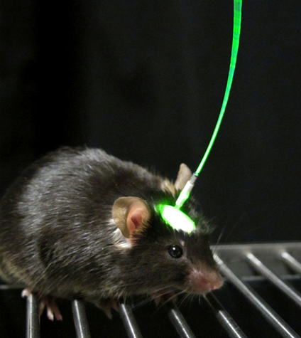
What makes us have an emotion at a given moment?
Panksepp:
SEEKING
RAGE
FEAR
PANIC
PLAY
MATING
CARE
“Once an electrode is in the correct neuroanatomical location, essentially identical emotional tendencies can be evoked in all mammals, including humans.”
Notes:
The most tractable emotion that is amenable to study both in humans and animals is fear. However, inducing fear responses (e.g., via conditioning using electrical shocks) may be ethically dubious. The same applies for trying to experimentally manipulate depression, post-traumatic stress, etc…

Slide 8
What makes us have an emotion at a given moment?
Dogs with transected vagus nerves
No visceral feedback
Still behaved emotionally
Quadriplegics
Still experience emotions
The evidence is mixed: quadriplegics tend to rate pleasant things as less pleasant and negative things as less negative; Mack et al., 2006
Regardless, there isn’t a sudden total lack of emotion
Notes:
-> quadriplegics are numb and sensation affected in certain areas
-> basic idea is that sensation alone cannot be responsible for emotions
“The vagus nerve is one of the cranial nerves that connect the brain to the body. ... The vagus nerve functions contribute to the autonomic nervous system, which consists of the parasympathetic and sympathetic parts. The nerve is responsible for certain sensory activities and motor information for movement within the body.”

Slide 9
What makes us have an emotion at a given moment?
Cannon-Bard theory
Visceral sensations across emotions are similar
Physiological changes and subjective feeling are separate and independent
Arousal doesn’t have to come before the emotion
An emotional stimulus is first processed by the diencephalon (thalamus/hypothalamus/etc.), which then signals to the peripheral autonomic nervous system (eliciting behavior) and to the neocortex (eliciting feelings)
Notes:
In the 1920s, Cannon and Bard argued against the James-Lange model, suggesting that autonomic nervous system responses are much too undifferentiated (very similar across quite dissimilar emotion states) and too slow to give rapid rise to distinct emotions. Instead they argued that the body produces a prototypical fight-or-flight response to various challenges. They found in surgical experiments that cats could show bodily emotional reactions (e.g., defensive behavior) only if decortation was performed above the level of the diencephalon (thalamus and hypothalamus). It was also found that electrical stimulation of the hypothalamus could elicit a ‘sham rage’ in cats
Other ways of thinking about how emotion is generated… Kluver-Bucy syndrome, Papez circuit, limbic system theory

Slide 10
The generation of an emotion
1- The evaluation of sensory input (“Is this a bear running toward me?”)
2- The experience of a feeling (Fear)
3- The expression of physiological and behavioral responses (high heart rate, running away from the bear!)
Different models disagree over how these stages relate to each other, conceptually, anatomically, and temporally.

Slide 11
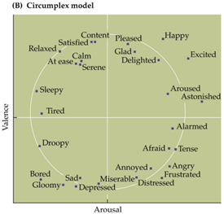
What if we got away from specific emotions?
Valence
Hedonic quality (pleasant or unpleasant)
Arousal
Sense of physical activation (excited/active/jittery vs. calm/relaxed/disengaged)
Emotions that fall close to each other are considered similar.
Notes:
Categorical theories regard each emotion as a separate entity and typically distinguish between a few ‘basic emotions’ (that are innate, pan-cultural, and evolutionarily old) and additional ‘complex emotions’ (that are learned, culturally shaped, evolutionarily new, e.g. ‘pride’).
Different categorical theories propose different numbers (and members) for the basic emotions, but most of them include anger, disgust, fear, happiness, sadness, and surprise. The universal nature of these emotions can be tested by whether people from different cultures recognize the facial expressions associated with these emotions
If a scientist approached research with a dimensional vs. categorical view of emotion, how do you think their research goals would change?
o Dimensional theorists are interested in uncovering neural correlates of valence and arousal, whereas categorical theorists might look for discrete neural correlates associated with each basic emotion.

Slide 12
Schachter & Singer
Physiological arousal
Use environmental cues to label it as some kind of emotion (appraisal)
Slightly different from James-Lange
Physical reactions aren’t as defined as for James-Lange/Panksepp-style models
Much more weight placed on APPRAISAL
Notes:
“... emotional states may be considered a function of a state of physiological arousal and of a cognition appropriate to this state of arousal. From this follows these propositions: (a) Given a state of physiological arousal for which an individual has no immediate explanation, he will label this state and describe his feelings in terms of the cognitions available to him… . (b) Given a state of physiological arousal for which an individual has a completely appropriate explanation, no evaluative needs will arise and the individual is unlikely to label his feelings in terms of the alternative cognitions available. (c) Given the same cognitive circumstances, the individual will react emotionally or describe his feelings as emotions only to the extent that he experiences a state of physiological arousal. An experiment is described which, together with the results of other studies, supports these propositions. “

Slide 13
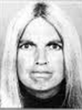
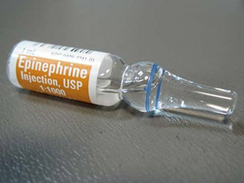

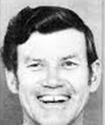

Schachter & Singer (1962)
If appraisal matters, different emotions would result from positive vs. negative influences on appraisal
Notes:
Individuals are more likely to engage in affiliative behavior when given a shot of epinephrine in the presence of a jovial as opposed to angry stranger

Slide 14
Do cultural expectations influence your emotional experience?
Positivity in the United States
Disgust and gender
Anger and gender and race
It depends on what you think really “counts” as an emotion
Can you say you’re feeling it?
Can you measure it in your physiology?
Does it make you do a particular thing?

Slide 15
What would happen if your emotions were completely unchecked at all times?
What are some specific examples of ways you have regulated your emotions?

Slide 16
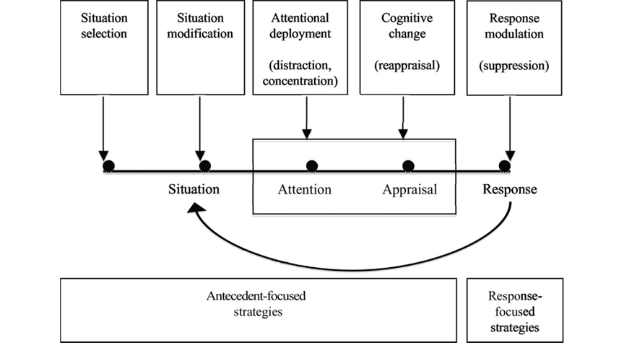
Gross’s model of emotion regulation
Notes:
Life is comprised of an infinite amount of complex choices, and our emotional responses are partly determined by which situations we select... You can choose to put yourself into a potentially awkward situation or spend your time doing something else. (Avoiding or approaching)
While you are in a particular situation, you can also modify what happens during it. (e.g., temporal distance - put space between you and the person…) This is particularly relevant for unavoidable situations…. You can modify the situation by choosing to not do XYZ. Additionally, you can also choose which particular aspects of the situation to focus on or selectively deploy your attention. (e.g., I’m not going to focus on the bad thing that happened; distraction, rumination, worry, thought suppression).
The meaning that you ascribe to the event can also be modulated through changing cognition… How you choose to think about these situations especially how you can reframe or reappraise your thinking in a more positive or adaptive light is the focus of many types of behavioral therapy.
After the emotional response occurs, you still have the opportunity to modulate your response or influence your emotions afterwards. You may choose to suppress your emotions, or use drugs or alcohol to alter both your cognitive experience as well as your body’s physiological responses. Many of these response modulations involve avoidance strategies...
Gross (1998b) specifically examined the difference between antecedent- and response-focused regulation strategies and found that although both methods were effective at reducing emotion expression, antecedent strategies (reappraisal) were better at reducing the experience of emotion while response strategies (suppression) induced physiological changes. This suggests that antecedent- and response-focused emotion regulation processed may have different purposes and mechanisms.

Slide 17
Gross’s model of emotion regulation
Suppression has negative health consequences
Suppressing anger = heart disease
Once you’re in the situation, reappraisal is often touted as the better option
Temporal distancing
Get more objective about it
But: do you ALWAYS want to regulate your emotions?
Notes:
Reappraise the meaning so it’s not so bad
independent, third-person perspective when evaluating an emotional event
Or use humor
Or, there’s recent research on how thinking about positive autobiographical memories can reduce stress

Slide 18
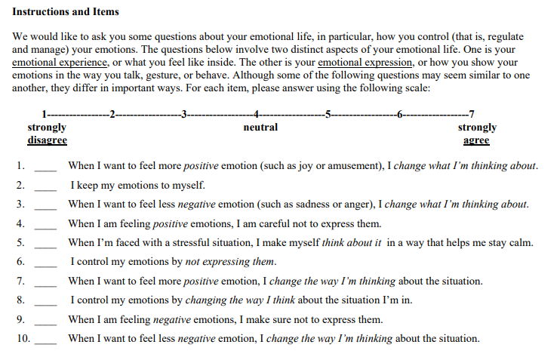
Gross & John (2003): Emotion Regulation Questionnaire
1,3,5,7,8,10 - reappraisal
2,4,6,9 - suppression
Notes:
Used in d’Arbeloff et al. (2018)

Slide 19
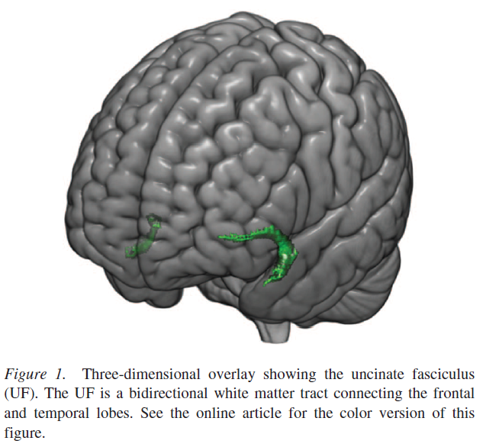
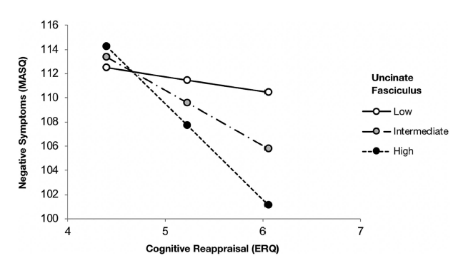
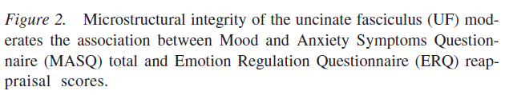
d’Arbeloff et al. (2018)
Notes:
DTI; FA is fractional ansiotrophy. Measures flow of water through the brain’s white matter tracts to identify information flow. Structural imaging.
“The Mood and Anxiety Symptoms Questionnaire (MASQ) Short Form is a 62-item self-report questionnaire used to assess current anxious and depressive symptoms over the past week.” [Weird methodology: over the past week for the MASQ but then ERQ is daily, so they’re not on the same time scale for symptom reporting.]
“At relatively low UF microstructural integrity, the correlation between MASQ total and ERQ reappraisal scores was not significant (1.238, p = .44). At intermediate (4.55, p =.001) and relatively high UF microstructural integrity (b = 7.86, p = .001), there were significant negative correlations between MASQ total and ERQ reappraisal scores.“
“Here, we provide initial evidence that the microstructural integrity of a pathway linking the dlPFC and amygdala moderates an association between typical use of cognitive reappraisal to down regulate negative emotions and the experience of anxiety and depressive symptoms”
“It is important to note that our cross-sectional data cannot determine if higher microstructural integrity of the UF supports more typical use of cognitive reappraisal or vice versa”
“Another limitation is that the ERQ assesses spontaneous or natural use of cognitive reappraisal in daily life”
“...only disorder risk (e.g., Swartz, Knodt, Radtke, & Hariri, 2015) but also response to cognitive– behavioral therapy.” [Similar to the Kragel study in wanting to provide biomarkers that would index clinical severity]

Slide 20
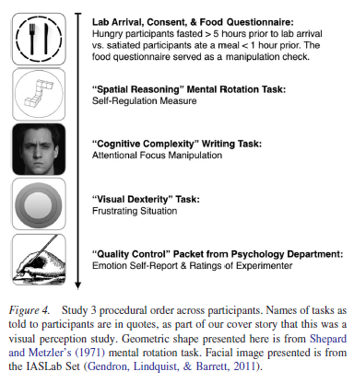
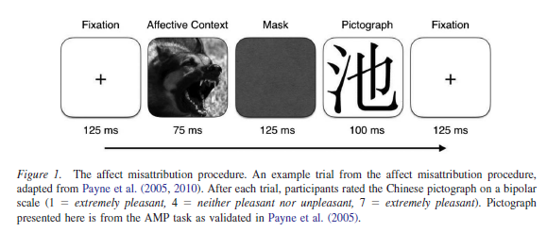
Regulate emotion by paying attn to bodily signals...
“Psych 101 students, bless their heart…”
MacCormack & Lindquist, 2019
Notes:
-what did they do?
-what were they expecting to see?
-mention why they have the mask

Slide 21
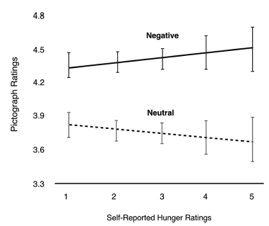
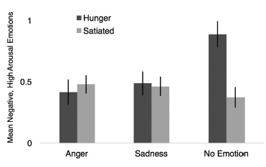
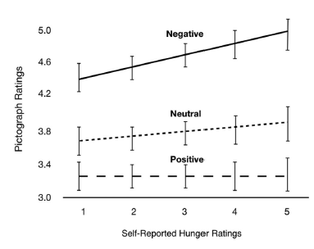
MacCormack & Lindquist (2019)
Graphs on judging the experimenter
Mean hate ratings
Siegel et al. (2018) of a similar perspective for constructionist view of emotion
Notes:
-what did they find?
-why did they run study 2?
-why did they run study 3?
-what is the overall main point?

Slide 22
Lindquist et al., 2013: The Hundred Year Emotion War
“To suggest that emotions are natural kinds is to hypothesize that each category has a biological essence that causes it or that the instances have some cluster of properties (i.e., coordinated changes in sensory, perceptual, motor, and physiological functions) that recur with sufficient consistency and specificity as to be diagnostic for that category” (p. 255).
IF the natural kind hypothesis was true:
This particular set of sensory, perceptual, motor, and physiological changes occurs ONLY for one specific emotion
The relationship is consistent enough that when all those changes are present, you know that emotion’s happening
if a 150% increase in heart rate is “diagnostic” for fear, then whenever someone has a 150% increase in heart rate, it means they’re feeling afraid
Notes:
OK, now we’ve discussed one of the constructionist papers…
“the term natural kind identifies a grouping of entities that always share particular qualities, independently of human knowledge of the entities or their qualities”

Slide 23
Instead Lindquist et al. suggest:
“[E]motions must be inventions (i.e., constructions) of the human mind. This is not a claim that emotions are illusions…” (p. 255-256)
What we call an “emotion” is really a folk category, or a way for people to name to their feelings at the moment

Slide 24
An analogy
Sense of touch
What we think of as our “sense of touch” doesn’t exist in that same form in nature (i.e., not a natural kind)
Mechanosensation
Nociception (pain)
Visceral interoception (sense of internal state)
Different neurons, different parts of the brain, different reactions
“Sense of touch” is just a label for a bunch of different experiences
Notes:
Mechanosensation is a response mechanism to mechanical stimuli. The physiological foundation for the senses of touch, hearing and balance, and pain is the conversion of mechanical stimuli into neuronal signals: mechanosensation.
Nociception (also nocioception or nociperception, from Latin nocere 'to harm or hurt') is the sensory nervous system's response to certain harmful or potentially harmful stimuli.
Interoception is contemporarily defined as the sense of the internal state of the body

Slide 25
Applying analogy to emotions
Just like there’s no “sense of touch,” maybe there’s no “anger,” because that label applies to too many situations that are too different
Gritting your teeth and being polite to your jerk boss
Screaming at a guy who cuts you off in traffic

Slide 26
Applying analogy to emotions
Just like there’s no “sense of touch,” maybe there’s no “anger,” because that label applies to too many situations that are too different
Gritting your teeth and being polite to your jerk boss; heart rate = 100 BPM
Screaming at a guy who cuts you off in traffic; heart rate = 150 BPM
Different physiology, different behavior, different functions, maybe even different qualia
Could be different for different people!

Slide 27
The discrete emotion hypothesis
Lindquist et al.’s take on what you need to prove this idea: Consistency + specificity = diagnostic
Example: Disgust = bradygastria + gape face + withdrawal of processing resources + “eww”…
How consistently does a given emotion make a particular change in the outcome measure?
How often does inducing disgust cause all that stuff?
To what extent is the change in a given outcome measure specific to a given emotion?
When people show that pattern up there, is it only for disgust?
Notes:
A bradygastria is defined, how decreased rate of electrical activity in the stomach, as less than 2 cycles per minute for at least 1 minute.

Slide 28
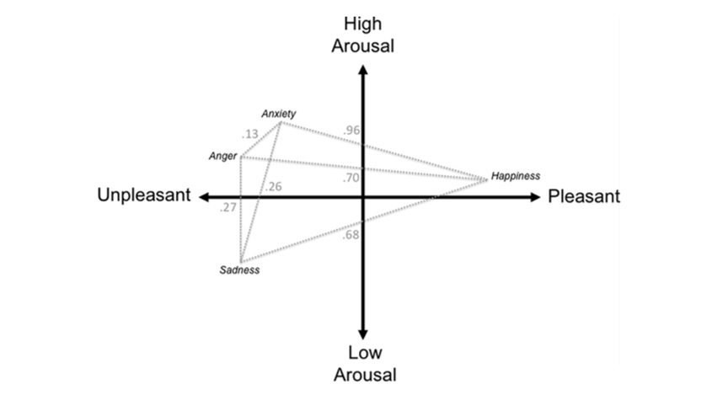
Pairwise comparisons do not reveal strong evidence for discrete emotions
Specifically critiquing the meta-analysis they’re commenting on (Lench et al.)
Small *effect size* between emotions that are close in arousal and valence (anger and anxiety)
Why is this important?
Notes:
I.e., emotional categories are not as important compared to valence & arousal

Slide 29
The psychological construction approach
So, valence & arousal explain a lot
But not everything
Emotions don’t have diagnostic output
So what does that mean about the cognition, behavior, physiology, and qualia of all these emotions?
“Diagnostic”

Slide 30
The psychological construction approach
Experience core affect
Feelings that have some values of valence and arousal; Barrett’s “recipe” discussion
Make meaning out of that core affect
Once in a while, some affect + meaning event pops out from the rest
Emotion!
Notes:
Lindquist paper - hangry isn’t really about the “anger” so much as the construction of the negative, high arousal feeling

Slide 31
The psychological construction approach
Context + concepts + core affect = variability
In experience
In physiology etc.
A bunch of versions of a given emotion, specific to each person
Specificity and consistency not necessary

Slide 32
Construct validity?
If emotions are natural kinds
All the features of an emotion will correlate highly in time and intensity
A pattern for one emotion won’t show up for another emotion
These patterns will be similar across people
If emotions are constructed
The kinds of features involved in emotion don’t have to correlate
A pattern for one emotion might be similar to another
These patterns will be somewhat unique across people

Slide 33
Summary of Lindquist et al.
There’s no way to diagnose emotions, so the natural kind theory fails
Any “emotion” is a label you’re putting on a bunch of experiences you’ve had
Some similarity across those experiences, but plenty of variability
Could be different across contexts, cultures, people…
Those experiences come out of valence + arousal + concept knowledge about “disgust” or “anger”

Slide 34
Kragel et al. (2016)
https://science360.gov/obj/tkn-video/b8b7ea9c-b267-460f-8c1e-776e111a024b/mysteries-brain-emotional-brain

Slide 35
Kragel et al. (2016)
Don’t ALWAYS have to have EXACTLY all the characteristics of a category to exist
Use JUST physiology to distinguish between emotions, above chance?
In previous study: looked at heart rate, respiration rate, gastric muscle movement, sweaty palms…
This study: fMRI signals

Slide 36
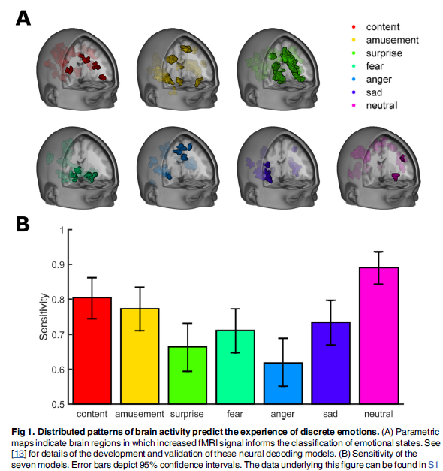
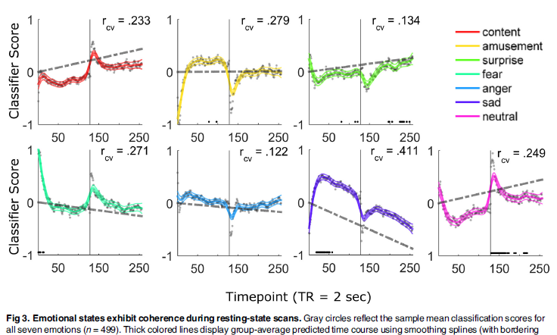
Kragel et al. (2016)
Notes:
•Induced a bunch of different emotions
–Film clips
–Music
•Physiological measures
•Machine learning
–Can you train a computer to see a pattern?

Slide 37
Kragel et al. (2016)
Not diagnosing, but you can predict what emotion someone’s feeling from physiology (or in this specific study, MRI signals) alone above chance
Consistent across people
Specific to each emotion

Slide 38
Today’s Goals & Agenda
LO1: Apply principles of good science communication
Compare & contrast the CNN and NPR reporting of the two academic papers: did they follow the principles we've discussed?
LO2: Describe the basic fundamental principles of emotion & emotion regulation research
Compare & contrast different theories of emotion, such as: James-Lange and Cannon-Bard theories, constructionist and discrete emotion hypothesis
LO3: Summarize and critically analyze academic journal articles
Compare & contrast the two constructionist articles we have read to the Kragel paper
Apply the d'Arbeloff paper to discussion on the Gross reappraisal theory of emotion regulation

Slide 39
Tomorrow’s Work
Readings:
Textbook chapters 1 & 2: most of this, I think, would be review for y’all
We will be doing review

Slide 40
Participation + various forms
https://tinyurl.com/PSY102Participation
https://tinyurl.com/PSY102MinutePaperMay23
https://tinyurl.com/PSY102FB

