Slide 1
PSY102: Introduction to Cognitive Psychology
Day 5 (05/21/19): Attention II

Slide 2
Today’s Goals + Agenda
LO1: Continue to build a supportive classroom culture & discuss science communication
Gallery walk: peer feedback on headline/lead assignment, given assignment
LO2: Define, identify, and apply previous constructs that we have discussed in class
Quiz on material that we have covered from Wednesday last week to today: multiple choice & short answer
LO3: Apply principles of good science communication
Compare & contrast the Hidden Brain podcasts, which were loosely on "attention”
Discuss what made the podcasts an ineffective or effective piece of SciComm
How do lay theories of attention (e.g., NPR podcast) fit in with these theories? Contrast with Russ Poldrack blog post.
LO4: Describe the paradigms & principles associated with multi-tasking & attentional control
Demo on task-switching (and dual-tasking), video on cognitive science & driving
Lecture/guide on current research
LO5: Summarize and critically analyze academic journal articles - tomorrow
Discuss Wechsler et al. (2018) & Seli et al. (2018) - tomorrow

Slide 3
Quick Announcement
Textbook?
Neural?
On statistics & other measures
E.g., MVPA
Resting state

Slide 4
Peer Feedback on Headline/Lead + Rubric
Continue to build a supportive classroom culture & discuss science communication

Slide 5
NPR Podcasts & Discussion on lay vs. scientific “attention”
Apply principles of good science communication

Slide 6
Multitasking & Attention
Describe the paradigms and principles associated with multi-tasking and attentional control

Slide 7

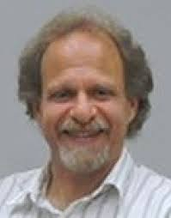
Attention Researchers @ Duke
Tobias Egner
Marty Woldorff

Slide 8
Multitasking
Two paradigms
Dual-tasking
Task-switching
Self-report
“Media Multitasking”

Slide 9
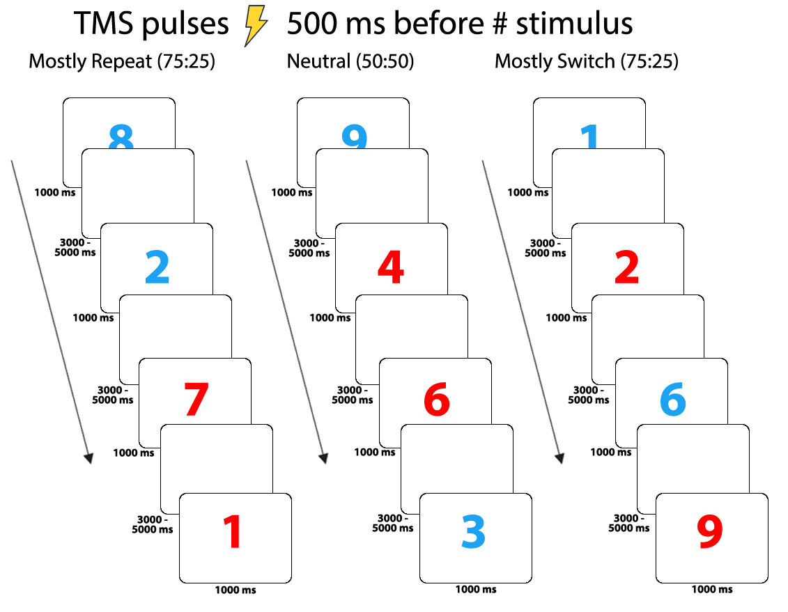
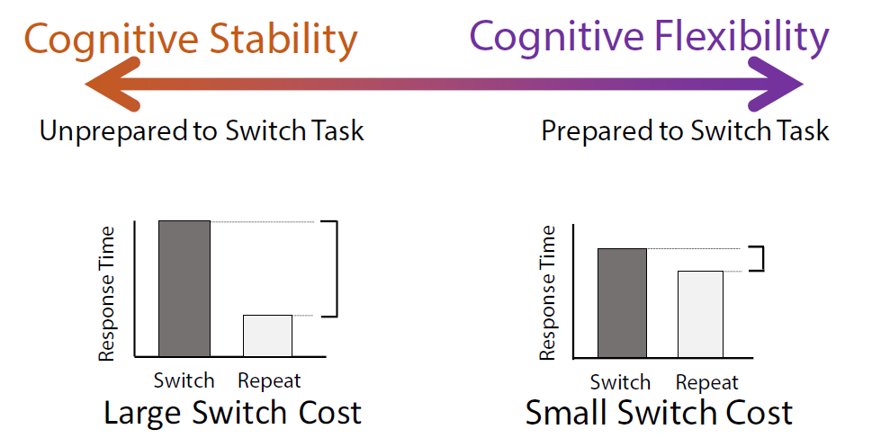
Task-switching & Dual-tasking
https://nbrosowsky.github.io/online-psychology-demos/task-switching/index.html
https://psych.hanover.edu/JavaTest/CLE/Cognition_js/exp/dualTask.html
Notes:
Figs: mine from TMS project & PDR

Slide 10
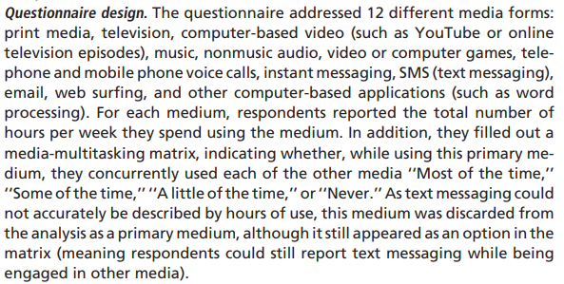
Media multitasking
Ophir et al., 2009, PNAS

Slide 11
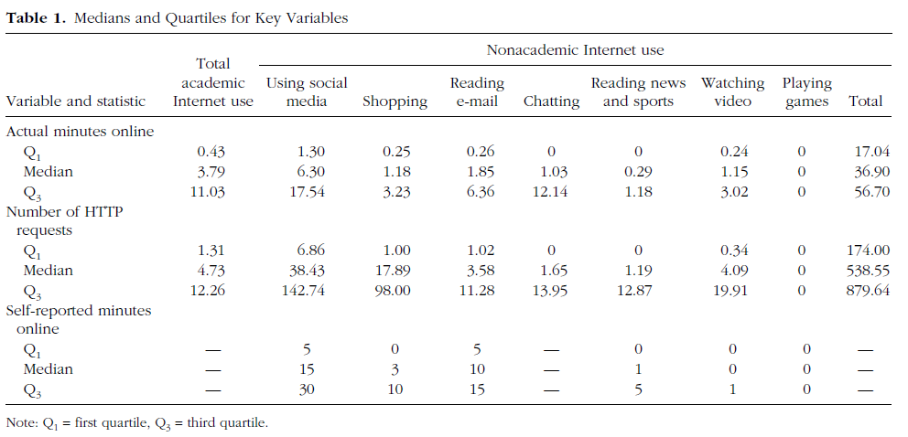
Self-Report & Other Measures
Ravizza et al., 2018, Psych Sci

Slide 12
Is this research best applied to driving contexts?
https://vimeo.com/331272529

Slide 13
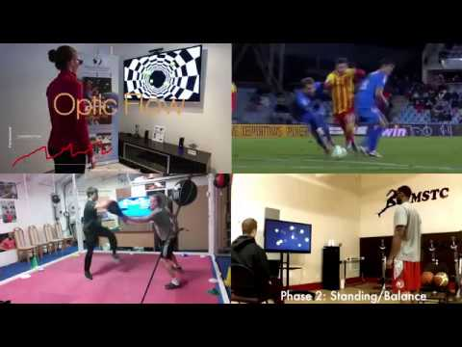
Monetizing Dual-tasking Research
Notes:
https://www.youtube.com/watch?v=YoaZ5RlpSbg

Slide 14
“How to Multitask”
https://dualtask.org/how-to-multitask/
1. Don’t think you can actually do two things at once.
2. Prioritize.
3. Immerse yourself in your immediate task, but don’t forget what remains to be done next.
4. Depend on routines — and compare new tasks with old ones.
5. Make schedules, not to-do lists.

Slide 15
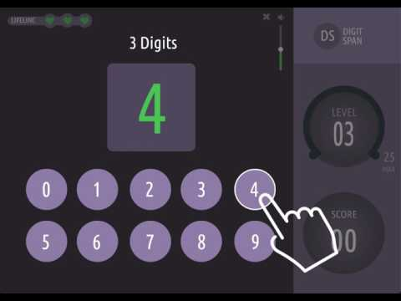
Digit Span, Classic Working Memory Capacity Task
Notes:
https://www.cambridgebrainsciences.com/science/tasks/digit-span
How to take the Digit Span Test
A sequence of numbers appears on the screen, one at a time. At the sound of the beep, users click the numbers in the same order. The number of digits increases with correct answers, and performance is indicated by the average number of digits correctly remembered.

Slide 16
More working memory paradigms
Working memory (n-back paradigm): http://cognitivefun.net/test/4
Spatial working memory: http://cognitivefun.net/test/23
Others: http://cognitivefun.net/test/10, http://cognitivefun.net/test/22

Slide 17
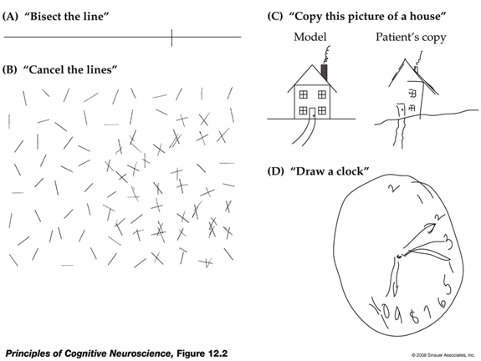
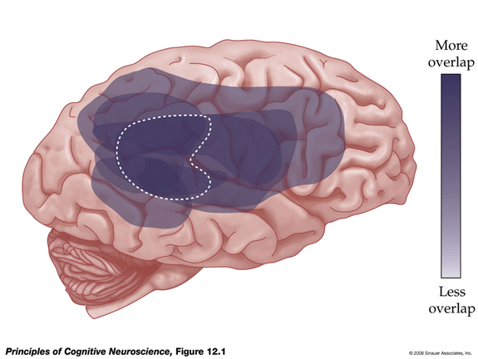
Attentional Control - Neglect syndrome
Notes:
Brain lesions impairing attentional control
‘Neglect syndrome’, or ‘hemi-spatial neglect’ is reflected in the patient’s marked inability to attend to the left side of personal and extra-personal space (and even to internal, memory representations!). Importantly, these patients’ eyesight and visual cortex function just fine, indicating that their specific deficit is attentional in nature.
The attentional nature of this syndrome is also confirmed by the phenomenon of ‘extinction’: patients can often detect an object that is presented to their left side in isolation, but fail to notice the object if it is accompanied by another object in the right visual field. The latter seems to win the competition for attentional resources
‘Neglect syndrome’ is seen most frequently after lesions to the right inferior parietal cortex (typically due to stroke affecting the right middle or posterior cerebral arteries), but can also result from more anterior lesions, and many researchers view neglect as a ‘disconnection syndrome’ disrupting the right side of the ‘spatial attention network’.

Slide 18
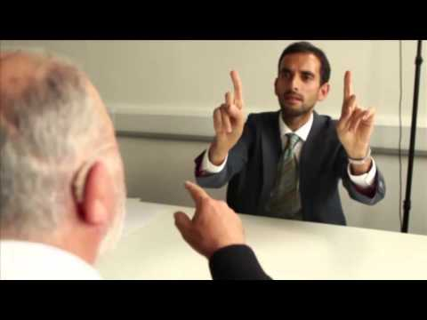
Attentional Control - Neglect syndrome

Slide 19
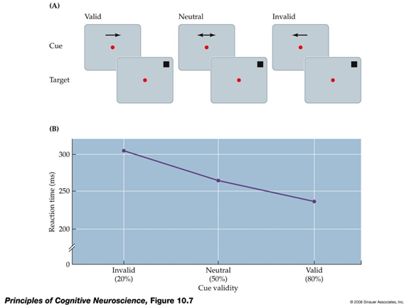
Endogenous Cueing (Posner)
Notes:
Attention can be guided endogenously (‘top-down’, i.e. by our internal goals) or exogenously (‘bottom-up’, i.e. by salient stimulus features of the environment). Fig.: a typical endogenous cuing study (‘Posner task’), where target detection times are fastest following valid cues, and slowest following invalid cues.
For studying the neural substrates of attention, it is particularly interesting to distinguish activity related to the cue period from that of the target period. Cue period activity is considered to reflect ‘pure’ top-down attention, whereas the target period captures a mix of processes, incl. target detection and response selection. In order to statistically separate cue- from target-related activity, fMRI studies tend to use a long (and ‘jittered’) cue period.

Slide 20
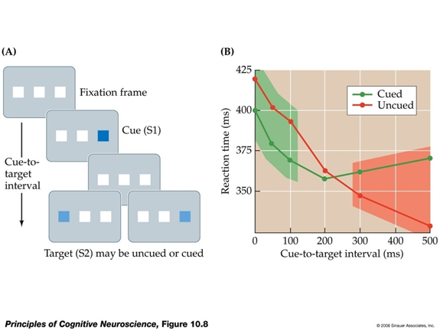
Exogenous Cueing
Notes:
Fig.: a typical exogenous cuing study, where salient but task-irrelevant stimuli attract attention (‘attentional capture’). Note that the capture effect starts early, is short-lived, and reverses if the salient distracter stimulus precedes the target by more than circa 300ms (‘inhibition of return’).
The neural correlates of exogenous orienting are harder to study, since it is tricky to dissociate the (visual) responses to a salient external stimulus from the attentional orienting response itself

Slide 21
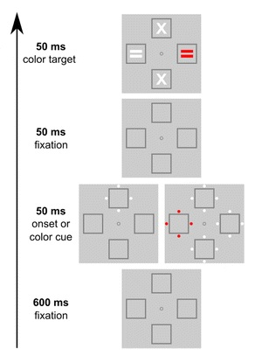
Contingent Capture interaction of top-down vs. bottom-up
Folk et al., 1992, JEP:HPP
Notes:
Importantly, top-down and bottom-up influences on attention interact, as evident in the finding of “contingent capture”: When asked to detect the location of a color “singleton” stimulus (here, the red “=“ symbol), subjects’ spatial attention will be captured “bottom-up” by a preceding cue only if it is a color cue (i.e., relevant to the current task set), but not if it is a sudden-onset cue (not relevant to task, but usually a potent stimulus to capture attention).

Slide 22
Takeaways
Multitasking is thought to sap executive function resources, such that high media multitaskers are the most easily distracted and perform worse working memory tasks , and can be measured by task-switching, dual-tasking, and self-report measures.
Attention can be directed internally (like working memory) or externally, and can be measured endogenously (top-down, by internal goals) or exogenously (bottom-up, by stimulus salience).
You can’t pay attention to all things in your environment (cc: change blindness), and certain conditions also result in attentional deficits (cc: hemispatial neglect/neglect syndrome).

Slide 23
Wechsler et al. (2018) & Seli et al. (2018)
Summarize and critically analyze academic journal articles

Slide 24
Quiz + Fill out Participation & Minute Paper
Define, identify, and apply previous constructs that we have discussed in class

Slide 25
Today’s Goals + Agenda
LO1: Continue to build a supportive classroom culture & discuss science communication
Gallery walk: peer feedback on headline/lead assignment, given assignment
LO2: Define, identify, and apply previous constructs that we have discussed in class
Quiz on material that we have covered from Wednesday last week to today: multiple choice & short answer
LO3: Apply principles of good science communication
Compare & contrast the Hidden Brain podcasts, which were loosely on "attention”
Discuss what made the podcasts an ineffective or effective piece of SciComm
How do lay theories of attention (e.g., NPR podcast) fit in with these theories? Contrast with Russ Poldrack blog post.
LO4: Describe the paradigms & principles associated with multi-tasking & attentional control
Demo on task-switching (and dual-tasking), video on cognitive science & driving
Lecture/guide on current research
LO5: Summarize and critically analyze academic journal articles - tomorrow
Discuss Wechsler et al. (2018) & Seli et al. (2018) - tomorrow

Slide 26
Tomorrow’s Work
Articles:
Kragel et al. (2016) (Duke article)
Siegel et al. (2018)
Podcast:
The creation of emotions | All in the Mind
You don’t have to fill out reading worksheets, but they do suggest the kinds of things that we would/will talk about; if you want to fill them out, you can.

Slide 27
When finished with the Quiz:
https://tinyurl.com/PSY102Participation
https://tinyurl.com/PSY102MinutePaperMay21

