Slide 1
PSY102: Introduction to Cognitive Psychology
Day 2 (05/16/19): Cognitive Methodology

Slide 2
Today’s Goals + Agenda
LO1: Continue to build a supportive classroom culture & discuss science communication.
Another Icebreaker: Get to know each other as scholars and people
Tweet summaries: brainwriting via the curated worksheet
Apply our Class Generated SciComm Principles to Yong (2019) and Ben Goldacre's TED talk
LO2: Describe the advantages and disadvantages, as well as basic mechanisms of, each methodology
Work in pairs to come up with the pros and cons of each methodology based off textbook
Team Jeopardy style check for understanding with multiple choice questions
LO3: Summarize the types of questions typically answered with each methodology
Team Jeopardy style check for understanding with multiple choice questions
In teams, pose hypothetical studies with specific methodologies for particular questions
If there's time: work on vignettes as teams
LO4: Assess current problems within psychological methodology such as WEIRD samples and the lack of open science
More Jeopardy style check for understanding questions on the open science reading
Thought probe on how WEIRD samples affects cognitive psychology

Slide 3
Icebreaker
Find someone you didn’t talk to yesterday, and repeat the icebreaker:
Introduce yourself (name, year, major, fun fact etc.) & discuss one or both of the hypotheticals on your notecard
Suggested: Exchange contact info with your person, in case you need notes or have a question.

Slide 4
SciComm: Tweet Summaries
For each tweet summary that you see, fill out part of the handout
We will come together to discuss what you thought in terms of how well scientists, journalists, etc. communicated

Slide 5
SciComm: Yong (2019) & TED talk
What does Yong (2019) do well?
What did Ben Goldacre do well with his TED talk?
Notes:
-everyone said that what drew them into reading a science news article was usually the title or the relevance of the topic (i.e., curiosity)

Slide 6
Check for Understanding of Cognitive Methodology
Describe the advantages and disadvantages, as well as basic mechanisms of, each methodology
Summarize the types of questions typically answered with each methodology

Slide 7
Mind & the Brain:
Mind ≠ brain
Mind : brain ::
– Traffic laws : traffic lights
– Software : hardware
– System that accomplishes cognitive goals using representations : the actual neuronal stage that system plays out on

Slide 8
Advantages & Disadvantages of Cognitive Methodologies
Level 1 (explicitly mentioned):
Modeling
Transcranial Magnetic Stimulation (TMS)
Lesion
Single Cell Recordings
Level 2 (not explicitly mentioned):
Behavior (RT/accuracy/self report)
Diffusion Tensor Imaging (DTI) /structural imaging
Genetic manipulations
Electroencephalography (EEG)/ event related potentials (ERPs)
Functional magnetic resonance imaging (fMRI)
Positron Emission Topography (PET)
MEG
With the person next to you, come up with a list of pros and cons to each methodology within cognitive psychology & neuroscience. We’ll come back together as a class to discuss.
Notes:
Quick aside on EcoG and epilepsy

Slide 9
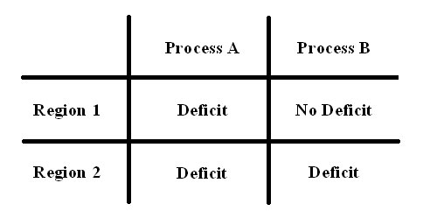
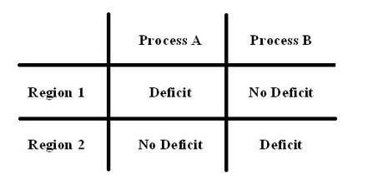
Review: Single vs. Double Dissociation

Slide 10
Some Things Not Mentioned
Experience Sampling
Eye-tracking
ECoG (within epilepsy patients)
Pharmacological manipulations
Newer advances on stimulation techniques: tDCS, tACS, ultrasound, fNIRS, etc.

Slide 11
Now for some Jeopardy Style questions...
Teams of 3-4
Multiple choice check for understanding questions
Methodology is the category of focus...

Slide 12
Which of the following non-invasive neuroscience methods represents a direct measure of neuronal activity?
PET
EEG
fMRI
DTI
Notes:
B - EEG

Slide 13
You are interested in non-invasively assessing the responses of the human amygdala (which lies deep inside the brain) to different types of face stimuli (neutral, fearful, happy, etc.) shown at a pace of about one stimulus every 3-5 seconds. Which methodology should you choose?
EEG
PET
fMRI
TMS
Notes:
C - fMRI

Slide 14
Why are lesion studies still considered to be indispensable in understanding how the brain works?
Because they provide great temporal resolution
Because they provide great spatial resolution
Because they provide a clean assessment of the specific function of a brain region
Because they can document the necessity of a brain region for a particular cognitive process
Notes:
D

Slide 15
Choose the statement that correctly describes one main advantage and one main disadvantage of using EEG recordings versus functional MRI in exploring cognition in the brain?
EEG has a higher spatial but a lower temporal resolution than fMRI
EEG has a higher temporal but a lower spatial resolution than fMRI
EEG is cheaper but more invasive than fMRI
EEG is more expensive but less invasive than fMRI
Notes:
B

Slide 16
With your team, come up with sample expt ideas
What method would you use to test...
Does synchronized attention predict learning?
Is prefrontal cortex necessary for optimizing our multi-tasking?
How does curiosity change on a daily basis?
Do our decisions depend on the value we associate with different options?
Notes:
First question: inspired by study on synchronized attention from Dikker (Bevilacqua, D., Davidesco, I., Wan, L., Chaloner, K., Rowland, J., Ding, M., ... & Dikker, S. (2019). Brain-to-brain synchrony and learning outcomes vary by student–teacher dynamics: Evidence from a real-world classroom electroencephalography study. Journal of cognitive neuroscience, 31(3), 401-411.)
Second question: cognitive control usually associated w/ prefrontal cortex
Third question: Inspired by curiosity PsyArxiv paper we will read
Fourth question: inspired by various decision-making tasks from Huettel lab that combine modeling, eye-tracking, etc.

Slide 17
Summary: Usually...
Interested in the noninvasive measure of particular role of a brain region in cognitive process? fMRI
Chiu, Y. C., Jiang, J., & Egner, T. (2017). The caudate nucleus mediates learning of stimulus–control state associations. Journal of Neuroscience, 37(4), 1028-1038.
Interested in how cognitive processes unfold at a specific temporal scale? EEG
Whitehead, P. S., Ooi, M. M., Egner, T., & Woldorff, M. G. (2019). Neural Dynamics of Cognitive Control over Working Memory Capture of Attention. Journal of cognitive neuroscience, 1-12.
Interested in how neuromodulators impact cognition? PET
Castrellon, J. J., Seaman, K. L., Crawford, J. L., Young, J. S., Smith, C. T., Dang, L. C., ... & Samanez-Larkin, G. R. (2019). Individual differences in dopamine are associated with reward discounting in clinical groups but not in healthy adults. Journal of Neuroscience, 39(2), 321-332.
Notes:
Putting people at duke

Slide 18
Summary: Usually...
Interested in noninvasive measure whether a particular region is causally involved in a particular cognitive process? TMS
Muhle-Karbe, P. S., Jiang, J., & Egner, T. (2018). Causal evidence for Learning-Dependent frontal lobe contributions to cognitive control. Journal of Neuroscience, 38(4), 962-973.
Interested in how networks within the brain interact? Graph theory, functional connectivity, etc.
Davis, S. W., Szymanski, A., Boms, H., Fink, T., & Cabeza, R. (2018). Cooperative contributions of structural and functional connectivity to successful memory in aging. Network Neuroscience, 3(1), 173-194.
Interested in how disease impacts cognition? No one particular method, depends on the question… e.g., Neurogenetics lab by Ahmad Hariri. Methods often “converge” for Qs.
Some methods also depend on what “level” you’re at: do you want to look at neural vs. neuronal activity? Invasive vs. noninvasive?

Slide 19

Review: reliability vs. validity
https://www.buzzfeed.com/eleanorbate/accurate-af-sorting-quiz
Notes:
Show me with a raise of hands, how many of you think this is a reliable measure? Why/why not? (reliable--likely to get the same answer if you took it in a couple weeks, your preferences likely don’t change)
But are these surveys a valid measure of your personality? Probably not.
Remember, reliable does not imply valid, but to be valid you HAVE to be reliable.

Slide 20
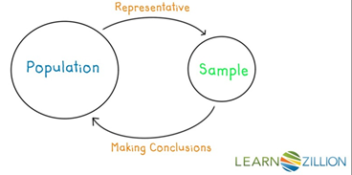
Descriptive vs. Inferential Statistics

Slide 21
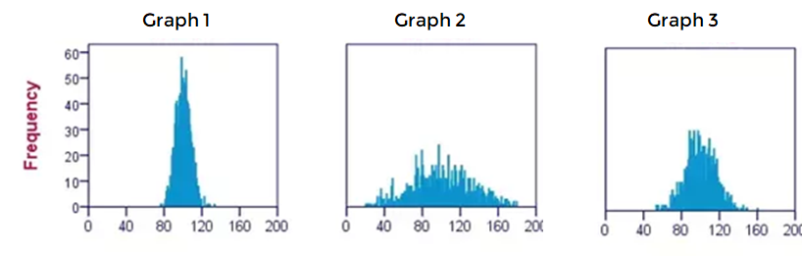
Descriptive vs. Inferential Statistics
Notes:
(original file is histograms for IQ test components)
https://www.quora.com/What-does-a-small-standard-deviation-signify
Is the mean or average between these three graphs the same or different? SAME. *click*

Slide 22
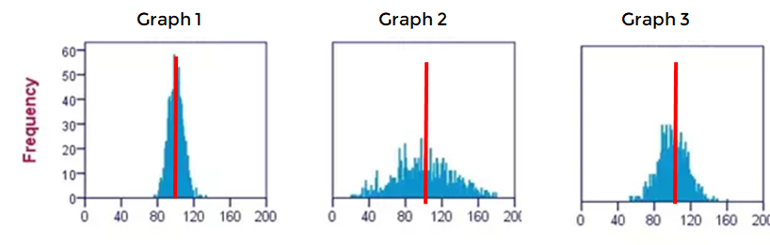
Descriptive vs. Inferential Statistics
Notes:
(original file is histograms for IQ test components)
https://www.quora.com/What-does-a-small-standard-deviation-signify
Is the mean or average between these three graphs the same or different? SAME. *click*

Slide 23
Descriptive vs. Inferential Statistics
Notes:
Go ahead and decide, in your head, which graph has the largest deviation. Think about it for a sec….[wait time]... And on 3, go ahead and tell me on your fingers what you think...3, 2, 1… tell me.

Slide 24
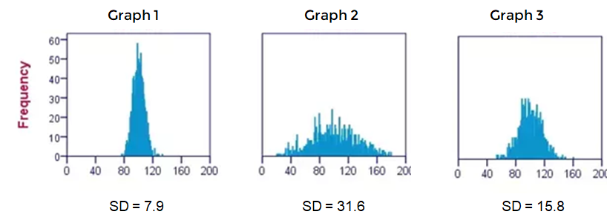
Descriptive vs. Inferential Statistics
Notes:
[feedback]
You can see that measures of central tendency (e.g. mean) are the same in all graphs, these data are extremely different from each other. That’s why you’ll also see a measure of dispersion (standard deviation) reported along with mean with descriptive statistics.

Slide 25
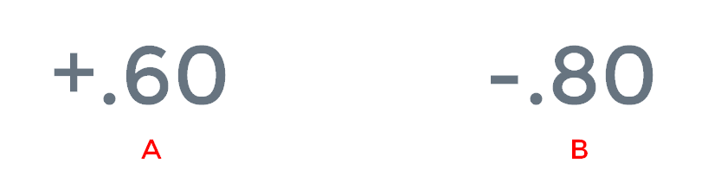
What’s a stronger correlation?

Slide 26
What’s a stronger correlation?
Notes:
Same goes for any kind of effect size: usually the absolute value of the differences

Slide 27
Review: Research Methods
Correlational versus experimental designs
How to compare the sign and absolute value of correlations
Independent and dependent variables (IVs and DVs)
Within- and between-subject experiments
The importance of random assignment
Reliability versus validity
Descriptive statistics
Measures of central tendency (mean, mode, median)
Standard deviation
Inferential statistics
P-values
Null hypotheses
Notes:
-> if you don’t know these concepts, let’s chat

Slide 28
Today’s Goals + Agenda
LO1: Continue to build a supportive classroom culture & discuss science communication.
Another Icebreaker: Get to know each other as scholars and people
Tweet summaries: brainwriting via the curated worksheet
Apply our Class Generated SciComm Principles to Yong (2019) and Ben Goldacre's TED talk
LO2: Describe the advantages and disadvantages, as well as basic mechanisms of, each methodology
Work in pairs to come up with the pros and cons of each methodology based off textbook
Team Jeopardy style check for understanding with multiple choice questions
LO3: Summarize the types of questions typically answered with each methodology
Team Jeopardy style check for understanding with multiple choice questions
In teams, pose hypothetical studies with specific methodologies for particular questions
If there's time: work on vignettes as teams
LO4: Assess current problems within psychological methodology such as WEIRD samples and the lack of open science
More Jeopardy style check for understanding questions on the open science reading
Thought probe on how WEIRD samples affects cognitive psychology
Notes:
Red = not covered

Slide 29
Tomorrow’s Work
Gruters, K. G., Murphy, D. L. K., Jenson, C. D., Smith, D. W., Shera, C. A., & Groh, J. M. (2018). The eardrums move when the eyes move: A multisensory effect on the mechanics of hearing. Proceedings of the National Academy of Sciences, 115(6), E1309–E1318. https://doi.org/10.1073/pnas.1717948115.
Science News:
Yong, E. (2018, January 23). When Your Eyes Move, So Do Your Eardrums. Retrieved from The Atlantic website: https://www.theatlantic.com/science/archive/2018/01/when-your-eyes-move-so-do-your-eardrums/551237/.
Dean, S. (2018, January 25). Our Eye Movements Also Move Eardrums, And Nobody Knows Why. Retrieved from https://www.sciencealert.com/eye-movements-cause-vibrations-eardrums-hearing-weird-brain.

Slide 30
Participation + Minute Paper
https://tinyurl.com/PSY102Participation
https://tinyurl.com/PSY102MinutePaperMay16

