Slide 1
PSY102: Introduction to Cognitive Psychology
Day 12 (05/31/19): LTM Processes & Mechanisms

Slide 2
Today’s Goals + Agenda
LO1: Continue to build a supportive classroom culture & discuss science communication
Discuss Wikipedia profile
Discuss a rubric for science summary pieces based off of the ripples article + previous Journal club article
LO2: Describe the basic mechanisms of memory processes
Review LTM: structure material
Discuss Goldstein chapter 7 about memory processes
LO3: Summarize and critically analyze academic journal articles
Now that the research has been contextualized on what are considered basic memory processes, how does our previous discussion on WEIRD samples apply here? Are these basic memory principles?
What are real-world implications? What are ongoing questions in the memory field?

Slide 3
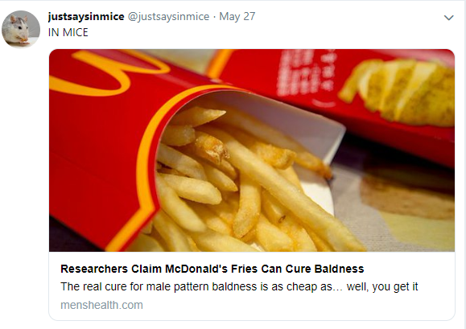
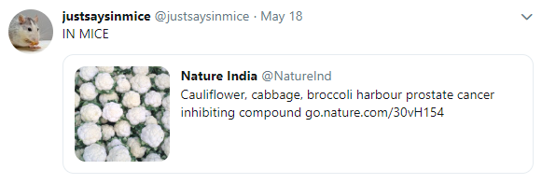
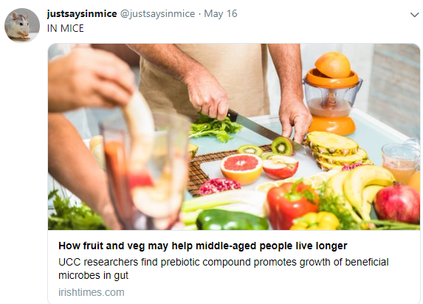
https://twitter.com/justsaysinmice
The importance of accurate science reporting

Slide 4
Minute Paper
Quiz, readings, + science summary next Monday-- push opening paragraph to Tuesday?
Priming
Some of the implicit/non-declarative distinctions
Hippocampus & primacy effect

Slide 5
Wikipedia + Science Summary Piece
Continue to build a supportive classroom culture & discuss science communication

Slide 6
Gelinas, Science Summary
Take a couple of minutes to refresh your memory of the Gelinas (2019) coverage of the Vaz article in Science
How did this piece differ in terms of audience, structure, etc. from yesterday’s science summary piece?
Is there anything you want to modify in the science summary assignment guideline?
After a couple of minutes, discuss with the person next to you. We will come together afterwards to discuss as a class.

Slide 7
Wikipedia Piece
Name, Photograph
Identifying information
Birth date, employment, degrees, education, workplaces, etc.
Summary of Significant Contributions to Psychology
Theories, What They’re Known For (e.g., often most cited papers)
Relevant Personal History
Career & Honors / Awards, Lab, Topics of interest, etc. Can help establish ‘notable academic’ criterion
More detail:
Books, articles, professional service
References:
Journals, books, magazines, newspapers
Evidence piece

Slide 8
Review / A Little More on LTM: Structure

Slide 9
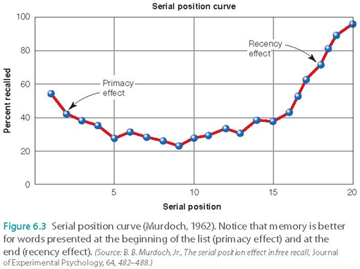
Serial Position Curve
Primacy Effect
Recency Effect
What happens w/ delay? Slow presentation?
MTL amnesic patients?
MTL includes hippocampus, amygdala, etc.
Notes:
–Primacy effect gave more time to rehearse info, more likely to enter LTM
–Recency effect
–Stimuli still in STM

Slide 10
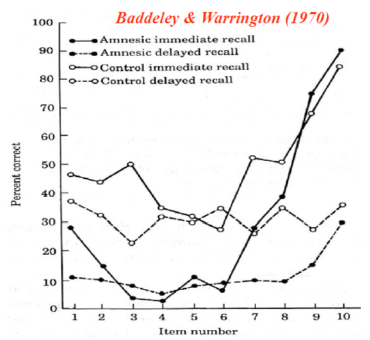
Serial Position Curve
Primacy Effect
Recency Effect
What happens w/ delay? Slow presentation?
MTL amnesic patients?
MTL includes hippocampus, amygdala, etc.
Notes:
–Primacy effect gave more time to rehearse info, more likely to enter LTM
–Recency effect
–Stimuli still in STM

Slide 11
Nondeclarative/Implicit
Memories that we “aren’t aware of”
Unconsciously influence our behavior or cognition
Procedural learning
Memory for skills
Priming
A change in processing of a stimulus due to previous encounter with the same or a related stimulus, in the absence of conscious awareness of the original encounter
Classical conditioning
Pairing one stimulus with another so that the conditioned stimulus evokes the same response as the unconditioned stimulus

Slide 12
Nondeclarative/Implicit
Procedural learning
Ex: Mirror drawing, typing, riding a bike, doing a somersault, playing an instrument
You might have a hard time explaining it, but you just do it
Priming
Seeing bird - responding faster to bird later on
Word-fragment/stem completion: _ S S _ S S _ _, ele______
Other types:
Your prime is Envelope, Target: Envelope, Cue: Stationary
Envelope, target is Letter (semantic priming)
Classical conditioning
Ex: blinking after tone; reaction to bugs
Notes:
A typical priming study could involve having subjects read a word list (for a made-up purpose), and at another time (which might be on a different day) ask them to complete ‘word-stems’ with the first word that comes to mind. Even though subjects may not recollect the original word list, they are more likely to use those words than other words they were not exposed to.

Slide 13
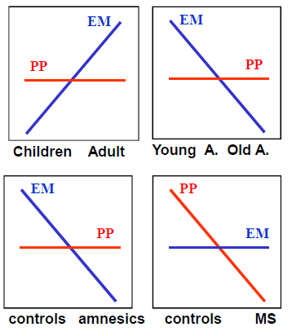
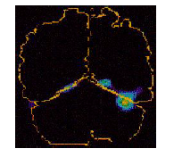
Episodic vs. (Perceptual) Priming
Developmental dissociations
Brain damage
MS had right occipital lobe lesion
Notes:
Functional dissociations
– E.g., retention interval (Tulving et al., 1982)
• Developmental dissociations
– Children vs. young adults
– Young adults vs. older adults
• Brain damage
– Amnesic patients
• Impaired EE, preserved PP
– Patient MS (right occipital lesion)
Gabrieli et al. (1995)
• Impaired PP, preserved EE
• Functional Neuroimaging
– EM: right PFC, MTL, medial parietal, cb
activations
– PP: occipital deactivations

Slide 14
Short-Term Memory vs. LTM
H.M. & Clive Wearing both OK on STM, but impaired in LTM
K.F. impaired in STM, but OK in LTM
Lesion close to language processing area
Digit span only 3 digits
Recency vs. primacy effect; MTL amnesics on serial position curve
Recent research suggests maybe more complicated
Notes:
Patient K.F. (Warrington & Shallice, 1969)
• Lesion
– close to left Sylvian fissure (language processing area)
– hesitant speech but no aphasia
• Specific deficit in immediate verbal memory
– Digit span only 3 digits!
• McCarthy & Warrington patient with word span of 1 word!
– Poor performance in Brown-Peterson
• Normal long-term memory

Slide 15
If you can’t find a neuropsych patient...
See what part of the brain activates in healthy participants
E.g., semantic & episodic activate different regions of the brain
Temporarily turn off parts of healthy participants’ brains
What methods are these pts?
Complementary w/ lesions

Slide 16
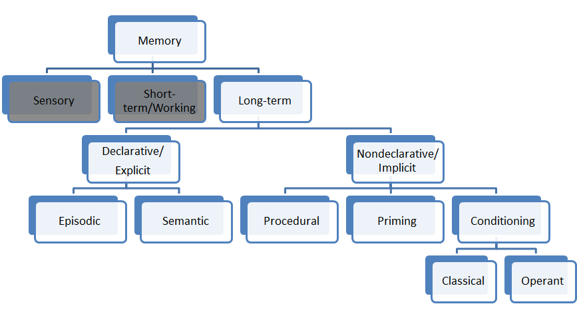
Try to fill out evidence for each branch in a group

Slide 17
Subdivisions of Memory
Declarative/Explicit vs. Nondeclarative/Implicit: H.M./Clive
Episodic vs. Semantic: K.C. vs. Italian Woman
Episodic vs. Procedural: H.M./Clive vs. Parkinson’s
Episodic vs. Priming: Developmental & MS
Episodic vs. Conditioning: exists, not discussing
STM vs. LTM: HM/Clive vs. K.F.; recency vs. primacy
Emotion: amygdala
Motor: cerebellum
Past exp
facts
skills
MTL
diencephalon
MTL
Left Temporal Cortex
striatum
neocortex

Slide 18
Demo Instructions
You will be presented with three 12-word lists and you must ‘encode’ them for 1 minute before I ask you to recall the words that were presented to you…
Any questions? Ready?

Slide 19
Demo: List 1
CYB
WSP
LXK
TPR
SSS
DRW
JPL
CLT
MSY
CLA
BLR
QRZ
Notes:
Countdown 1 minute from slide presentation

Slide 20
Demo: Recall
For the next minute, try to write down as many trigrams you can remember…
Notes:
Countdown 1 minute from slide presentation

Slide 21
Demo: List 2
FLL
PHX
LAS
CLT
SFO
DEN
DFW
LAX
ORD
IAD
DTW
PHL
Notes:
Countdown 1 minute from slide presentation

Slide 22
Demo: Recall
For the next minute, try to write down as many trigrams you can remember…
Notes:
Countdown 1 minute from slide presentation

Slide 23
Demo: List 3
YOU
HIM
HIS
MAN
HER
BOY
DAD
MOM
ALL
WHO
OLD
OUR
Notes:
Countdown 1 minute from slide presentation

Slide 24
Demo: Recall
For the next minute, try to write down as many trigrams you can remember…
Notes:
Countdown 1 minute from slide presentation

Slide 25
Check Your Answers
LIST 1
CYB
WSP
LXK
TPR
SSS
DRW
JPL
CLT
MSY
CLA
BLR
QRZ
LIST 2
FLL
PHX
LAS
CLT
SFO
DEN
DFW
LAX
ORD
IAD
DTW
PHL
LIST 3
YOU
HIM
HIS
MAN
HER
BOY
DAD
MOM
ALL
WHO
OLD
OUR

Slide 26
Thoughts on the Demo?
Which list did you remember the best? (Include both # of correct & incorrect responses)
Why do you think that might be?
How does that relate to the LTM structure you learned?
Notes:
List 1: nonwords
List 2: airport trigrams
List 3: real words
don’t think people will notice that there are airports in the 2nd list; if they do (like identifiers), might access semantic knowledge. All a function of whether they’re recognizing that there’s a pattern or category to which the items fall under.
Hit rate high for list 2, then 3, then 1
False alarm rate for list 2, then 3, then 1

Slide 27
Everyday Implications
Perfect and Askew (1994)
Propaganda effect: more likely to rate statements read or heard before as being true
“Buying Attention”
Pop culture
Memory loss is everywhere… Dory, The Bourne movies, Memento, Eternal Sunshine of the Spotless Mind...
Notes:
Repetition priming, scan thru magazine, not looking at ads, then had them rate ads later on a number of details, and ads they’d seen before > ads they hadn’t

Slide 28
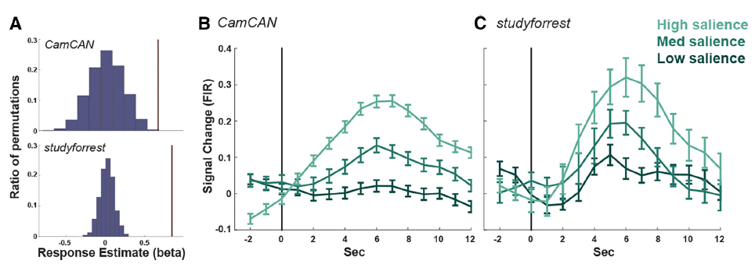
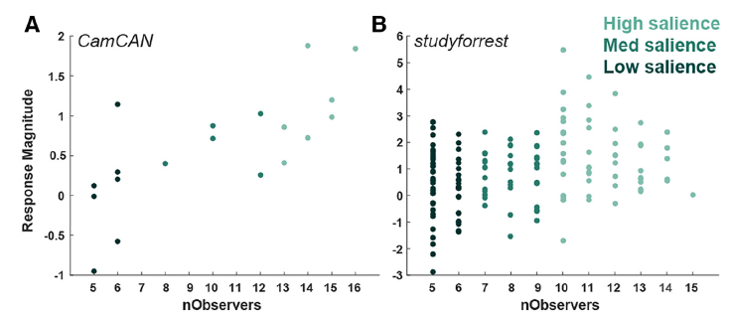
Ben-Yakov & Henson (2018)

Slide 29
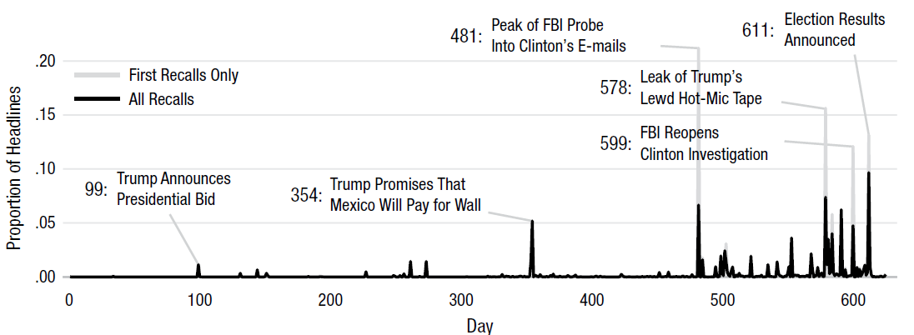
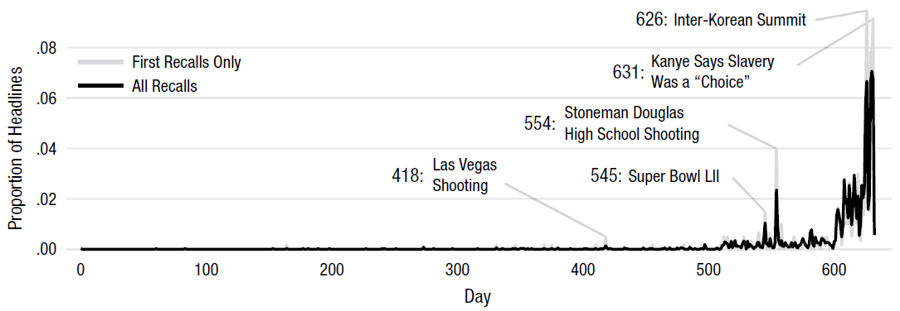
Uitvlugt and Healey (2018)

Slide 30
LTM: Processes & Mechanisms
Describe the basic mechanisms of memory processes

Slide 31
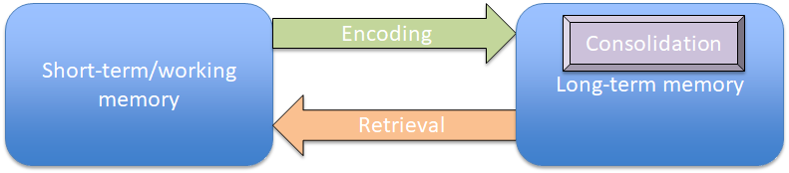
How the Processes Relate
Notes:
•Encoding: acquiring information and transforming it into memory
•Retrieval: transferring information from LTM to working memory
•Maintenance rehearsal
–Repetition of stimuli that maintains information but does not transfer it to LTM
•Elaborative rehearsal
–Using meanings and connections to help transfers information to LTM

Slide 32
Rehearsal
Maintenance rehearsal
“P. Sherman, 42 Wallaby Way, Sydney” x 1000
Elaborative rehearsal
Favorite books, movies, etc.
My friend lives in Sydney
Notes:
•Encoding: acquiring information and transforming it into memory
•Retrieval: transferring information from LTM to working memory
•Maintenance rehearsal
–Repetition of stimuli that maintains information but does not transfer it to LTM
•Elaborative rehearsal
–Using meanings and connections to help transfers information to LTM

Slide 33
Demo
I will present a list of words
Your job is to count the of consonants in the list
You will have 30 seconds
Notes:
Conduct a levels-of-processing experiment. The text describes processing levels including shallow (e.g., counting the number of vowels in words) and deep (e.g., naming antonyms of words). Develop two lists of 20 common words for which students can conduct shallow and deep levels of encoding. Give different encoding instructions for each list and ask them to recall the words following the presentation of each of the lists. Have students compare memory performance for the two types of encoding, and discuss the results in light of the levels-of-processing theory.

Slide 34
Demo: List 1
Teacher
Campus
Yoga
Winter
Firefighter
Worm
Home
Rose
Woman
Restaurant
Shoe
Rabbit
Brother
Pretzel
Car
Pillow
Waitress
Bank
Coin
Yarn
Notes:
Conduct a levels-of-processing experiment. The text describes processing levels including shallow (e.g., counting the number of vowels in words) and deep (e.g., naming antonyms of words). Develop two lists of 20 common words for which students can conduct shallow and deep levels of encoding. Give different encoding instructions for each list and ask them to recall the words following the presentation of each of the lists. Have students compare memory performance for the two types of encoding, and discuss the results in light of the levels-of-processing theory.

Slide 35
Demo: List 1 Recall
Recall as many words as you can
Notes:
Conduct a levels-of-processing experiment. The text describes processing levels including shallow (e.g., counting the number of vowels in words) and deep (e.g., naming antonyms of words). Develop two lists of 20 common words for which students can conduct shallow and deep levels of encoding. Give different encoding instructions for each list and ask them to recall the words following the presentation of each of the lists. Have students compare memory performance for the two types of encoding, and discuss the results in light of the levels-of-processing theory.

Slide 36
Demo: List 2 Recall
I will present a list of words
Your job is to think of an antonym for each word
You will have 30 seconds
Notes:
Conduct a levels-of-processing experiment. The text describes processing levels including shallow (e.g., counting the number of vowels in words) and deep (e.g., naming antonyms of words). Develop two lists of 20 common words for which students can conduct shallow and deep levels of encoding. Give different encoding instructions for each list and ask them to recall the words following the presentation of each of the lists. Have students compare memory performance for the two types of encoding, and discuss the results in light of the levels-of-processing theory.

Slide 37
Demo: List 2
Dentist
Office
Lunchbox
Friend
Cucumber
Lake
Paper
Drink
Beard
Boat
Pencil
Black
Sun
Toothbrush
President
Mustard
Football
Evening
Mail
Wallet
Notes:
Conduct a levels-of-processing experiment. The text describes processing levels including shallow (e.g., counting the number of vowels in words) and deep (e.g., naming antonyms of words). Develop two lists of 20 common words for which students can conduct shallow and deep levels of encoding. Give different encoding instructions for each list and ask them to recall the words following the presentation of each of the lists. Have students compare memory performance for the two types of encoding, and discuss the results in light of the levels-of-processing theory.

Slide 38
Demo: List 2
Recall as many words as you can
Notes:
Conduct a levels-of-processing experiment. The text describes processing levels including shallow (e.g., counting the number of vowels in words) and deep (e.g., naming antonyms of words). Develop two lists of 20 common words for which students can conduct shallow and deep levels of encoding. Give different encoding instructions for each list and ask them to recall the words following the presentation of each of the lists. Have students compare memory performance for the two types of encoding, and discuss the results in light of the levels-of-processing theory.

Slide 39
Demo Debriefing
Which list was easier to recall?
Why?
How can this idea be applied when studying for a test?
Notes:
Studying for a test
→ think of it like the generation effect

Slide 40
Retrieval Success Related to How You Encode
Levels of processing
Shallow processing
little attention to meaning
focus on physical features
poor memory
Deep processing
close attention to meaning
better memory

Slide 41
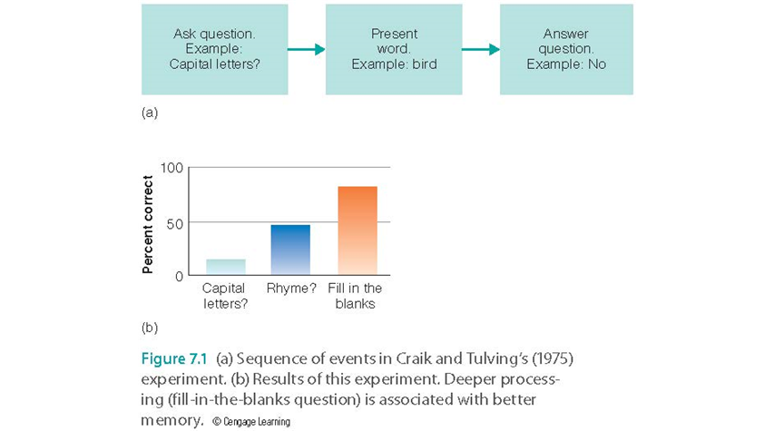
Levels of Processing

Slide 42
Problems with LOP theory
Circularity
Why?
Deeper processing at encoding → facilitated retrieval
Except?
Notes:
“Defining a procedure as deeper because it results in better memory and then using that procedure to show that deeper processing results in better memory doesn’t really prove anything.”
•Which task causes deeper processing?
–Using a word in a sentence
–Deciding how useful an object might be on a desert island
•Depth of processing has not been defined independently of memory performance
–Therefore, this is circular reasoning

Slide 43
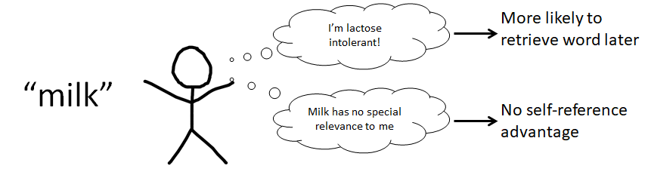
Self-reference
“[W]hen we relate things we want to remember to ourselves, this can lead to stronger memories…” (Rogers et al., 1977)
Yin et al. (2019), re: working memory & self-reference
Notes:
** why I switched to asking in the minute paper about things that surprised or interested them

Slide 44
Demo: Organization
Left side of class, close your eyes
Right side of class, pay attention to the following passage.
Try to remember it.
Notes:
•Bransford & Johnson (1972)
•Presented participants with difficult-to-comprehend information
–Experimental Group 1 first saw a picture that helped explain the information
–Experimental Group 2 saw the picture after reading the passage
–Control Group did not see the picture
•Group 1 outperformed the others.
–Having a mental framework of comprehension aided memory encoding and retrieval
•

Slide 45
Demo: Organization
If the balloons popped, the sound wouldn’t be able to carry since everything would be too far away from the correct floor. A closed window would also prevent the sound from carrying, since most buildings tend to be well insulated. Since the whole operation depends on the steady flow of electricity, a break in the middle of the wire would also cause problems. Of course, the fellow could shout, but the human voice is not loud enough to carry that far. An additional problem is that the string could break on the instrument. Then there would be no accompaniment to the message. It is clear that the best situation would involve less distance. Then there would be fewer potential problems. With face-to-face contact, the least number of things could go wrong.

Slide 46
Demo: Organization
Right side of class, close your eyes
Left side of class, pay attention to the following passage.
Try to remember it.
Notes:
•Bransford & Johnson (1972)
•Presented participants with difficult-to-comprehend information
–Experimental Group 1 first saw a picture that helped explain the information
–Experimental Group 2 saw the picture after reading the passage
–Control Group did not see the picture
•Group 1 outperformed the others.
–Having a mental framework of comprehension aided memory encoding and retrieval
•

Slide 47
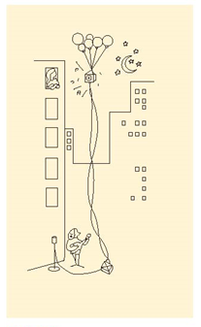
Demo: Organization

Slide 48
Demo: Organization
If the balloons popped, the sound wouldn’t be able to carry since everything would be too far away from the correct floor. A closed window would also prevent the sound from carrying, since most buildings tend to be well insulated. Since the whole operation depends on the steady flow of electricity, a break in the middle of the wire would also cause problems. Of course, the fellow could shout, but the human voice is not loud enough to carry that far. An additional problem is that the string could break on the instrument. Then there would be no accompaniment to the message. It is clear that the best situation would involve less distance. Then there would be fewer potential problems. With face-to-face contact, the least number of things could go wrong.

Slide 49
Demo Debriefing
Left side: what do you remember?
Right side: what do you remember?
Takeaway?
Notes:
•Bransford & Johnson (1972)
•Presented participants with difficult-to-comprehend information
–Experimental Group 1 first saw a picture that helped explain the information
–Experimental Group 2 saw the picture after reading the passage
–Control Group did not see the picture
•Group 1 outperformed the others.
–Having a mental framework of comprehension aided memory encoding and retrieval
•

Slide 50
Demo Debriefing
Left side: what do you remember?
Right side: what do you remember?
Takeaway?
Having a mental framework of comprehension aids memory encoding and retrieval
Notes:
•Bransford & Johnson (1972)
•Presented participants with difficult-to-comprehend information
–Experimental Group 1 first saw a picture that helped explain the information
–Experimental Group 2 saw the picture after reading the passage
–Control Group did not see the picture
•Group 1 outperformed the others.
–Having a mental framework of comprehension aided memory encoding and retrieval
•

Slide 51
Testing Effect / Retrieval Practice
Roediger & Karpicke 2006
Group 1: Re-read a passage
Group 2: Tested on material in passage
At delay, Group 2 > Group 1

Slide 52
Retrieval
Retrieval: process of transferring information from LTM back into working memory (consciousness)
Most of our failures of memory are failures to retrieve
Paradigms:
Cued Recall
Free Recall
Recognition Memory
Notes:
•Cued-recall: cue presented to aid recall
–Increased performance over free-recall
–Retrieval cues most effective when created by the person who uses them
-use study techniques in combination: retrieval cues most effective when self-generated

Slide 53
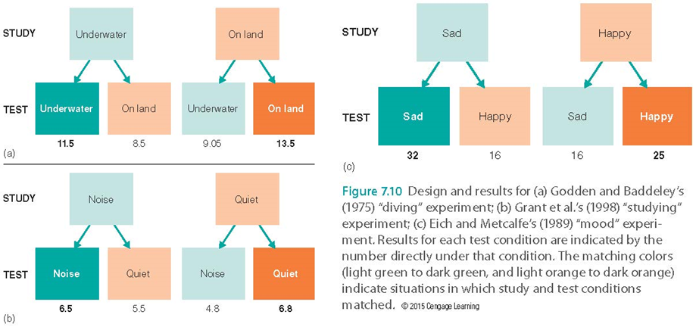
Encoding specificity (A)
Notes:
•We learn information together with its context
•Baddeley’s (1975) “diving experiment”
–Best recall occurred when encoding and retrieval occurred in the same location
•Already in our educational system: take tests in the same room

Slide 54
State-dependent learning
Learning is associated with a particular internal state
Better memory if person’s mood at encoding matches mood during retrieval

Slide 55
Transfer-appropriate processing
Encoding task
Group 1: Meaning task
Group 2: Rhyming task
Retrieval task: “Was there a word that rhymed with ___?”
Group 2 > Group 1
Notes:
•Transfer-appropriate processing: phenomenon whereby the results of a memory task will be better if the type of processing used during encoding is the same as the type during retrieval
•Morris et al. (1977)

Slide 56
Spaced Learning
Distributed versus massed practice
Difficult to maintain close attention throughout a long study session
Studying after a break gives feedback about what you already know
In part why summer session is not actually good, via cog psych...

Slide 57
Other Factors that Aid Encoding
Visual imagery (paired associates; boat-tree)
Generation effect (demos, worksheets)
Relating words to survival value
Study tips:
Elaborate
Generate & test
Avoid “illusion of learning”
Sleep
Notes:
•Elaborate - associate what you are learning to what you already know
•Generate and test – The generation effect
•Take breaks
–Memory is better for multiple short study sessions (the spacing effect)
–Consolidation is enhanced if you sleep after studying (in other words, no all nighters!)
•Avoid the “illusion of learning”
–Familiarity does not mean comprehension

Slide 58
Consolidation
Transforms new memories from fragile state to more permanent state
Synaptic consolidation occurs at synapses, happens rapidly
Systems consolidation involves gradual reorganization of circuits in brain

Slide 59
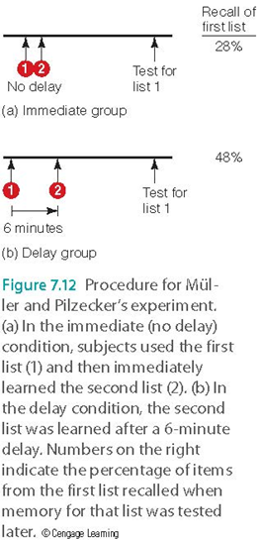
Consolidation

Slide 60
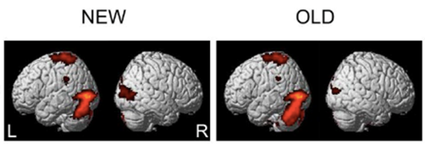
Information Storage at the Synapse
Long-term potentiation (LTP)
Enhanced firing of neurons after repeated stimulation
Structural changes & enhanced responding in the postsynaptic neuron
Repetition suppression
Notes:
•Hebb (1948)
–Learning and memory represented in the brain by physiological changes at the synapse
–Neural record of experience
Image credit:
https://bmcneurosci.biomedcentral.com/articles/10.1186/1471-2202-13-124, Kim et al., 2012
Link between repetition suppression and LTP = Grill-Spector et al., 2006

Slide 61
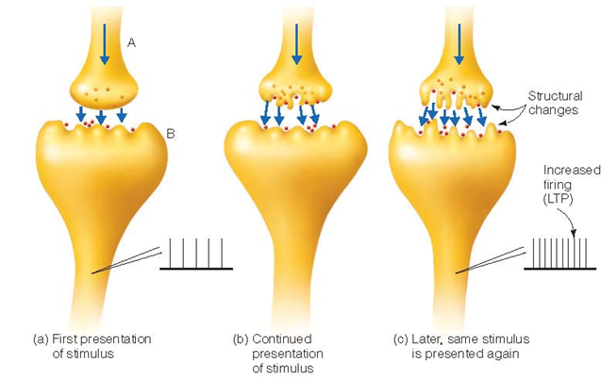
Information Storage at the Synapse

Slide 62
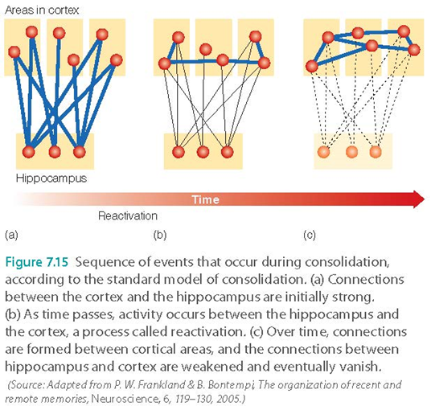
Standard Model of Consolidation
Retrieval depends on hippocampus during consolidation; after consolidation hippocampus is no longer needed
Reactivation: hippocampus replays neural activity associated with memory

Slide 63
Consolidation: Not Everything Has Been Solved
Multiple trace hypothesis
Questions the assumption that the hippocampus is important only at the beginning of consolidation
Hippocampus: activated during retrieval of recent & remote memories
Hippocampus response can change over time
Ripples...

Slide 64
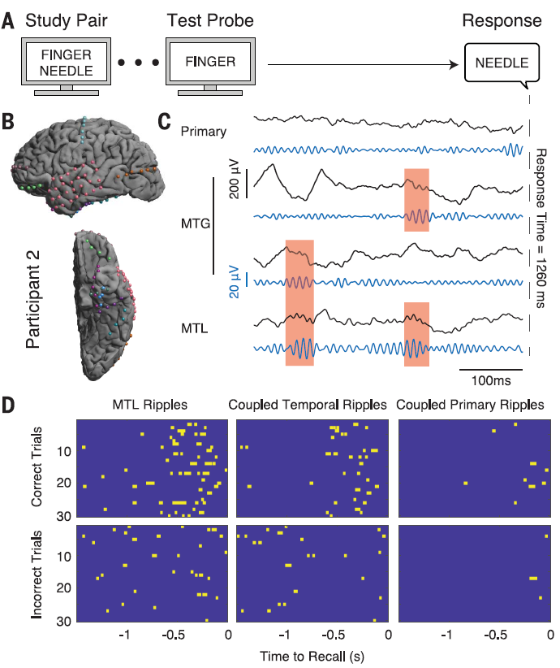
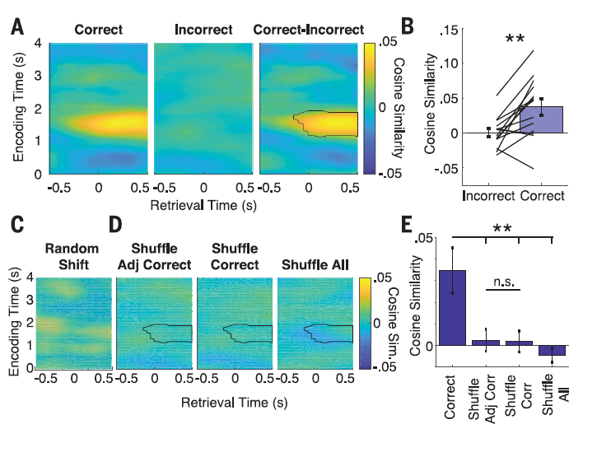
Vaz et al. (2019)

Slide 65
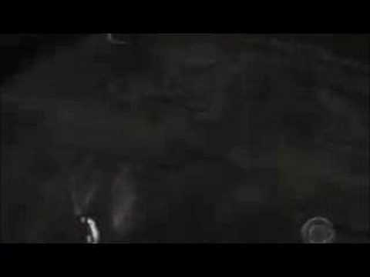
Can You Modify Memories?
Propranolol
Reconsolidation
Memory is constructive, possibly never permanent b/c needs to be updated (cc: Shute, 2014)
Real-world clinical impact?
Notes:
https://www.youtube.com/watch?v=AhK0EX4G018

Slide 66
Takeaways
Retrieval of information is affected by how you encoded that information
Levels of processing theory → deeper processing at encoding = more likely to retrieve later
Elaborative vs. maintenance rehearsal
Organization facilitates retrieval
Self-reference facilitates retrieval
But LOP theory has a big problem…
The encoding context (encoding specificity), state during encoding (state-dependent learning), and task during encoding (transfer-appropriate processing) matter
Memory is a constructive process

Slide 67
Today’s Goals + Agenda
LO1: Continue to build a supportive classroom culture & discuss science communication
Discuss Wikipedia profile
Discuss a rubric for science summary pieces based off of the ripples article + previous Journal club article
LO2: Describe the basic mechanisms of memory processes
Review LTM: structure material
Discuss Goldstein chapter 7 about memory processes
LO3: Summarize and critically analyze academic journal articles
Now that the research has been contextualized on what are considered basic memory processes, how does our previous discussion on WEIRD samples apply here? Are these basic memory principles?
What are real-world implications? What are ongoing questions in the memory field?

Slide 68
Monday’s Work
Readings
Rubin et al. (2019) - duke
Stanley et al. (2017) - duke
Leung (2019) - cool real-world application
Podcast: A Highly Superior Memory | All in the Mind
Quiz
Opening Paragraph Science Summary (Possibly Tuesday if Class Moved)

Slide 69
Participation + Minute Paper
https://tinyurl.com/PSY102Participation
https://tinyurl.com/PSY102MinutePaperMay31

Slide 70
Additional Practice
Optional: Test Yourself

Slide 71
General questions
What strategies or tips would you give to someone looking to study better, knowing what you know about cognitive psychology research into memory and attention? Self generate examples of each behavioral effect outside the study examples. What does it mean for memory to be constructive? What are the breakdowns of each memory process and the structure of long-term memory, and how does this interact with what we know about short-term/working memory? What are the open questions of the field?

Slide 72
Elaborative rehearsal of a word will LEAST likely be accomplished by
Repeating it over and over
Linking the new word to a previously learned concept
Using it in a sentence
Thinking of its synonyms & antonyms

Slide 73
Elementary school students in the U.S. are often taught to use the very familiar word "HOMES" as a cue for remembering the names of the Great Lakes (each letter in "HOMES" provides a first-letter cue for one of the lakes: Huron, Ontario, Michigan, Erie, Superior). This memory procedure usually works better than repeating the names over and over. The use of this familiar word provides an example of
A self-reference effect
Repetition priming
Implicit memory
Elaborative rehearsal

Slide 74
Which of the following learning techniques is LEAST likely to lead to deep processing of the information?
Trevor is trying to understand how to use statistics by drawing associations between a set of data describing how adolescents respond to peer pressure and the theories he learned last semester in developmental psychology.
Maggie is trying to learn new vocabulary words because she is taking the SAT next month. Each day, she selects one word. Throughout the day, she repeats the definition over and over to herself and generates sentences using it in her conversations that day
Bree has just bought a new car and is trying to learn her new license plate sequence. Every morning, for three weeks, she repeats the sequence out loud when she wakes up.
For his history course, Bruce is trying to learn the order of the U.S. presidents by creating a silly sentence where each consecutive word starts with the same letter of the next president to be remembered.

Slide 75
People often report an annoying memory failure when they walk from one end of the house to the other for something and then forget what they went to retrieve when they reach their destination. As soon as they return to the first room, they are reminded of what they wanted in the first place. This common experience best illustrates the principle of
The self-reference effect
Maintenance rehearsal
Levels of processing theory
Encoding specificity

Slide 76
Brief episodes of retrograde amnesia (e.g., the traumatic disruption of newly formed memories when a football player takes a hit to the head and can't recall the last play before the hit) reflect
A failure of memory consolidation
Disrupted long-term potentiation
Temporary post-traumatic stress disorder
Korsakoff’s syndrome

Slide 77
Answer Key
Repeating
Elaborative
Bree
Encoding specificity
Failure of memory consolidation

