Slide 1
PSY102: Introduction to Cognitive Psychology
Day 10 (05/29/19): Working Memory / Cognitive Training

Slide 2
Today’s Goals + Agenda
LO1: Continue to build a supportive classroom culture & discuss science communication
In class practice of your written SciComm pitches to a partner
Discuss what Duong article meant in terms of science journalism - https://www.eurekalert.org/
Towards the end of class, can discuss how research on working memory applies to science writing (e.g., sentence construction)
LO2: Describe the basic fundamental principles of working memory & why cognitive training does not work
Discussion of Goldstein, Chpt 5, possibly some from Purves et al., and historical perspectives on short-term & working memory (contextualize background for articles)
Recall what we learned on attention last week & its relation to working memory
LO3: Summarize and critically analyze academic journal articles
Compare and contrast the evidence for & against working memory training & how science communicators cover this topic
Critically discuss the academic journal articles: what does this mean for society?

Slide 3
Pitches, Science Journalism
Continue to build a supportive classroom culture & discuss science communication

Slide 4
How does science journalism happen?
https://www.eurekalert.org/
(universities also self-publish at www.futurity.org… “Futurity features the latest discoveries by scientists at top research universities in the US, UK, Canada, Europe, Asia, and Australia.”)

Slide 5
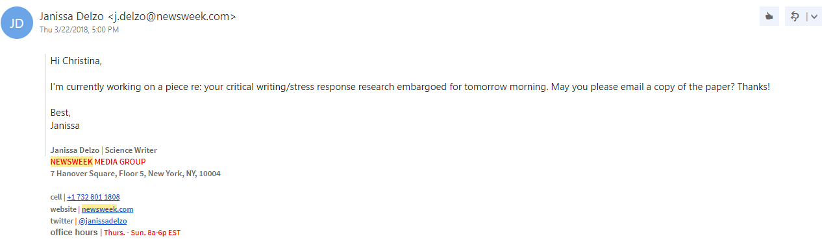
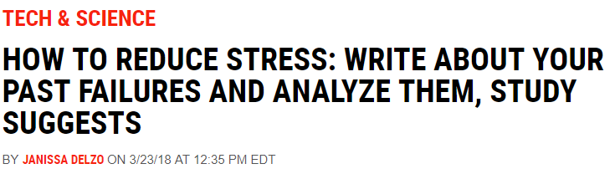
Contacts with Media & Authorship Details
Notes:
-what does it mean to be first/second/third/last author on a paper?
-sometimes there are embargos (Pro – Time to do quality work. Con – artificial control, implied newsworthiness, stifling of competition.)
-paper accepted, forward paper acceptance + paragraph of explanation to news & communications team
-news and communications team will write a press release like Duong for the Yin article
-journals + universities + societies will put out press releases for things they want to be covered onto eureka
-science journalists will find the press release, sometimes contact the authors to ask for more information if they can’t get it from the press release
https://www.newsweek.com/reduce-stress-writing-failures-journal-858691

Slide 6
Science Communication Pitches
First, you’ll pair off into groups of 2 (one group of 3-- unless one of y’all wants to practice with me)
For the first round of SciComm pitch practice, you’re going to just practice the pitch that you wrote up for me:
Average (Smart) American w/ ~8th grade science jargon
Feel free to interrupt each other, too. Although we assume pitches are “pitches,” in all likelihood, our audience is not that passive
Both of you get practice; take ~4 min per person
After that… we’ll switch over to some other types of audience.

Slide 7
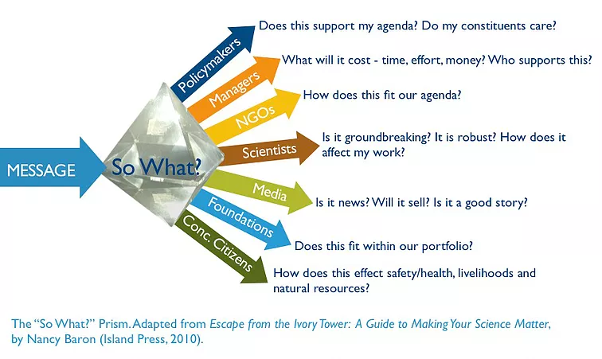
Reminder:
Notes:
-Granny
-Fellow psychologist
-Policymaker
-Media

Slide 8
Working Memory, Short-Term Memory & More
Describe the basic fundamental principles of working memory & the claims underlying cognitive training

Slide 9
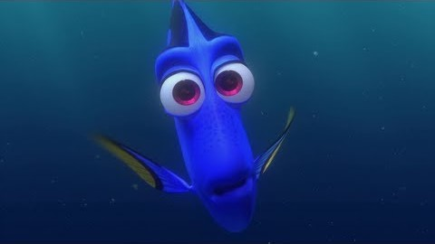
What Is Short Term Memory Loss?
Notes:
https://www.youtube.com/watch?v=ixVaAQVEiSM

Slide 10
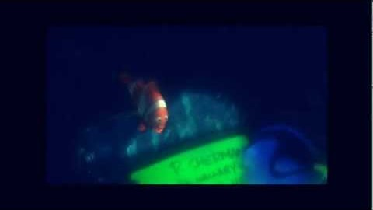
What Is Short Term Memory Loss?
Is this accurate? Let’s see...
Notes:
https://www.youtube.com/watch?v=l8vZHdKzesg

Slide 11
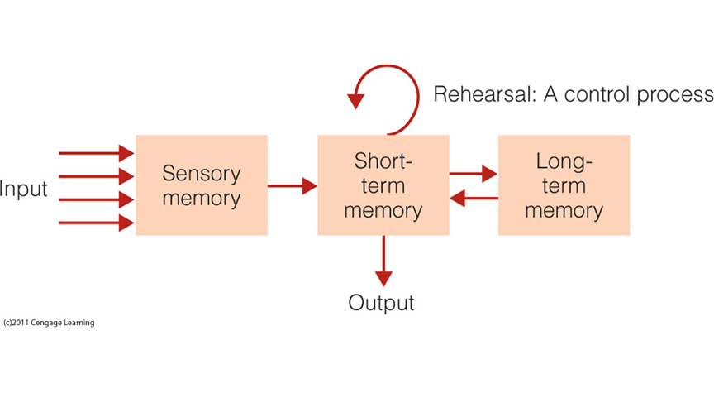
The Modal Model of Memory
Notes:
•Atkinson and Shiffrin (1968)
•Three different types of memory:
1.Sensory Memory – Initial stage that holds all incoming information for seconds or fractions of a second
2.Short-term Memory – Holds five to seven items for about 15 to 20 seconds.
3.Long-term Memory – Can hold a large amount of information for years or even decades
•Control processes: active processes that can be controlled by the person
–Rehearsal
–Strategies used to make a stimulus more memorable
–Strategies of attention that help you focus on specific stimuli

Slide 12
The Modal Model of Memory
Atkinson & Shiffrin
Sensory information storage (SIS)/sensory memory
Brief retention of the effects of sensory stimulation
Short-term memory (STM)
Storing small amounts of information for a brief period of time; “experience of the present”
Long-term memory (LTM)
Storing large amounts of information for a long period of time

Slide 13
Sensory Memory
An initial stage that fields incoming sensory information
Iconic, cc: persistence of vision
Echoic, cc: persistence of sound
DURATION: very short (anywhere from a fraction of a second to a few seconds)
CAPACITY: very large; hard to measure this
Notes:
•Sensory Memory: The retention, for brief periods of time, of the effects of sensory stimulation.
–Information decays very quickly
•Persistence of vision: retention of the perception of light
–Sparkler’s trail of light
–Frames in film
•Iconic memory: Brief sensory memory of the things that we see
–Responsible for persistence of vision
•Echoic memory: Brief sensory memory of the things that we hear
–Responsible for persistence of sound

Slide 14

Notes:
Persistence of vision

Slide 15
Sensory Memory: Measuring Capacity & Duration
Sperling experiment
Whole report
Partial report
Delayed partial report
Notes:
•Holds large amount of information for a short period of time
–Collects information
–Holds information for initial processing
–Fills in the blank
•Measuring the capacity and duration of sensory memory (Sperling, 1960)
–Array of letters flashed quickly on a screen
–Participants asked to report as many as possible
•Whole report method: participants asked to report as many as could be seen
–Average of 4.5 out of 12 letters (37.5%)
•Partial report method: participants heard tone that told them which row of letters to report
–Average of 3.3 out of 4 letters (82%)
–Participants could report any of the rows
•Delayed partial report method: presentation of tone delayed for a fraction of a second after the letters were extinguished
–Performance decreases rapidly

Slide 16
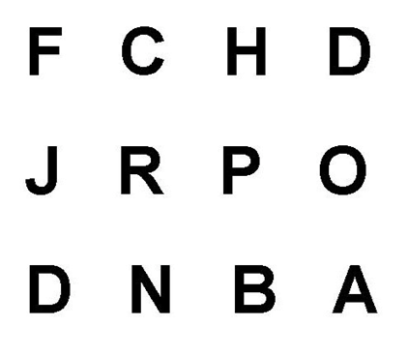
Sensory Memory

Slide 17
Sensory Memory
Was Dory retaining things in her sensory memory?
How do you know?

Slide 18
Short-Term Memory (STM)
Storing small amounts of information for a short amount of time; your “experience of the present”
DURATION: 15-20 seconds
CAPACITY: 4-9 “items”
Notes:
•Stores small amounts of information for a brief duration
•Includes both new information received from the sensory stores and information recalled from long-term memory
•Measuring the duration of short-term memory
–Read three letters, then a number
–Begin counting backwards by threes
–After a set time, recall three letters
•After three seconds of counting, participants performed at 80%
•After 18 seconds of counting, participants performed at 10%
•This reduction in performance is explained by the existence of decay, which is the vanishing of a memory trace due to the passage of time and exposure to competing stimuli

Slide 19
Demo: Duration of STM
Your task is to remember the letters
After the letters, you’ll see a number
When you see the number, you have to count backwards from 3s from that number
When I say “Recall”, stop counting & write down what letters you saw before the number

Slide 20
Short-Term Memory (STM)
E P F H
Notes:
•After three seconds of counting, participants performed at 80%
•After 18 seconds of counting, participants performed at 10%
•This reduction in performance is explained by the existence of decay, which is the vanishing of a memory trace due to the passage of time and exposure to competing stimuli

Slide 21
Short-Term Memory (STM)
76
Notes:
-repeat it and begin counting backwards by 3 from that number
•After three seconds of counting, participants performed at 80%
•After 18 seconds of counting, participants performed at 10%
•This reduction in performance is explained by the existence of decay, which is the vanishing of a memory trace due to the passage of time and exposure to competing stimuli

Slide 22
Short-Term Memory (STM)
?
Notes:
•After three seconds of counting, participants performed at 80%
•After 18 seconds of counting, participants performed at 10%
•This reduction in performance is explained by the existence of decay, which is the vanishing of a memory trace due to the passage of time and exposure to competing stimuli

Slide 23
Short-Term Memory (STM)
L H K T
Notes:
•After three seconds of counting, participants performed at 80%
•After 18 seconds of counting, participants performed at 10%
•This reduction in performance is explained by the existence of decay, which is the vanishing of a memory trace due to the passage of time and exposure to competing stimuli

Slide 24
Short-Term Memory (STM)
76
Notes:
-repeat it and begin counting backwards by 3 from that number
•After three seconds of counting, participants performed at 80%
•After 18 seconds of counting, participants performed at 10%
•This reduction in performance is explained by the existence of decay, which is the vanishing of a memory trace due to the passage of time and exposure to competing stimuli

Slide 25
Short-Term Memory (STM)
?
Notes:
•After three seconds of counting, participants performed at 80%
•After 18 seconds of counting, participants performed at 10%
•This reduction in performance is explained by the existence of decay, which is the vanishing of a memory trace due to the passage of time and exposure to competing stimuli

Slide 26
Short-Term Memory (STM)
Decay
Information in STM decays after 15-20 seconds
Retroactive interference
Information in STM can be subject to interference from other information in STM
Proactive vs. retroactive
Proactive: Old interfering with New
Retroactive: New learning interfering w/ remembering Old information
Rehearsal restarts the clock
Notes:
•Short-term memory, when rehearsal is prevented, is about 15-20 seconds
–
•Proactive interference: occurs when information learned previously interferes with learning new information
–Example: Your native language may make it more difficult to learn and remember a new foreign language
•Retroactive interference: occurs when new learning interferes with remembering old learning
–Example: After you get a new telephone number and use it for a while, you may have difficulty remembering your old phone number

Slide 27
Short-Term Memory (STM)
4-9 items
Can also measure with change detection: can you recognize whether an initial display is the same as a later display?
What is an item?
Demo: recall idea of digit span
I will read to you list of letter at rate of 1 letter/2 seconds
Notes:
•Capacity of short-term memory
–Digit span: how many digits a person can remember
•Typical result: 5-8 items
•But what is an item?
•Change detection
–

Slide 28
Short-Term Memory (STM)
R Y S E D J E Q X H T

Slide 29
Short-Term Memory (STM)
?

Slide 30
Short-Term Memory (STM)
R Y S E D J E Q X H T

Slide 31
Short-Term Memory (STM)
C I A F B I N B C C B S

Slide 32
Short-Term Memory (STM)
?

Slide 33
Short-Term Memory (STM)
C I A F B I N B C C B S
Chunking
Notes:
•Chunking: small units can be combined into larger meaningful units
–Chunk is a collection of elements strongly associated with one another but weakly associated with elements in other chunks

Slide 34
Short-Term Memory (STM)
Was Dory using her short-term memory?
How do you know?
Did she use any technique to retain information in STM?
Rehearsal
Chunking

Slide 35
Long-Term Memory (LTM)
The process by which information is ENCODED in long-term storage for later RETRIEVAL
Facts you know
Events from your life
Skills you can perform
Many more
DURATION: ∞
CAPACITY: ∞
Was Dory using her long-term memory?
How do you know?

Slide 36
What’s wrong with Dory?
“I suffer from short-term memory loss.”
Sensory stimulation → Sensory memory?
No
Sensory → Short-term memory?
No
Short-term → Long-term memory?
Maybe
Long-term → Short-term memory?
Maybe
Some deficit in getting information from STM to LTM, OR from LTM to STM, OR both
Not a total loss of function

Slide 37
STM vs. working memory
“STM” = simple short-term storage
Working memory = short-term storage AND MANIPULATION of information
Notes:
•Similar concept to short-term memory
•Baddeley and Hitch (1974)
•Working memory: limited capacity system for temporary storage and manipulation of information for complex tasks such as comprehension, learning, and reasoning
•Working memory differs from STM
–STM holds information for a brief period of time
–WM is concerned with the processing and manipulation of information that occurs during complex cognition

Slide 38
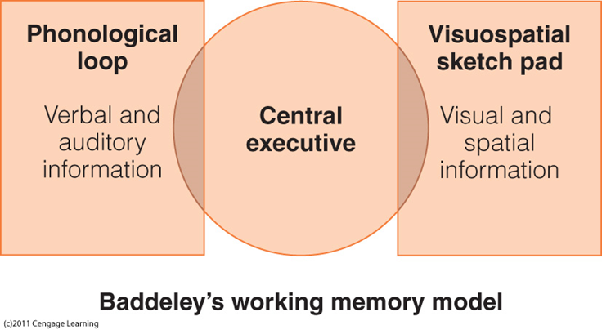

Slide 39
Phonological Loop
Phonological store
Limited capacity
Short duration (a few seconds)
Articulatory rehearsal process
Phonological similarity effect
Word length effect: better for short words
Articulatory suppression process
Notes:
•Phonological similarity effect
–Letters or words that sound similar are confused
•Word-length effect
–Memory for lists of words is better for short words than for long words
–Takes longer to rehearse long words and to produce them during recall
•Articulatory suppression
–Prevents one from rehearsing items to be remembered
•Reduces memory span
•Eliminates word-length effect
•Reduces phonological similarity effect for reading words
•WM is set up to process different types of information simultaneously
•WM has trouble when similar types of information are presented at the same time

Slide 40
Demo: List 1
I will read a list of words
Your task: remember as many words as you can, but in the order in which they’re presented
Notes:
List 1: cot, top, cod, pot, cop, pod, mob, dot, cob

Slide 41
Demo
Count backward from 100 by 7’s
Write down as many words as you can remember
Notes:
Count backward: 15 sec

Slide 42
Demo
Check your answers
Cot
Top
Cod
Pot
5. Cop
6. Pod
7. Mob
8. Dot
9. Cob
Notes:
List 1: cot, top, cod, pot, cop, pod, mob, dot, cob

Slide 43
Demo: List 2
Clear your mind
Ready?
Notes:
Read List 2
List 2: dig, man, boat, tar, cup, mate, pine, lamb, key

Slide 44
Demo
Count backward from 100 by 7’s
Write down as many words as you can remember
Notes:
Count backward: 15 sec

Slide 45
Demo
Check your answers
Dig
Man
Boat
Tar
Cup
6. Mate
7. Pine
8. Lamb
9. Key
Notes:
List 2: dig, man, boat, tar, cup, mate, pine, lamb, key

Slide 46
Demo Debriefing
Which set was easier to remember?
Example of “Phonological Similarity Effect” (Conrad, 1964)
Notes:
Dissimilar set (list 2) easier to remember because there is less phonological confusion between words

Slide 47
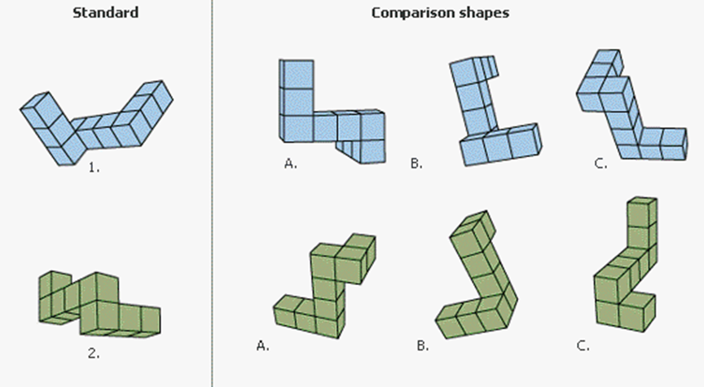
Visuospatial sketchpad
Notes:
•Visual and spatial information
• Visual imagery: The creation of visual images in the mind in the absence of a physical visual stimulus
–Shepard and Metzler (1971)
–Mental rotation task
–Tasks that called for greater rotations took longer

Slide 48
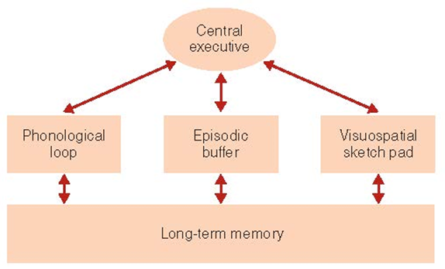
STM vs. working memory
Baddeley’s revised model w/ episodic buffer
Phonological loop
Verbal/auditory information
Visuospatial sketch pad
Visual and spatial information
Central executive
Retrieves information from LTM and coordinates phonological loop and visuospatial sketch pad; not for storing information, but for managing its use in the other parts of working memory
Episodic buffer
Can store information & connects to LTM
Notes:
•Attention controller
–Focus, divide, switch attention
•Controls suppression of irrelevant information
•Perseveration: repeatedly performing the same action or thought even if it is not achieving the desired goal
•Backup store that communicates with LTM and WM components
•Hold information longer and has greater capacity than phonological loop or visuospatial sketch pad
-typically prefrontal cortex is associated with working memory

Slide 49
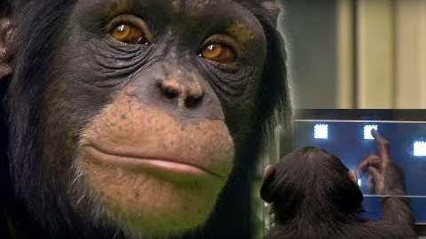
Working Memory
Notes:
https://www.youtube.com/watch?v=zsXP8qeFF6A

Slide 50
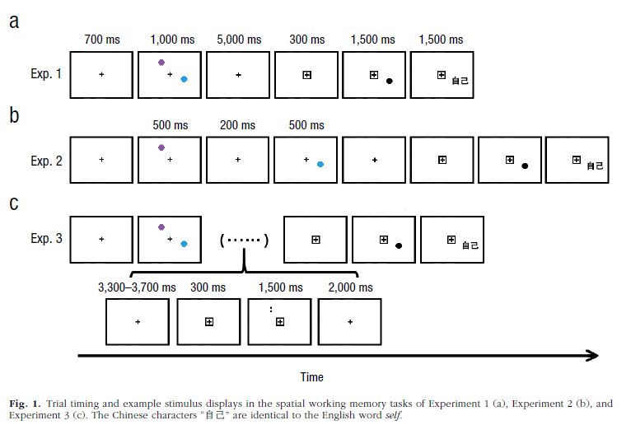
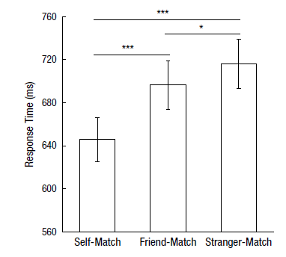
Yin et al. (2019)
Notes:
-delay periods common
-delayed response task here: hold information in wm during a delay period

Slide 51
Takeaways
What are the three elements of Atkinson & Shiffrin’s Modal Model of Memory?
What are the elements of Baddeley’s working memory model?
Why might we prefer the construct of “working memory” to the construct of “short-term memory” outlined by Atkinson & Shiffrin?

Slide 52
Brain Training
Evaluate the claims proposed by brain training programs

Slide 53
Brain Training
How many of you have heard the claim that ‘Brain training makes you smarter’ or some version of it?
Where? What versions?
Do you believe it?
Do you think others would believe it?
Why would someone believe it?
Notes:
Activity adapted from https://www.psychologicalscience.org/uncategorized/myth-brain-training-will-make-you-smarter.html

Slide 54
“Brain Training makes you smarter”
What evidence supports the claim and how strong is that evidence?
Is there evidence that does not support the claim and how strong is the opposing evidence?
Do we need additional evidence before drawing conclusions about the claim, and if so, how could we collect it?
What conclusions are most reasonable given the evidence available so far?

Slide 55
With the two handouts...
You have both an article for & against brain teaching, and each person has a different article in favor of brain training
What is the actual claim being made? Does the site attempt to justify the claim? Does the site give evidence to support the claim? What types of evidence? How clearly is evidence related to the claim? Does the site provide a source for the evidence or a way of accessing the source?
Are the claims supported by the data? Why is it important that the research methodology relate directly to the claim being made?

Slide 56
Brain Training: Pro
Usually do not claim improvement in cognitive function, but rely on readers to infer use of product = you’ll improve
Evidence? Testimonials, researchers at XYZ (no source), lists of reported research (but you know to evaluate)
Why does it matter?
What types of evidence support what types of claims?
How do you recognize the difference?
Why do you think the FTC judged Lumosity’s claim as unjustified? What types of research would need to be done to make such claims?

Slide 57
Brain Training: Against
Are the claims supported by the data? Why is it important that the research methodology relates directly to the specific claim made?
Claims versus evidence
Health claims must be backed by research that rules out alternative explanations; “active control groups”
The nature of scientific claims
What is the importance of reviewing the body of evidence? Opportunity costs? Scientific consensus statement?
Intelligence
Is intelligence “one thing”?

Slide 58
Brain Training: In Sum
What is the best conclusion you can draw?
Evidence evaluation and why claims seem believable despite their providing weak evidence
Trouble thinking critically; “cognitive misers”
The nature of intelligence
Don’t want to get into different definitions, BUT you can improve on one task without it generalizing to another task (near vs. far transfer)
Learning & Development
Lifetime of engagement is good

Slide 59
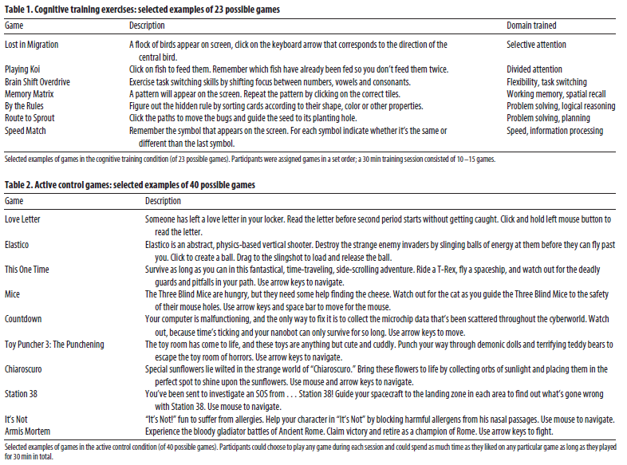
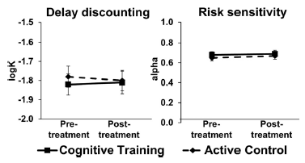
Kable et al. (2017)
https://www.lumosity.com/en/brain-games/
https://www.lumosity.com/en/brain-games/memory-matrix/
http://drexelgames.com/

Slide 60
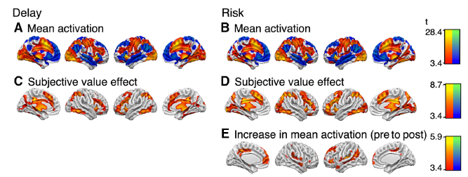
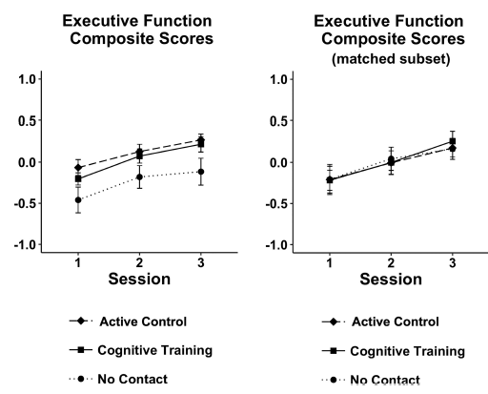
Kable et al. (2017)

Slide 61
Et Voila
Today & Tomorrow’s goals

Slide 62
Today’s Goals + Agenda
LO1: Continue to build a supportive classroom culture & discuss science communication
In class practice of your written SciComm pitches to a partner
Discuss what Duong article meant in terms of science journalism - https://www.eurekalert.org/
Towards the end of class, can discuss how research on working memory applies to science writing (e.g., sentence construction)
LO2: Describe the basic fundamental principles of working memory & why cognitive training does not work
Discussion of Goldstein, Chpt 5, possibly some from Purves et al., and historical perspectives on short-term & working memory (contextualize background for articles)
Recall what we learned on attention last week & its relation to working memory
LO3: Summarize and critically analyze academic journal articles
Compare and contrast the evidence for & against working memory training & how science communicators cover this topic
Critically discuss the academic journal articles: what does this mean for society?

Slide 63
Tomorrow’s Work
Readings:
Uitvlugt & Healey (2019)
Ben-Yakov & Henson (2018)
Williams et al. (2019) (science summary / commentary on Ben-Yakov)
Shute (2014) - on another article

Slide 64
Participation + Minute Paper
https://tinyurl.com/PSY102Participation
https://tinyurl.com/PSY102MinutePaperMay29

Slide 65
Additional Practice
Optional: Test yourself

Slide 66
Sperling's delayed partial report procedure provided evidence that
STM & LTM are independent components of memory
Information in sensory memory fades within 1 or 2 seconds
Information in STM must be rehearsed to transfer into LTM
STM has a limited capacity

Slide 67
Jill's friends tell her they think she has a really good memory. She finds this interesting so she decides to purposefully test her memory. Jill receives a list of to-do tasks each day at work. Usually, she checks off each item as the day progresses, but this week, she is determined to memorize the to-do lists. On Monday, Jill is proud to find that she remembers 95 percent of the tasks without referring to the list. On Tuesday, her memory drops to 80 percent, and by Thursday, she is dismayed to see her performance has declined to 20 percent. Jill's memory is declining over the course of the week because other information she encounters is “competing” with that which she memorized on Monday. This process is called
Anterograde amnesia
Episodic buffering
Chunking
Proactive Interference

Slide 68
The primary effect of chunking is to
Maximize the recency effect
Increase memory for items by grouping them together based on sound
Develop a visual code to supplement a phonological code for the information
Increase the efficiency of short-term memory

Slide 69
Lamar has just gotten a new job and is attending a company party where he will meet his colleagues for the first time. His boss escorts him around to small groups to introduce him. At the first group, Lamar meets four people and is told only their first names. The same thing happens with a second group and a third group. At the fourth group, Lamar is told their names and that one of the women in the group is the company accountant. A little while later, Lamar realizes that while remembers the names of the people in the fourth group, he can no longer recall the names of anyone he met earlier in the party. Lamar's experience demonstrates
The phonological similarity effect
Retroactive interference
The cocktail party phenomenon
A partial-report procedure

Slide 70
According to the model of working memory, which of the following mental tasks should LEAST adversely affect people's driving performance while operating a car along an unfamiliar, winding road?
Trying to imagine how many cabinets are in their kitchen
Trying to remember a map of the area
Trying to remember the definition of a word they just learned
Trying to imagine a portrait from a recent museum exhibit

Slide 71
Answer Key
Information fades w/in 1-2
Proactive interf
Increase efficiency
Retroactive interf
Remember definition

