Slide 1
PSY102: Introduction to Cognitive Psychology
Day 6 (05/22/19): Emotion I

Slide 2
Today’s Goals + Agenda
LO1: Continue to build a supportive classroom culture & discuss science communication
Paragraph-by-paragraph critique of 2 SciAm articles
Group worksheets today on attention & emotion
LO2: Apply principles of good science communication
In minute paper, reflect on good/bad of podcast SciComm
Also discuss podcast in emotion paper
LO3: Describe the basic fundamental principles of emotion research
Group worksheet on emotion papers and podcast
LO4: Summarize and critically analyze academic journal articles
Group worksheets on attention & emotion

Slide 3
Course Changes
Practice Quizzes (optional)
Checks for understanding
Move around some of the material (order wise)
Change Friday to review + some other basic cog psych/neuro material
Switch out some articles for occasional textbook chapter?

Slide 4
Quick Note
Ignore sections like power analysis and MRI data & preprocessing: you don’t need to know those details
DTI: diffusion tensor imaging - testing where water flows in the brain to get a sense of white matter structural tracts

Slide 5
Science Communication
Paragraph-by-paragraph critique of 2 SciAm articles

Slide 6
Paragraph-by-Paragraph critique of SciAm articles:
Are Our Scientific Heroes Too Heroic?
Revealing the struggles that lie behind ultimate success can motivate students better--from grade school to grad school
How to Turn Failure into Success
Research reveals strategies for staying motivated in the face of challenges

Slide 7
Attention (Review & Discussion)
Summarize and critically analyze academic journal articles & review content on attention research

Slide 8
Attention Handout
Fill out the worksheet together in groups of 3-4 (2 groups of 3, 2 groups of 4)
I have the answer key

Slide 9
Emotion
Describe the basic fundamental principles of emotion research
Summarize and critically analyze academic journal articles

Slide 10
Writing Exercise
Think about a memory you have that is especially (pick one):
Joyful
Serene/content
Angry
Disgusted
Amused
What caused that emotion?
What did your face do?
What did you say/what noises did you make?
What did it feel like in your body?
What did it make you think, or focus on?
What did it make you do?
Do you think there was a job that emotion was supposed to be doing? Do you think it accomplished that job?

Slide 11
Why Study Emotion?
Emotion directly modulates our cognition in numerous ways:
Negative memories are more likely to be remembered than positive memories
Fear can make you perceive time as slowing down and can make you attend to a gun but ignore everything else in the scene
Disgust can cause you to change the way you make your moral decisions, even when you don’t realize it

Slide 12
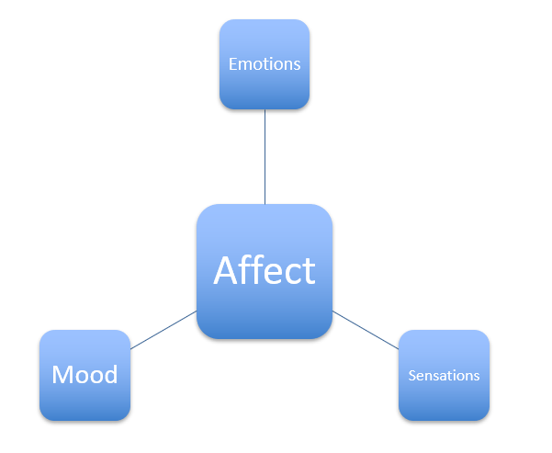
What are emotions?
States that feel a certain way (qualia)
States that motivate you to do something, particularly something of evolutionary/functional significance
States that have associated physiological patterns
States that signal to conspecifics (facial expressions)
Notes:
3 components that can be studied independently: Behavior (motor output: e.g., approach or avoidance), physiology (e.g., autonomic nervous system activity), and feelings (subjective, conscious experience associated with the emotional state).
Confused about terminology?
Emotions are typically triggered by a particular event and are short-lived (seconds to minutes). Emotional states that endure for longer periods and often have no clear antecedent are called moods (cf. ‘mood disorders’).
Affect is technically the same as emotion, but it is most commonly used to describe outward expression of emotion (like facial expressions, gestures).
Temperament refers to someone’s stable disposition (a ‘personality trait’) to experience and react to events in certain ways (e.g. ‘he’s choleric’).
Motivation describes an urge to ‘reduce drives’, e.g. one is motivated to eat in order to reduce hunger (a ‘drive’). However, motives can also be more lofty and very long-term, such as the motive to graduate with honors.
(All of these concepts have some overlap, and each of them may interact with each other and influence emotional responses.)

Slide 13
What are emotions?
“Emotion refers to a collection of psychological states that include subjective experience, expressive behavior (e.g., facial, bodily, verbal), and peripheral physiological responses (e.g., heart rate, respiration).”
- Gross & Barrett, 2011
Quick onset/duration (“minutes and seconds, not hours and days”)

Slide 14
Why Have Emotions?
It’s useful to motivate certain behavioral patterns
Disgust: “I don’t want to touch that or eat it”
It is important to prepare the organism for adaptive action
Fear: Pupils dilate
Anger: Blood to extremities
It is important to signal to others
Panic/sadness: “I need help or nurturance”
Anger: “You betrayed me and I’m going to show everyone that there are consequences to betraying me”
Paul Ekman: Facial expressions are universal, and are there primarily to signal stuff to other people (classic view)
Notes:
Emotions are functional: they are neurally based dispositions that facilitate appropriate reactions to events of biological significance, increasing our our evolutionary ‘fitness’. E.g., the emotion of fear when we encounter a predator is associated with a fight-or-flight response (behavior), autonomic mobilization (increased heart rate, blood pressure, etc), and a negative feeling (‘fear’) which may be functionally important for learning to avoid similar situations in the future.

Slide 15
Worksheet: what makes us have an emotion at a given moment?
Different group than your attention worksheet group
Fill out the worksheet together in groups of 3-4 (2 groups of 3, 1 group of 4)
I have the answer key

Slide 16
Today’s Goals + Agenda
LO1: Continue to build a supportive classroom culture & discuss science communication
Paragraph-by-paragraph critique of 2 SciAm articles
Group worksheets today on attention & emotion
LO2: Apply principles of good science communication
In minute paper, reflect on good/bad of podcast SciComm
Also discuss podcast in emotion paper
LO3: Describe the basic fundamental principles of emotion research
Group worksheet on emotion papers and podcast
LO4: Summarize and critically analyze academic journal articles
Group worksheets on attention & emotion

Slide 17
Tomorrow’s Work
Readings:
d’Arbeloff et al. (2018)
MacCormack & Lindquist (2018)
CNN & NPR articles (Chen & Strickland)
Opening Paragraph (~100 words or less) of non-Duke article covered:
MacCormack, Middlebrooks, Wechsler, Siegel, or Kang and Wheatley
Choose one that you haven’t already done

Slide 18
Participation & Minute Paper
https://tinyurl.com/PSY102Participation
https://tinyurl.com/PSY102MinutePaperMay22

