Slide 1
EIST – 1st Tutorial
18.04.2018

Slide 2
Agenda
Introduction
Grade Bonus / Homework
Tool Usage
ArTEMiS Tutorial
Amati Tutorial
Homework Sheet 1
Questions

Slide 3
Agenda
Introduction
Grade Bonus / Homework
Tool Usage
ArTEMiS Tutorial
Amati Tutorial
Homework Sheet 1
Questions

Slide 4

Group Registration
Fill out sheet (will be going round)
Were you matched to this group?
Do you want to stay?
Do you want to change somewhere else? (IMPORTANT: Have to be registered for a group to participate in Homework)
German or English?

Slide 5
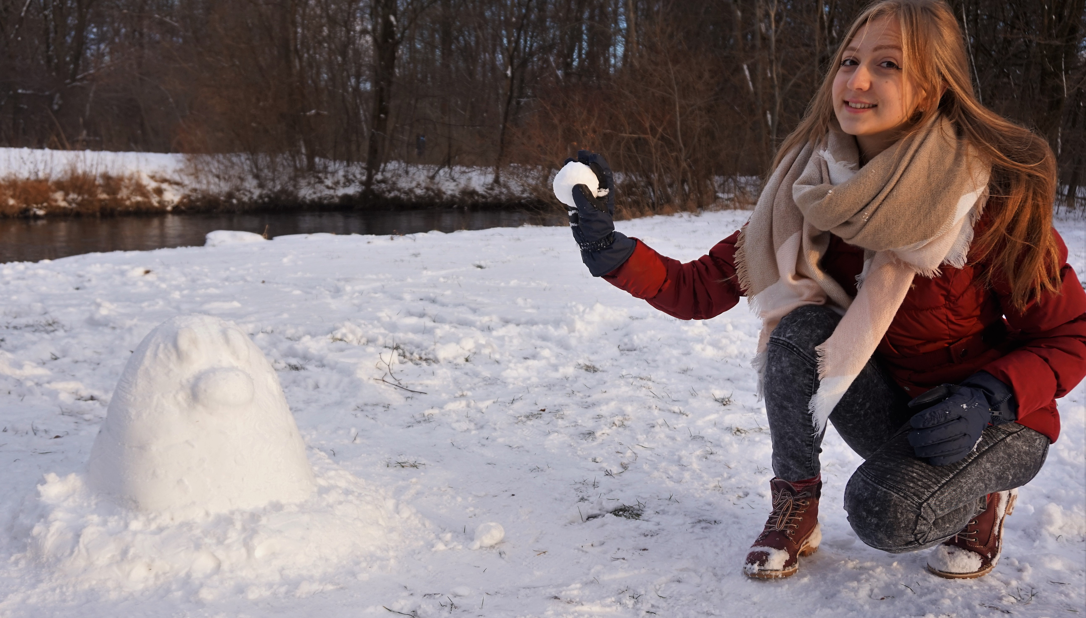
Your tutor
Name: Christina Halemba
Age: 20
Study program:
Management & Technology (6th semester Bachelor)
And who are you? ☺

Slide 6
Agenda
Introduction
Grade Bonus / Homework
Tool Usage
ArTEMiS Tutorial
Amati Tutorial
Homework Sheet 1
Questions

Slide 7
Grade Bonus / Homework
Quizzes during lecture , Morning Exercises
Homework participation
→ Upload homework on Moodle as PDF → If Coding exercise: via ArTEMiS / GIT → Work on your own!! → Late submissions don‘t get graded
Present your correct homework at least 2 times during exercise → Present in group you are registered → Cover all important points

Slide 8
Agenda
Introduction
Grade Bonus / Homework
Tool Usage
ArTEMiS Tutorial
Amati Tutorial
Homework Sheet 1
Questions

Slide 9
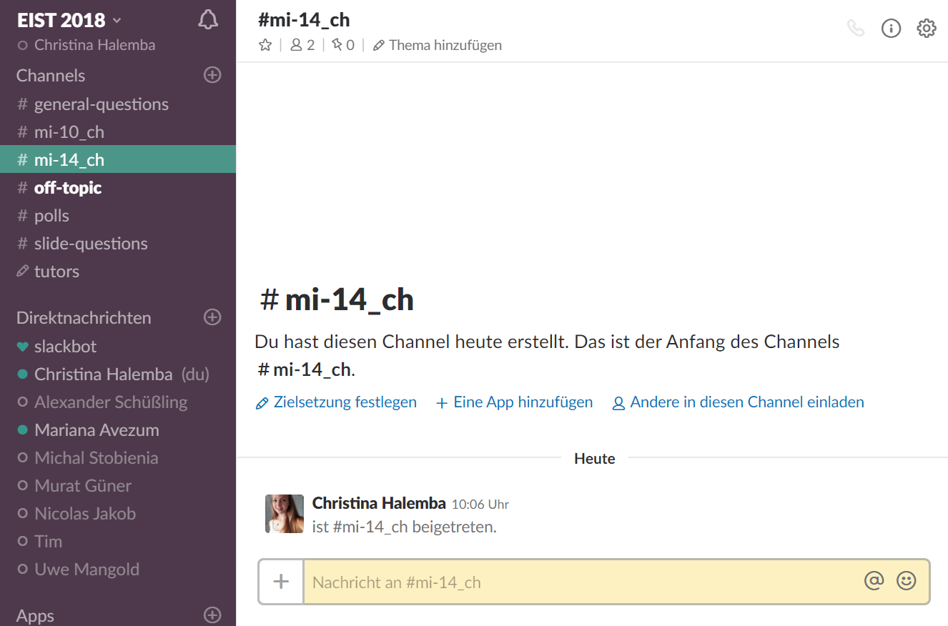
Have you all …
… registered for TUM Online? (Lecture course & tutor group)
… registered for Moodle?
… access to Confluence?
… access to Slack?

Slide 10
Agenda
Introduction
Grade Bonus / Homework
Tool Usage
ArTEMiS Tutorial
Amati Tutorial
Homework Sheet 1
Questions

Slide 11
Agenda
Introduction
Grade Bonus / Homework
Tool Usage
ArTEMiS Tutorial
Amati Tutorial
Homework Sheet 1
Questions

Slide 12
Agenda
Introduction
Grade Bonus / Homework
Tool Usage
ArTEMiS Tutorial
Amati Tutorial
Homework Sheet 1
Questions

Slide 13
Agenda
Introduction
Grade Bonus / Homework
Tool Usage
ArTEMiS Tutorial
Amati Tutorial
Homework Sheet 1
Questions

Slide 14

See you next week! ☺

