Slide 1
EIST – 2nd Tutorial
25.04.2018

Slide 2
Agenda
Task 1
Task 2
Task 3
Task 4
Task 5
Homework 2

Slide 3
Agenda
Task 1
Task 2
Task 3
Task 4
Task 5
Homework 2

Slide 4
Task 1
What is the difference between a functional, object and dynamic model?

Slide 5
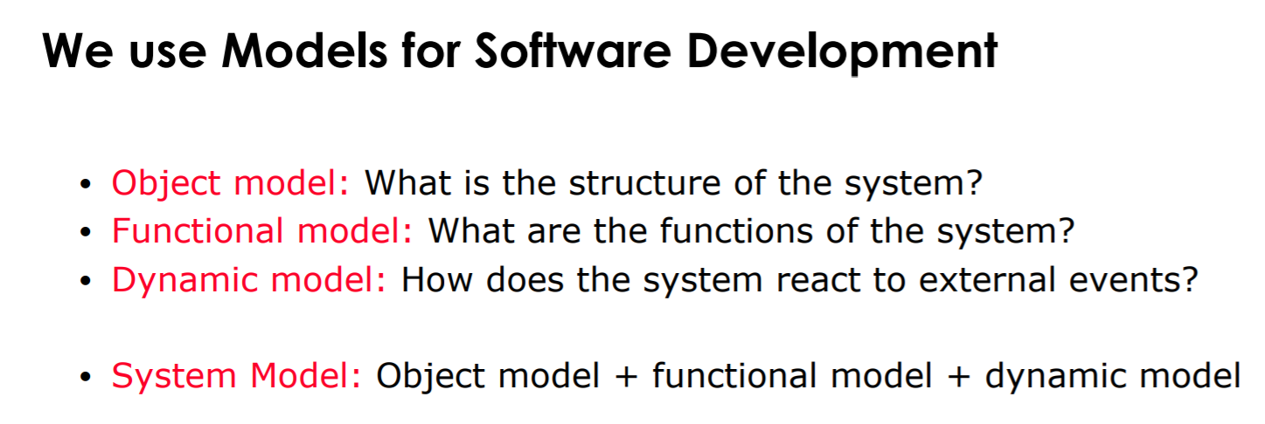

Slide 6
Agenda
Task 1
Task 2
Task 3
Task 4
Task 5
Homework 2

Slide 7
Task 2
Explain why software development is difficult?

Slide 8
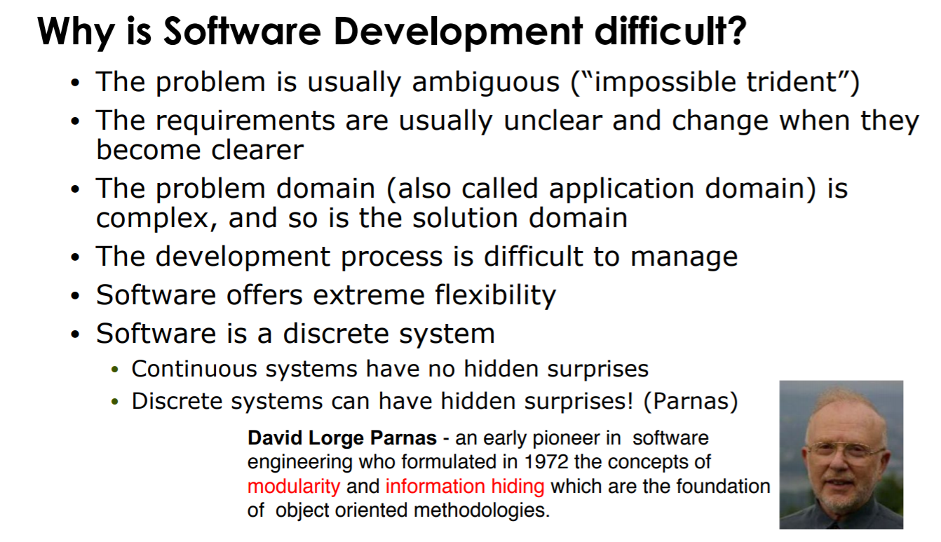

Slide 9
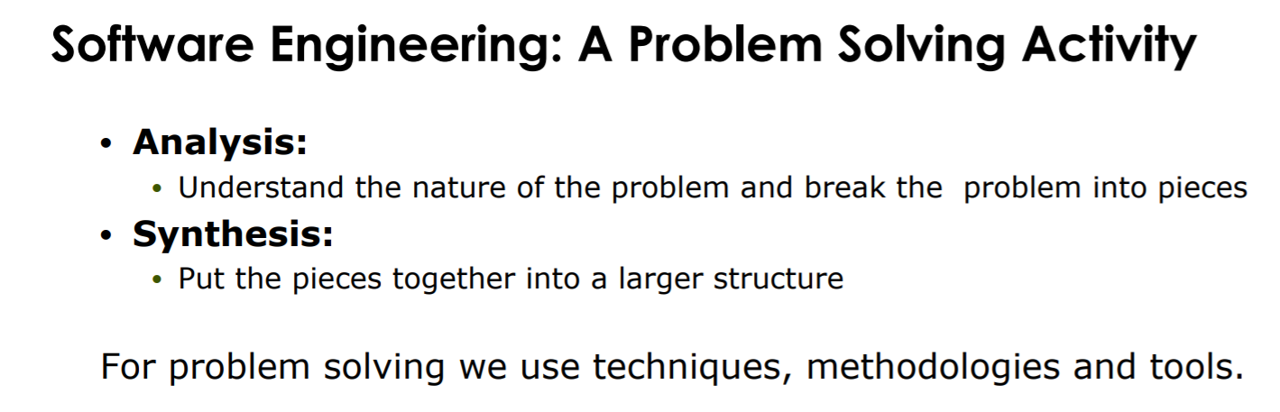

Slide 10
Agenda
Task 1
Task 2
Task 3
Task 4
Task 5
Homework 2

Slide 11
Task 3
Why does change happen in software development? Provide examples from your own experience and discuss them in the 3 areas of requirements changes, technology changes and organization change.

Slide 12
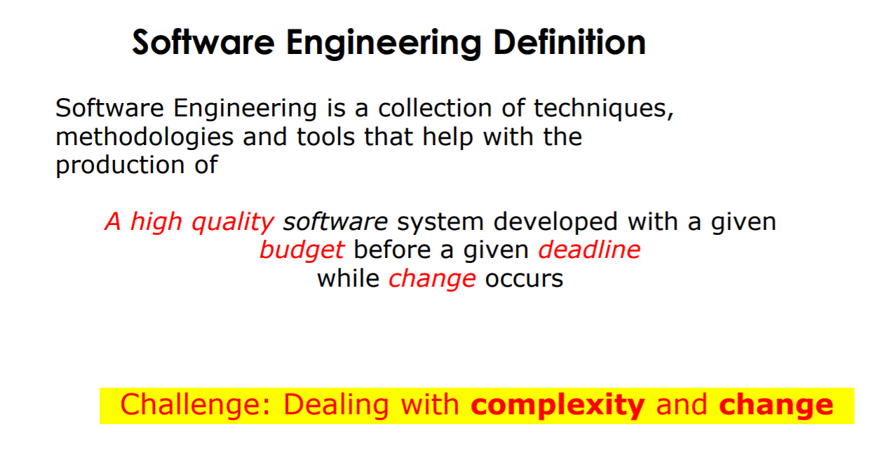

Slide 13
Requirements change throughout the project, e.g. the customer changes their mind or requirement turns out to be unfeasible
The EIST instructors change their minds about how the player can steer their car (using a mouse is just too boring) and now require you to implement voice commands to steer the player’s car instead

Slide 14
Requirements change throughout the project, e.g. the customer changes their mind or requirement turns out to be unfeasible
Technologies change, e.g. new releases, updates
since updating Bumpers to JDK 10, the AudioPlayer is outdated and has to be refactored. For instance, the AudioPlayer can only play .au and .wav files, but should also support .mp3 files

Slide 15
Requirements change throughout the project, e.g. the customer changes their mind or requirement turns out to be unfeasible
Technologies change, e.g. new releases, updates
Organizational changes, e.g. laws, recruitment
The EIST instructors decide to add 10 more tutor groups and now all the students have to be re-distributed among the tutor groups

Slide 16
Agenda
Task 1
Task 2
Task 3
Task 4
Task 5
Homework 2

Slide 17
Task 4
Explain the differences between programming and modeling (source code vs. model)

Slide 18
Modeling
reduce complexity
Pseudo Code, UML
simplified representation of reality
Programming
Map Model to program
Java, C, C++, Python, Swift, …

Slide 19
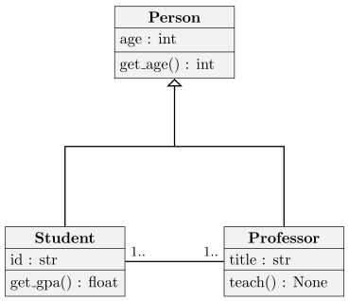
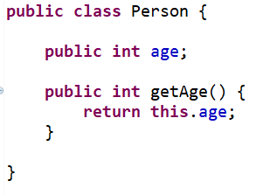
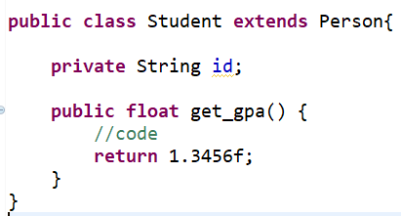
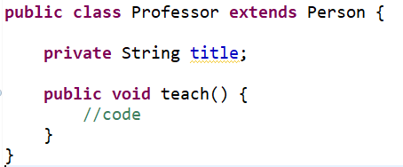
Model
Program

Slide 20
Agenda
Task 1
Task 2
Task 3
Task 4
Task 5
Homework 2

Slide 21
Task 5
Explain the differences between a model, a view and a system.

Slide 22
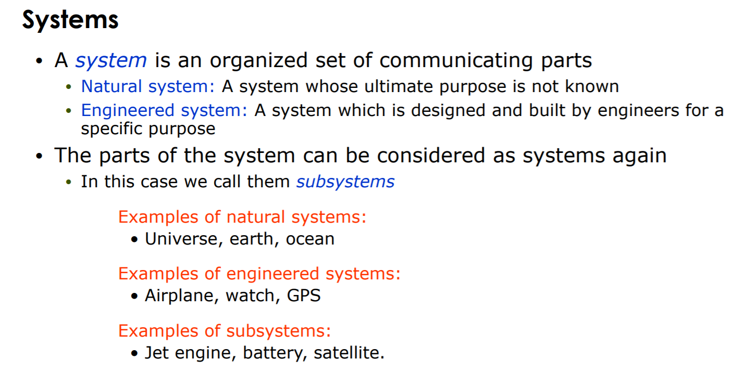

Slide 23
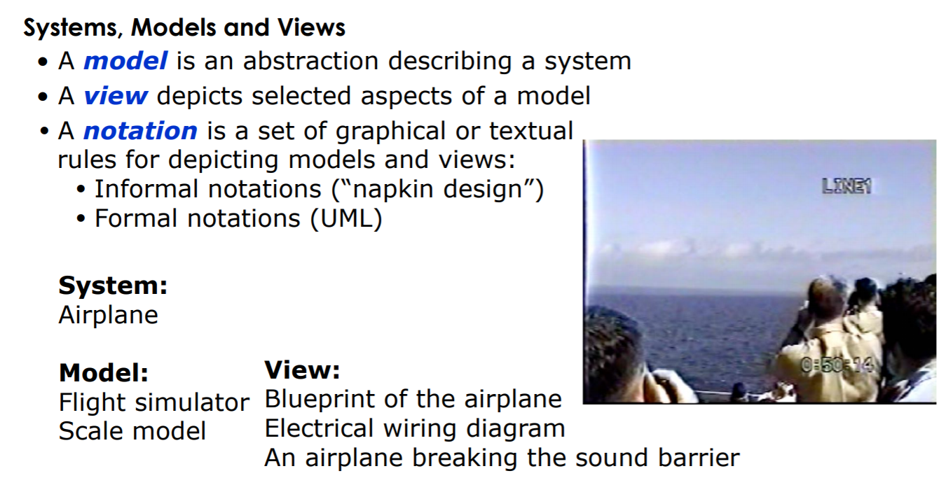

Slide 24
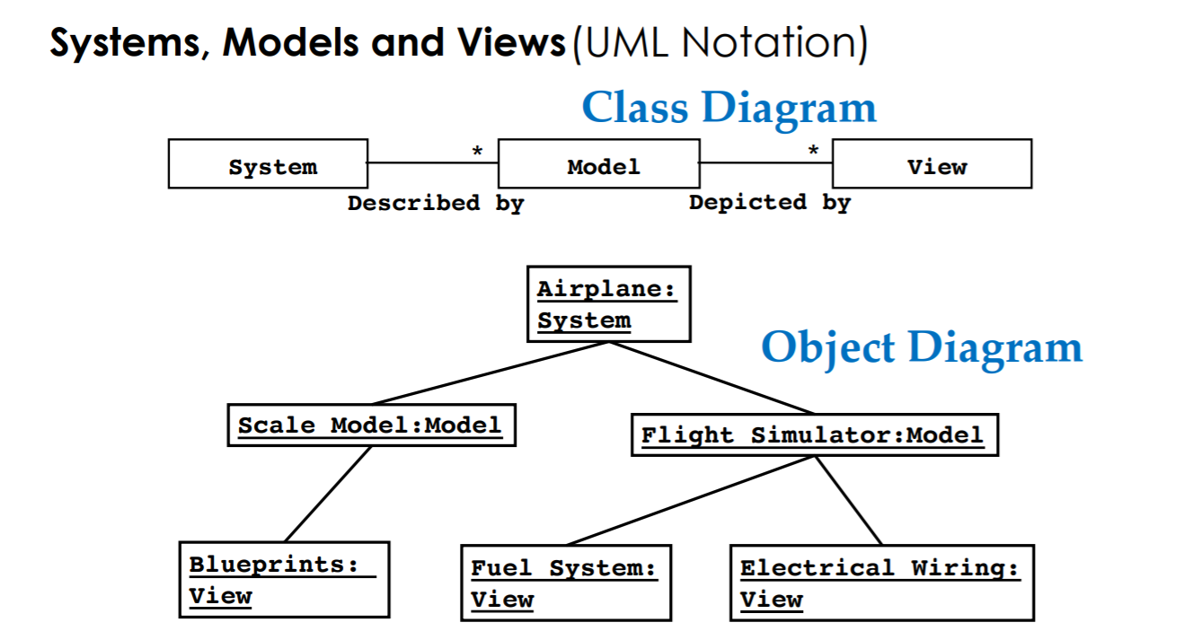

Slide 25
Agenda
Task 1
Task 2
Task 3
Task 4
Task 5
Homework 2

Slide 26
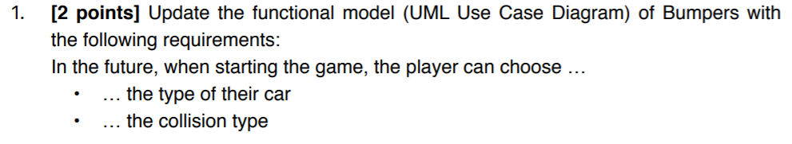
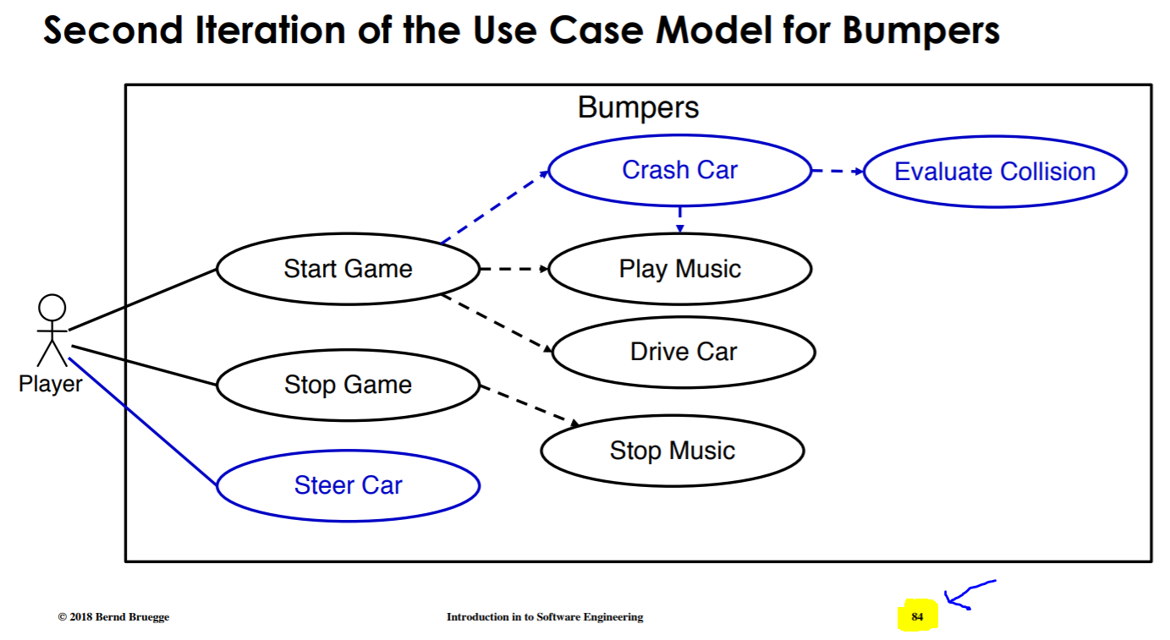
Part 2 – Task 1
Slide: L02:84

Slide 27
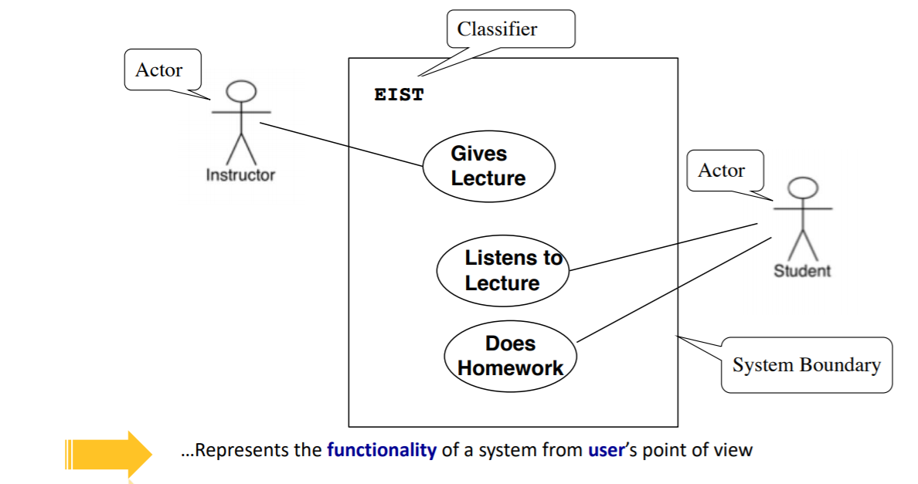
Repitition: Use Case Diagram
- An actor: specific type of user
- External entity interacting with the system
A use case represents a functionality provided
by the system

Slide 28
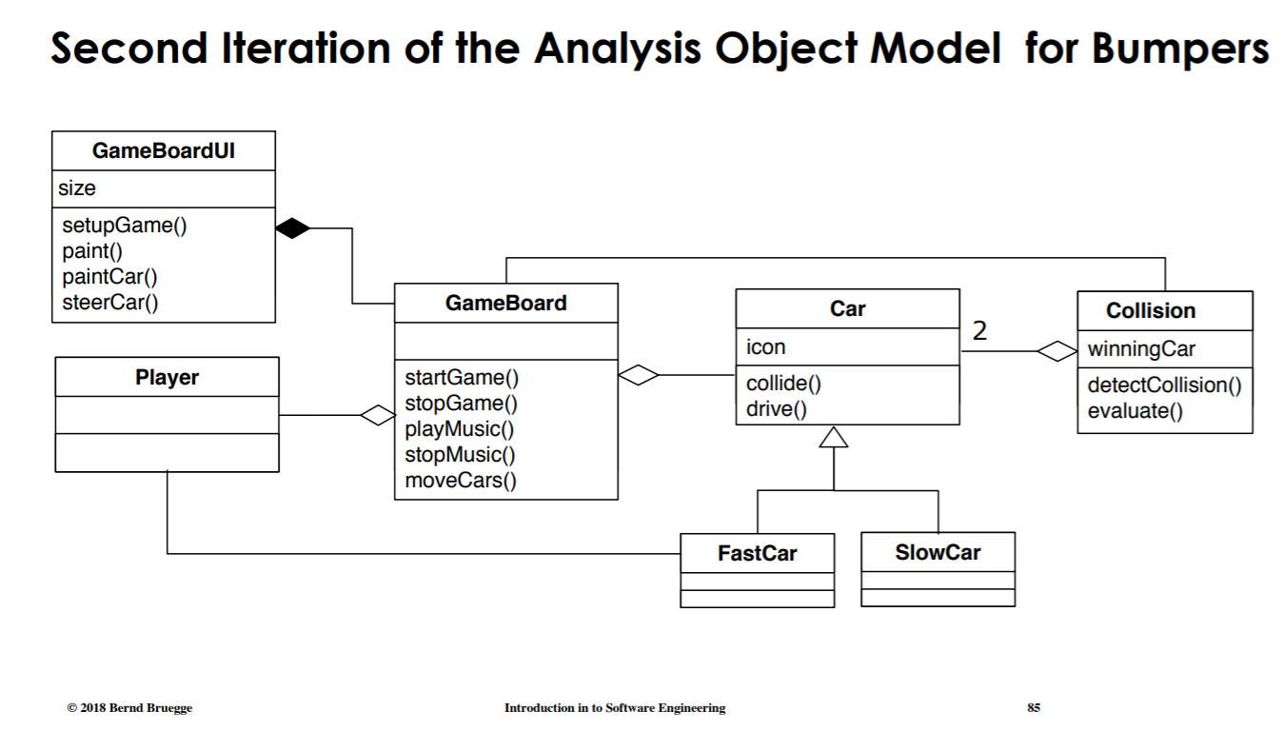
Part 2 – Task 2
Slide: L02:85

Slide 29
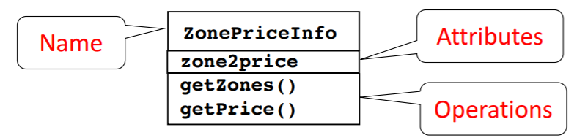
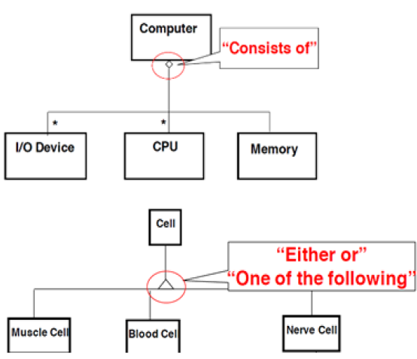
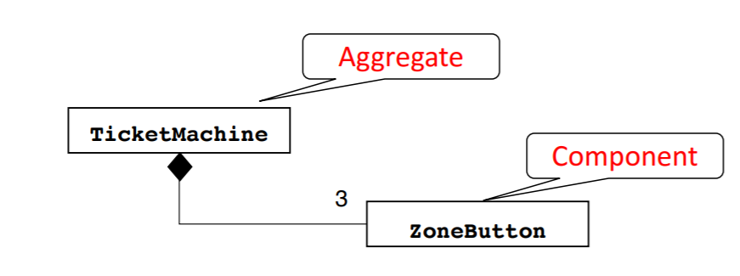
Repitition: Class Diagram
Class Diagram
Does not exist without component

Slide 30
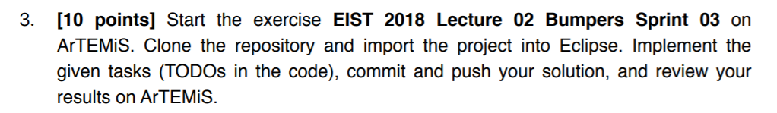
Part 2 – Task 3
The more creative/cool your solution,
the more points you will get! ☺

Slide 31
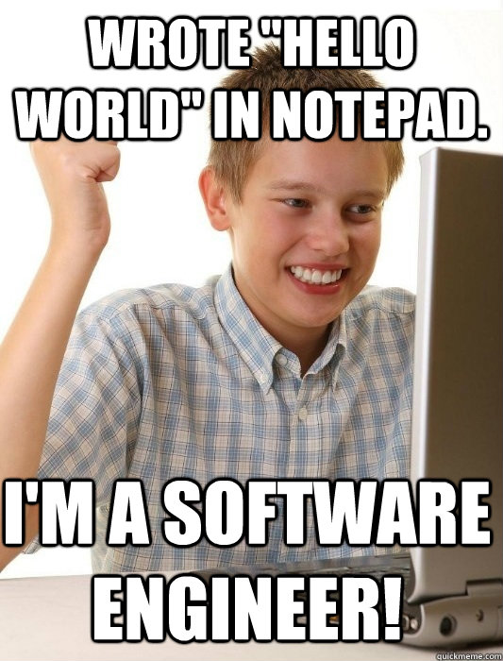
See you next time! ☺

