Slide 1



NCEP’s UNIFIED POST PROCESSOR (UPP)
Hui-Ya Chuang
NOAA/NCEP/EMC
2016 HWRF Tutorial

Slide 2
Outline
Overview
Components and Functions
Sample fields generated
Running unipost
Controlling output generation
Running copygb
Specifying target grid
Combining parent and nest domains
Visualization

Slide 3
The critical big picture overview
Processes model output from both the NMM and the ARW dynamic cores
The UPP generates output in GRIB1 or GRIB2
The UPP enables product generation on any output grid up to 3 decimal points of precision
Notes:
Main take-away points

Slide 4
Components of Post-Processing
Post control file
Note: Bold arrows indicate
Operational HWRF path
wrfout Files
unipost
(primarily ARW)
tracker
copygb
Visualization
(general forecast applications)

Slide 5
Functions and features of unipost
Performs vertical interpolation onto isobaric and other non-model surfaces
Computes diagnostic fields
De-staggers wind onto mass points for ARW core only
An MPI parallel code that will run faster with more processors

Slide 6
Functions of copygb
Perform horizontal interpolation onto a defined output grid
Useful for both cores in creating an output grid not fixed by the model integration domain
Combines the nest data onto the parent domain
Performs de-staggering for NMM core only
Many visualization packages cannot properly handle staggered grids

Slide 7
Ingesting WRF model output
unipost reads in WRF model output in netCDF format using the WRF I/O package
A single time per wrfout file works best with sample UPP run scripts (frames_per_outfile=1 in WRF namelist)
By default, the WRF model will provide all fields that unipost requires
Only a concern if you are modifying the Registry file
All model fields read in by unipost for both dynamic cores can be found in the respective User Guides (listed by WRF Registry file variable names)

Slide 8
Fields generated by the UPP
The UPP currently outputs hundreds of possible fields
Complete list in the Post Processing Utilities chapter of the ARW or NMM User Guides
http://www.dtcenter.org/wrf-nmm/users/docs/user_guide/V3/users_guide_nmm_chap1-7.pdf
Sample fields generated by UPP
T, Z humidity, wind, cloud water, cloud ice, rain, and snow on isobaric levels
Shelter level T, humidity, and wind fields
SLP (two types)
Notes:
Check # fields for UPP

Slide 9
Fields generated by the UPP
Precipitation-related fields: accumulated and instantaneous precipitation for total, convective, and grid scale
PBL-related fields
Diagnostic fields: satellite look-alike, isentropic, vorticity, and simulated radar reflectivity
Radiative fluxes
Cloud-related fields
Aviation products
Notes:
Check # fields for UPP

Slide 10
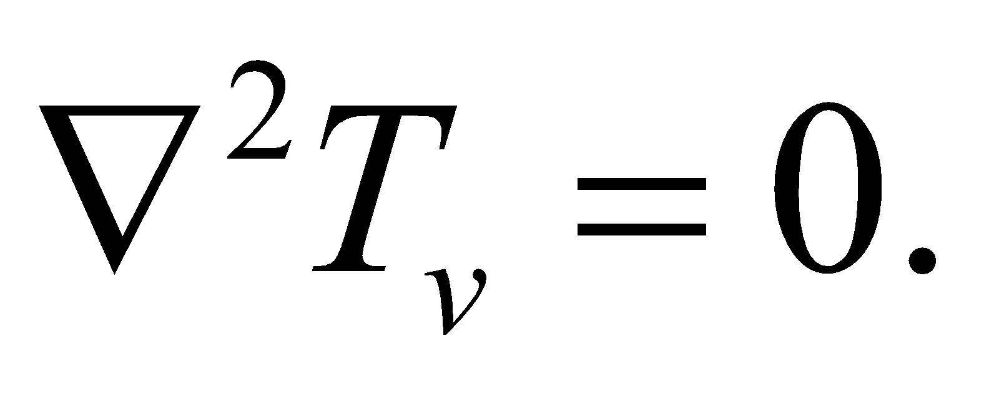
Derivation of sea level pressure
Standard NCEP SLP:
Based on underground temperatures extrapolated using a constant lapse rate, but subject to the Shuell correction.
Can be very noisy over mountainous terrain in higher-resolution model runs
Membrane NCEP SLP:
Underground temperatures recomputed by solving
using successive overrelaxation method.
Hydrostatic integration of this smooth underground
temperature field yields a much smoother SLP field.

Slide 11
Computation of Satellite Look-Alike Products
They are derived by calling Community Radiative Transfer Model (CRTM) forward model using model predicted cloud, moisture, and surface fields as input
Allow users to make direct comparisons between satellite observations and model forecast
HWRF has been generating simulated GOES and F-17 SSMIS operationally for several years
EMC has also been generating NADIR simulated GOES products operationally for both GFS and NAM since 2007

Slide 12
Fields required by the tracker
Input for the tracker program
Primary
MSLP
Relative vorticity* at 10m, 850 and 700 hPa
Geopotential height at 850 and 700 hPa
Secondary
Winds (u/v) at 10m, 850 and 700 hPa
also used to extract intensity
*UPP outputs absolute and the tracker derives relative

Slide 13
Running unipost and copygb

Slide 14
UPP directory contents (subset)
sorc/: source codes
scripts/: sample scripts for running UPP and generating
graphics
lib/: libraries used in the build
parm/: control file used when running unipost to specify which variables to output
exec/: UPP executables
configure: script to configure how to compile post
compile: script to compile the UPP code
clean: script to clean created files and executables

Slide 15
Input to run unipost
Post needs three input files in addition to model output
itag: specifies details on model output to process
model output file name
format of model output (binary or netcdf)
forecast validation time
model name (NMM or NCAR)
wrf_cntrl.parm, hwrf_cntrl.nosat, or hwrf_cntrl.sat : control file to let users specify which fields/levels to output
eta_micro_lookup.dat: binary look-up table for Ferrier MP
In the scripts provided in with tutorial, these files are automatically generated or linked

Slide 16
unipost control file: wrf_cntrl.parm
Users specify which fields and which level(s) of fields to output by modifying control file
GRIB packing precision**
(PRESS ON MDL SFCS ) SCAL=(6.0)
L=(11000 00000 00000 00000 00000 00000 00000…
(HEIGHT ON MDL SFCS ) SCAL=(6.0)
L=(11000 00000 00000 00000 00000 00000 00000…
Each column represents a single model/isobaric level:
“1” = output, “0” = no output
Product description – unipost code keys on these character strings.
** larger values → more precision, but larger GRIB files.

Slide 17
unipost control file
The wrf_cntrl.parm file has entries for every possible output field
The hwrf_cntrl.nosat file has entries required by the tracker plus some additional diagnostics
Table 3 in previously mentioned users’ guide explains the character string abbreviations used in the control file:
http://www.dtcenter.org/wrf-nmm/users/docs/user_guide/V3/users_guide_nmm_chap1-7.pdf

Slide 18
Outputting fields on different vertical coordinates
unipost outputs on several vertical coordinates:
Native model levels
47 isobaric levels: 2, 5, 7, 10, 20, 30, 50, 70, then every 25 hPa from 75-1000 hPa
7 flight levels above MSL: 914, 1524, 1829, 2134, 2743, 3658, and 6000 m
6 PBL layers: each averaged over 30 hPa AGL layer
2 AGL levels: 1000 & 4000 m (radar reflectivity).
Except for AGL and isobaric levels, vertical levels are counted from the ground surface up in the parameter control file

Slide 19
Examples of using Post control file
Output T every 50 hPa from 50 hPa to 1000 hPa:
(TEMP ON PRESS SFCS ) SCAL=( 4.0)
L=(00000 01001 01…)
2 5 7 10 20 30 50 70 75 100 125 150
Isobaric levels increase from left to right: 2, 5, 7, 10, 20, 30,
50, 70, then every 25 hPa from 75-1000 hPa.
Output instantaneous surface sensible heat flux:
(INST SFC SENHEAT FX ) SCAL=( 4.0)
L=(10000 00000 00000 00000 00000 00000 00000 00000

Slide 20
copygb target grid definition
The generic command to run copygb and horizontally interpolate onto a new grid is:
copygb.exe –xg”$grid ” in.grb out.grb
Three options on how to specify the target $grid include:
Pre-defined NCEP standard grid number
Defined grid definition
Operational HWRF grid definition
User-defined grid definition
Grid navigation file created by unipost

Slide 21
Run copygb – Option 1
Interpolate to a pre-defined NCEP standard grid (restrictive but simple)
For example, to interpolate onto NCEP grid 212:
copygb.exe –xg212 in.grb out.grb
Description of NCEP grids are available online:
http://www.nco.ncep.noaa.gov/pmb/docs/on388/tableb.html

Slide 22
Run copygb – Option 2a
Create a user-defined Lambert Conformal grid by specifying a full set of grid parameters (complicated but flexible).
copygb.exe –xg”255 3 NX NY STARTLAT STARTLON 8 CENLON DX DY 0 64 TRUELAT1 TRUELAT2 ” in.grb out.grb
copygb –xg”255 3 185 129 12190 -133459 8 -95000
40635 40635 0 64 25000 25000” in.grb out.grb
indicates user-
defined grid
map type (3=LC)
SW corner
(millidegrees)
Proj cent lon
(millidegrees)
# of points
horizontal spacing
(meters)
Proj true latitudes
(millidegrees)
Notes:
8=grid relative winds
64 = +I, +j scanning order

Slide 23
Run copygb – Option 2b
Create a user-defined Polar Stereographic grid by specifying a full set of grid parameters (complicated but flexible).
copygb.exe –xg”255 5 NX NY STARTLAT STARTLON 8 CENLON DX DY 0 64” in.grb out.grb
copygb –xg”255 5 580 548 10000 -128000 8 -105000
15000 15000 0 64” in.grb out.grb
map type
(5=STR)
Center flag (0=NH ; 1=SH)
Notes:
Skim through just to show users how to project onto their own PS grid.

Slide 24
Run copygb – Option 2c
Create a user-defined Latitude-Longitude grid by specifying a full set of grid parameters (complicated but flexible).
copygb.exe –xg”255 0 NX NY STARTLAT STARTLON 136 ENDLAT ENDLON DLAT DLON 64” in.grb out.grb
Example of create an operational HWRF output domain:
copygb –xg”255 0 1101 901 66700 334800 136 -23300 224800 100 100 0” in.grb out.grb
map type
(0=LTLN)
NE lat
(millidegrees)
NE lon
(millidegrees)
grid spacing
(millidegrees)
Notes:
Skim through just to show users how to project onto their own LL grid.

Slide 25
Run copygb – Option 3
Read in grid navigation file created by unipost (simple, restrictive)
Running unipost produces up to two ASCII files containing grid navigation information which is similar in domain and grid spacing to the model integration domain
copygb_gridnav.txt for a Lambert Conformal grid (NMM only)
copygb_hwrf.txt for a regular Lat-Lon grid (ARW and NMM)
For example:
read nav < ‘copygb_hwrf.txt’
copygb.exe –xg “$nav “ in.grb out.grb
Note: This file is not used in operations

Slide 26
Combine input files with copygb
Put nest data onto the parent domain and generates a new GRIB file with the combined data
copygb.exe –g”$grid ” -xM parent_in.grb nest_in.grb

Slide 27
GRIB file visualization with GrADS
GrADS has utilities to read GRIB files on any non-staggered grids and generate GrADS “control” files. The utilities grib2ctl and gribmap are available via: http://www.cpc.ncep.noaa.gov/products/wesley/grib2ctl.html
Package download and user guide for GrADS are available online:
http://grads.iges.org/grads/gadoc/
A sample script named run_grads is included in hwrf_utilities/scripts/ that can be used to plot various fields using GrADS

Slide 28
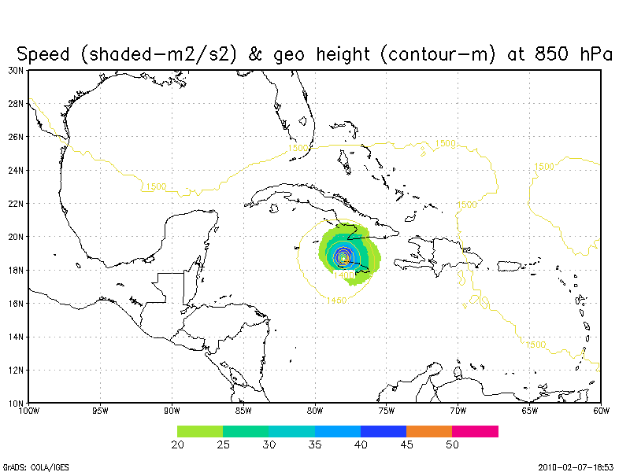
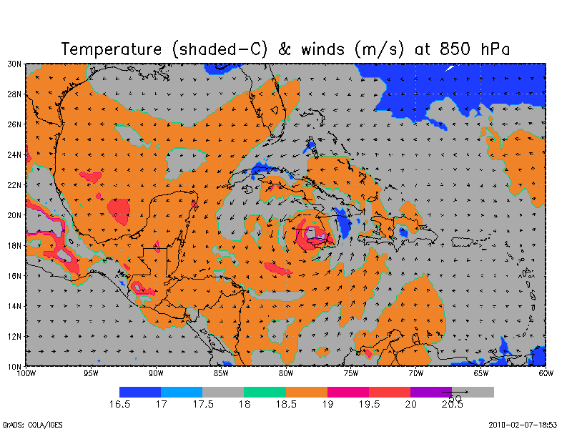
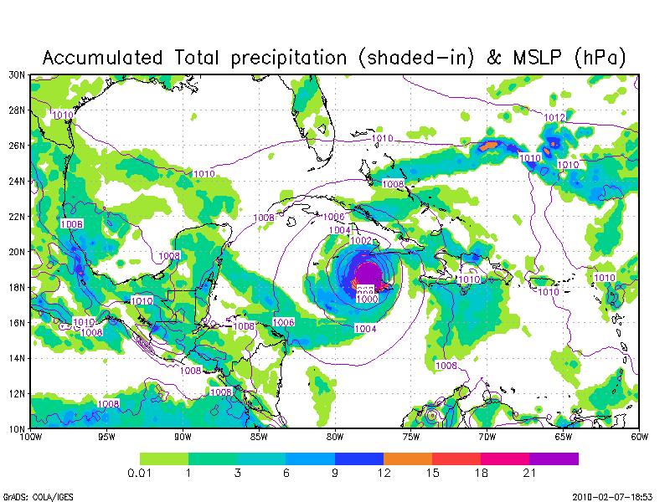
Forecast plotted with GrADS:

Slide 29
HWRF Simulated SSMIS for Hurricane Melissa Also Plotted with GrADS

Slide 30
GRIB file visualization with GEMPAK
The GEMPAK utility “nagrib” reads GRIB files from any non-staggered grid and generates GEMPAK-binary files that are readable by GEMPAK plotting programs
GEMPAK can plot horizontal maps, vertical cross-sections, meteograms, and sounding profiles.
Package download and user guide are available online:
http://my.unidata.ucar.edu/content/software/gempak/index.html
Further details on this script and using GEMPAK are available in the user’s guide
Notes:
GEMPAK sample script available?

Slide 31
Future Plans
Continue to add new products and expand code portability
HWRF will be switching from MTSAT-2 synthetic brightness temperatures to Himawari 8 in its West Pacific and East Indian Ocean storms
Transition all operational models to output GRIB2. Benefits include better representation of fine resolution grid and up to 50% saving in memory. New utility “wgrib2” is used operationally to perform horizontal interpolation and will be available to users

Slide 32
Additional Resources
WRF-NMM Users Page
http://www.dtcenter.org/wrf-nmm/users/
WRF-NMM Users Guide
http://www.dtcenter.org/wrf-nmm/users/docs/users_guide/V3/users_guide_nmm_chap1-7.pdf
WRF-ARW Users Page
http://www.mmm.ucar.edu/wrf/users/
WRF-ARW Users Guide
http://www.mmm.ucar.edu/wrf/users/docs/user_guide_V3/contents.html
HWRF Users Page
http://www.dtcenter.org/HurrWRF/users/docs/index.php
Questions regarding UPP can be directed to: wrfhelp@ucar.edu

Slide 33
Questions?

