Slide 1



HWRF Dynamics The WRF-NMM
Zavisa Janjic – Creator of the NMM
Samuel Trahan - Presenter
Matt Pyle

Slide 2
NMM Dynamic Solver
Basic Principles
Equations / Variables
Model Integration
Horizontal Grid
Spatial Discretization
Vertical Grid
Boundary Conditions
Dissipative Processes
Namelist switches
Summary

Slide 3
Basic Principles
Use full compressible equations split into hydrostatic and nonhydrostatic contributions
Easy comparison of hydro and nonhydro solutions
Reduced computational effort at lower resolutions
Apply modeling principles proven in previous NWP and regional climate applications
Use methods that minimize the generation of small-scale noise
Robust, computationally efficient

Slide 4
Mass Based Vertical Coordinate
*
To simplify discussion of the model equations, consider a sigma coordinate to represent a vertical coordinate based on hydrostatic pressure ( ):

Slide 5
*
WRF-NMM dynamical equations inviscid, adiabatic, sigma form
Analogous to a hydrostatic system, except for p and , where p is the total (nonhydrostatic) pressure and is defined below.
Momentum eqn.
Thermodynamic eqn.
Hydrostatic Continuity eqn.
Janjic et al. 2001, MWR
Notes:
Thermo equation – consistency with omega_1 and omega_2 contributions

Slide 6
*
Hypsometric eqn.
Nonhydro var. definition (restated)
generally is small. Even a large vertical acceleration of 20 m/s in 1000 s produces of only ~0.002, and nonhydrostatic pressure deviations of ~200 Pa.
3rd eqn of motion
Nonhydrostatic continuity eqn.

Slide 7
Properties of system
*
, w, and are not independent → no independent prognostic equation for w!
<< 1 in meso- and large-scale atmospheric flows.
Generically, the impact of nonhydrostatic dynamics becomes detectable at resolutions < 10 km, and important at ~1 km.

Slide 8
Vertical boundary conditions for model equations
*
Top: ,
Surface: ,

Slide 9
WRF-NMM predictive variables
Mass variables:
PD – hydrostatic pressure depth (time/space varying component) (Pa)
PINT – nonhydrostatic pressure (Pa)
T – sensible temperature (K)
Q – specific humidity (kg/kg)
CWM – total cloud water condensate (kg/kg)
Q2 – 2 * turbulent kinetic energy (m²/s²)
Wind variables:
U,V – wind components (m/s)

Slide 10
Model Integration
Explicit time differencing preferred where possible, as allows for better phase speeds and more transparent coding:
horizontal advection of u, v, T
advection of q, cloud water, TKE (“passive substances”)
Implicit time differencing for very fast processes that would require a restrictively short time step for numerical stability:
vertical advection of u, v, T and vertically propagating sound waves

Slide 11
Model Integration Horizontal advection of u, v, T
*
2nd order Adams-Bashforth:
Stability/Amplification:
A-B has a weak linear instability (amplification) which either can be tolerated or can be stabilized by a slight off-centering as is done in the WRF-NMM.

Slide 12
Model Integration Vertical advection of u, v, & T
*
Crank-Nicolson (w/ off centering in time):
Stability:
An implicit method, it is absolutely stable numerically. Short time steps still needed for accuracy.

Slide 13
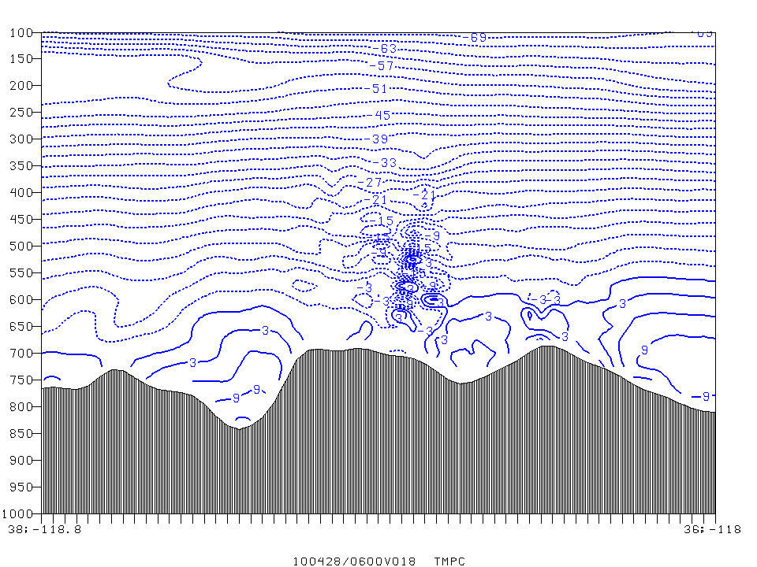
Cross-section of temperatures 18 h into an integration experiencing strong orographically-forced vertical motion and using centered in time C-N vertical advection

Slide 14
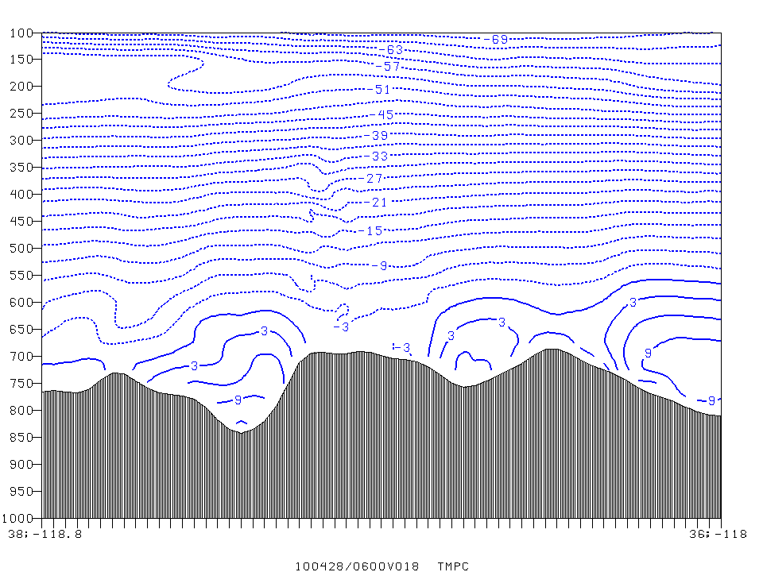
Cross-section of temperatures 18 h into an integration experiencing strong orographically-forced vertical motion and using off-centered in time C-N vertical advection.

Slide 15
Model Integration Advection of TKE (Q2) and moisture (Q, CWM, species)
Traditionally has taken an approach similar to the Janjic (1997) scheme used in Eta model:
Starts with an initial upstream advection step
Anti-diffusion/anti-filtering step applied to reduce dispersiveness
Conservation enforced after each anti-filtering step
maintain global sum of advected quantity
prevent generation of new extrema
Eulerian advection also available, but not used by HWRF.

Slide 16
Model Integration
Subroutine sequence within solve_nmm (ignoring physics):
PDTE – integrates mass flux divergence, computes vertical velocity and updates hydrostatic pressure.
ADVE – horizontal and vertical advection of T, u, v, Coriolis and curvature terms applied.
ADV2/ADV2_SCAL (typically every other step) – vertical/horizontal advection of q, CWM, TKE
VTOA – updates nonhydrostatic pressure, applies ωα term to thermodynamic equation
VADZ/HADZ – vertical/horizontal advection of height. w=dz/dt updated.
(3%)
(21%)
(32%)
(1%)
(6%)
(approximate relative % of dynamics time spent in these subroutines)

Slide 17
Model Integration
Subroutine sequence within solve_nmm (cont):
EPS – vertical and horizontal advection of dz/dt, vertical sound wave treatment.
HDIFF – horizontal diffusion
BOCOH – boundary update at mass points
PFDHT – calculates PGF, updates winds due to PGF, computes divergence.
DDAMP – divergence damping
BOCOV – boundary update at wind points\
Nest motion
Diagnostics
(9%)
(11%)
(<1%)
(14%)
(1%)
(<1%)

Slide 18
All dynamical processes every fundamental time step, except….
t1
t2
t3
t4
t5
…passive substance advection, every other time step
Model time step “dt” specified in model namelist.input is for the fundamental time step.
Generally about 2.25x** the horizontal grid spacing (km), or 350x the namelist.input “dy” value (degrees lat).
** runs w/o parameterized convection may benefit from limiting the time step to about 1.9-2.0x the grid spacing.

Slide 19
*
Impact on variation of over domain
For a domain spanning 10N to 70N:
Regular lat-lon grid
Rotated lat-lon grid
0º
0º

Slide 20
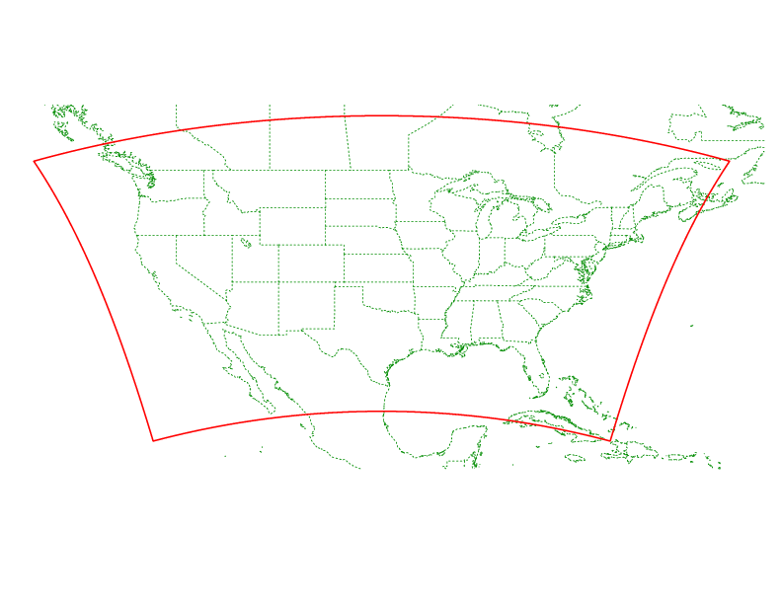
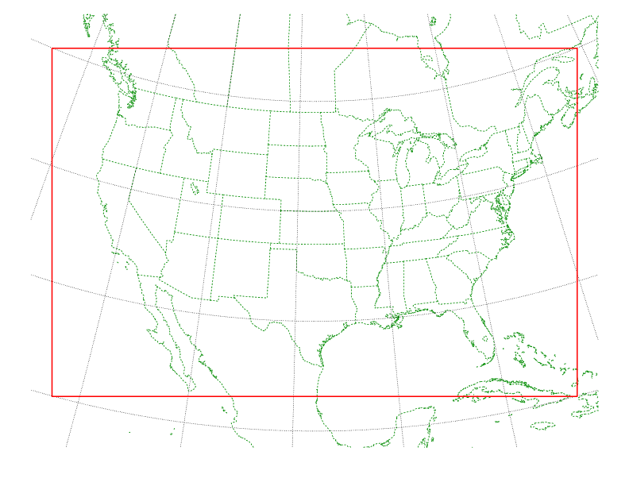
Sample rotated lat-lon domain
On a regular lat-lon map background
On a rotated lat-lon map background (same rotation as model grid).

Slide 21
The E-grid Stagger
H v H v H v H (v)
v H v H v H v (H)
H v H v H v H (v)
v H v H v H v (H)
H v H v H v H (v)
H=mass point, v=wind point
red=(1,1) ; blue=(1,2)

Slide 22
The E-grid Stagger
H v H v H v H (v)
v H v H v H v (H)
H v H v H v H (v)
v H v H v H v (H)
H v H v H v H (v)
XDIM=4 (# of mass points on odd numbered row)
YDIM=5 (number of rows)

Slide 23
The E-grid Stagger
v H
H v
Conventional grid spacing is the diagonal distance “d”.
Grid spacings in the WPS and WRF namelists are the “dx” and “dy” values, specified in fractions of a degree for the WRF-NMM.
“WRF domain wizard” takes input grid spacing “d” in km and computes the angular distances “dx” and “dy” for the namelist.
“d”
“dy”
“dx”

Slide 24
Spatial Discretization General Philosophy
“Mimetic” approach
http://www.math.unm.edu/~stanly/mimetic/mimetic.html
Conserve energy and enstrophy to control nonlinear energy cascade
reduce the need for numerical filtering
Conserve some first order and quadratic quantities
(mass, momentum, energy, …)
Use consistent order of accuracy for advection and divergence operators and the omega-alpha term; consistent transformations between KE and PE in the hydrostatic limit.
Preserve properties of differential operators.

Slide 25
NMM
Formal 4th order
Advection and divergence operators – each point talks to all eight neighboring points (isotropic)

Slide 26
mass point
wind point
1/3 of the contribution to divergence/advection comes from these N/S and E/W fluxes.

Slide 27
mass point
wind point
avg wind point
2/3 of the contribution to divergence/advection comes from these diagonal fluxes.

Slide 28
Horizontal temperature advection detail (computerese)
T₅
T₈
V₄
T₉
T₄
V₃
T₁
V₁
T₂
T₇
V₂
T₆
For each T_{n}, there is an associated layer pressure depth (here denoted dp_{n}). There also is a dx_{n} specific to each point
T₃

Slide 29
NMM Vertical Coordinate Pressure-sigma hybrid (Arakawa and Lamb, 1977)
Has the desirable properties of a terrain-following pressure coordinate:
Exact mass (etc.) conservation
Nondivergent flow remains on pressure surfaces
No problems with weak static stability
No discontinuities or internal boundary conditions
And an additional benefit from the hybrid:
Flat coordinate surfaces at high altitudes where sigma problems worst (e.g., Simmons and Burridge, 1981)

Slide 30
sigma
sigma-p hybrid
15 km
Wind developing due to the spurious pressure gradient force in an idealized integration. The hybrid coordinate boundary between the pressure and sigma domains is at ~400 hPa.

Slide 31
Pressure-Sigma Hybrid Vertical Coordinate
P_{T}
eta=0.0
pressure range
PD_{TOP}
P_{T}+PD_{TOP}
0.4
PD
sigma range
P_{T}+PD_{TOP}
+PD
1.0
= eta₁ * PD_{TOP} + eta₂ * PD + P_{T}

Slide 32
Equations in Hybrid Coordinate
*
pressure range
sigma range

Slide 33
Vertical discretization
P, w, Z
v,T
P, w, Z
v,T
P, w, Z
v,T
P, w, Z
Vertical advection combines the advective fluxes computed above and below the layer of interest.
Lorenz

Slide 34
Lateral Boundary Conditions
Lateral boundary information prescribed only on outermost row:
Upstream advection in three rows next to the boundary
No computational outflow boundary condition for advection
Enhanced divergence damping close to the boundaries.
… H v H v H …
… v H v H v …
… H v H v H …
… v H v H v …
Pure boundary information
Avg of surrounding H points (blends boundary and interior)
Freely evolving

Slide 35
Dissipative Processes – lateral diffusion
A 2nd order, nonlinear Smagorinsky-type horizontal diffusion is utilized:
Diffusion strength a function of the local TKE, deformation of the 3D flow, and a namelist-specified diffusion strength variable (coac).
Lateral diffusion is zeroed for model surfaces sloping more than 4.5 m per km (0.0045) by default.
This slope limit can be adjusted with the namelist variable slophc. slophc is expressed as sqrt(2) times the true slope (making the 0.0045 default ~0.00636)

Slide 36
Dissipative Processes - divergence damping
*
Internal mode damping (on each vertical layer)
External mode damping (vertically integrated)
CODAMP is a namelist controlled variable = 6.4 by default.

Slide 38
Gravity Wave Drag & Mountain Blocking
Accounts for sub-grid scale mountain effects: mountain waves (GWD) and stability-dependent blocking of low-level flow around topography (MB).
More important for coarser grid spacing (> ~10 km) and longer (multi-day) integrations.
gwd_opt=2 in physics namelist to invoke for the WRF-NMM.
Benefits overall synoptic patterns and near-surface wind and temperature forecasts.
Based on the GFS model package for GWD (Alpert et al., 1988, 1996; Kim & Arakawa,1995) and MB (Lott & Miller, 1997).
Courtesy of Brad Ferrier

Slide 39
Relatively new NMM namelist switches
&dynamics
wp = 0.00
coac = 0.75,
codamp = 6.4,
slophc = 0.006364
WP - off-centering weight in nonhydrostatic computation (value of ~0.1 improves stability of some sub-1.5 km grid forecasts).
COAC - diffusion strength (larger → more diffusive smoothing)
CODAMP - divergence damping strength (larger → more damping, fewer small-scale regions of divergence).
SLOPHC - max surface slope for diffusion (larger value applies lateral diffusion over more mountainous terrain).
Defaults

Slide 40
A corrected namelist switch in WRFV3.4
&dynamics
non_hydrostatic = .true.
If .false., the model will run as a hydrostatic system.
May make sense for > ~20 km grid spacing where nonhydrostatic effects are minimal – the model runs more quickly (~20%) in hydrostatic mode.
Default

