Slide 1
Vortex Initialization in HWRF Model
HWRF Tutorial, 2016
Qingfu Liu, Vijay Tallapragada, Zhan Zhang
Banglin Zhang, Ligia Bernardet (DTC)
Samuel Trahan, Mingjing Tong, Weiguo Wang
Xuejian Zhang (HRD)
NOAA/NCEP/EMC
Thanks to the management support: Bill Lapenta, Hendrik Tolman, Robert Gall, Stephen Lord, John Derber, Frank Mark and Sundararaman Gopalakrishnan
1/09/2016

Slide 2
Outline
Overview
HWRF cycling system
Bogus storm
Storm relocation
Storm size correction
Storm intensity correction
Summary and discussions

Slide 3
1. Overview
HWRF initialization design:
Mini analysis for background vortex + GSI (Hybrid)
  The mini analysis is to create a better background fields, and includes three parts:
    storm relocation (data: storm center position)
    storm size correction (data: radius of maximum surface wind speed, and radius of the outermost closed isobar or average radius of 34 knots wind speed)
    storm intensity correction (data: maximum surface wind speed, to some extent, minimum surface pressure).
  Important for model consistent formulation:
    if vortex location, size and intensity in background are close to observations: all corrections are small.
    If they match the observations: no changes to the background fields

Slide 4
  The following is considered:
  1). No bogus data in data assimilation
  Reasons: a) bogus data may conflict with observation data
  b) we will get the storm structure we specified
  2) No conflict between the mini-vortex analysis and the traditional data assimilation
  a) if we have no inner core data, and choose not to run GSI, the final analysis are (for West Pac and East Pac)
  mini-vortex analysis + environmental field from GFS analysis
  for hurricane model initialization
  b) If we have inner core data (such as the airborne radar data), we can use the results from
  mini-vortex analysis + GSI
  to further improve the vortex structure and the environment fields through GSI data assimilation

Slide 5
  3) Model-consistent
  Generally speaking, the differences are large between the model and the observation in hurricane area. 1) We want the final analysis close to observation, 2) we also want the final analysis to be model consistent. We have two choices:
  a) Small correction
  pro: model-consistent
  small adjustment in model first-guess
  con: vortex structure may be bad
  ➔ HWRF initialization can be considered as small correction (correction is large in a few cases):
  Storm size correction is limited to 15%
  wind speed correction < 15% (in most of the cases)

Slide 6
  3) Model-consistent (continue)
  b) Large correction
  pro: good vortex structure
  con: generally speaking, Not model-consistent
  Large adjustment in model first-guess
  Once model forecast starts, the good vortex structure can be lost in several hours forecast time.
  Case study: 2005 Wilma has an 8-km eyewall size at 140 knots wind. Model forecast gives ~ 20km eyewall size in the background fields. If we produce a nice initial vortex with 8-km eyewall size in HWRF initial fields, the eyewall will collapse, and significant spin-down will occur in model forecast. The current HWRF model does not have the capability to maintain this kind of hurricane structure.

Slide 7
2. HWRF Cycling System
  In HWRF analysis system, only the HWRF vortex is cycled, and the environment field comes from GDAS forecast or GFS, depending on the configuration/basin.
  HWRF guess field = GDAS environment field
  + corrected vortex from HWRF 6h forecast
  After the guess field is created, HWRF analysis will be performed to create HWRF analysis field.
  For East Pac and West Pac regions, the initialization is slightly different,
  Final analysis = environment field from GFS analysis
  + corrected 6h HWRF vortex

Slide 8
3. Bogus vortex
Only used to increase storm intensity if background vortex is weaker compared to observation
Cold start: background vortex comes from GDAS (or GFS) analysis
Bogus storm has the same storm size as the observation
Bogus storm is created from a 2D axi-symmetric composite vortex. The 2D axi-symmetric composite vortex is pre-generated.
The 2D vortex has hurricane perturbations U, V, T, r (water vapor mixing ratio) and Ps

Slide 9
Bogus vortex (continue)
Creation of the bogus vortex
  Horizontally smooth the 2D storm profiles (U, V, T, r and Ps, note: Ps is 1D) until the radius of maximum wind or the maximum wind speed of the 2D vortex is close to the observation.
  After smooth, the storm size is corrected to match the observation
  The 2D composite vortex should be recreated whenever the changes of model physics strongly affect the storm structures

Slide 10
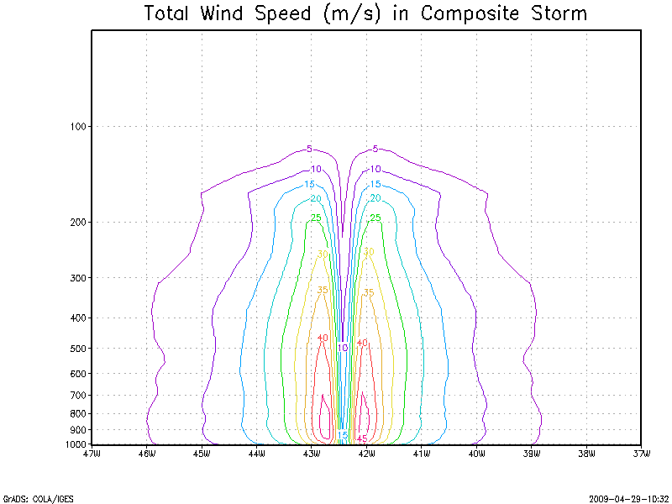

Slide 11
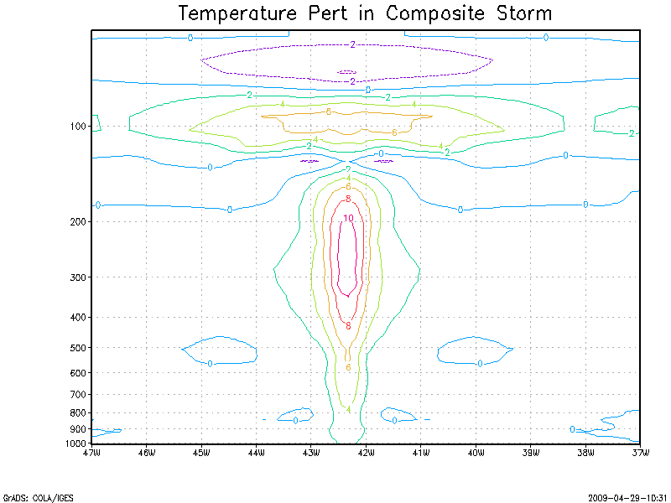

Slide 12
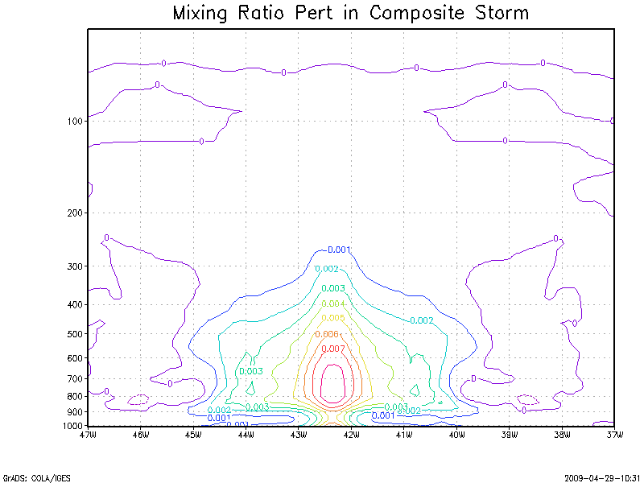

Slide 13
4. Vortex relocation
GFS (Liu et al., 2000)
A vortex relocation procedure to initialize hurricanes was implemented in GFS in year 2000. The relocation procedure takes the guess field and moves the hurricane vortex to the correct location before the GSI updates the analysis.
The steps can be briefly summarized as follows:
1) locate the hurricane vortex center in the guess field,
2) separate hurricane model's vortex from its environmental field,
3) move the hurricane vortex to the NHC's official position, and
4) if the vortex is too weak in the guess field, add a bogus vortex in the GSI analysis*
* this step is not done in HWRF

Slide 14
4. Vortex relocation
GFS (Liu et al., 2000)
  31% improvement in track forecasts from GFS
  25% improvement from GFDL model
GFS Ensemble (Liu et al. 2006b)
  Reduce the spreads of storm track and storm intensity forecasts
COAMPS-TC (Liou, 2008, personal communication)
ARW (Hsiao et al., MWR, 2009)
  28%-50% improvements in track forecasts

Slide 15
5. Storm Size Correction
Observation data used from TC vitals for the eyewall and storm size corrections are:
  radius of maximum wind speed
  radius of outmost closed isobar
  radius of 34 knots wind (for strong storms)
  We use this information to correct the size of the composite storm, as well as the storm produced from the 6-h model forecast by stretching or compressing the model grid.

Slide 16
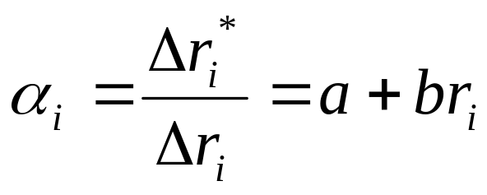
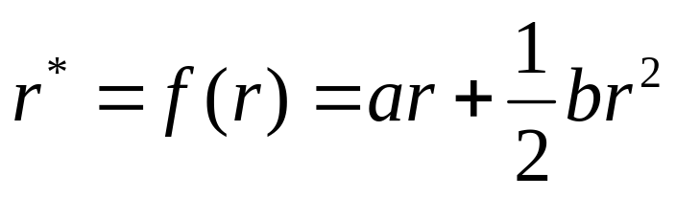
Storm Size Correction (continue)
Stretch/compress the model grid
        (1.4.1.1)
Integrate equation (4.1.1), we have
(1.4.1.2)
  Where a and b are constants, r and r* are the distances from the storm center before and after the model grid is stretched

Slide 17






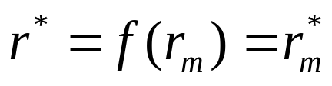
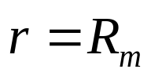
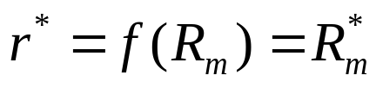
Storm Size Correction (continue)
Data used:
  Radius of the maximum wind speed (r_{m} and r_{m}*)
  Radius of the outmost closed isobar (R_{m} and R_{m}*)
    Model data: r_{m} , R_{m}
    Observation data: r_{m}* , R_{m}*
We compress/stretch the model grids such that
At , (1.4.1.3)
At , (1.4.1.4)

Slide 18
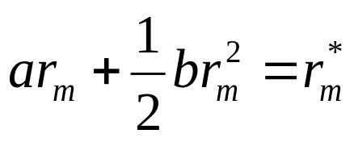
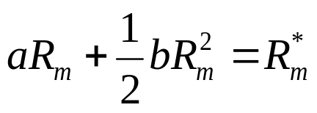
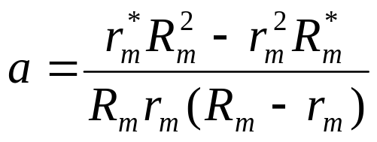
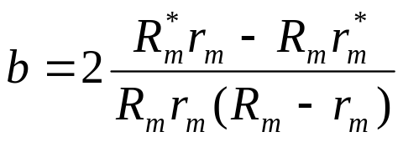
Storm Size Correction (continue)
Substituting (1.4.1.3) and (1.4.1.4) into (1.4.1.2),
(1.4.1.5)
(1.4.1.6)
Solve equations (1.4.1.5) and (1.4.1.6), we have
(1.4.1.7)

Slide 19
Storm Size Correction (continue)
Define the radius of outermost closed isobar from model output
As discussed in 2013 HWRF v3.5a Scientific Document, the minimum surface pressure needs to be scaled to observation value before calculating the radius of outermost closed isobar,
Define the radius of 34 knots wind from output
Similar to the calculation of the radius of the outermost closed isobar, we need to scale the max wind speed for vortex #1 (background vortex) and vortex #2 (bogus vortex) before calculating the radius of 34 knot wind.

Slide 20
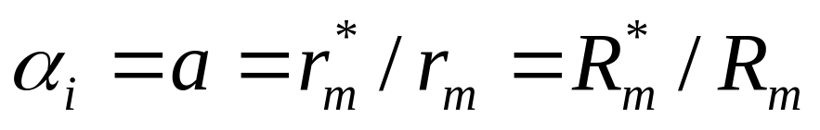
Storm Size Correction (continue)
In 2010 operational HWRF, only radius of the maximum wind speed was used for storm size correction, and α_{i} was set to be constant (b=0).
We limit the correction to be 15% of the model value (0.85 < α_{i}<1.15), and
(1.4.1.9)
Since 2011 HWRF, the second parameter is added in the storm size correction according to equation (1.4.1.7)

Slide 21
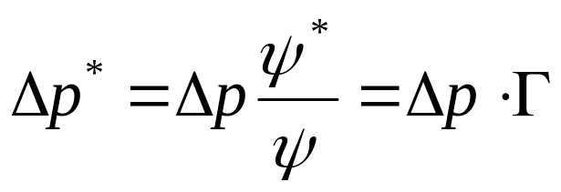
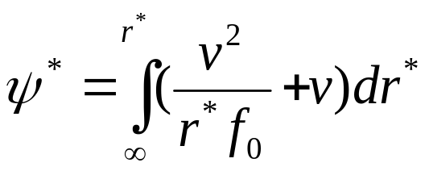
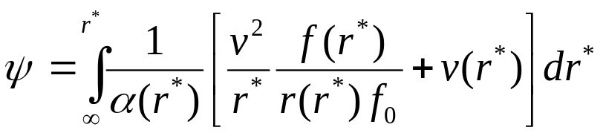
Storm Size Correction (continue)
Sea-level pressure adjustment
  (1.4.1.1.9)
  where,
  (1.4.1.1.6)
  And
  (1.4.1.1.4)

Slide 22
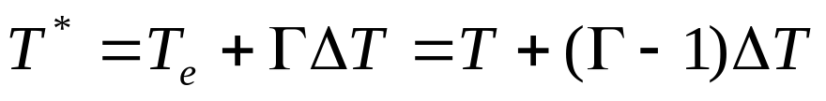
Storm Size Correction (continue)
Temperature adjustment
Temperature adjustment is proportional to the magnitude of the vortex temperature perturbation,
  (1.4.1.2.9)

Slide 23
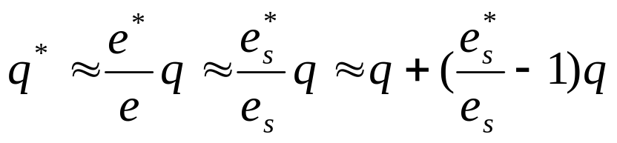
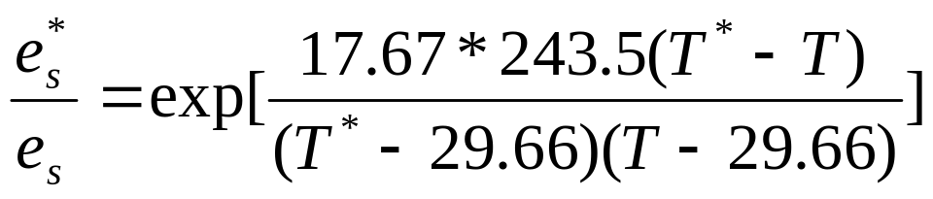
Storm Size Correction (continue)
Water vapor adjustment
  Assumption: relative humidity is unchanged before and after the temperature correction, we have
  (1.4.1.3.4)
  and
  (1.4.1.3.6)

Slide 24
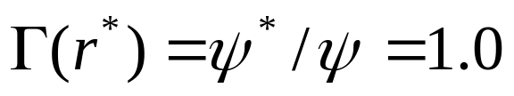
Storm Size Correction (continue)
Convergence
  If α=1.0, no storm size correction, we have
  from equations (1.4.1.1.9), (1.4.1.2.9) and (1.4.1.3.6), there will be no adjustments in 2D sea-level pressure, 3D temperature and 3D water vapor fields in the background

Slide 25


6. Storm Intensity Correction
Wind speed correction
  Denotes u₁ and v₁ as the background horizontal velocity, and u₂ and v₂ as the vortex horizontal velocity
  Define two functions
(1.4.2.1.1)
(1.4.2.1.2)
  F₁ is the 3D wind speed if we simply add a vortex to the background fields, and F₂ is the new wind speed after intensity correction.
  To find β, assume that the maximum wind speed for F₁ and F₂ are at the same model grid point.
    First find the model grid point m where F₁ is at its maximum (denotes the wind components as u₁^{m} , v₁^{m} , u₂^{m} , and v₂^{m} ).
    At model grid m, let F₂=v_{obs} , then solve the equation to obtain β.

Slide 26


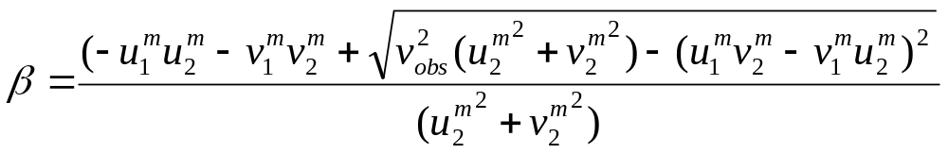
Storm Intensity Correction (continue)
New initial 3D wind fields
  And
  (1.4.2.1.4)
  where v_{obs} is the maximum 10m observed wind converted to the first model level.

Slide 27
Storm Intensity Correction (continue)
We consider two cases in the following discussion
➔ Case I: wind speed in background is stronger than obs.
    The background fields are the same as the HWRF (or GFS) environment fields (no vortex).
    We correct the intensity of vortex #1 (6h HWRF model vortex) before adding it to the background fields
  Case II: wind speed in background is weaker than obs.
    First, we add back the 6-h HWRF model vortex to the GFS environment fields (after relocation and storm size correction)
    Correct the intensity of vortex #2 (axi-symmetric vortex) before adding it to the new background fields.
    Note: Vortex #2 has the observed radius of the maximum wind speed and radius of outmost closed isobar (or radius of 34 knot wind) as vortex #1

Slide 28
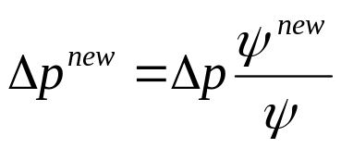
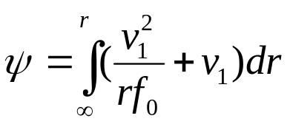
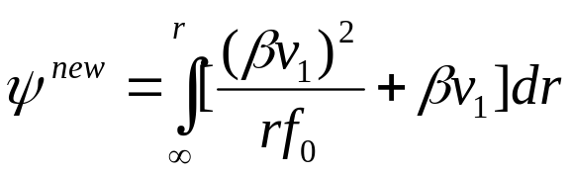
Storm Intensity Correction (continue)
Sea-level pressure adjustment after wind speed correction
  Case I: wind speed in background is stronger than obs.
    If the background vortex is close to observation, we have,
    β is close to 1
    And the pressure adjustment is
  (1.4.2.2.5)
    and
  (1.4.2.2.2)
  (1.4.2.2.3)

Slide 29

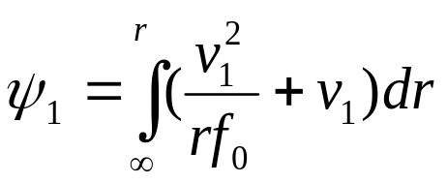
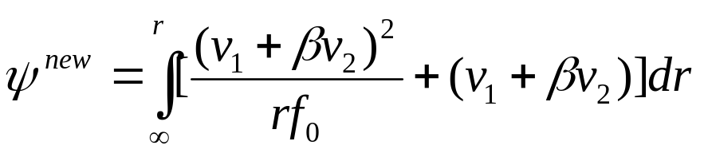
Storm Intensity Correction (continue)
Sea-level pressure adjustment after wind speed correction
  Case II: wind speed in background is weaker than obs.
    Since the background vortex is already added back, we have,
    β is close to 0
    model consistent pressure adjustment
    (1.4.2.2.7)
    And
    (1.4.2.2.5)
        (1.4.2.2.6)

Slide 30
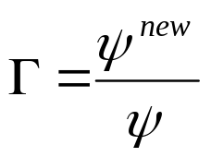
Storm Intensity Correction (continue)
Temperature and water vapor adjustments after wind speed correction
  Model consistent temperature adjustment:
  Case I: wind speed in background is stronger than obs.
    If the background vortex is close to observation, we have,
    β is close to 1
    Define
    Then temperature fields can be corrected using equation (1.4.1.2.9), and water vapor fields can be corrected following equations (1.4.1.3.4) and (1.4.1.3.6).

Slide 31
Storm Intensity Correction (continue)
Temperature and water vapor adjustments after wind speed correction
  Model consistent temperature adjustment:
  Case II: wind speed in background is weaker than obs.
    If the background vortex is close to observation, we have,
    β is close to 0
    Define
    Then temperature field and moisture fields can be similarly corrected as in Case I.
  Note: Intensity correction can be moderately large, the nonlinear effect of the balance equation is included in the formulation.

Slide 32

Storm Intensity Correction (continue)
Convergence for intensity adjustment
➔Case I: wind speed in background is stronger than obs.
  In this case β=1.0, no wind speed correction, from equations (1.4.1.2.2), (1.4.2.2.3) and (1.4.1.2.5), we have,
  ➔Case II: wind speed in background is weaker than obs.
  In Case II, β=0, no wind speed correction, from equations (1.4.2.2.5), (1.4.1.2.6), we have (1.4.1.2.7),
  From equations (1.4.1.1.9), (1.4.1.2.9) and (1.4.1.3.6), there will be no adjustments in 2D surface pressure, 3D temperature and 3D water vapor fields in the background

Slide 33
7. Summary and discussions
Creation of the guess fields can be considered as a mini data analysis for storm vortex in the background fields which includes three parts:
  storm relocation (data used: storm center position)
  storm size correction (data used: radius of maximum surface wind speed, and radius of the outermost closed isobar)
  storm intensity correction (data used: maximum surface wind speed, and to some extent, the minimum sea level pressure)
  Note: Do storm size correction before storm intensity correction to avoid broad eyewall structure, or worse, two distinct eyewalls.
If the background vortex is close to the observation, all corrections are small.
  From the convergence discussions, if the vortex location, vortex size and vortex intensity in the background fields match the observations, there will be no changes to any of the background fields

Slide 34
Summary and discussions (continue)
Limitation in current operational HWRF vortex initialization
The purpose of the mini-analysis is to create better background fields using TCVitals. Then add 3D data on top of the new vortex. The current GSI has the capability to add airborne radar data. Since the airborne radar data are expensive to collect, only less than 10% of the forecast cycles have these data. So, for most of the storms, we only have the low level control, upper level structure (for example, storm depth) may be very different from observation, particularly in shear environment.
Current work in HWRF vortex initialization
We are working to add the satellite radiance data in the hurricane core area. We have made very good progresses. We are hoping a major improvement in hurricane intensity forecast after the work is completed.
Thank you very much for attending this tutorial !!!

