Slide 1



HWRF Data Assimilation System
Mingjing Tong
NOAA/NCEP/EMC
2016 HWRF Tutorial, January 25th, NCWCP

Slide 2
Outline
HWRF Data assimilation system
GSI customization
Data assimilation configuration
Set up hybrid DA
Control assimilation of observations
Conventional data preprocessing
TDR DA
Satellite DA

Slide 3
Data assimilation for HWRF
2013 | A GSI based one-way hybrid ensemble-variational data assimilation system was implemented for HWRF. The system uses the global ensemble from the NCEP GFS GSI/EnKF hybrid system to estimate flow-dependent background error covariance. The first time the assimilation NOAA P3 Tail Doppler Radar (TDR) data was implemented in operational HWRF.
2014 | Assimilation of satellite observations (radiance from IR, MW; satellite wind, GPS RO) was implemented in operational HWRF (E. Liu, B. Zhang) New technique implemented for radiance assimilation – use global-regional blended vertical coordinate in analysis (D. Parrish)
2015 | 40 member ‘warm-start’ HWRF ensemble for inner-core background error covariance Assimilation of HS3/Global Hawk dropsonde observations Assimilation of TC vitals Minimum Sea Level Pressure data
3

Slide 4
HWRF hybrid data assimilation system
Conventional data
TDR data
Satellite radiance data
Satellite derived wind
GPS RO banding angle
HS3 dropsonde, Tcvital MSLP data
HWRF one-way hybrid system
GSI hybrid Ens/Var DA d03
Analysis outer, middle, inner
HWRF
3-9hr
forecast
Vortex initialization
GSI hybrid Ens/Var DA d02
Analysis outer, middle, inner
HWRF
forecast
HWRF ensemble forecast
member 1
member 2
……
member 40
Vortex
relocation
member 1
member 2
……
member 40
Outer domain
analysis
TDR available
TDR
not available
Global EnKF/Var hybrid system
Recenter analysis
Analysis
member 1
member 2
……
member 80
Forecast
member 1
member 2
……
member 80
Analysis
member 1
member 2
……
member 80
Forecast
member 1
member 2
……
member 80
EnKF member
update
high res
analysis
high res
forecast
GSI hybrid Ens/Var
high res
analysis
high res
forecast

Slide 5
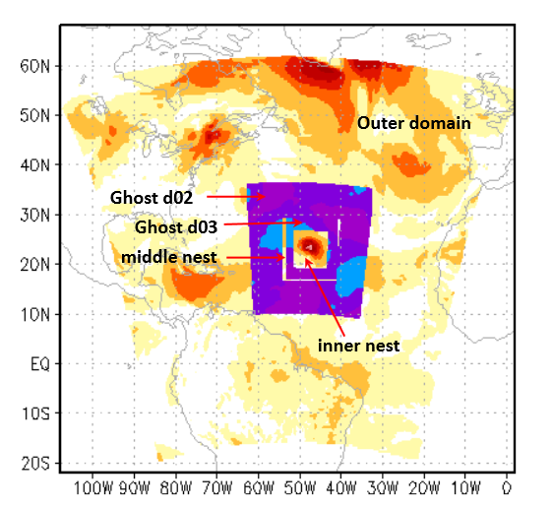
HWRF Data Assimilation Configuration
61 vertical levels with 2 hPa model top
Model forecast domains
outer domain: 288x576 – 80°x80° ; 0.135°
middle nest: 142x274 – 12°x11°; 0.045°
inner nest: 265x472 – 7.1°x6.5°; 0.015°
HWRF vortex initialization domain
3x domain: 748x1504 – 30°x30°
GSI analysis domain (configurable):
ghost d02: 289x579 - 26°x26°; 0.045°
ghost d03: 434x867 - 13°x13°; 0.015°
GSI analysis domains are configurable.
ens d02
2015 domain configuration

Slide 6
Assimilation System
First guess
TC environment cold start from GDAS forecast
TC vortex cycled from HWRF forecast + vortex relocation/initialization
First Guess at Appropriate Time (FGAT) – configurable (3hourly , hourly)
Hybrid data assimilation configuration
80 ensemble member at T254L64 (2013, 2014) T574L64 (2015)
Localization
Horizontal: 773 km (ghost d02), 387 km (ghost d03)
Vertical: 1.28 scale height (in natural log of pressure)
Static vs. ensemble covariance: 80% ensemble, 20% static
assimilation window
-6 hr
-3 hr
0 hr
+3 hr

Slide 7
Assimilation System
GSI analysis variables
Analysis variables used for HWRF include streamfunction (ψ), unbalanced velocity potential (χ), unbalanced temperature (T), unbalanced surface pressure (Ps), normalized relative humidity,
Balanced part of velocity potential , temperature and surface pressure (χ_{b}, T_{b} and P_{sb}) are calculated from ψ using pre-specified statistical balance relationship specified in the background error statistics file.
Currently ozone, cloud variables and satellite bias correction coefficients are not analyzed for HWRF
Model variables currently updated
u, v, t, q, pd, pint

Slide 8
Assimilation System - Observations
2014 HWRF | 2015 HWRF | Future
Conventional data radiosondes; dropwindsondes; aircraft reports (AIREP/PIREP, RECCO , MDCRS-ACARS, TAMDAR, AMDAR); surface ship and buoy observations; surface observations over land; pibal winds; wind profilers; radar-derived Velocity Azimuth Display (VAD) wind; WindSat scatterometer winds; and integrated precipitable water derived from the Global Positioning System. | Conventional data same as 2014 | Conventional data
Satellite data Radiances from IR instruments: HIRS,AIRS, IASI, GOES Sounders Radiances from MW instruments: AMSU-A, MHS, ATMS Satellite derived wind: IR/VIS cloud drift winds, water vapor winds Satellite derived wind: IR/VIS cloud drift winds, water vapor winds GPS RO bending angle | Satellite data same as 2014 | Satellite data Hourly AMVs Cloudy radiance
Aircraft Reconnaissance observations P3 TDR | Aircraft Reconnaissance observations P3 TDR, GH dropsondes | Aircraft Reconnaissance observations Flight level, SFMR, G-IV radar, GH radar, UAS

Slide 9
GSI customization

Slide 10
Data Assimilation Configuration
Set up DA configuration in parm/hwrf_basic.conf
[config]
run_gsi=yes ;; GSI and FGAT initialization
run_relocation=yes ;; vortex relocation
If run_gsi=no, initial condition = GFS analysis + vortex initialization
conditional_gsid03=no ;; run gsi_d03, only when high-res inner-core data are available
conditional_gsid02=no ;; run gsi_d02, only when high-res inner-core data are available
blend_innercore=yes ;; use vortex initialization in inner core region
< 150 km from TC center: vortex initialization
150 km to 300 km: blending zone
>300 km GSI analysis
Vertically (< 150 km from TC center):
> 600 hPa: vortex initialization
600 hPa-400 hPa: blending zone
< 400 hPa: GSI analysis

Slide 11
Data Assimilation Configuration
Set up DA configuration in parm/hwrf.conf
[relocate]
initopt=0 ;; 0: full vortex initialization (relocation + size correction + intensity correction), 1: relocation only
tdrconditionalvinit=yes ;; if yes, relocation only when TDR data available
[fgat]
# FGAT hours:
FGATSTR=-3 ;; FGAT starting hour (relative to analysis time)
FGATINV=3 ;; Step in hours between the FGAT hours
FGATEND=3 ;; FGAT end hour
[forecast_products]
wrfcopier_step=3 ;; Step between times WRF output is copied to COM (hours)
Change time levels of FGAT: e.g. hourly FGAT -> FGATINV=1, wrfcopier_step=1

Slide 12
Set up hybrid DA configuration
Using global ensemble
hwrf_basic.conf:
[config]
run_ensemble_da=no ;; run HWRF ensemble forecast for DA
This one controls if HWRF ensemble will be run
hwrf.conf:
[gsi_d02] /[gsi_d03]
use_hwrf_ensemble = no
[gsi_d02_nml]
REGIONAL_ENSEMBLE_OPTION=1
Using HWRF ensemble (non-cycled)
hwrf_basic.conf:
[config]
run_ensemble_da=yes ;; run HWRF ensemble forecast for DA
run_ens_relocation=no ;; Turn on/off relocation for ensemble members
hwrf.conf:
[gsi_d03]
use_hwrf_ensemble = yes
[gsi_d03_nml]
REGIONAL_ENSEMBLE_OPTION=2

Slide 13
Set up hybrid DA Configuration - continued
Set up GSI namelist through parm/hwrf.conf
[gsi_d02_nml]/[gsi_d03_nml]
# Namelist settings for domain 2 (6km) GSI as an example
HZSCL=0.25,0.5,1.0 ;; background error scale factor for horizontal smoothing
DELTIM=1200 ;; model timestep used for assimilation of precipitation rates
twind=3.0 ;; maximum half time window (hours) for observations
HYBENS_REGIONAL=T ;; logical variable, if .true., then turn on hybrid ensemble option
ENSEMBLE_SIZE_REGIONAL=80 ;; ensemble size
HYBENS_UV_REGIONAL=T ;; if T, then ensemble perturbation wind stored as u,v. if F, streamfunction and velocity potential
BETA1_INV_REGIONAL=0.2 ;; value between 0 and 1, relative weight given to static background B
HYBENS_HOR_SCALE_REGIONAL=300 ;; horizontal localization correlation length (km)
HYBENS_VER_SCALE_REGIONAL=-0.5 ;; vertical localization correlation length (>0. grid units, <0. lnp)
READIN_LOCALIZATION=F ;; if T, then read in localization information from external file
GENERATE_ENS_REGIONAL=F ;; if T, generate ensemble perturbations internally as random samples of static B.
## integer, used to select type of ensemble to read in for regional application.
# =1: use GEFS internally interpolated to ensemble grid.
# =2: ensembles are WRF NMM format
# =3: ensembles are ARW netcdf format.
# =4: ensembles are NEMS NMMB format.
REGIONAL_ENSEMBLE_OPTION=1 (global ensemble)
PSEUDO_HYBENS=F ;; if T, use pseudo HWRF (NMM) ensemble
GRID_RATIO_ENS=1 ;; ratio of ensemble grid resolution to analysis grid resolution
MERGE_TWO_GRID_ENSPERTS=F ;; merge ensemble from two nests for HWRF (NMM)
PWGTFLG=F ;; if T, use vertical integration function on ensemble contribution of Psfc
BETAFLG=F ;; if T, use vertical weighting on beta1_inv and beta2_inv, for regional
HYBENS_ANISO_REGIONAL=F ;; if T, then use anisotropic recursive filter for localization
WRITE_ENS_SPRD=F ;; if T, write out ensemble spread

Slide 14
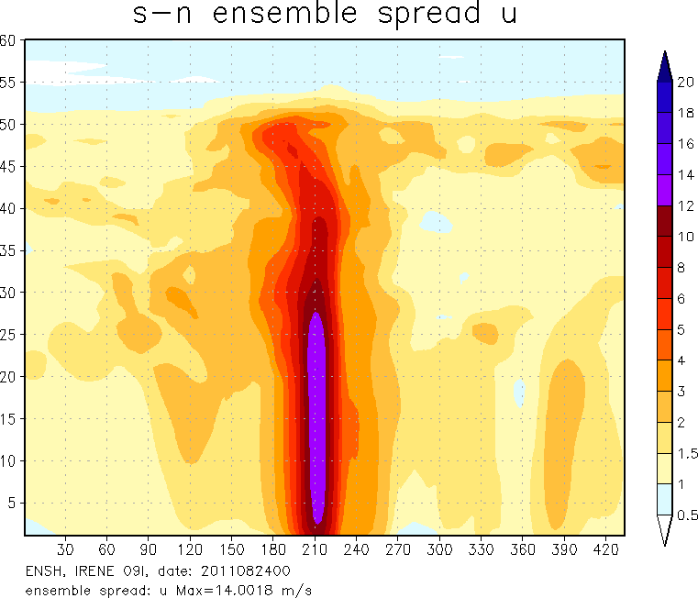
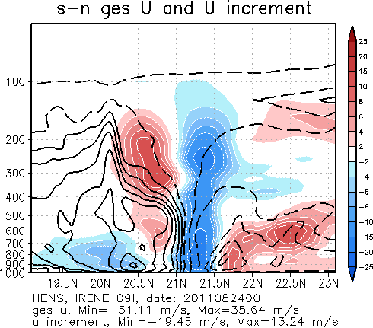
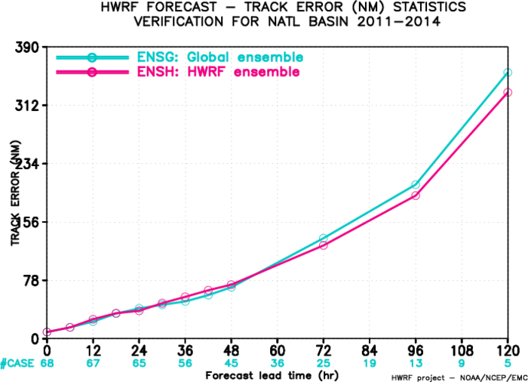
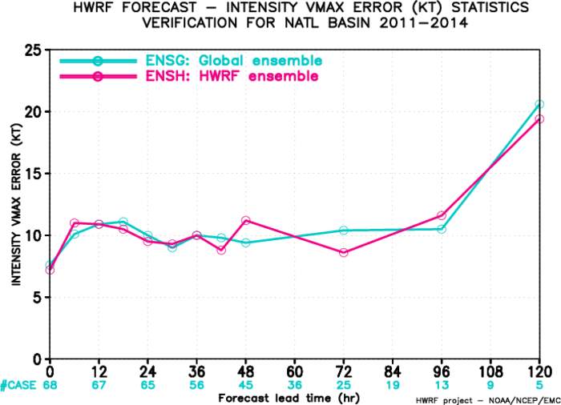
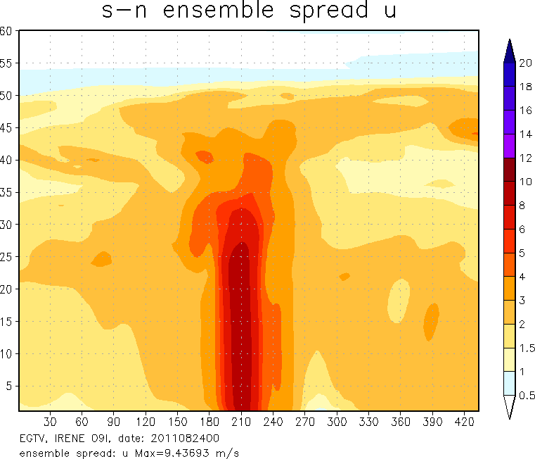
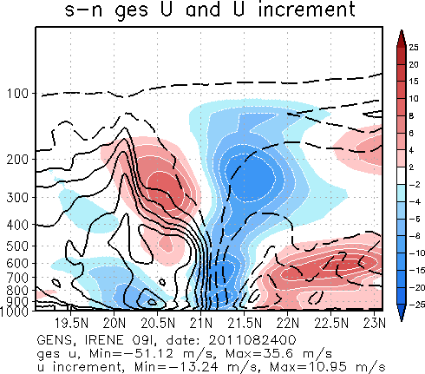
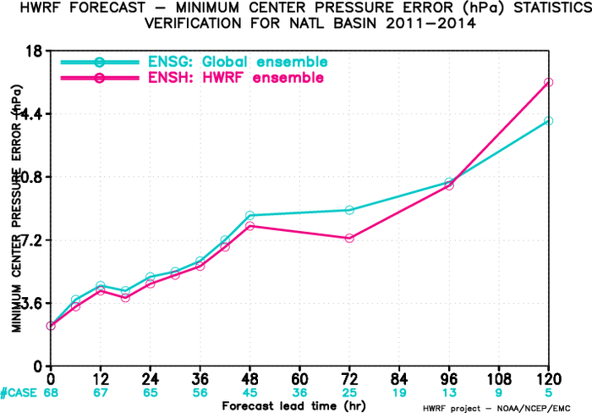
‘Warm-start’ HWRF vs. global ensemble (2015)
‘warm-start’ HWRF ensemble:
improves track forecast, has neutral impact on intensity forecast.
larger spread with smaller scale structures
larger analysis increments

Slide 15
Observations – control data usage
Presence or lack of input data – control through hwrf.conf
[gsi_d02]/[gsi_d03]
obstypes = hdob_obstype,sat_radiance_obstypes,sat_wnd_obstype,tdr_new_obstype ;; List of obstype sections
(data type not listed will not be linked for assimilated)
[sat_radiance_obstypes] (instruments not listed here will not be linked for assimilated)
gpsrobufr=gpsro ;; GFS/GDAS bufr_d name for gpsrobufr data
gsnd1bufr=goesfv ;; GFS/GDAS bufr_d name for gsnd1bufr data
amsuabufr=1bamua ;; GFS/GDAS bufr_d name for amsuabufr data
hirs4bufr=1bhrs4 ;; GFS/GDAS bufr_d name for hirs4bufr data
mhsbufr=1bmhs ;; GFS/GDAS bufr_d name for mhsbufr data
airsbufr=airsev ;; GFS/GDAS bufr_d name for airsbufr data
seviribufr=sevcsr ;; GFS/GDAS bufr_d name for seviribufr data
iasibufr=mtiasi ;; GFS/GDAS bufr_d name for iasibufr data
amsuabufrears=esamua ;; GFS/GDAS bufr_d name for amsuabufrears data
amsubbufrears=esamub ;; GFS/GDAS bufr_d name for amsubbufrears data
hirs3bufrears=eshrs3 ;; GFS/GDAS bufr_d name for hirs3bufrears data
# ssmitbufr=ssmit
# amsrebufr=amsre
# ssmisbufr=ssmisu
atmsbufr=atms ;; GFS/GDAS bufr_d name for atmsbufr data
crisbufr=cris ;; GFS/GDAS bufr_d name for crisbufr data
Notes:
Observational data are expected to be in BUFR format.

Slide 16
Observations – control data usage
GSI namelist
&OBS_INPUT
dmesh(1)=90.0,dmesh(2)=45.0,dmesh(3)=45.0,dmesh(4)=45.0,dmesh(5)=90,time_window_max=<r:twind>,l_foreaft_thin=.false.,
/
OBS_INPUT::
! dfile dtype dplat dsis dval dthin dsfcalc
prepbufr ps null ps 0.0 0 0
prepbufr t null t 0.0 0 0
prepbufr q null q 0.0 0 0
prepbufr pw null pw 0.0 0 0
prepbufr uv null uv 0.0 0 0
satwndbufr uv null uv 0.0 0 0
prepbufr spd null spd 0.0 0 0
prepbufr dw null dw 0.0 0 0
radarbufr rw null rw 0.0 0 0
prepbufr sst null sst 0.0 0 0
tcvitl tcp null tcp 0.0 0 0 -> assimilate tcvitals MSLP data
<s:tdrtype> rw null rw 0.0 0 0
hdobbufr uv null uv 0.0 0 0
hdobbufr t null t 0.0 0 0
hdobbufr q null q 0.0 0 0
hdobbufr spd null spd 0.0 0 0
gpsrobufr gps_bnd null gps 0.0 0 0
ssmirrbufr pcp_ssmi dmsp pcp_ssmi 0.0 -1 0
tmirrbufr pcp_tmi trmm pcp_tmi 0.0 -1 0
sbuvbufr sbuv2 n16 sbuv8_n16 0.0 0 0
sbuvbufr sbuv2 n17 sbuv8_n17 0.0 0 0
sbuvbufr sbuv2 n18 sbuv8_n18 0.0 0 0
hirs3bufr hirs3 n17 hirs3_n17 0.0 1 0
Data thinning grid size (km), work with dthin
Maximum half time window (hrs)
work with twindow in convinfo
Observations not listed here will not be assimilated

Slide 17
Observations – control data usage
3. GSI info/fix files
convinfo (for conventional data)
!otype type sub iuse twindow numgrp ngroup nmiter gross ermax ermin var_b var_pg ithin rmesh pmesh npred pmot ptime
tcp 112 0 1 3.0 0 0 0 75.0 5.0 1.0 75.0 0.000000 0 0. 0. 0 0. 0. -> tcvital MSLP
ps 111 0 -1 3.0 0 0 0 5.0 3.0 1.0 5.0 0.000 0 0. 0. 0 0. 0.
ps 120 0 1 3.0 0 0 0 4.0 3.0 1.0 4.0 0.000300 0 0. 0. 0 0. 0.
ps 132 0 -1 3.0 0 0 0 4.0 3.0 1.0 4.0 0.000300 0 0. 0. 0 0. 0.
satinfo (for satellite data)
sensor/instr/sat chan iuse error ermax var_b var_pg
amsua_n15 1 1 3.000 4.500 10.00 0.000
amsua_n15 2 1 2.000 4.500 10.00 0.000
amsua_n15 3 1 2.000 4.500 10.00 0.000
amsua_n15 4 1 0.600 2.500 10.00 0.000
amsua_n15 5 1 0.300 2.000 10.00 0.000
amsua_n15 6 1 0.230 2.000 10.00 0.000

Slide 18
Conventional Data Pre-processing
Control through hwrf.conf
[bufrprep]
## options to preprocess prepbufr file
#
# 0: make no change
# 1: remove some inner-core data
# 2: flag/unflag mass and dropsonde u, v data
# 3: unflag HS3/Global Hawk dropsonde data (assimilate HS3 dropsonde in FY15 HWRF)
prepbufrprep=3 ;; parameter used to preprocess prepbufr file
## parameter used to define an area where inner-core data are removed/(un)flagged
#
# radius of a circle centered at TC center
# > 0. remove conventional data, when prepbufrprep=1
# flag dropsonde wind data, when prepbufrprep=2
# < 0. unflag dropsonde wind data, when prepbufrprep=2
# = 0. no change for dropsonde wind data, when prepbufrprep=2
RRADC=50.
## parameter used to define a square area to flag pressure data
#
# half side length of a squre centered at TC center
# > 0. flag pressure data, when prepbufrprep=2
# <= 0. no change, when prepbufrprep=2
RBLDC=-200.

Slide 19
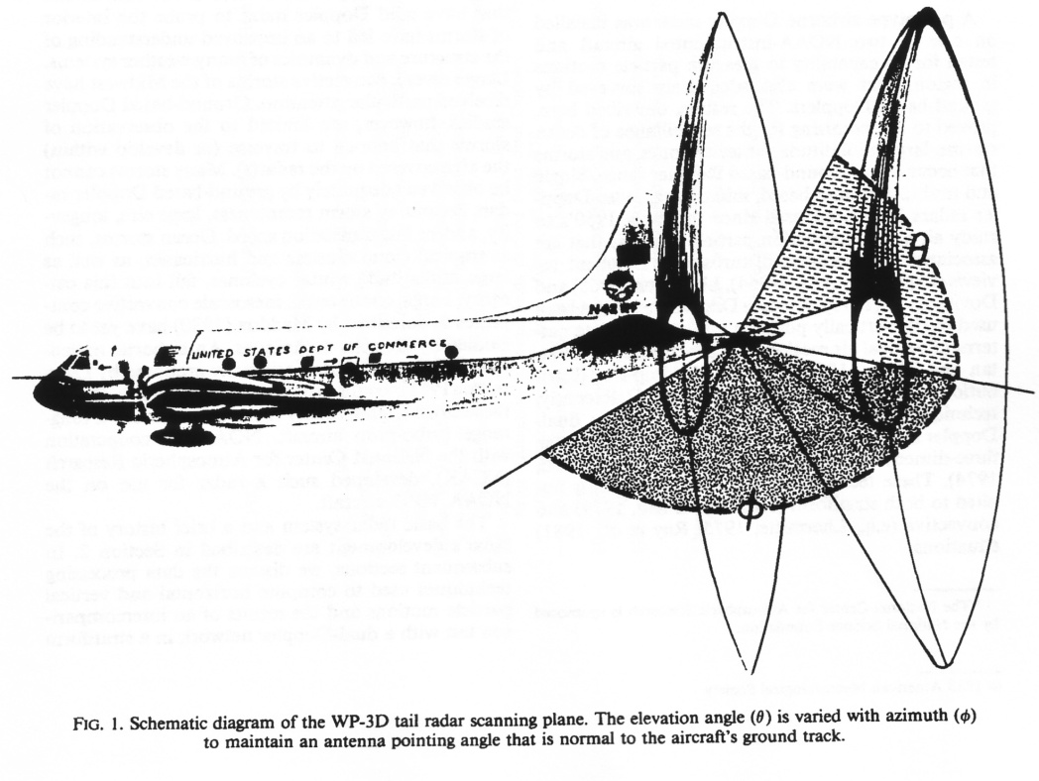
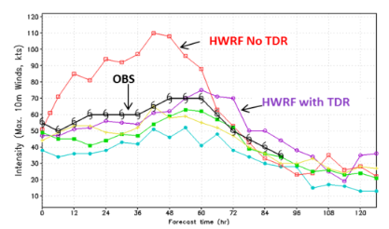
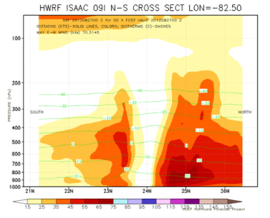
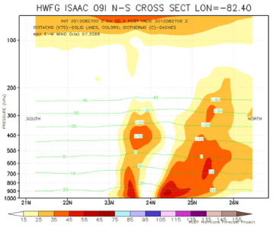
Assimilation of NOAA P3 TDR data
Jorgensen et al., 1983, J. Climate Appl. Meteor, 22, 744-757
No TDR
with TDR

Slide 20
TDR Data Assimilation
parm/hwrf.conf:
[gsi_d02]/[gsi_d03]
obstypes = hdob_obstype,sat_radiance_obstypes,sat_wnd_obstype,tdr_new_obstype
parm/hwrf_gsi.nml
OBS_INPUT::
! dfile dtype dplat dsis dval dthin dsfcalc
prepbufr sst null sst 0.0 0 0
tcvitl tcp null tcp 0.0 0 0
<s:tdrtype> rw null rw 0.0 0 0
GSI fix file – hwrf.convinfo
!otype type sub iuse twindow numgrp ngroup nmiter gross ermax ermin var_b var_pg ithin rmesh pmesh npred pmot ptime
……
t 134 0 1 3.0 0 0 0 7.0 5.6 1.3 7.0 0.004000 0 0. 0. 0 0. 0.
……
rw 999 0 -1 2.5 0 0 0 10.0 10.0 2.0 10.0 0.000000 0 0. 0. 0 0. 0.
rw 990 0 1 3.0 0 0 0 5.0 10.0 2.0 10.0 0.000000 1 9. 0. 0 0. 0. -> P3
rw 991 0 1 3.0 0 0 0 5.0 10.0 2.0 10.0 0.000000 1 9. 0. 0 0. 0. -> P3
rw 992 0 -1 3.0 0 0 0 5.0 10.0 2.0 10.0 0.000000 1 9. 0. 0 0. 0. -> G-IV
rw 993 0 1 3.0 0 0 0 5.0 10.0 2.0 10.0 0.000000 1 9. 0. 0 0. 0. -> P3
20

Slide 21
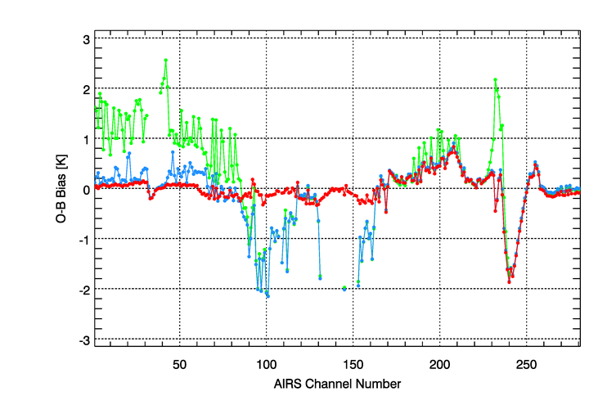
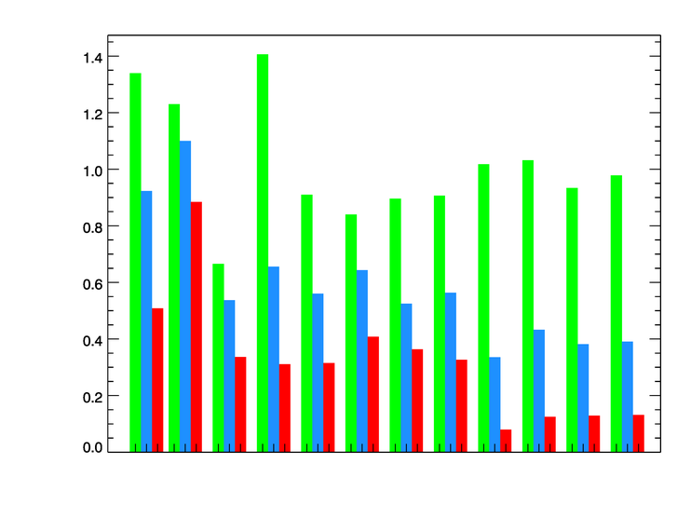
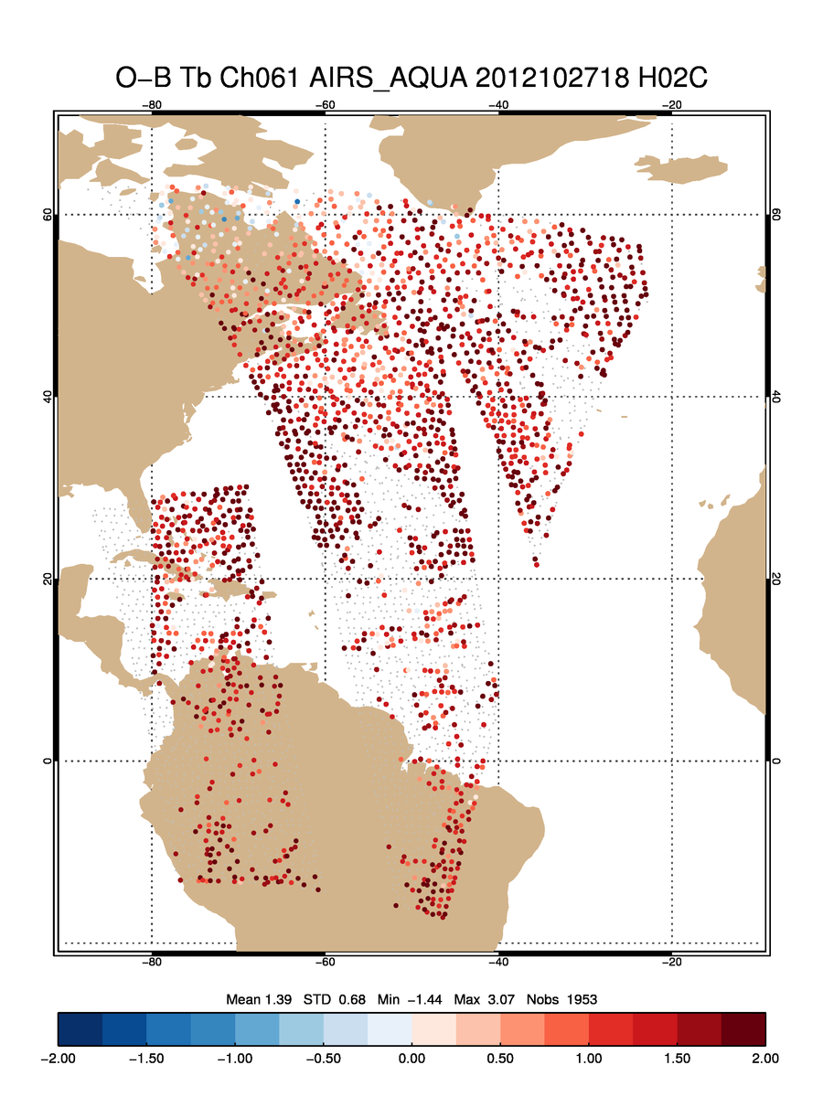
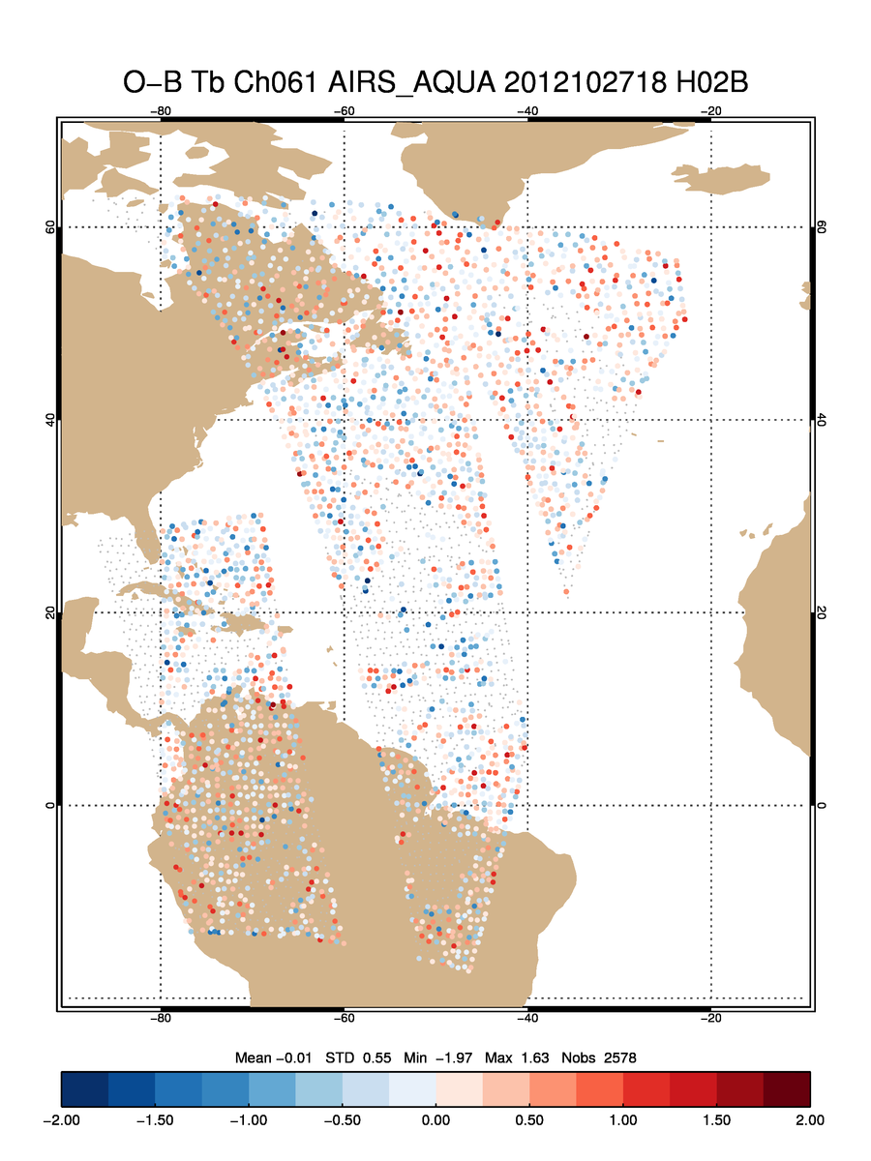
Assimilation of satellite radiance observations
AIRS O-B Bias
Penalty per Observation
61 levels; model top at 2 hPa
76 levels; model top at 0.3 hPa
76 levels; model top at 0.3 hPa; GFS Ozone
IASI
AIRS
61 levels; model top at 2 hPa
76 levels; model top at 0.3 hPa; GFS Ozone
HRIS4
GOES Sonders
Benefit of blended vertical coordinate and GFS ozone in the analysis:
AIRS biases are greatly reduced when blended vertical coordinate and GFS ozone are used in the analysis
Cost function for IR instruments reduced more than 50%
Ch 61
Ch 61
Use GFS ozone
Use bias correction coefficients from GDAS
Emily Liu, David Parrish, Yanqiu Zhu

Slide 22
Satellite Data Assimilation
parm/hwrf.conf
[gsi_d02]/[gsi_d03]
sat_wnd_da = no ;; Enable assimiation of satellite wind?
sat_radiance_da = no ;; Enable satellite radiance data assimilation?
use_newradbc=yes ;; Use new bias correction data for 2015 GFS and later
use_gfs_stratosphere = yes ;; Use blended global-regional vertical coordinate for satellite radiance DA
obstypes = hdob_obstype,sat_radiance_obstypes,sat_wnd_obstype,tdr_new_obstype
GSI fix file - anavinfo
use_gfs_stratosphere = yes -> fix/hwrf-gsi/anavinfo_hwrf_L75
(analysis grid has 75 vertical levels – blended global-regional coordinate)
= no -> fix/hwrf-gsi/anavinfo_hwrf_L60
(analysis grid has 60 vertical levels – model grid)
22

Slide 23
More information about GSI can be found from documentations and tutorial slides at DTC GSI webpage
http://www.dtcenter.org/com-GSI/users/

