Slide 1
Prediction of ride duration of taxi trips
in New York City
Jason Su | Zheming Lian | Jiahui Jiang | Quenu Chen

Slide 2
motivation
Three main transportation tools in New York:
SUBWAY
TAXI
UBER
Regular, unaffected by other factors like weather, time

Slide 3
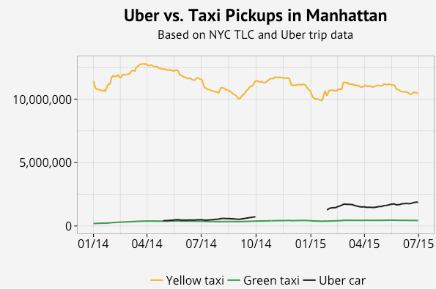
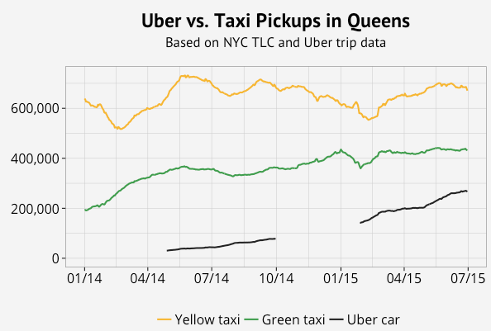
Taxi vs Uber

Slide 4
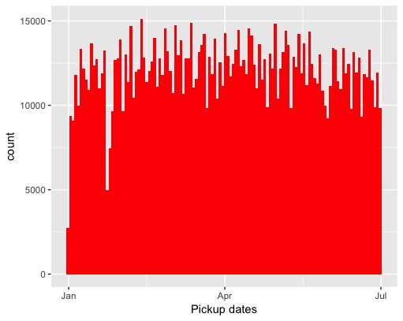
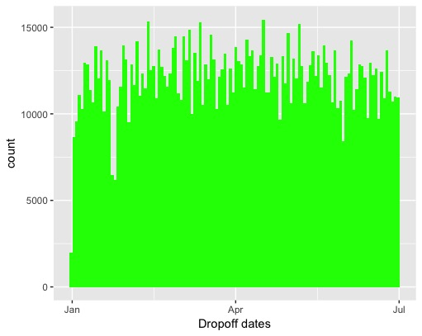

Slide 5
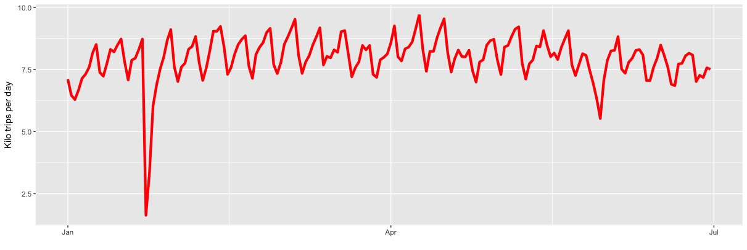
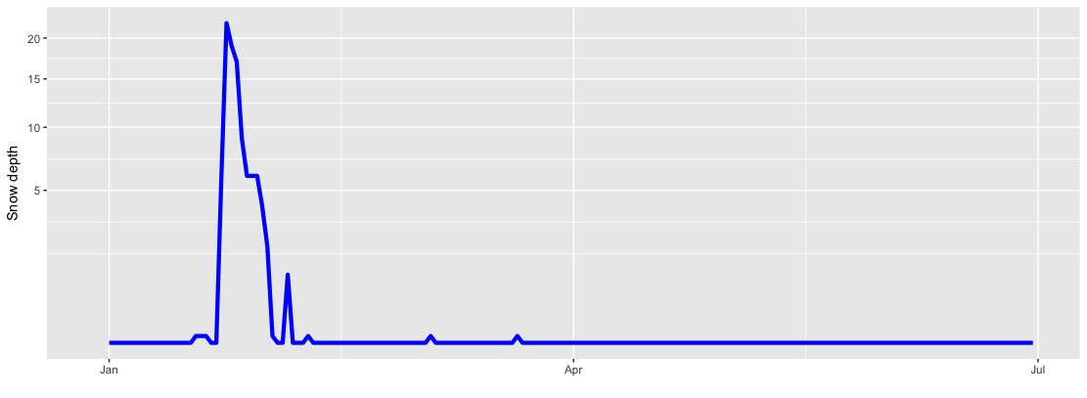
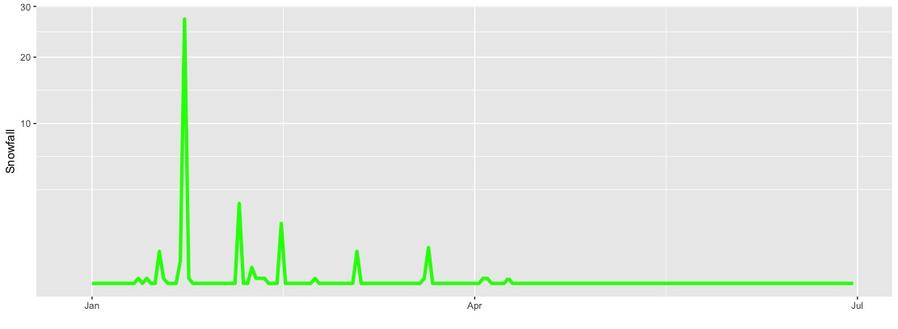
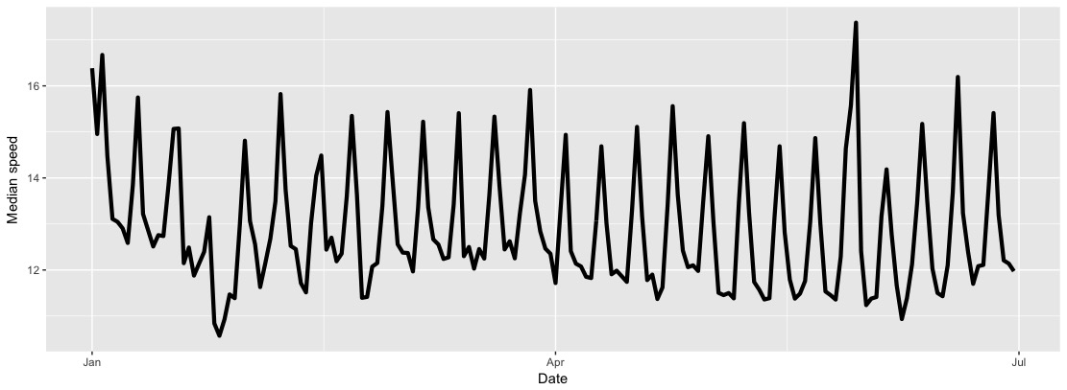

Slide 6
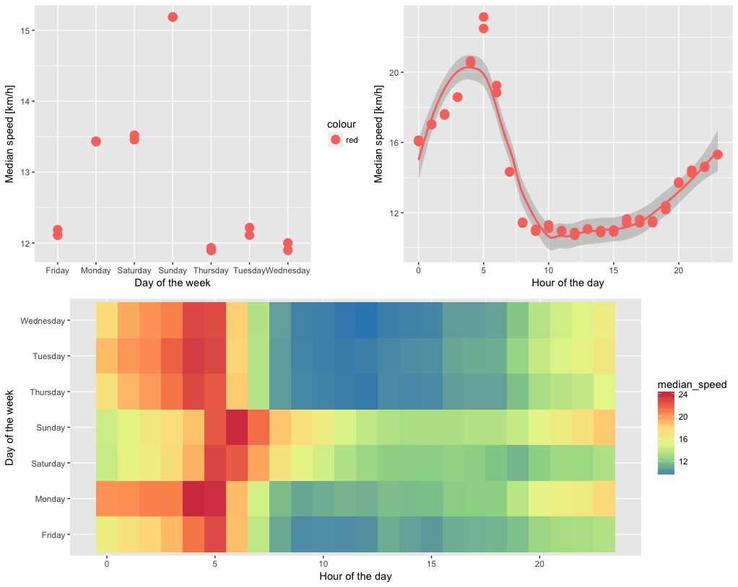
Days&Hours
-
-
-

