Slide 1
China-US Trade Relations
Presented by: Arjun, Christina, Ed, Julio, and Tamara

Slide 2
Background
Important dates:
April 2017 -- Trump launches investigation into steel imports
August 2017 -- Second investigation into China’s trade practices
January 2018 –Tariffs imposed against China on solar panels and washing machines
February 2018 -- Commerce Department proposes tariffs on steel and aluminum
March 9, 2018 -- Trump imposes tariffs on steel and aluminum
April 2, 2018 -- China imposes tariffs on fruits, nuts, wine, steel pipes, recycled aluminum and pork
Source: http://money.cnn.com/2018/04/04/news/economy/trump-china-us-tariffs-trade-timeline/index.html

Slide 3
Volume of Trade

Slide 4
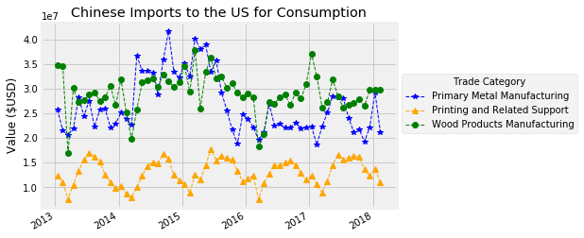
Jump in metals trade imports from China in January, followed by a tumble in February

Slide 5
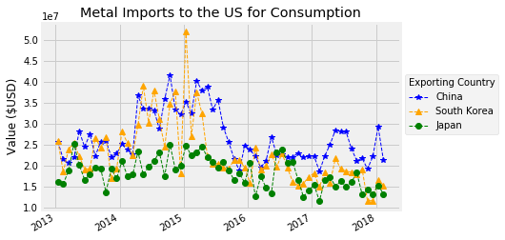
Recent Metals Trade Volatility between the US and China large compared to Volatility between the US and South Korea, Japan

Slide 6
Stock Prices

Slide 7
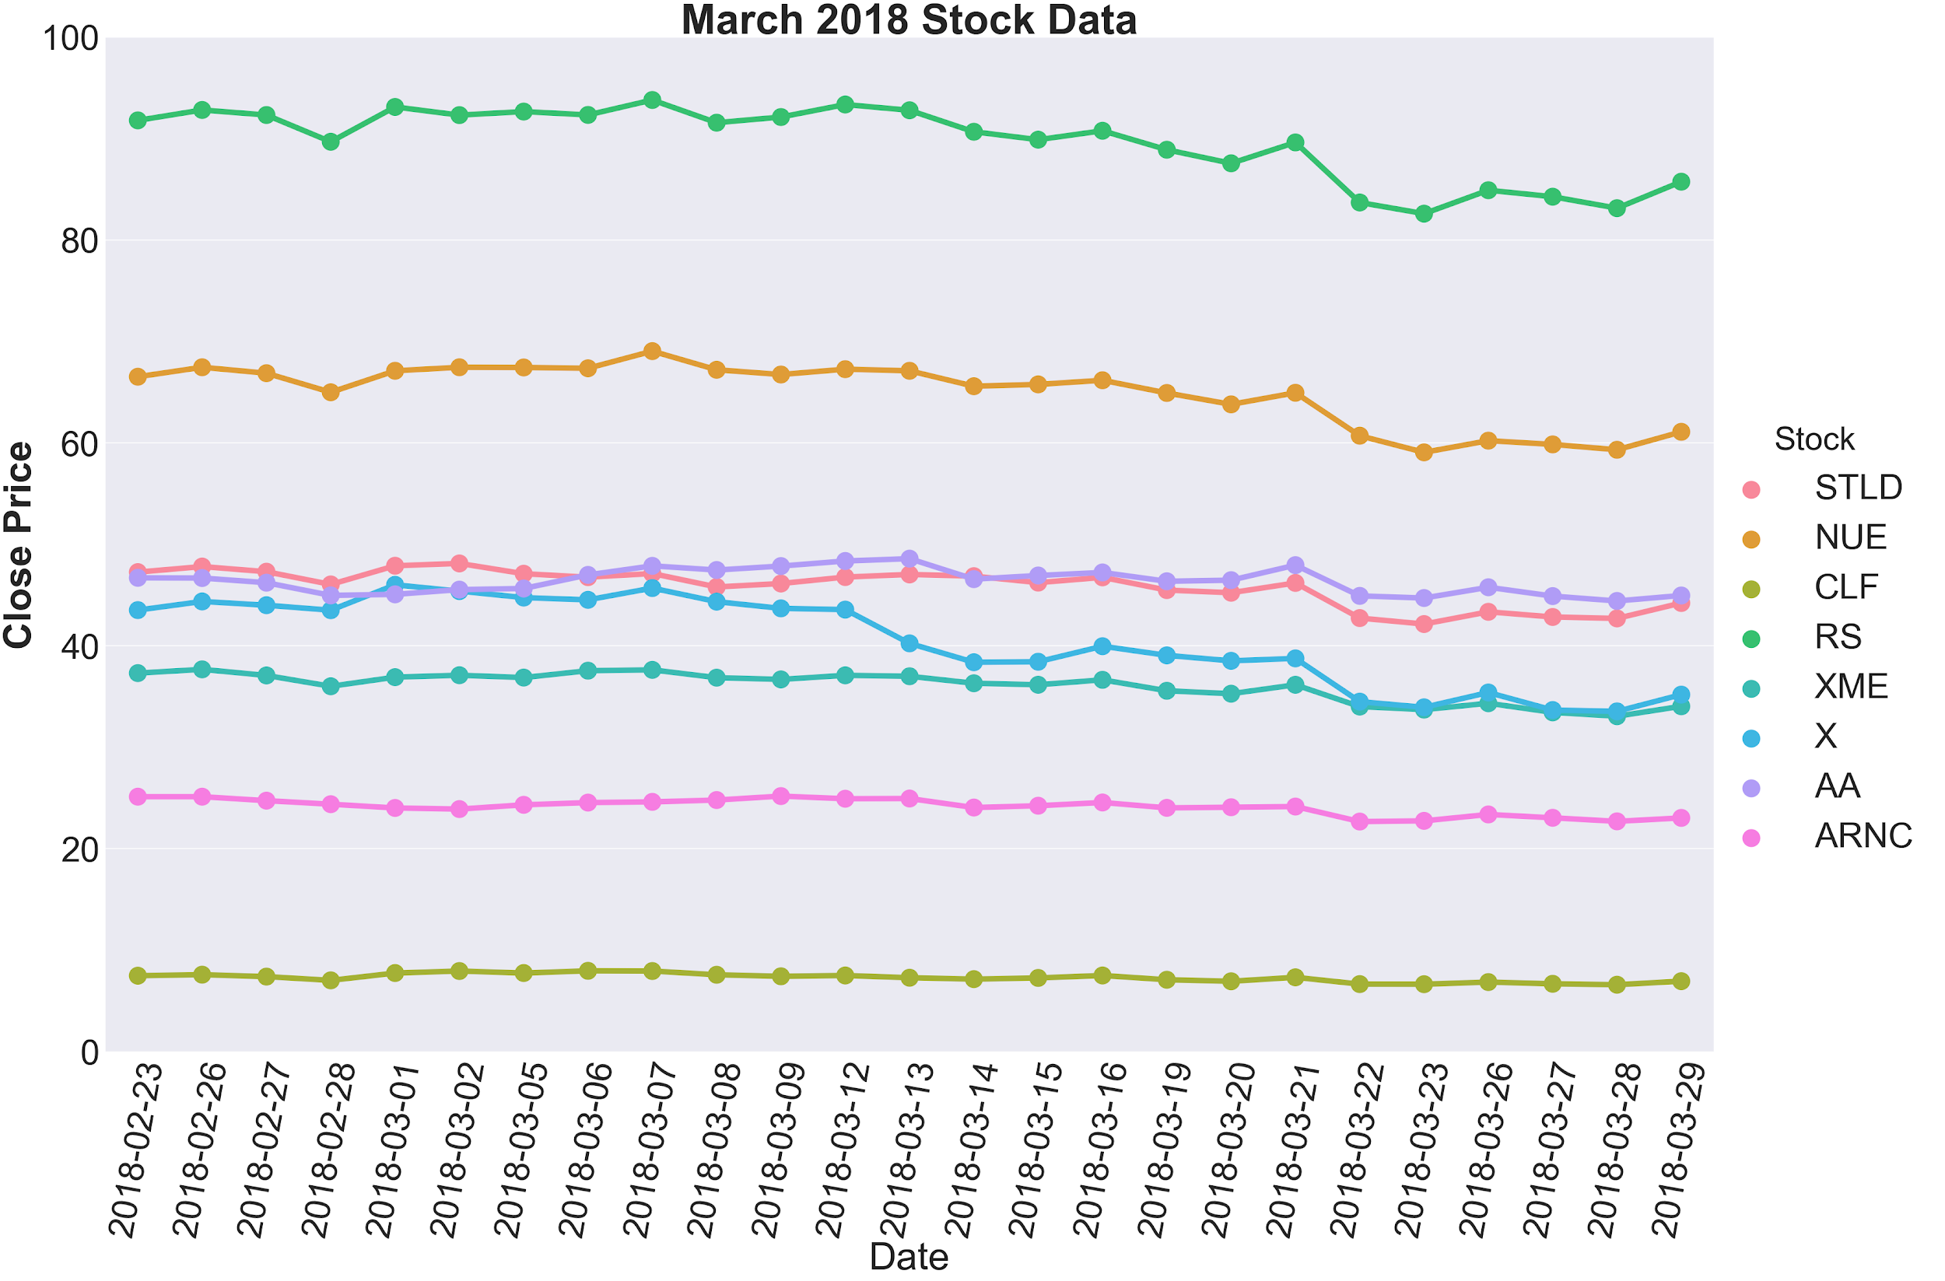

Slide 8
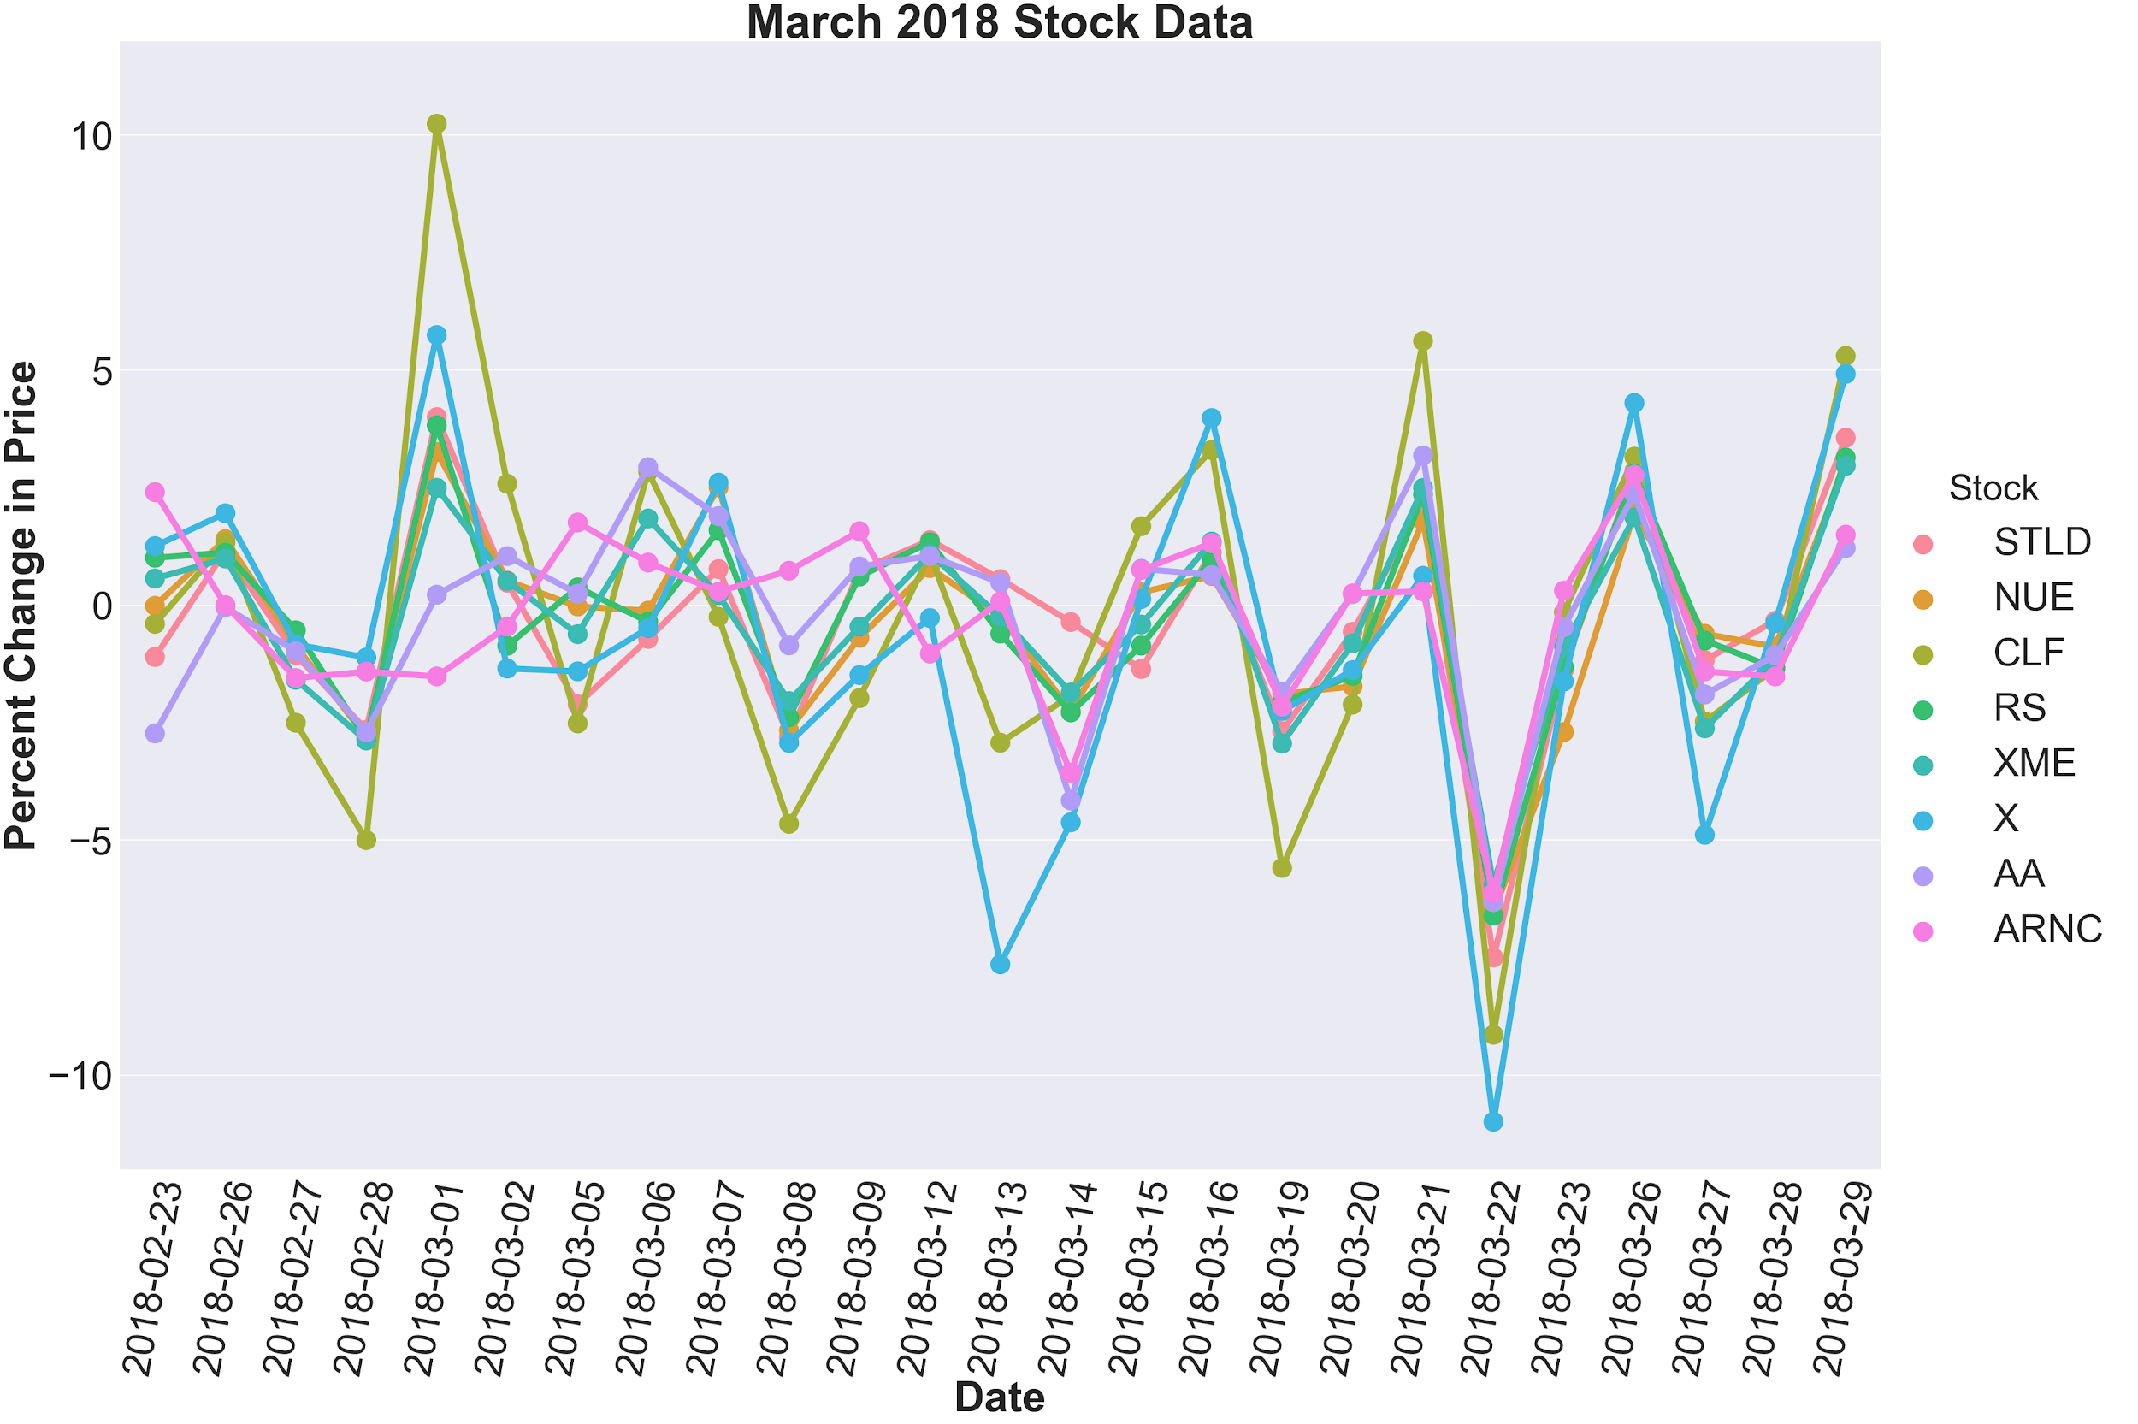

Slide 9
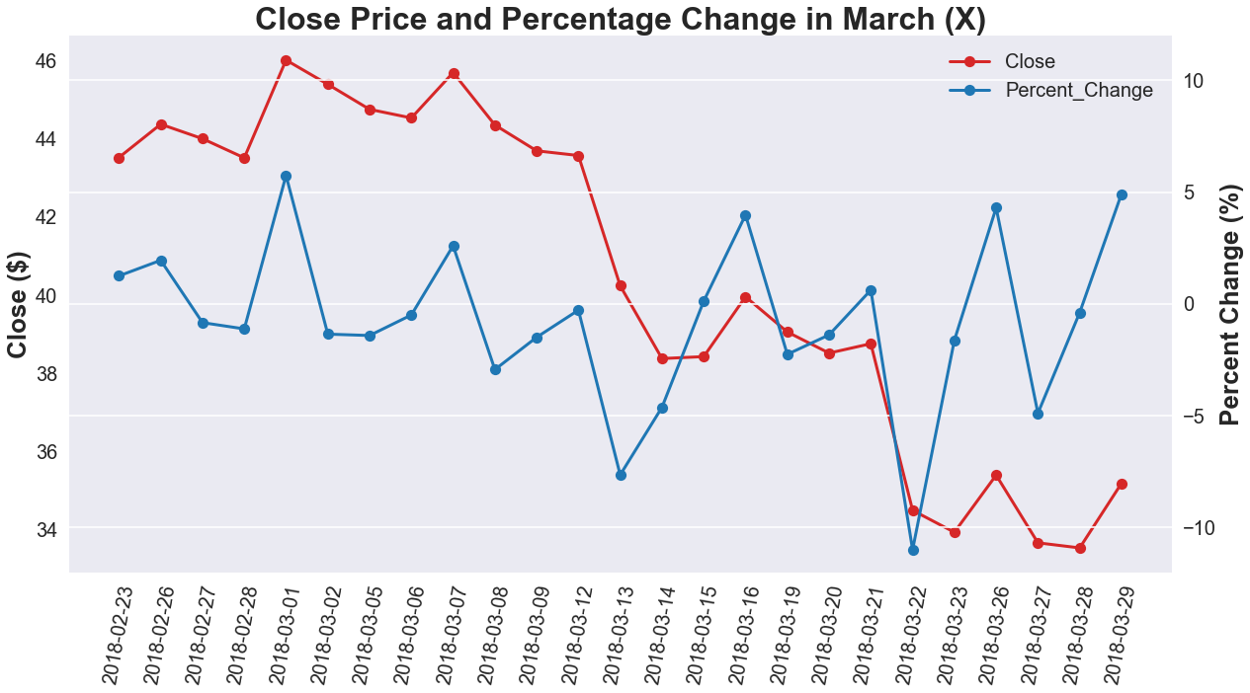

Slide 10
Public Sentiment

Slide 11
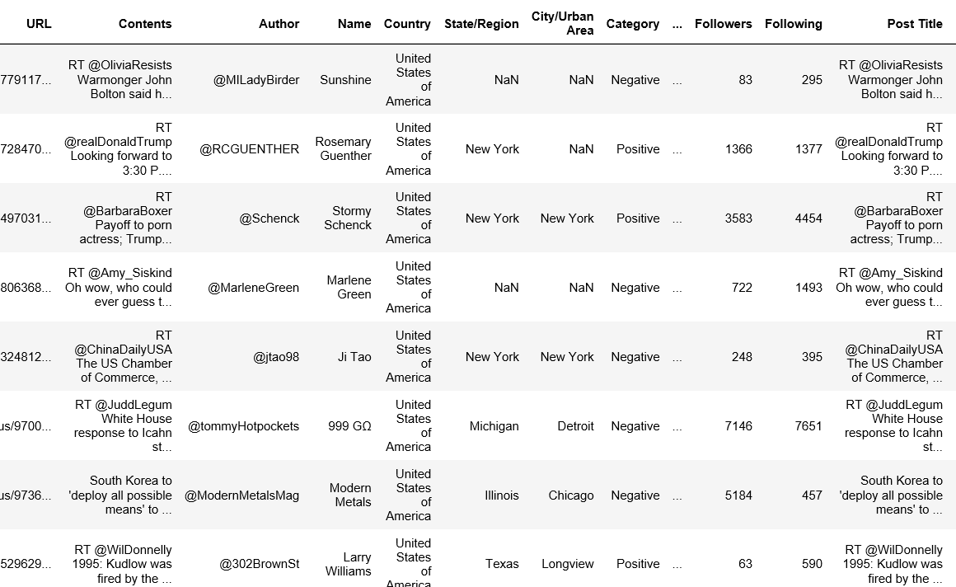
VADER Sentiment Analysis of Sample Tweets
Imported 9,757 tweets to analyze through VADER text sentiment analysis.
Distinguished between tweets and retweets (5,360 are tweets, 4,397 are retweets)
Categorize posts by polarity (2555 Positive - 7202 Negative)

Slide 12
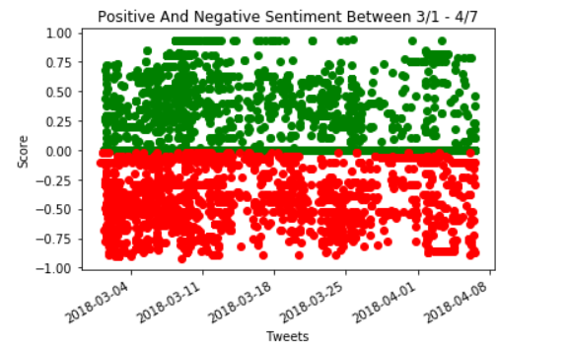
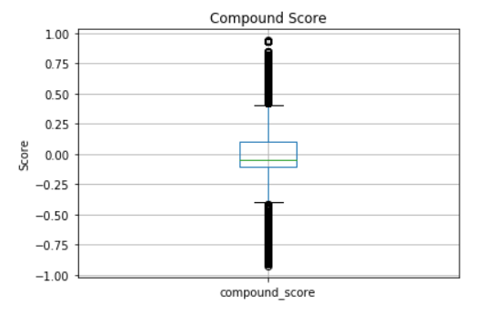
Apply VADER Sentiment Analysis:

Slide 13
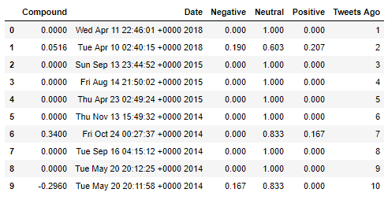
Donald Trump trade Data frame

Slide 14
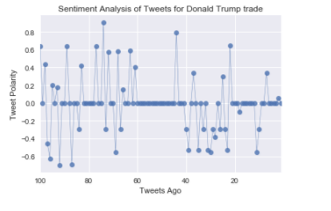
Donald Trump trade Plot Graph

Slide 15
Conclusions
Trade volume: Increased volatility in primary metal imports between December 2017 and February 2018
Stock prices: No significant impact on US steel and aluminum company stock prices in the long-term
Public sentiment: Mixed results

Slide 16
Thank you!
Questions?

