Slide 1
Geometric
Transformations
Notes:
Deck of cards (so avd can show shearing). (slide 27)
- viewing props (should all be together in avd's office)
- TinkerToy House
- Cardboard Frustum
- Square view volume
- Tinkertoy XYZ and UVN axes (make sure they are placed correctly
ie, y points up, before lecture starts)
- view volume shoe box
- camera (ask anne spalter, or bring your own!)
- Exploratories:
- Dot Prod applet (slide 8)
- Scenegraph applet (slide 2, 32)
- Transformation Game (slide 22)
- Transform Propagation (slide 30)
- Coordinate Transformations (slide 26)
- Hierarchy of Transformations (slide 30)
- 2D Normal Scaling?
- 3D Normal Scaling?

Slide 2
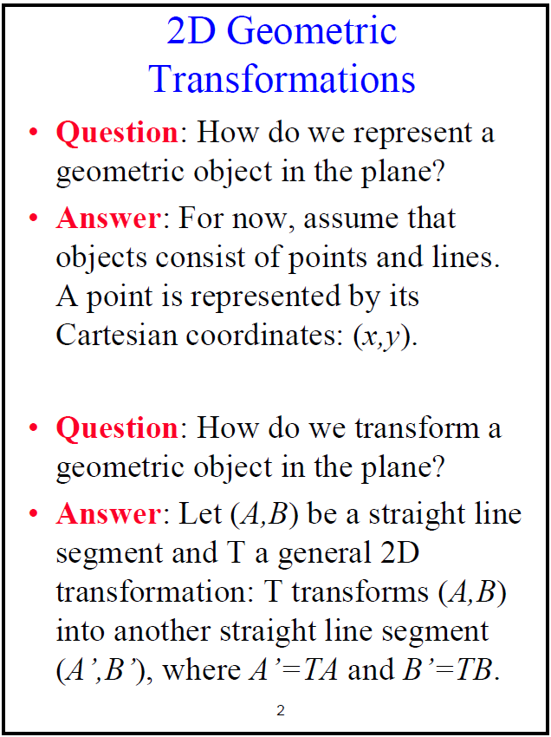


Slide 3
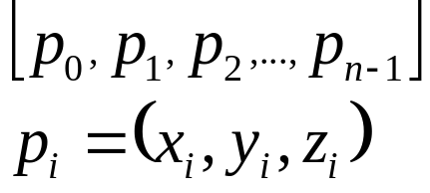
2D Object Definition (1/3)
Lines and Polylines
Polylines: lines drawn between ordered points
Same first and last point make closed polyline or polygon
If it does not intersect itself, called simple polygon
Polygons
Ένα πολύγονο (polygon or face = επιφάνεια) ορίζετε σαν μια σειρά από n σημεία (κορυφές, vertices)
Τα σημεία πρέπει να βρίσκονται στο ίδιο επίπεδο
3 σημεία ορίζουν επίπεδο, αλλά κάποιο τέταρτο δεν είναι κατ’ ανάγκη στο ίδιο επίπεδο

Slide 4
2D Object Definition (3/3)
  Convex vs. Concave Polygons
Convex: For every pair of points in the polygon, the line between them is fully contained in the polygon.
Concave: Not convex: some two points in the polygon are joined by a line not fully contained in the polygon.
Circle as polygon
A circle can be approximated by a polygon with many sides (>15)

Slide 5
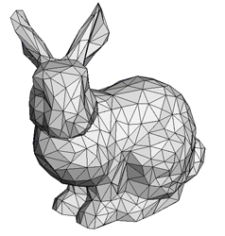
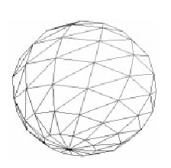
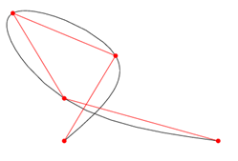
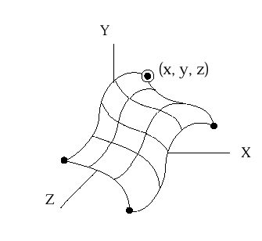
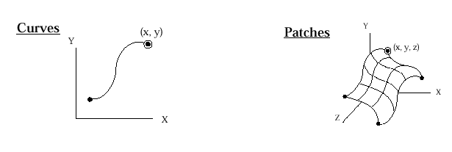
Building 3D Primitives
Triangles and tri-meshes
Often parametric polynomials, called splines
Curves
Patches
Boundaries are
Polynomial curves
In 3D

Slide 6
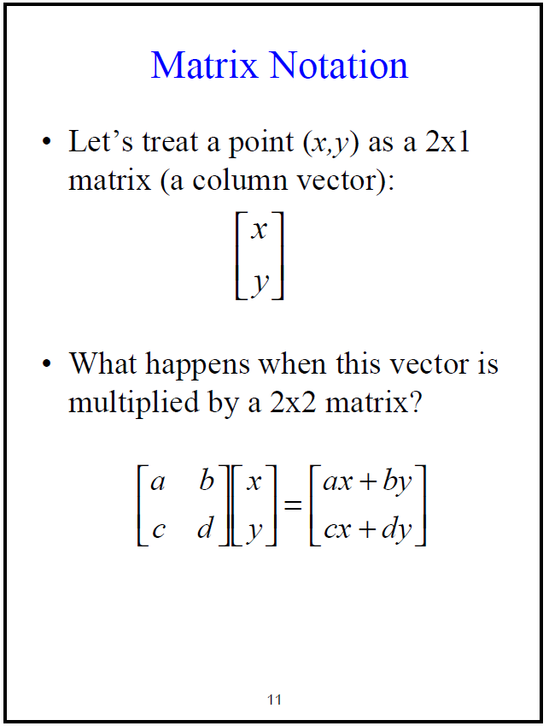

Slide 7


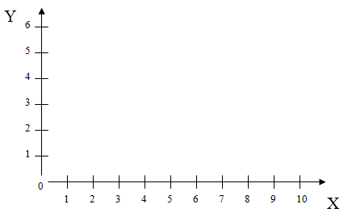
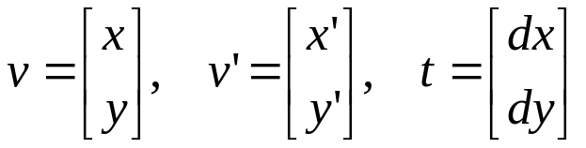
2D Translation
Component-wise addition of vectors
v’ = v + t where
and x’ = x + dx
y’ = y + dy
To move polygons: translate vertices (vectors) and redraw lines between them
Preserves lengths (isometric)
Preserves angles (conformal)
Y
6
5
dx = 2
dy = 3
4
(Note: Points are at object’s
local coordinate system origin)
3
Side effect: House shifts position relative to origin
2
1
0
1
2
3
4
5
6
7
8
9
10
X

Slide 8
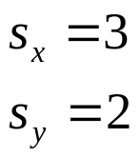




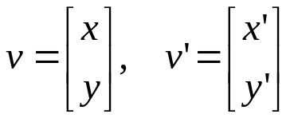
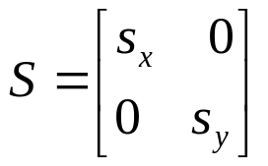
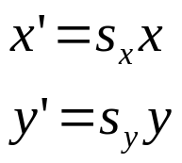
2D Scaling
Component-wise scalar multiplication of vectors
v’ = Sv where
and
Does not preserve lengths
Does not preserve angles (except when scaling is uniform)
Y
6
Side effect: House shifts position relative to origin
5
4
3
2
1
0
1
2
3
4
5
6
7
8
9
10
X

Slide 9

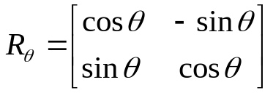
2D Rotation
Rotation of vectors through an angle θ
v’ = R_{θ} v where
and x’ = x cos Ө – y sin Ө
y’ = x sin Ө + y cos Ө
NB: A rotation by 0 angle, i.e. no rotation at all, gives us the identity matrix
Proof by sine and cosine summation formulas
Preserves lengths in objects, and angles between parts of objects
Y
6
Side effect: House shifts position relative to origin
5
4
3
2
1
0
1
2
3
4
5
6
7
8
9
10
X

Slide 10
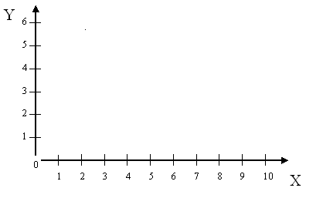
2D Rotation and Scale are Relative to Origin
Suppose object is not centered at origin and we want to scale and rotate it.
Solution: move to the origin, scale and/or rotate in its local coordinate system, then move it back.
This sequence suggests the need to compose successive transformations…
Object’s local coordinate
system origin

Slide 11
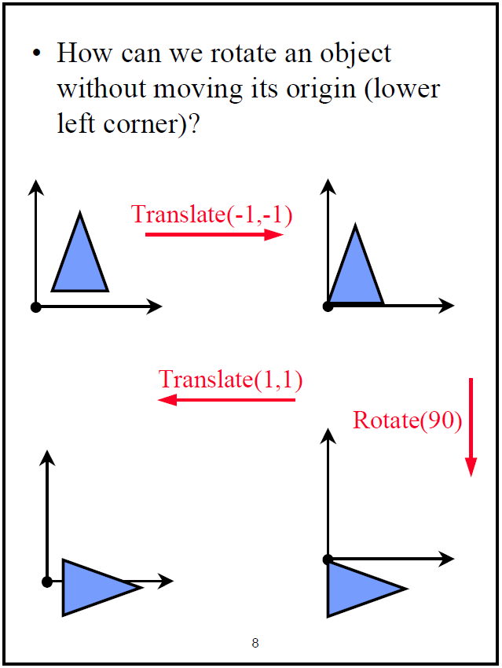

Slide 12
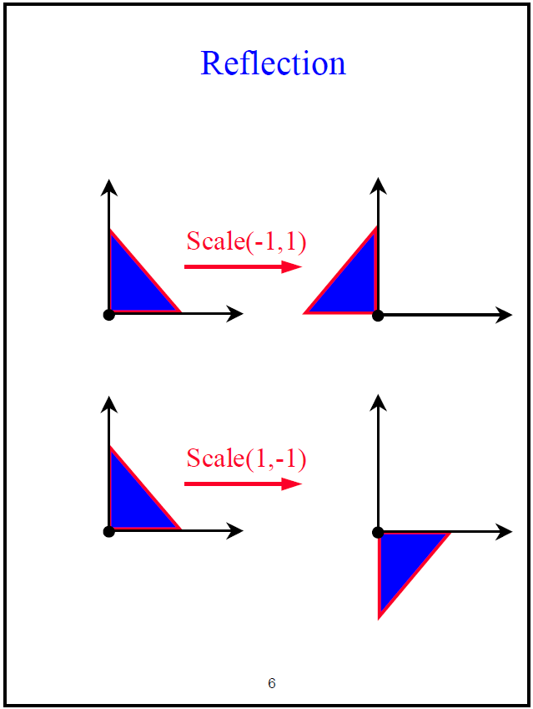

Slide 13
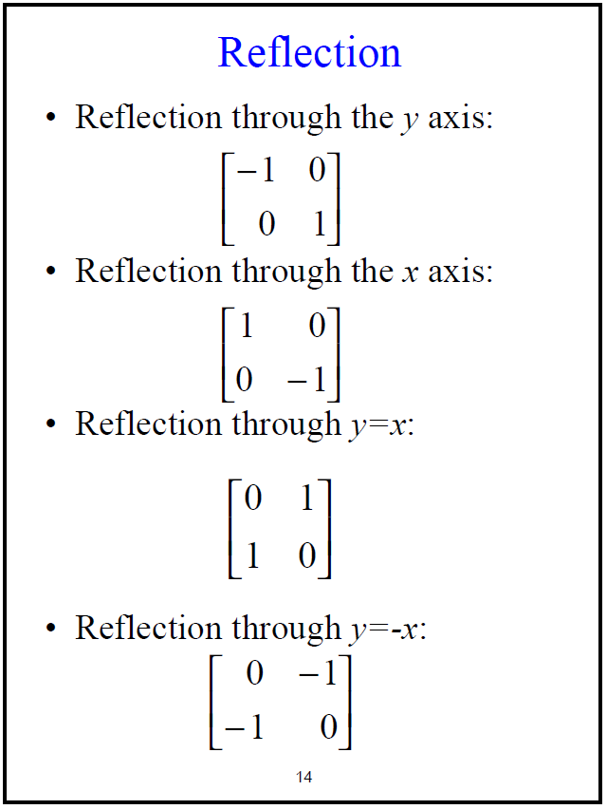

Slide 14
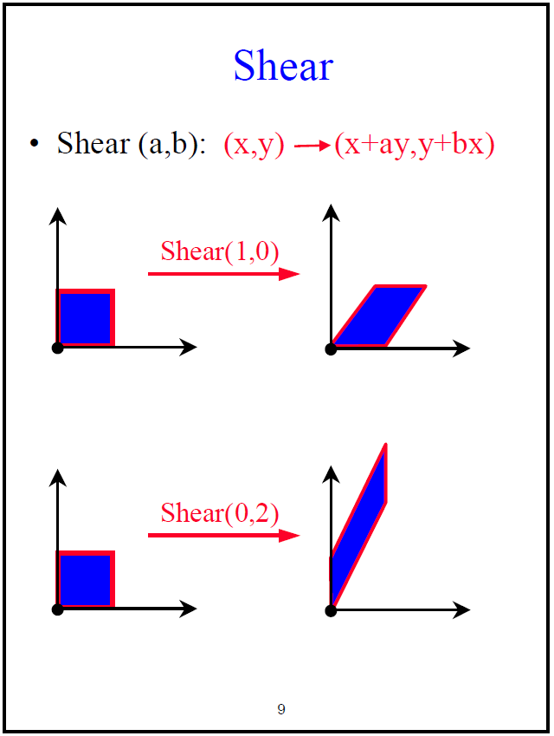

Slide 15
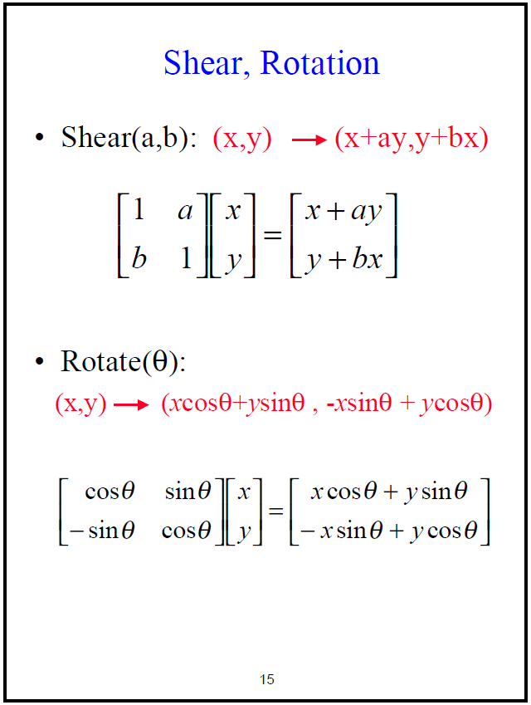

Slide 16
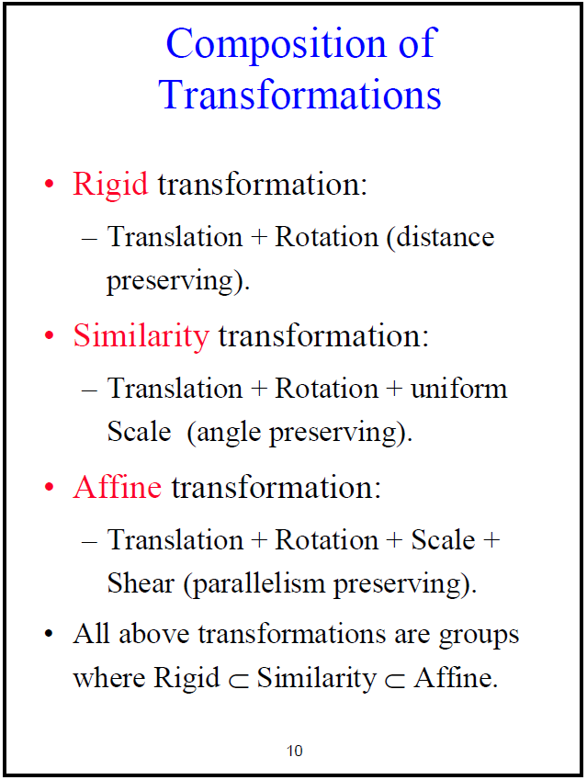

Slide 17
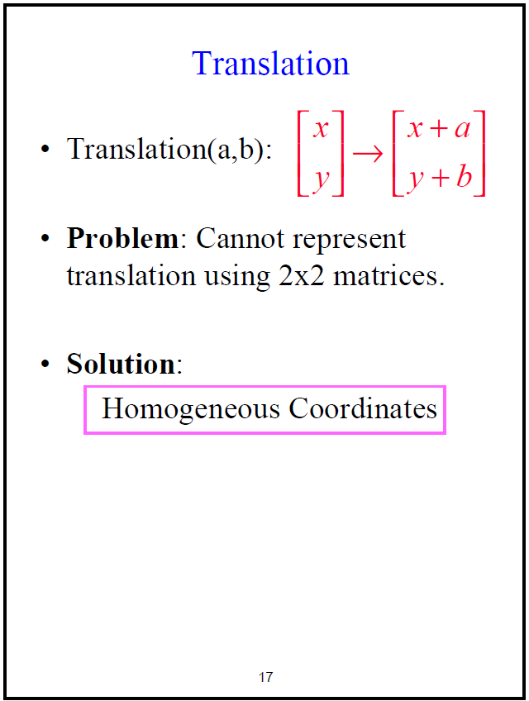

Slide 18
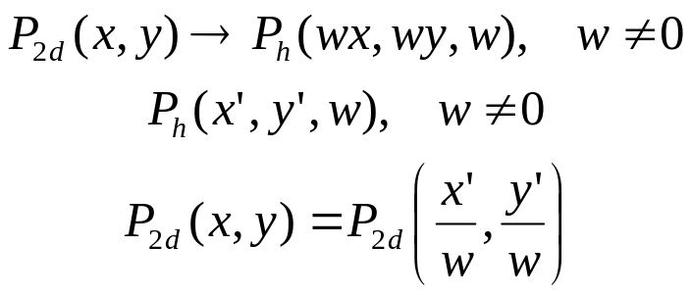
Homogenous Coordinates
Translation, scaling and rotation are expressed as:
Composition is difficult to express
  translation is not expressed as a matrix multiplication
Homogeneous coordinates allows expression of all three transformations as 3x3 matrices for easy composition
w is 1 for affine transformations in graphics
translation:
scale:
rotation:
v’ = v + t
v’ = Sv
v’ = Rv

Slide 19

What is ?
P_{2d} is intersection of line determined by P_{h} with the
w = 1 plane
Infinite number of points correspond to (x, y, 1) : they constitute the whole line (tx, ty, tw)
W
P_{h} (x,y,w)
1
P_{2d} (x/w,y/w,1)
X
Y

Slide 20
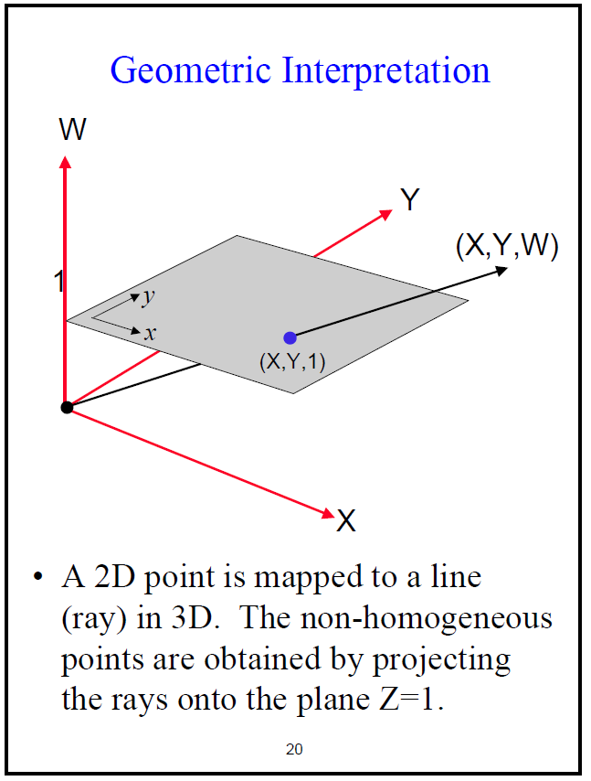

Slide 21

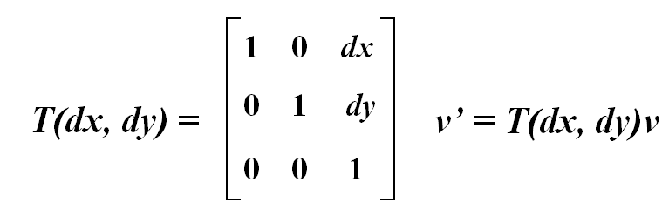
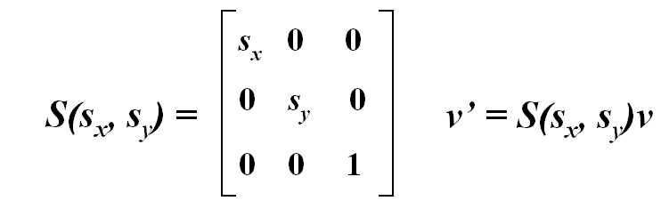
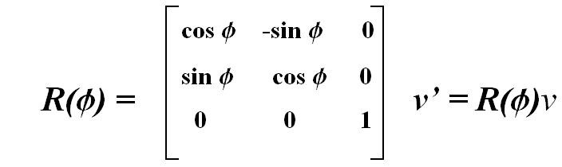
2D Homogeneous Coordinate
Transformations (1/2)
For points written in homogeneous coordinates,
translation, scaling and rotation relative to the origin are expressed homogeneously as:

Slide 22
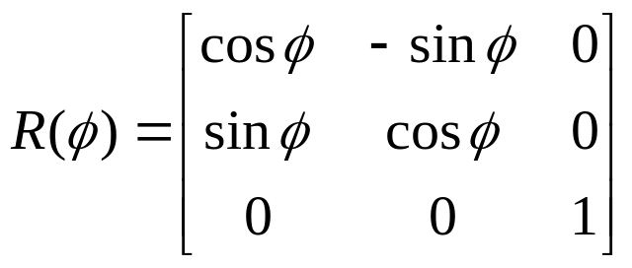
2D Homogeneous Coordinate Transformations (2/2)
Consider the rotation matrix:
The 2 x 2 submatrix columns are:
  unit vectors (length=1)
  perpendicular (dot product=0)
  vectors into which X-axis and Y-axis rotate
The 2 x 2 submatrix rows are:
  unit vectors
  perpendicular
  vectors that rotate into X-axis and Y-axis
Preserves lengths and angles of original geometry. Therefore, matrix is a “rigid body” transformation.
cos  -sin  0
sin  cos  0
0 0 1
R() =

Slide 23
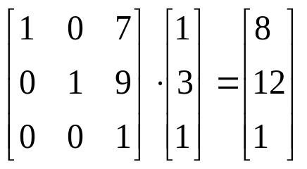
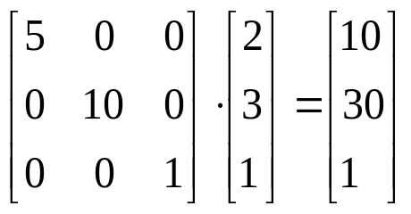
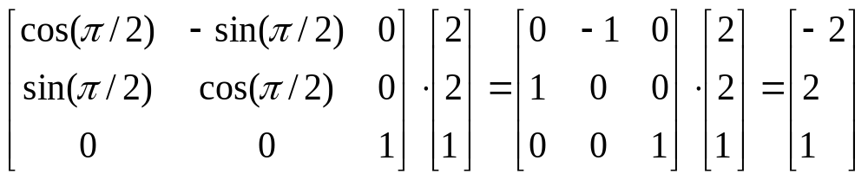
Examples
Translate [1,3] by [7,9]
Scale [2,3] by 5 in the X direction and 10 in the Y direction
Rotate [2,2] by 90° (π/2)

Slide 24
Matrix Compositions: Using Translation
Avoiding unwanted translation when scaling or rotating an object not centered at origin:
  translate object to origin, perform scale or rotate, translate back.
How would you scale the house by 2 in “its” y and rotate it through 90° ?
Remember: matrix multiplication is not commutative! Hence order matters! (refer to the Transformation Game at Demos->Scenegraphs)
Notes:
This is where we show the transformation game in class

Slide 25
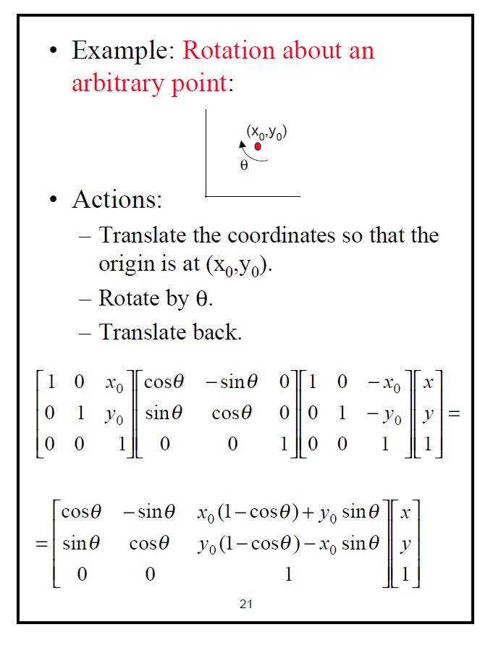

Slide 26
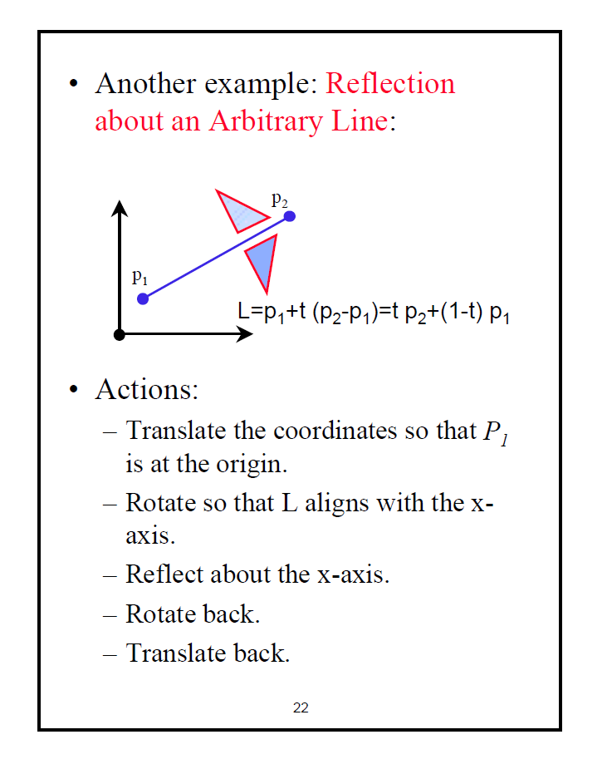

Slide 27
Transformations are NOT Commutative
Y
6
Translate by x=6, y=0 then rotate by 45º
5
4
3
2
1
0
1
2
3
4
5
6
7
8
9
10
X
Translation → Rotation
Y
6
Rotate by 45º then translate by x=6, y=0
5
4
3
2
1
0
1
2
3
4
5
6
7
8
9
10
X
Rotation → Translation

Slide 28
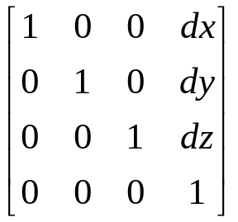
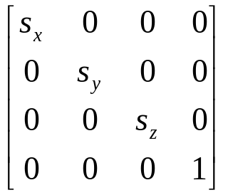
3D Basic Transformations (1/2)
(right-handed coordinate system)
Translation
Scaling
y
x
z

Slide 29
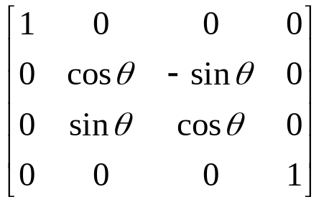
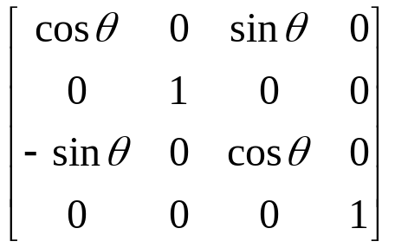
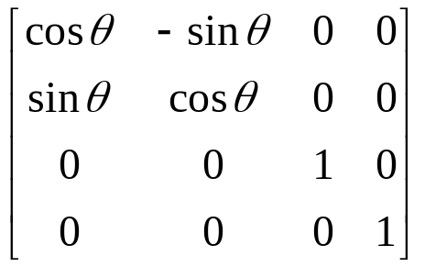
3D Basic Transformations (2/2)
(right-handed coordinate system)
Rotation about X-axis
Rotation about Y-axis
Rotation about Z-axis

Slide 30
Homogeneous Coordinates
Some uses we’ll be seeing later
Placing sub-objects in parent’s coordinate system to construct hierarchical scene graph
  transforming primitives in own coordinate system
View volume normalization
  mapping arbitrary view volume into canonical view volume along z-axis
Parallel (orthographic, oblique) and perspective projection
Perspective transformation

