Slide 1

Υπολογιστική Όραση
Computer Vision
EPL447
Linear filtering

Slide 2
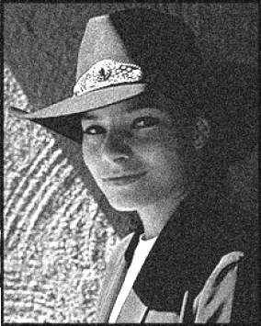


Lecture 05
Motivation: Noise reduction
Given a camera and a still scene, how can you reduce noise?
Take lots of images and average them!
What’s the next best thing?
Source: S. Seitz

Slide 3

Lecture 05
Moving average
Let’s replace each pixel with a weighted average of its neighborhood
The weights are called the filter kernel
What are the weights for a 3x3 moving average?
1
1
1
1
1
1
1
1
1
“box filter”
Source: D. Lowe

Slide 4
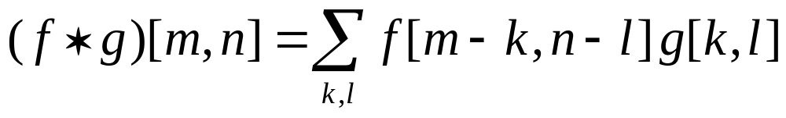


Lecture 05
Defining convolution
Let f be the image and g be the kernel. The output of convolving f with g is denoted f * g.
f
Convention: kernel is “flipped”
MATLAB: conv2 vs. filter2 (also imfilter)
Source: F. Durand

Slide 5
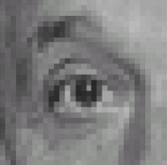
Lecture 05
Practice with linear filters
0
0
0
?
0
1
0
0
0
0
Original
Source: D. Lowe

Slide 6
Lecture 05
Practice with linear filters
0
0
0
0
1
0
0
0
0
Original
Filtered
(no change)
Source: D. Lowe

Slide 7
Lecture 05
Practice with linear filters
0
0
0
?
0
0
1
0
0
0
Original
Source: D. Lowe

Slide 8
Lecture 05
Practice with linear filters
0
0
0
0
0
1
0
0
0
Original
Shifted left
By 1 pixel
Source: D. Lowe

Slide 9
Lecture 05
Practice with linear filters
1
1
1
?
1
1
1
1
1
1
Original
Source: D. Lowe

Slide 10
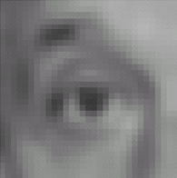
Lecture 05
Practice with linear filters
1
1
1
1
1
1
1
1
1
Original
Blur (with a
box filter)
Source: D. Lowe

Slide 11

Lecture 05
Practice with linear filters
0
0
0
-
1
1
1
?
0
2
0
1
1
1
0
0
0
1
1
1
(Note that filter sums to 1)
Original
Source: D. Lowe

Slide 12
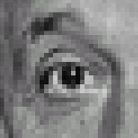
Lecture 05
Practice with linear filters
0
0
0
-
1
1
1
0
2
0
1
1
1
0
0
0
1
1
1
Original
Sharpening filter
  Accentuates differences with local average
Source: D. Lowe

Slide 13
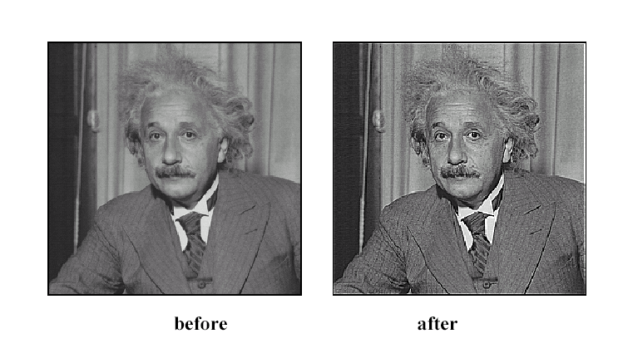
Lecture 05
Sharpening
Source: D. Lowe

Slide 14
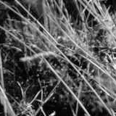
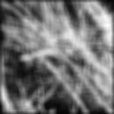
Lecture 05
Smoothing with box filter revisited
Smoothing with an average actually doesn’t compare at all well with a defocused lens
Most obvious difference is that a single point of light viewed in a defocused lens looks like a fuzzy blob; but the averaging process would give a little square
Source: D. Forsyth
Notes:
I always walk through the argument on the left rather carefully; it gives some insight into the significance of impulse responses or point spread functions.

Slide 15
Lecture 05
Smoothing with box filter revisited
Smoothing with an average actually doesn’t compare at all well with a defocused lens
Most obvious difference is that a single point of light viewed in a defocused lens looks like a fuzzy blob; but the averaging process would give a little square
Better idea: to eliminate edge effects, weight contribution of neighborhood pixels according to their closeness to the center, like so:
“fuzzy blob”

Slide 16
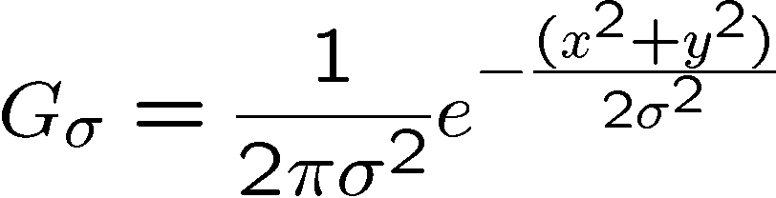
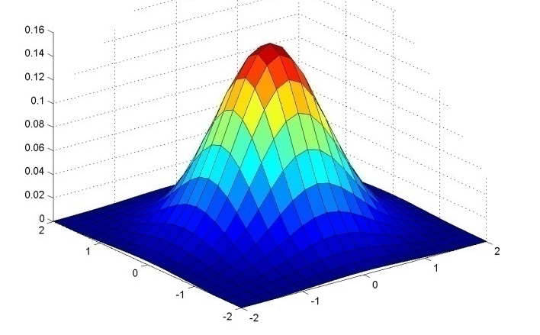
Lecture 05
Gaussian Kernel
0.003 0.013 0.022 0.013 0.003
0.013 0.059 0.097 0.059 0.013
0.022 0.097 0.159 0.097 0.022
0.013 0.059 0.097 0.059 0.013
0.003 0.013 0.022 0.013 0.003
5 x 5, σ = 1
Constant factor at front makes volume sum to 1 (can be ignored, as we should re-normalize weights to sum to 1 in any case)
Source: C. Rasmussen

Slide 17

Lecture 05
Example: Smoothing with a Gaussian

Slide 18
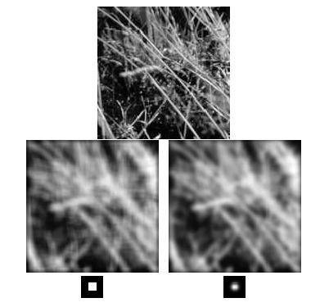
Lecture 05
Mean vs. Gaussian filtering

Slide 19
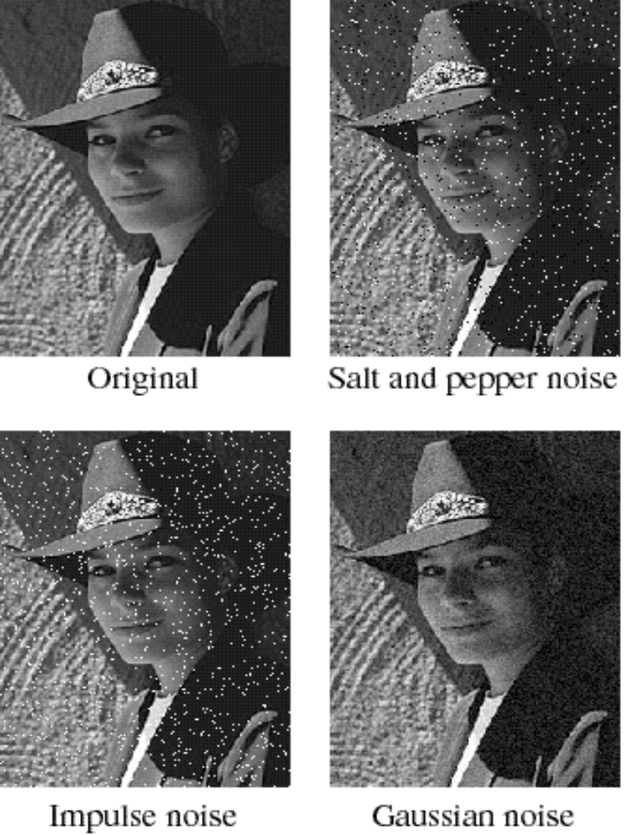
Lecture 05
Noise
Salt and pepper noise: contains random occurrences of black and white pixels
Impulse noise: contains random occurrences of white pixels
Gaussian noise: variations in intensity drawn from a Gaussian normal distribution
Source: S. Seitz
Notes:
Salt and pepper and impulse noise can be due to transmission errors (e.g., from deep space probe), dead CCD pixels, specks on lens

Slide 20
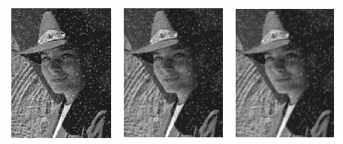
Lecture 05
Reducing salt-and-pepper noise
3x3
5x5
7x7
What’s wrong with the results?

Slide 21
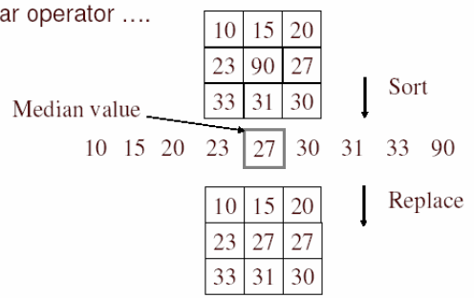
Lecture 05
Alternative idea: Median filtering
A median filter operates over a window by selecting the median intensity in the window
Is median filtering linear?
Source: K. Grauman

Slide 22
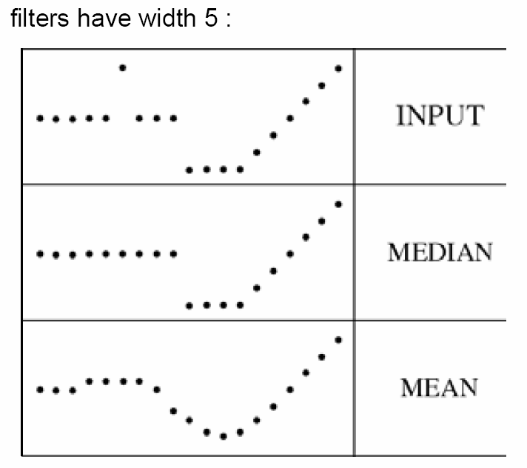
Lecture 05
Median filter
What advantage does median filtering have over Gaussian filtering?
  Robustness
  to outliers
Source: K. Grauman

Slide 23
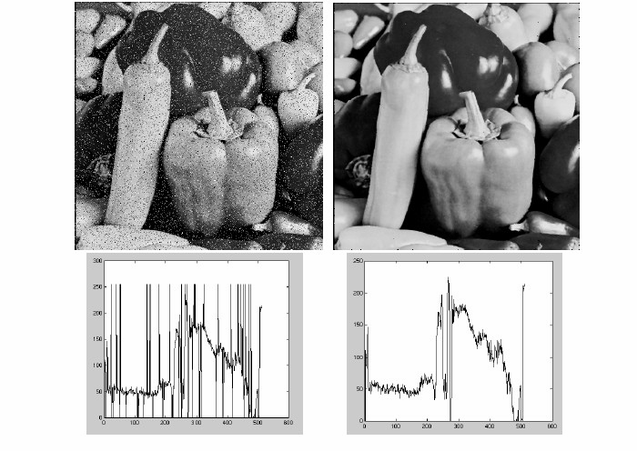
Lecture 05
Median filter
Salt-and-pepper noise
Median filtered
MATLAB: medfilt2(image, [h w])
Source: M. Hebert

Slide 24
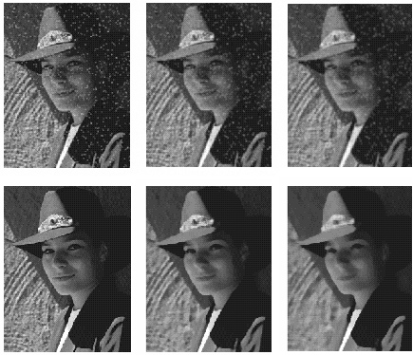
Lecture 05
Median vs. Gaussian filtering
3x3
5x5
7x7
Gaussian
Median

