Slide 1
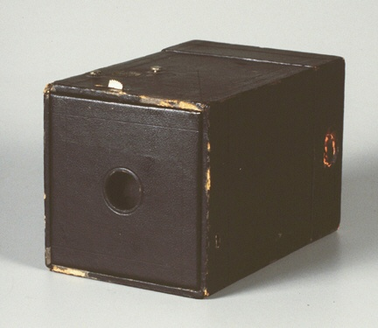
Viewing II
The Synthetic Camera

Slide 2
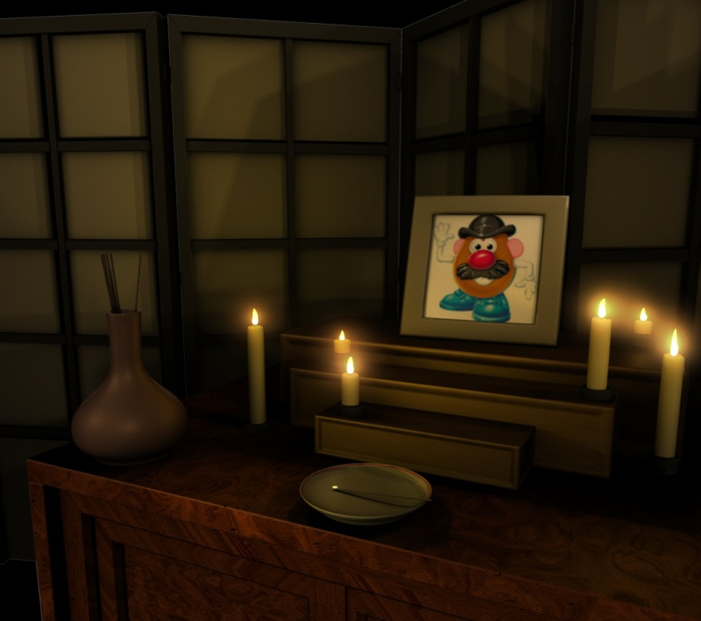
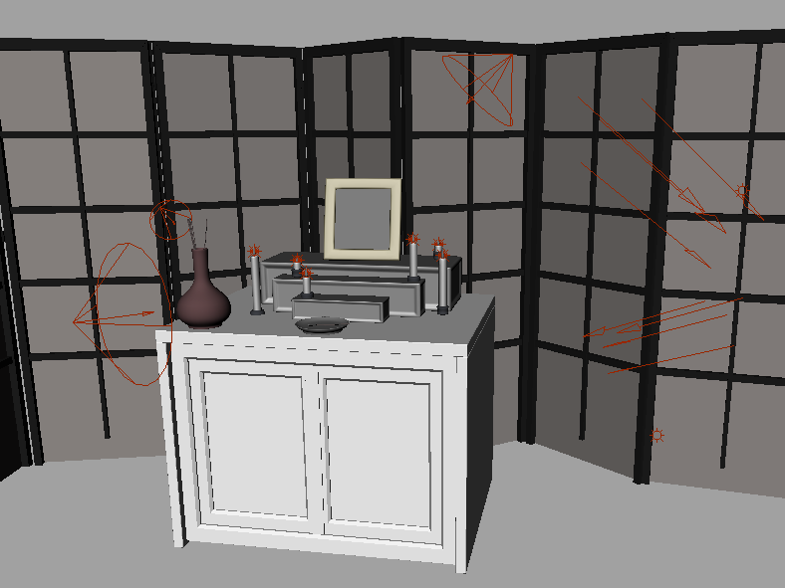
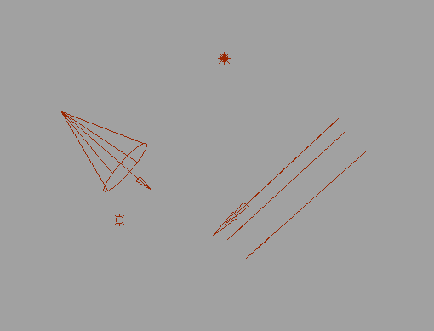
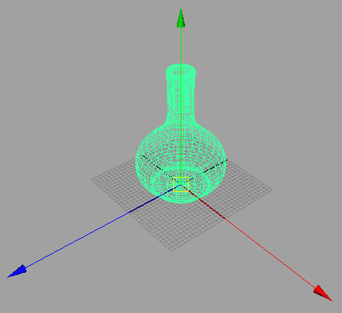
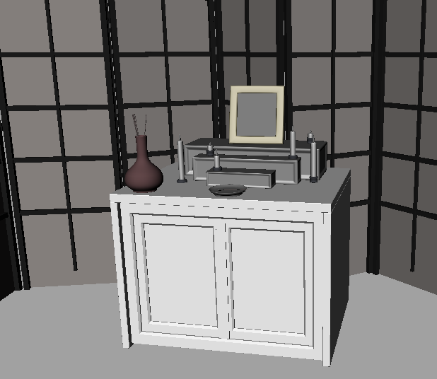
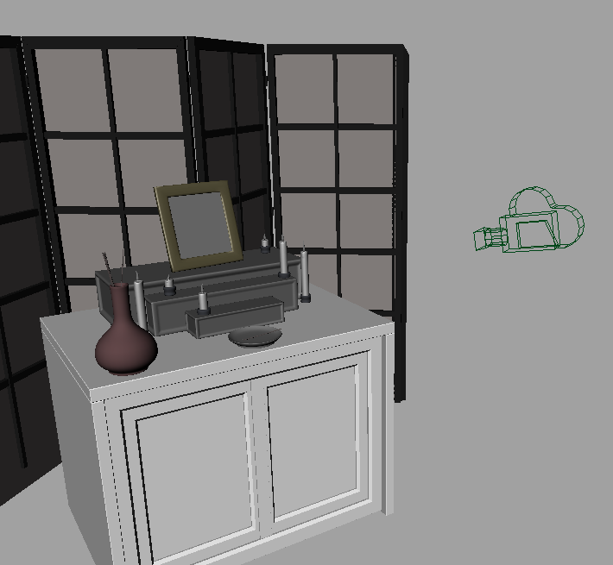
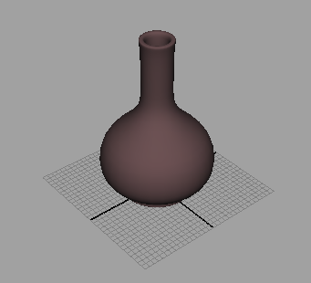
Modeling and Rendering
Modeling
Create models
Apply materials to models
Place models around scene
Place lights in scene
Place the camera
Rendering
Take “picture” with camera
This involves:
- Projecting the objects onto the image plane
- Finding the right color for each pixel (VSD, lighting, etc)
Point Light
Spot Light
Directional Light
Ambient Light
CS128 lighting assignment by Patrick Doran, Spring 2009
2
Notes:
2

Slide 3
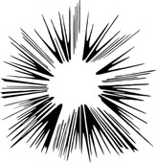
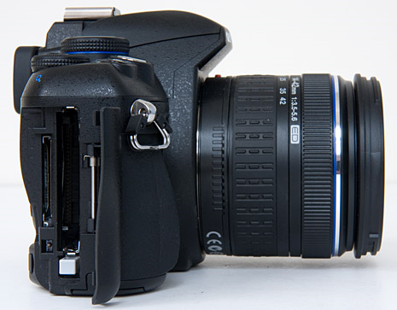
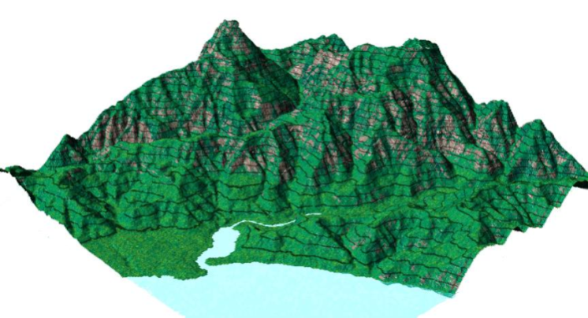
The camera and the scene
What does a camera do?
Takes in a 3D scene
Places (i.e., projects) the scene onto a 2D medium (a roll of film or a digital pixel array)
The synthetic camera is programmer’s model for specifying how a 3D scene is projected onto screen

Slide 4
3D Viewing: The Synthetic Camera
General synthetic camera: each package has its own but they are all (nearly) equivalent
Camera position
Orientation
Field of view (angle of view, wide, narrow, normal...)
Depth of field (near distance, far distance)
Focal distance
Tilt of view/ film plane (if not perpendicular to viewing direction, produces oblique projections)
Perspective of parallel projection (Camera near objects or infinite distance away
EPL607 uses a simpler slightly less powerful model than the one used in the book
Omit tilt of view/film plane, focal distance (blurring)

Slide 5
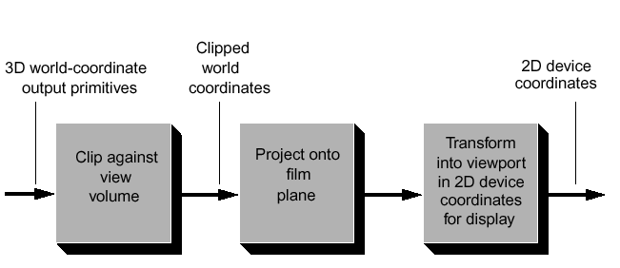
Cameras in the rendering process
We will talk about the coordinate system involved with cameras, the view volume specifications, projecting on to the film plane, and transforming into the viewport
Let’s first define viewport and view volume

Slide 6
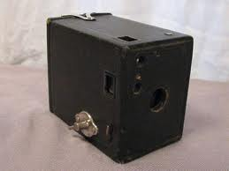
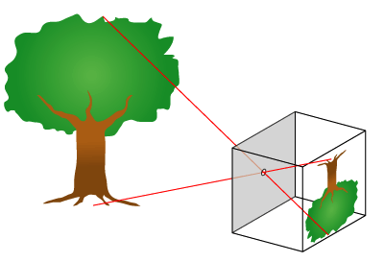
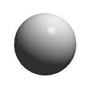
The pinhole model
You can think of camera as a pinhole. As you look through pinhole see a certain volume of space
Rays of light reflect off objects and converge to pinhole to let you see scene
Rays of light can be considered projectors, that converge towards the pinhole as center of projection
The pinhole is where our
camera position will be and the
volume we see will be our “view
volume”
Projectors intersect
a plane, usually in between
scene and pinhole, to get
projected onto that plane
Lastly, in synthetic camera
projection is mapped
to some form of viewing medium
(screen)
Object
Pinhole
Image projected
on image plane
(edited)

Slide 7
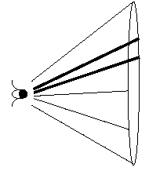
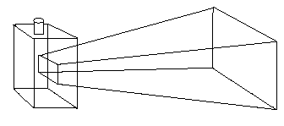
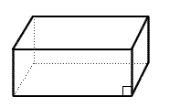
View Volumes (the focus of today’s lecture)
A view volume contains everything the camera sees
Conical – Approximates what eyes see, expensive math when clipping objects against cone’s surface (simultaneous quadratics)
Can approximate this using a rectangular frustum view volume
Simultaneous linear equations for easy clipping of objects against sides (stay tuned for clipping lecture)
Also parallel view volumes, for orthographic projections. These don’t simulate eye or camera
eye
conical perspective view volume (eye’s is much wider)
frustum approximation, view volume
synthetic
camera
View volume
(Parallel view)

Slide 8
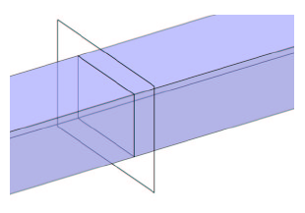
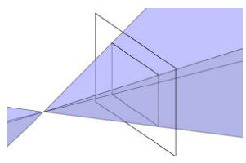
View Volumes and Projectors
Given our view volume need to start thinking about how to project scene contained in volume to film plane
Projectors: Lines that essentially map points in scene to points on film plane
Parallel Volumes: Parallel Projectors, no matter how far away an object is, as long as it is in the view volume it will appear as same size, (using our simple camera model, these projectors are also parallel to look vector)
Perspective Volumes: Projectors converge on eye point = center of projection, like rays of light converging to your eye

Slide 9
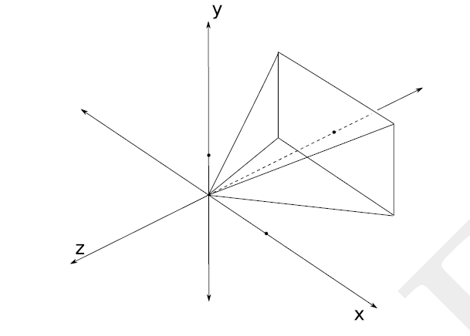
The film plane
Film plane is a plane in world space – 3D scene is projected onto a rectangle (the film) on that plane using some projection transformation and from there onto the viewport on screen
Film for our camera model will be perpendicular to and centered around the camera’s look vector, and will match dimensions of our view volume
Actual location of film plane along look vector doesn’t matter as long as it is in front of scene
Look Vector
Look Vector
Film Plane
Film
Plane

Slide 10
Προοπτική προβολή (απλή περίπτωση)
In order to get a natural looking image we need the perspective
For a simple arrangement it is easy to find the projection
⇨
Y
(x_{p},y_{p},z_{p})
(x_{p}´,y_{p}´, d)
⇨
Z
z=d

Slide 11
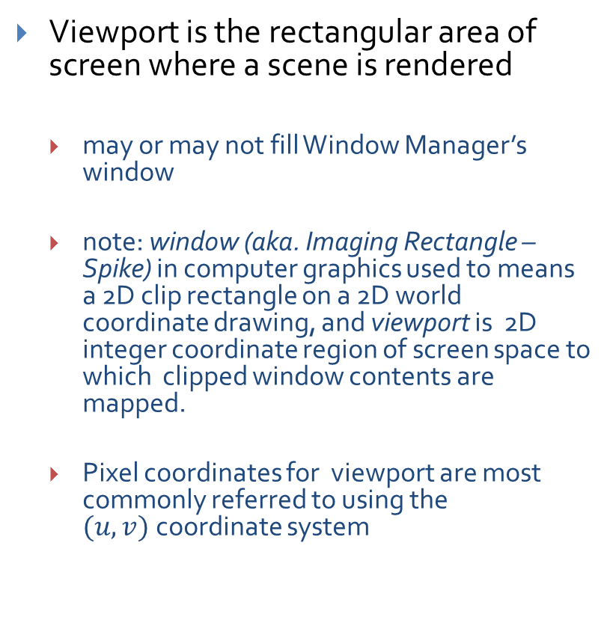
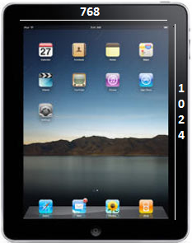
The viewport
Notes:
viewing window terminology-viewing window

Slide 12
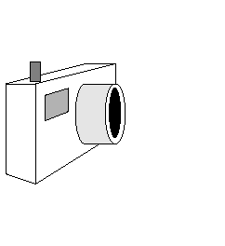
Constructing the view volume (1/2)
We need to know six things about our synthetic camera model in order to take a picture using our perspective view frustum
Position of camera (from where it’s looking)
Look vector specifies direction camera is pointing
Camera’s Orientation is determined by Look vector and angle through which the camera is rotated about that vector, i.e., the direction of Up vector
Up vector
Look vector
Position

Slide 13
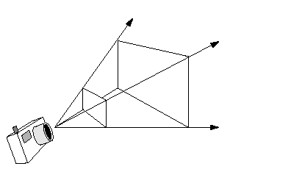
Constructing the view volume (2/2)
Width angle
Height angle
Front clipping plane
Back clipping plane
Aspect ratio of the electronic “film:” ratio of width to height
Height angle: determines how much of the scene we will fit into our view volume; larger height angles fit more of the scene into the view volume (width angle determined by height angle and aspect ratio)
the greater the angle, the greater the amount of perspective distortion
Front and back clipping planes: limit extent of camera’s view by rendering (parts of) objects lying between them and throwing away everything outside of them
Optional: Focal length, objects at length are sharp, objects closer/farther blurry
http://www.cs.brown.edu/exploratories/freeSoftware/repository/edu/brown/cs/
exploratories/applets/camera/perspective_camera_transformation_guide.html

Slide 14
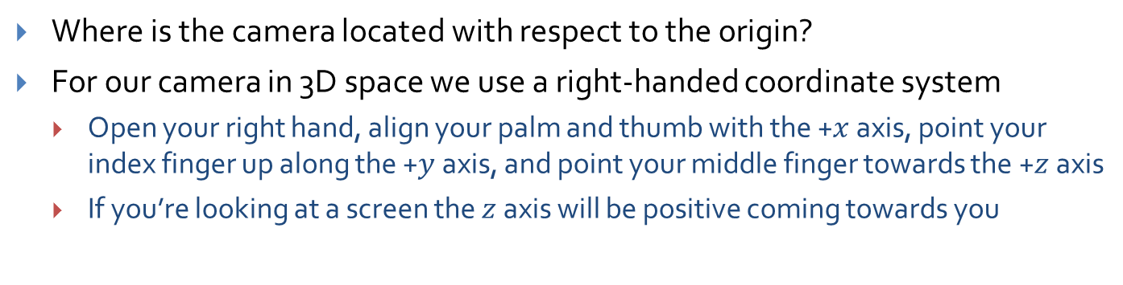
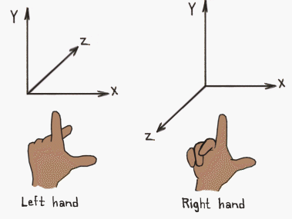
1) Position (1/1)

Slide 15
2 & 3) Orientation: Look and Up vectors (1/2)
Orientation is specified by a point in 3D space to look at (or a direction to look in) and an angle of rotation about this direction
These correspond to the look vector and up vectors
y
x
-z
Up vector
point to look at (x’, y’, z’)
Look vector
camera Position
z

Slide 16
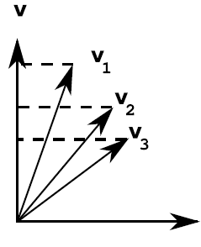
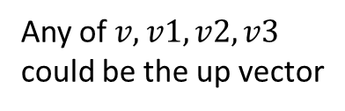
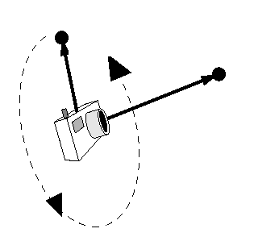
2 & 3) Orientation: Look and Up vectors (2/2)
Look Vector
Direction the camera is pointing
Three degrees of freedom; can be any vector in 3-space
Up Vector
determines how camera is rotated around Look vector
for example, holding camera horizontally or vertically
Up vector must not be parallel to Look vector but it doesn’t have to be perpendicular either– actual orientation will be defined by part of vector perpendicular to look vector, lying in plane with Look as normal
Look Vector
Up vector
Look vector
Projection of Up vector
Position
Demo!

Slide 17
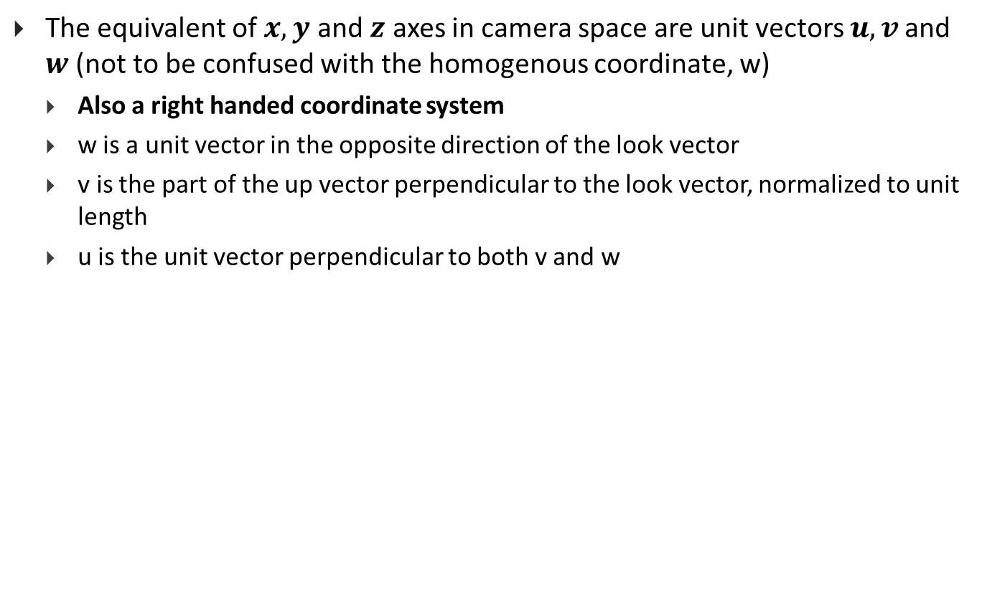
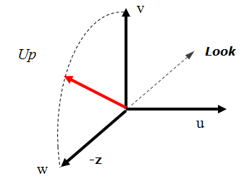
The camera coordinate space (1/2)

Slide 18
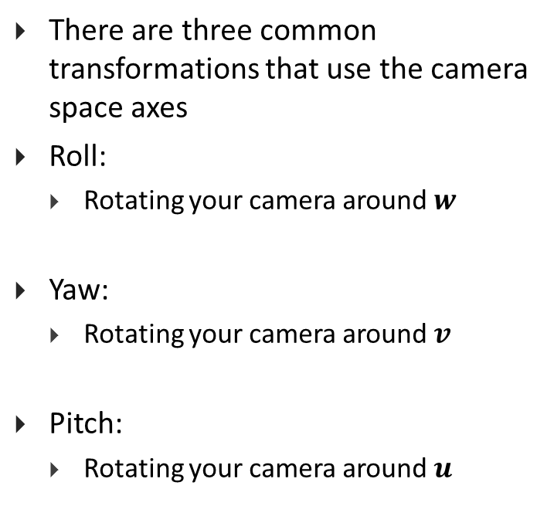
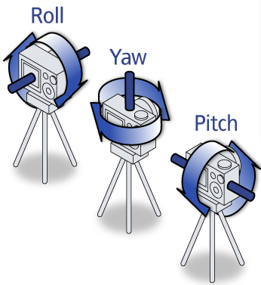



The camera coordinate space (2/2)
If we send the camera to the origin and align the axes with the standard axes, we can
use our rotation matrices to perform these transformations and then un-align and
un-translate.

Slide 19
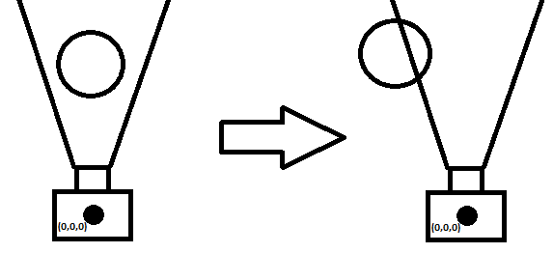
Aside: The Camera as a model
There are different ways we can model a camera
In the generalized model we have a camera and a scene where both the camera and objects in the scene are free to be transformed independently
In a more restricted model we have a camera that remains fixed in one position and orientation
To transform the camera we actually apply the inverse transformation to objects in the scene
This is the model OpenGL uses, note however that GLUT abstracts this concept away from the programmer (gluLookAt())
Translate “camera”
to the right
Our field of view in
OpenGL can be thought
of as the view of a camera
at the origin looking
down the –z axis
Object moves to
the left to simulate
a camera moving to
the right
Demo!

Slide 20
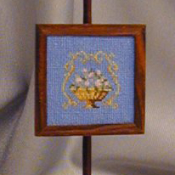
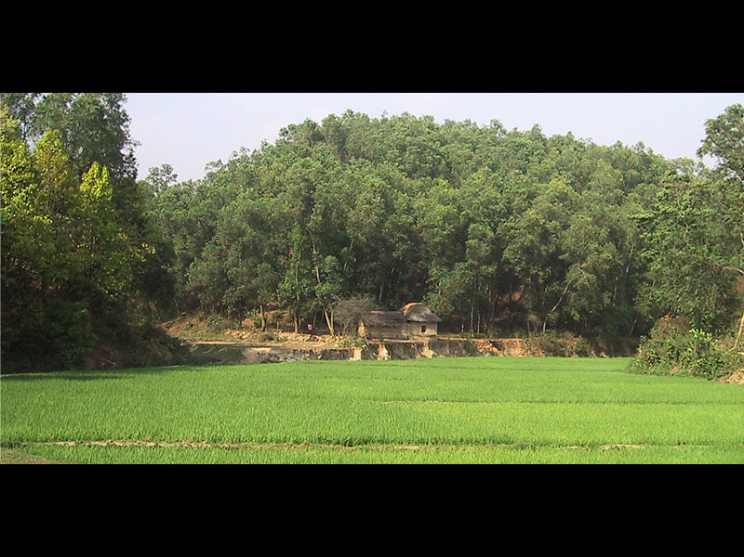
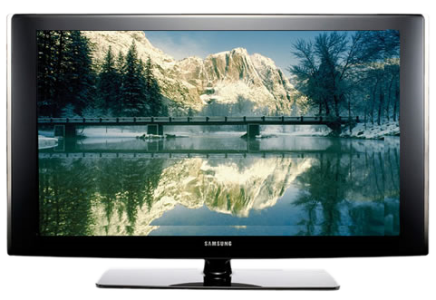
4) Aspect Ratio (1/1)
1:1
Analogous to dimensions of film used in a camera
Is defined as ratio of width to height of your viewing window
Viewport’s aspect ratio is usually defined by the device being used
A square viewing window has a ratio of 1:1
NTSC TV is 4:3, HDTV is 16:9 or 16:10
Aspect ratio of viewing window defines the dimensions of image that gets projected to that film plane, after which it is mapped to your viewport
typically it’s a good idea to have the same aspect ratio for both your viewing window and viewport, to avoid distortions/stretching
2:1
16:9

Slide 21
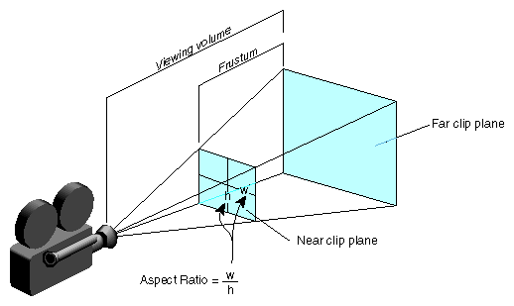
5) View Angle (1/2)
Determines amount of perspective distortion in picture, from none (parallel projection) to a lot (wide-angle lens)
In a frustum, two viewing angles: width and height angles
Usually width angle is specified using the height angle and aspect ratio
Choosing View angle analogous to photographer choosing a specific type of lens (e.g., a wide-angle or telephoto lens)
Width angle
The aspect ratio is defined
by width/height or
width angle/height angle
Height angle

Slide 22
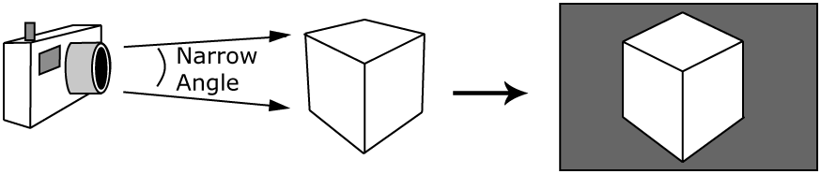
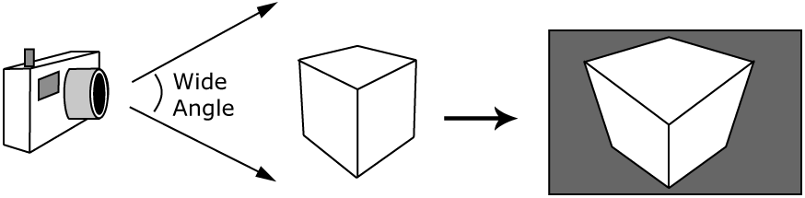
5) Viewing Angle (2/2)
Lenses made for distance shots often have a nearly parallel viewing angle and cause little perspective distortion, though they foreshorten depth
Wide-angle lenses cause a lot of perspective distortion
Resulting picture

Slide 23
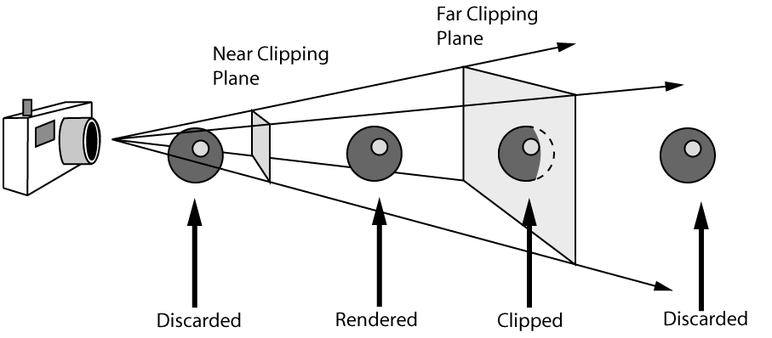
6) Near and Far Clipping Planes (1/2)
With what we have so far we can define four rays extending to infinity defining the edges of our current view volume
Now we need to bound front and back to make a finite volume -- can do this using the near and far clipping planes, defined by distances along the look vector (Also note that our look vector and clipping planes are perpendicular)
This volume defines what we can see in the scene
Objects outside are discarded
Objects intersecting faces of the volume are “clipped”

Slide 24
6) Near and Far Clipping Planes (2/2)
Reasons for Front (near) clipping plane:
Usually don’t want to draw things too close to camera
would block view of rest of scene
objects would be distorted
Don’t want to draw things behind camera
wouldn’t expect to see things behind camera
in the case of perspective camera, if we were to draw things behind camera, they would appear upside-down and inside-out because of perspective transformation
Reasons for Back (far) clipping plane:
Don’t want to draw objects too far away from camera
distant objects may appear too small to be visually significant, but still take long time to render
by discarding them we lose a small amount of detail but reclaim a lot of rendering time
can also help to declutter a scene
These planes need to be properly placed, not too close to the camera, not too far (mathematical justification next time)
Demo!

Slide 25
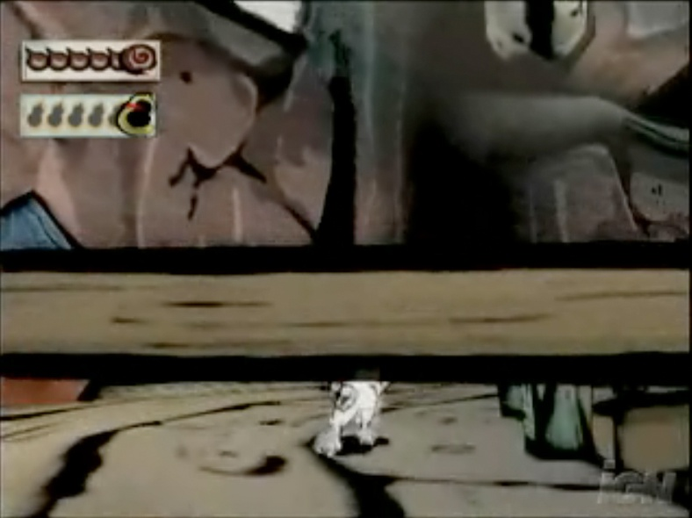
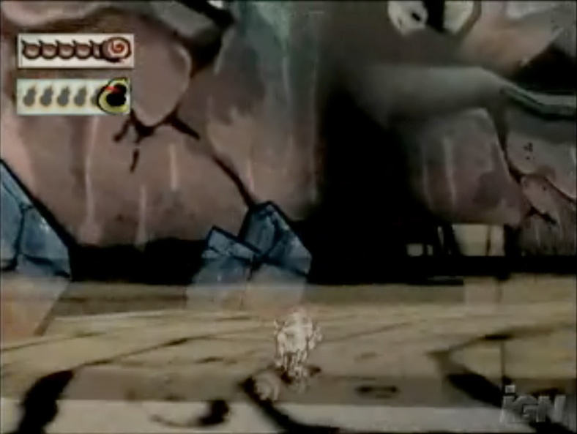
Games and Planes (1/2)
Problem: Sometimes in a game you can position the camera in the right spot that the front of an object gets clipped, letting you see inside of it.
Video games use various techniques to avoid this glitch. One technique is to have objects that are very close to the near clip plane fade out before they get cut off, as can be seen below
This technique gives a clean look while solving the near clipping problem (the wooden fence fades out as the camera follows the running wolf).
Screenshots from the game, Okami

Slide 26
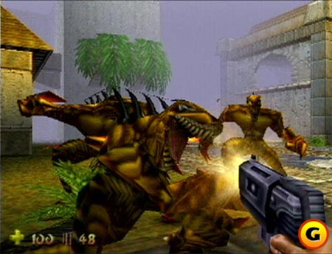

Games and Planes (2/2)
Problem: Ever played a video game and all of a sudden some object pops up in the background (e.g., a tree in a racing game)? That’s object coming inside far clip plane.
The old hack to keep you from noticing the pop-up is to add fog in the distance. A classic example of this is from Turok: Dinosaur Hunter
The modern solution is dynamic level of detail, mesh detail increases as you get closer to it, remember Stone Giant?
Now all you notice is fog. This practically defeats the purpose of an outdoor environment! And you can still see pop-up from time to time.
Thanks to fast hardware and level of detail algorithms, we can push the far plane back now and fog is much less prevalent

Slide 27

Focal Length
Some camera models take a Focal length
Focal Length is a measure of ideal focusing range; approximates behavior of real camera lens
Objects at distance equal to Focal length from camera are rendered in focus; objects closer or farther away than Focal length get blurred
Focal length used in conjunction with clipping planes
Only objects within view volume are rendered, whether blurred or not. Objects outside of view volume still get discarded
Notes:
In the simplified graphics that we will see in this course we will not deal at all with this effect.
We assume that the our idealised camera has no lens and its opening is the size of a mathematical point, therefore in the standard pipeline everything looks sharp.

Slide 28
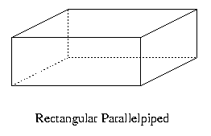
The Parallel View Volume (1/2)
Up until now we’ve been describing the specifications for a perspective view volume
We also need to discuss the parallel view volume (used for orthogonal/metric views)
What do we need to know this time?
Everything we wanted for a perspective view volume except for width and height angles, replaced by just a width and height (also the width and height of our film on our film plane)
A parallel view volume is a parallelepiped (all opposite edges parallel)

Slide 29
The Parallel View Volume (2/2)
Width
Far distance
Height
Look vector
Near distance
Projection of
up vector
Up vector
Position
Objects appear the same size no matter how far away they are since projectors are all parallel
A benefit of the parallel view volume is that it’s really easy to project a 3D scene to a 2D medium
http://www.cs.brown.edu/exploratories/freeSoftware/repository/edu/brown/cs/
exploratories/applets/camera/parallel_camera_transformation_guide.html

Slide 30
Παράδειγμα
Y
Ζ
(0, 2, 1)
(3, 2, 1)
εικόνα με
480x480 pixels
(3, 0, 2)
(0, 0, 2)
0
(3, 0, 0)
X
Έστω ότι έχουμε ένα αντικείμενο όπως αυτό που βλέπουμε στο πιο κάτω δεξιά σχεδιάγραμμα, με βάση 2x3 μονάδες και ύψος 2 μονάδες. Aν υποθέσουμε ότι χρησιμοποιούμε προοπτική προβολή, ποιες πρέπει να είναι οι τιμές των παραμέτρων της κάμερας για να έχουμε την παρακάτω εικόνα;
Notes:
Position (VRP) = 1.5, y, 1
Look vector (VPN) = (0, -1, 0)
Up vector (VUV) = (-1, 0, 0)
Height angle = tan (theta) = 1.5/y => theta = arctan (1.5/y)
Aspect ratio = 1
Near plane < y – 2
Far plane > y

