Slide 1
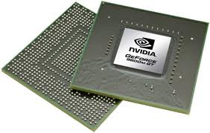
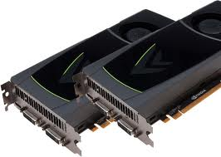
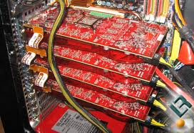

Programmable GPU - An Introduction (EPL 426 – Spring 2015)
University of Cyprus
Computer Science Department
Yiorgos Chrysanthou
Some slides adapted from: Menelaos Levas (Nvidia) and Mike Houston (AMD) edited by Efstathios Stavrakis

Slide 2
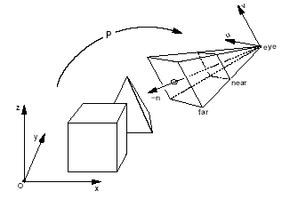
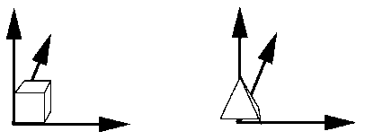
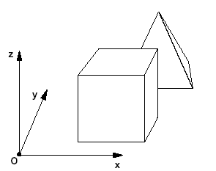

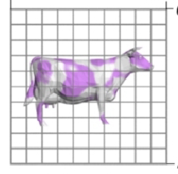
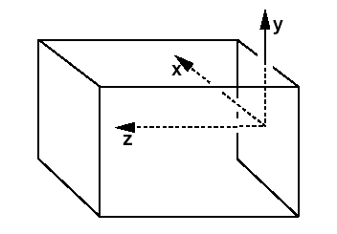
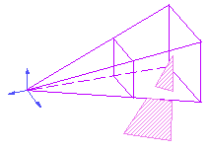
The Graphics Pipeline
Συντεταγμένες παρατηρητή
Τοπικές συντεταγμένες
Μετασχηματισμός μοντελοποίησης
(GTM)
Παγκόσμιες συντεταγμένες
Παγκόσμιες συντεταγμένες
Viewing
matrix
Ορισμός αντικειμένου (Object
definition)
Σύνθεση
σκηνής,
ορισμός
κάμερας
Φωτισμός (Lighting)
Display
space
Κανονική Παράλληλη
(normalised device
Coordinates)
Drop the z and
Map to view-port
Κανονική Προοπτική - (canonical Perspective)
Rasterisation,
Lighting*,
Visibility*
Set pixels
αποκοπή (clipping)

Slide 3
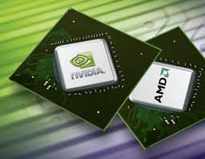
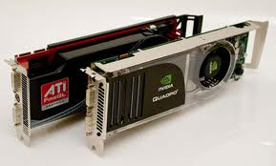
Graphics Processing Unit (GPU)
GPUs are dedicated processors for graphics acceleration
mainly 3D computer graphics
But also:
video decoding
general purpose computations
GPUs are massively parallel!
Standard component in modern computers (workstations, gaming computers, desktops, etc.)
Also popular in mobile and handheld devices (laptops, phones, tablets, etc.)

Slide 4
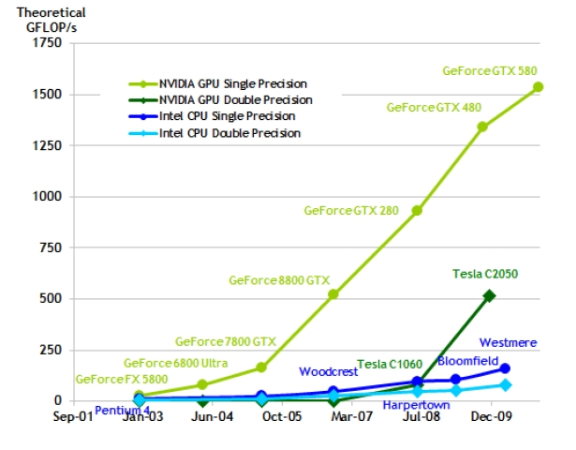
GPU vs CPU (or Oranges vs Apples!)
Even a consumer-level GPU is multiple times faster than the fastest CPU! (examples of 10x-100x)
Beware, each has its strengths and weaknesses
CPU → serial processing
GPU → parallel processing
CPUs good at complexity
GPUs good at concurrency

Slide 5
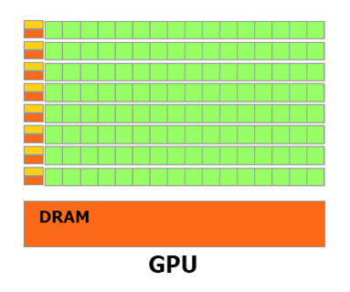
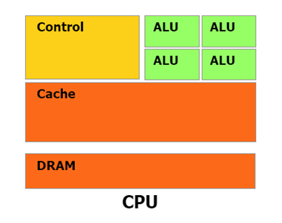
GPU vs CPU (or Oranges vs Apples!)
GPUs have many parallel execution units & high transistor counts.
CPUs have few execution units, but high clock speeds.
GPUs have advanced and faster memory interfaces than CPUs

Slide 6
Early Computer Graphics Pipeline
Software processing only on the CPU
No dedicated hardware (no GPUs)
Framebuffer updated from the CPU
CPU
Application Data
Software Rendering
Memory Interface

Slide 7
Computer Graphics Pipeline – Pre 2001
Graphics acceleration on GPUs, without programmability
Fixed algorithms implemented on the device (Fixed-Function Pipeline)
Control by setting flags (known as render states)
No ability to define our own algorithms
Graphics API
(DirectX/OpenGL)
3D Application Data
CPU
Host Interface
GPU
vertex
processing
triangle
setup
pixel
processing
memory
interface

Slide 8
Modern GPU - Programmable Graphics Pipeline
Introduces programmability in some parts of the Graphics Pipeline
Vertex, Geometry and Fragment Processing
Shaders are programs to be executed on a GPU
Vertex, geometry and fragment shaders (respectively)
Modify parts of the fixed-function graphics pipeline
Achieve realistic effects in real-time
Graphics API
(DirectX/OpenGL)
3D Application Data
CPU
Host Interface
shaders
GPU
vertex
processing
geometry
processing
triangle
setup
pixel
processing
memory
interface

Slide 9
Host Interface
The host interface is the communication bridge between the CPU and the GPU
It receives commands from the CPU and also pulls geometry information from system memory
It outputs a stream of vertices in object space with all their associated information (normals, texture coordinates, per vertex color etc)
Host Interface
vertex
processing
geometry
processing
triangle
setup
pixel
processing
memory
interface

Slide 10
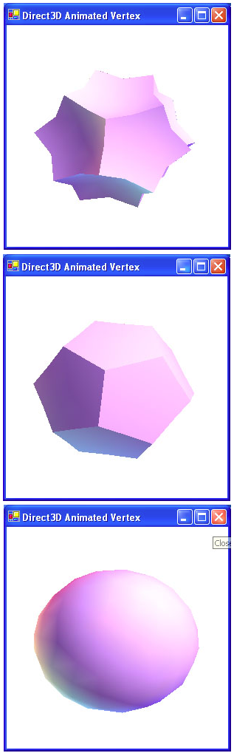
Vertex Processing
The vertex processing stage receives vertices from the host interface in object space and outputs them in screen space. (and z-values)
This may be a simple linear transformation, or a complex operation involving morphing effects.
Normals, texcoords etc. are also transformed.
No new vertices are created in this stage, and no vertices are discarded (input/output has 1:1 mapping)
vertex
processing
geometry
processing
triangle
setup
pixel
processing
memory
interface

Slide 11


Geometry Processing
Geometry processing handles geometry at a higher level than mere vertex (e.g. per triangle with adjacency info)
A geometry processing program takes primitives as an input and outputs 0 or more primitives.
Allows things like higher order surfaces, generation/destruction of geometry etc.
New geometry can be introduced.
vertex
processing
geometry
processing
triangle
setup
pixel
processing
memory
interface
New stage

Slide 12
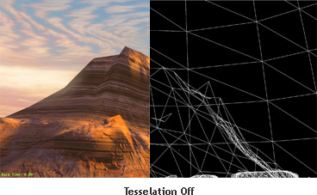
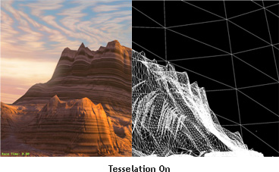

Slide 13
Triangle setup
In this stage geometry information becomes raster information (screen space geometry is the input, pixels are the output)
Clipping, culling (hidden surface elimination), rasterization.
A pixel is generated if and only if its center is inside the triangle.
Every pixel generated has its attributes computed to be the perspective correct interpolation of the three vertices that make up the triangle
vertex
processing
geometry
processing
triangle
setup
pixel
processing
memory
interface

Slide 14
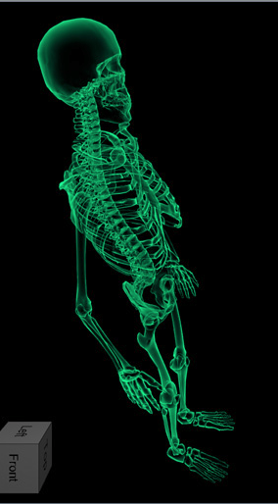

Pixel Processing
Each pixel provided by triangle setup is fed into pixel processing as a set of attributes (position, normal, texcoord etc), which are used to compute the final color for this pixel
The computations taking place here include texture mapping and math operations
Typically the bottleneck in modern applications
vertex
processing
geometry
processing
triangle
setup
pixel
processing
memory
interface

Slide 15
Memory Interface
Pixel colors provided by the previous stage are written to the framebuffer
Used to be the biggest bottleneck before pixel processing took over
Before the final write occurs, some pixels are rejected by the zbuffer, stencil and alpha tests
On modern GPUs, z and color are compressed to reduce framebuffer bandwidth (but not size)
vertex
processing
geometry
processing
triangle
setup
pixel
processing
memory
interface

Slide 16

Vertex and Pixel Shaders
( x, y, z, w )
( nx, ny, nz )
( s, t, r, q )
( r, g, b, a )
( x’, y’, z’, w’ )
( nx’, ny’, nz’ )
( s’, t’, r’, q’ )
( r’, g’, b’, a’ )
VERTEX
SHADER
( x, y )
( r’, g’, b’, a’ )
( depth’ )
( x, y )
( r, g, b, a )
( depth )
PIXEL
SHADER

Slide 17
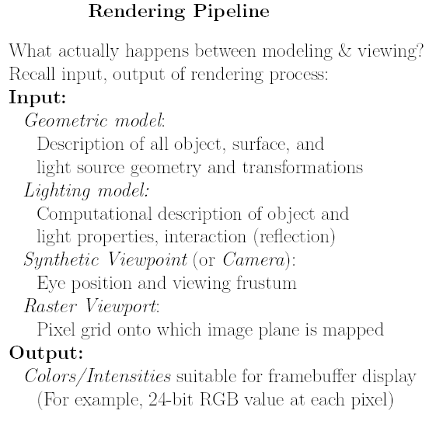
The Graphics Pipeline
Modeling Transformations
Illumination
(Shading)
Viewing Transformation
(Perspective / Orthographic)
Clipping
Projection (to Screen Space)
Scan Conversion (Rasterization)
Visibility / Display

Slide 18
Modern GPU - Programmable Graphics Pipeline
Graphics APIs offer shader programming facilities
Microsoft Direct3D API (9.0+)
High Level Shader Language (HLSL)
OpenGL API (2.0+)
OpenGL Shading Language (GLSL)
NVidia’s shading language – similar to HLSL
Cg (C for Graphics)
Shaders are typically written in a high level language (GLSL, HLSL, Cg) which are then compiled to API assembly instructions.
Assembly - Low-level shading language
The GPU driver takes this API assembly and compiles it to the machine code used by the specific GPU

Slide 19


Why are Shaders useful?
Modify parts of the fixed-function graphics pipeline.
Achieve realistic effects in real-time!

Slide 20
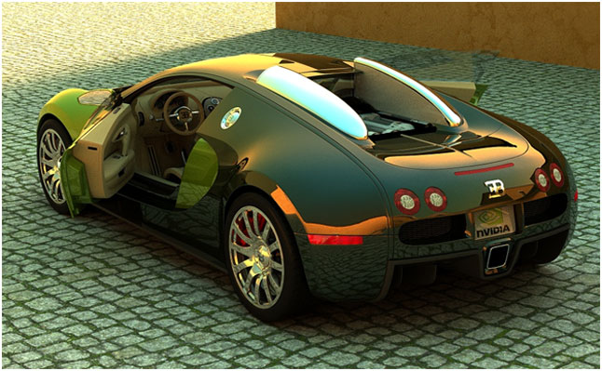
Real-time Raytracing on the GPU
Raytracing at 15fps with Nvidia GeForce 400/500 GPUs.
New advances demonstrate Real-time Raytracing (Kepler).

Slide 21
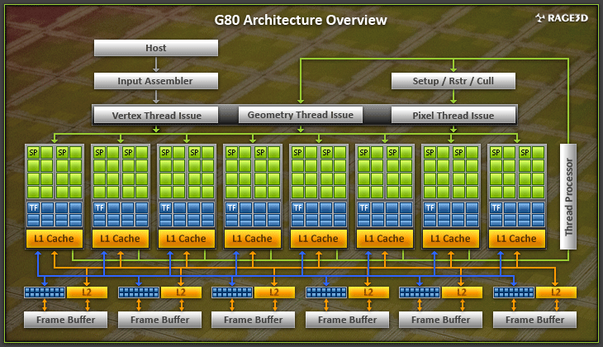
Unified Shading Architecture
The same processing units are utilized for vertex, geometry and fragment processing.
Fermi → 32 Cores / SM, some cards 32 SMs (1024 Cores)
Kepler → 192 Cores / SM, new cards have 8 SMs (1536 Cores)

Slide 22
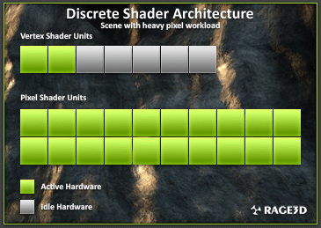
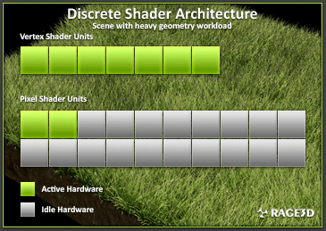
Unified Shading Architecture
In a traditional architecture when there is a lot of pixel workload, the vertex pipelines are sitting idle waiting for the pixel pipelines to finish (and vice versa)

Slide 23
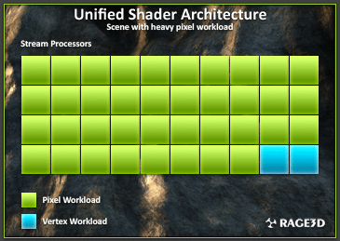
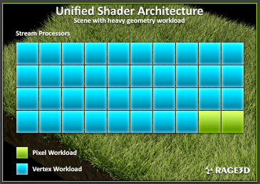
Unified Shading Architecture
In a unified architecture all processing resources are pooled together allowing the GPU to run with 100% efficiency
Very good for non-graphics workloads which typically use one type of processing for all their work
Simplifies chip design, as only one type of processor needs to be created and can be replicated as required

Slide 24
Modern Graphics Hardware
High Memory Bandwidth
Graphics Card
GPU
1Ghz
High bandwidth
190GB/s
Graphics memory
2GB
Output
Parallel Processes
PCIe bus
1GB/s
CPU
3.7Ghz
Main memory
32GB
Cache
8MB
18GB/s
Processor Chip

Slide 25
CPU/GPU interaction
The CPU and GPU inside the PC work in parallel with each other
There are two “threads” going on, one for the CPU and one for the GPU, which communicate through a command buffer:
GPU reads commands
Command
Ring Buffer
Pending GPU commands
CPU writes commands

Slide 26
CPU/GPU limitedness
If this command buffer is drained empty, we are CPU limited and the GPU will spin around waiting for new input.
If the command buffer fills up, the CPU will spin around waiting for the GPU to consume it, and we are effectively GPU limited.
GPU reads commands
Command
Ring Buffer
Pending GPU commands
CPU writes commands

Slide 27
Deferred execution
GPU programs do not follow the traditional sequential execution model.
In the CPU program below, the object is not drawn after statement A and before statement B:
Instead, all the API call does, is to add the command to draw the object to the GPU command buffer.
statement A;
API call to draw object
statement B;

Slide 28
GPU readbacks
The output of a GPU is a rendered image destined for the screen, what will happen if the CPU tries to read it?
The GPU must be synchronized with the CPU, i.e. it must drain the entire command buffer, and the CPU must wait while this happens.
GPU reads commands
Command
Ring Buffer
Pending GPU commands
CPU writes commands

Slide 29
GPU readbacks (cont)
We lose all parallelism, since first the CPU waits for the GPU, then the GPU waits for the CPU (because the command buffer has been drained)
Both CPU and GPU performance take a nosedive
Bottom line: the image the GPU produces is for your eyes, not for the CPU (treat the CPU -> GPU highway as a one way street)

Slide 30
Getting around GPU readbacks
Unfortunately, some applications (especially when using the GPU for non-graphics work) have to read the GPU output.
The best way to do this is to have the GPU copy the result in a temporary memory location but don’t attempt to read that with the CPU until some time later when the GPU is done.
To do that however, you have to be able to keep feeding the GPU with new input data that are not dependent on the result of a pending computation.

Slide 31
Some GPU tips
Since the GPU is highly parallel and deeply pipelined, try to dispatch large batches with each drawing call.
Sending just one triangle at a time will not occupy all of the GPU’s several vertex/pixel processors, nor will it fill its deep pipelines.
Since all GPUs today use the zbuffer algorithm to do hidden surface removal, rendering objects front-to-back is faster than back-to-front (painters algorithm), or random ordering.
Of course, there is no point in front-to-back sorting if you are already CPU limited
Avoid transferring data to and from the GPU while processing. Pre-load at startup your GPU with what data (e.g. textures) you may need later.

