Slide 1

Υπολογιστική Όραση
Computer Vision
Single and multi-view geometry
Slides by Dr Vasilis Argyriou

Slide 2
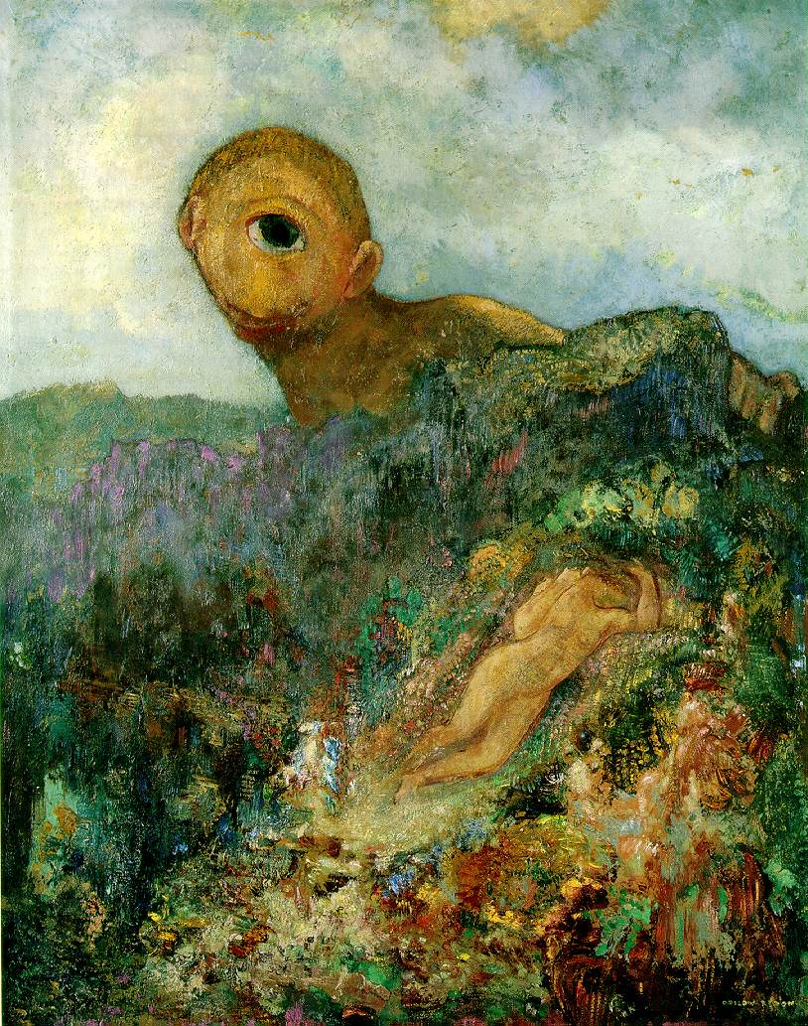
Single-view geometry
Odilon Redon, Cyclops, 1914

Slide 3
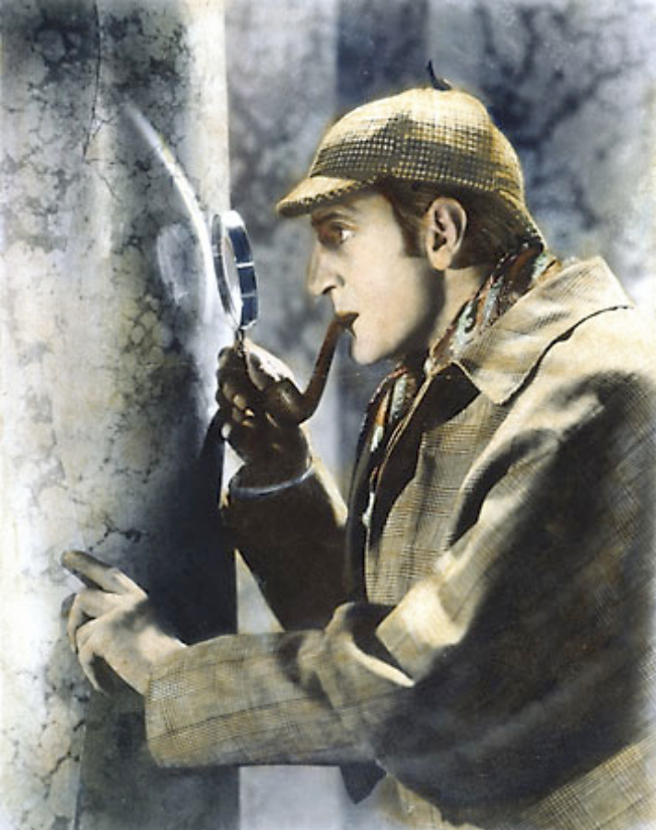
Geometric vision
Goal: Recovery of 3D structure
  What cues in the image allow us to do this?

Slide 4
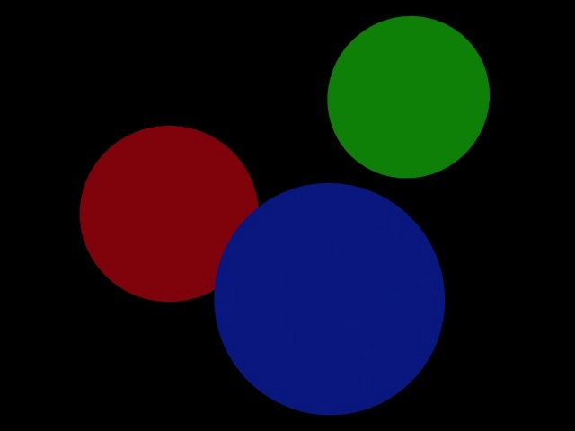
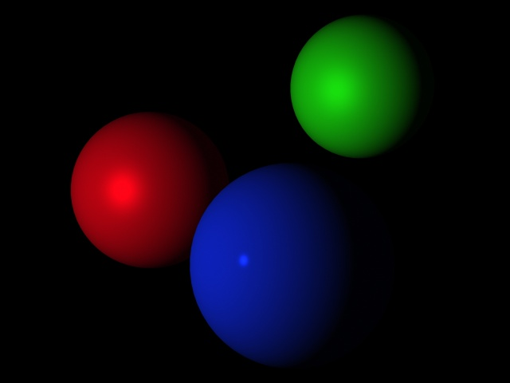
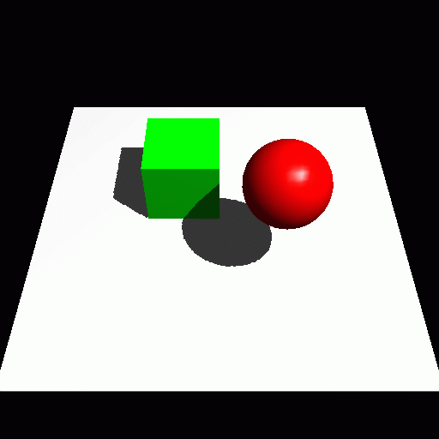
Visual cues
Shading

Slide 5
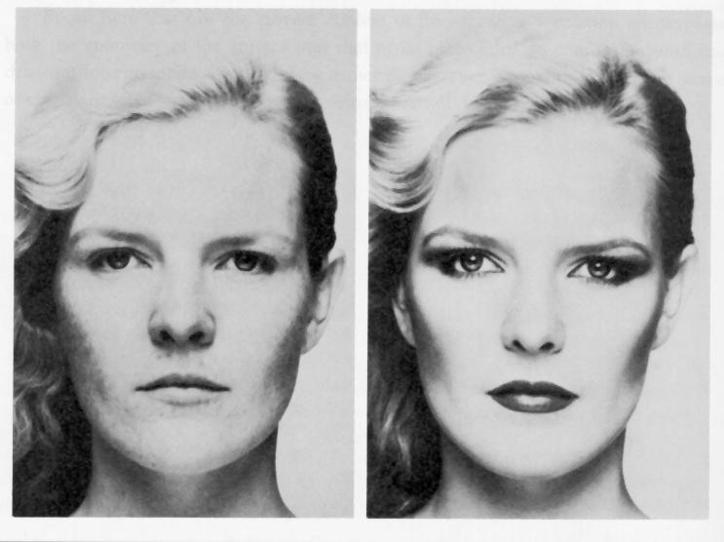
Visual cues
Shading
Slide credit: S. Seitz

Slide 6
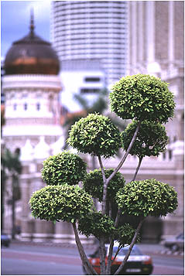
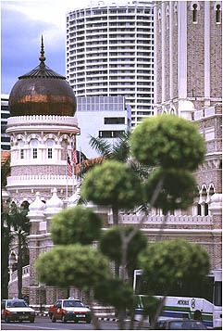
Visual cues
Focus
From The Art of Photography, Canon
Slide credit: S. Seitz

Slide 7
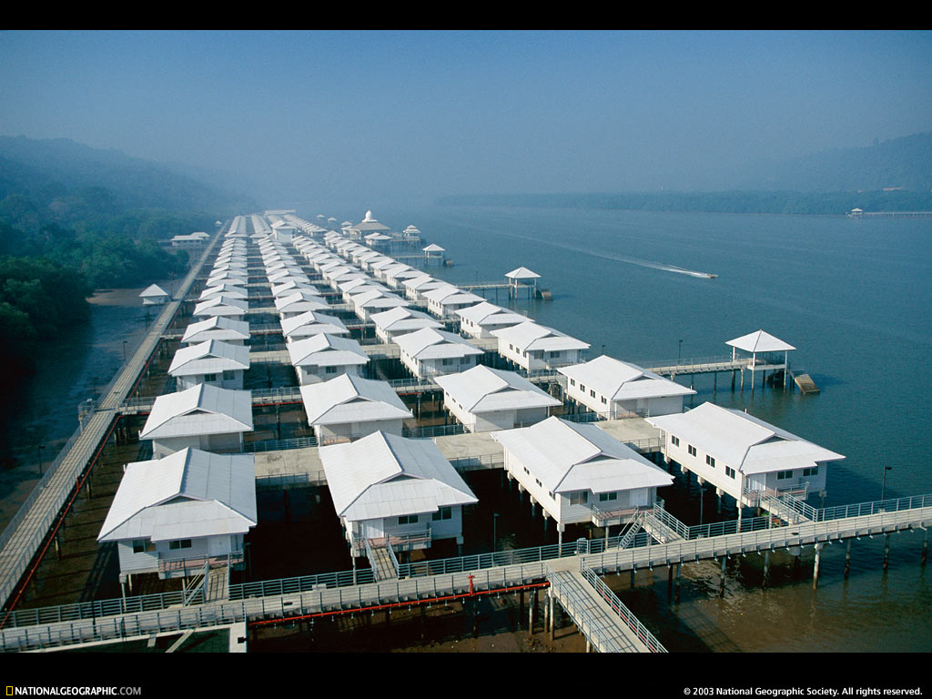
Visual cues
Perspective
Slide credit: S. Seitz

Slide 8
Our goal: Recovery of 3D structure
We will focus on perspective and motion
We need multi-view geometry because recovery of structure from one image is inherently ambiguous
X?
X?
X?
x

Slide 9
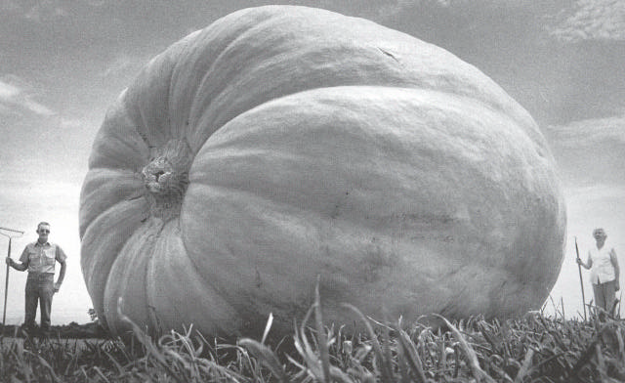
Our goal: Recovery of 3D structure
We will focus on perspective and motion
We need multi-view geometry because recovery of structure from one image is inherently ambiguous

Slide 10
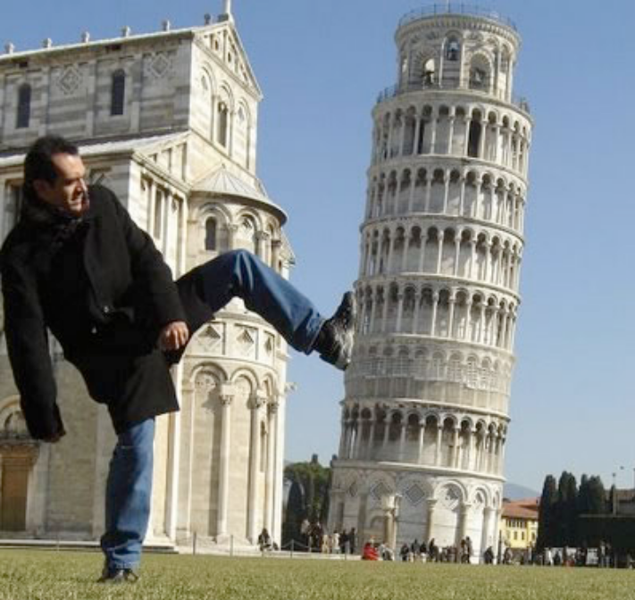
Our goal: Recovery of 3D structure
We will focus on perspective and motion
We need multi-view geometry because recovery of structure from one image is inherently ambiguous

Slide 11
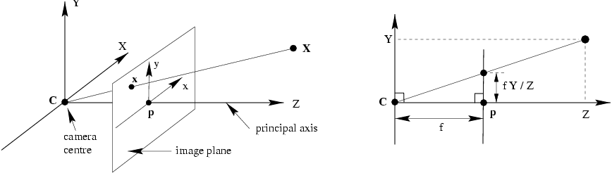
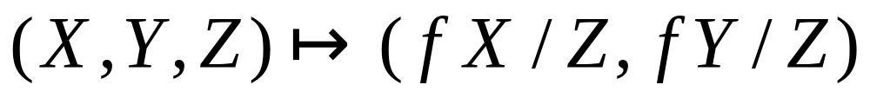
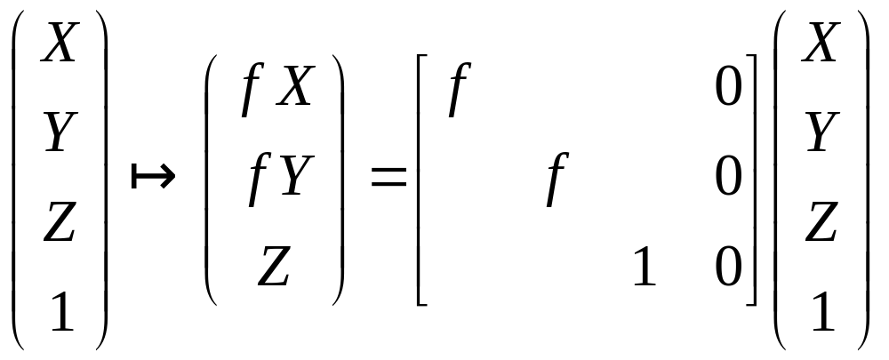
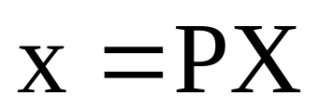
Recall: Pinhole camera model

Slide 12
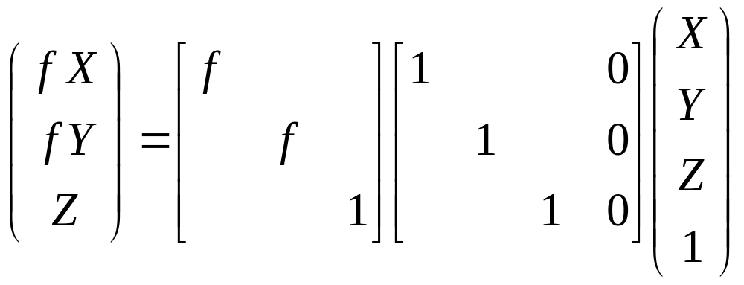
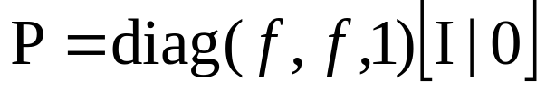
Pinhole camera model

Slide 13
Camera coordinate system
Principal axis: line from the camera center perpendicular to the image plane
Normalized (camera) coordinate system: camera center is at the origin and the principal axis is the z-axis
Principal point (p): point where principal axis intersects the image plane (origin of normalized coordinate system)

Slide 14
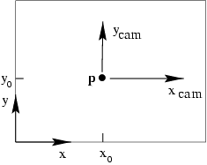
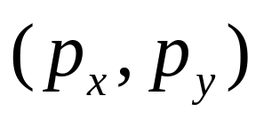
Principal point offset
principal point:
Camera coordinate system: origin is at the prinicipal point
Image coordinate system: origin is in the corner

Slide 15
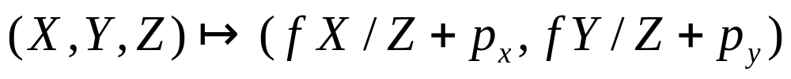
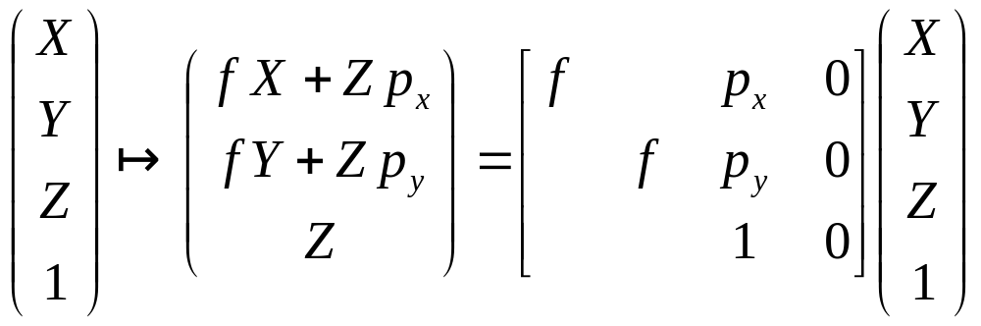
Principal point offset
principal point:

Slide 16
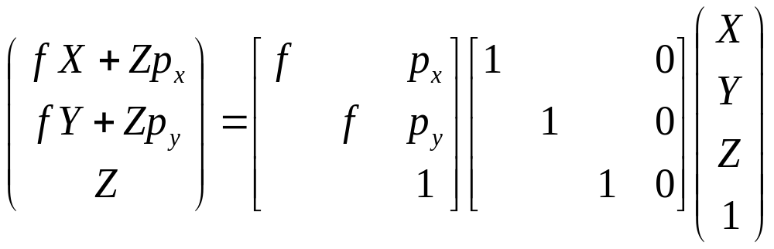
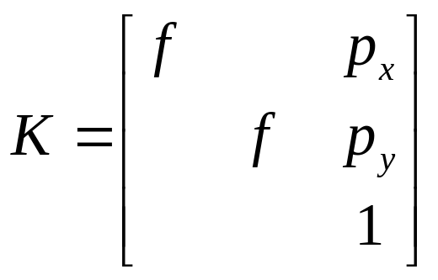
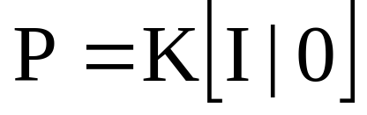
Principal point offset
principal point:
calibration matrix

Slide 17
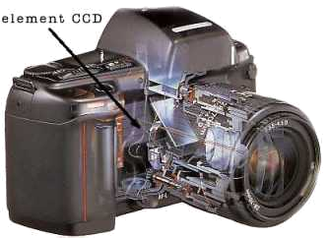
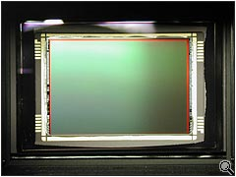
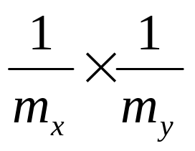
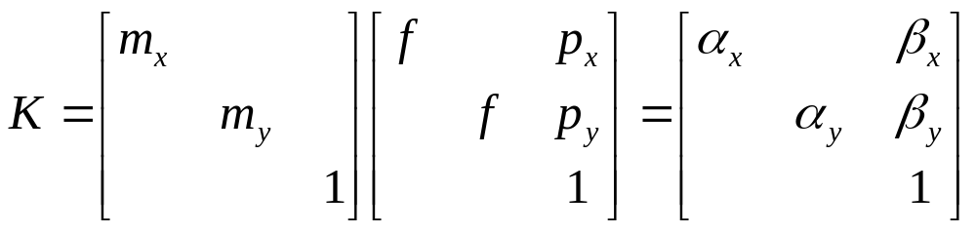
Pixel coordinates
Pixel size:
m_{x} pixels per meter in horizontal direction,
m_{y} pixels per meter in vertical direction
pixels/m
m
pixels

Slide 18
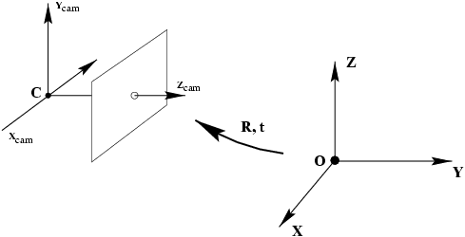
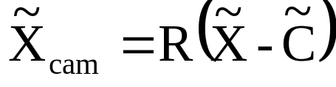
Camera rotation and translation
In general, the camera coordinate frame will be related to the world coordinate frame by a rotation and a translation
coords. of point
in camera frame
coords. of camera center
in world frame
coords. of a point
in world frame (nonhomogeneous)

Slide 19
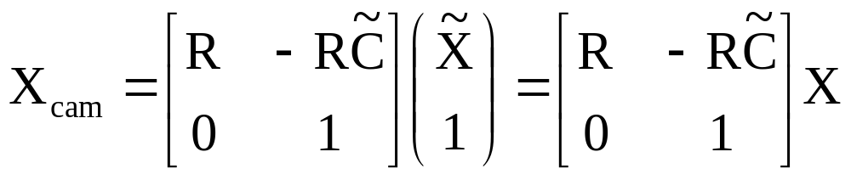
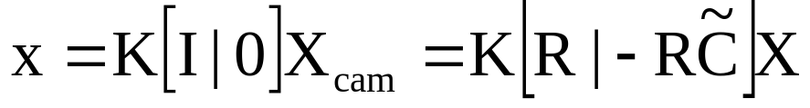
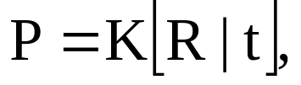
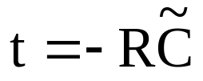
Camera rotation and translation
In non-homogeneous
coordinates:
Note: C is the null space of the camera projection matrix (PC=0)

Slide 20
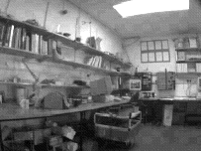
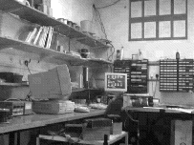
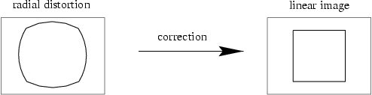
Camera parameters
Intrinsic parameters
  Principal point coordinates
  Focal length
  Pixel magnification factors
  Skew (non-rectangular pixels)
  Radial distortion

Slide 21
Camera parameters
Intrinsic parameters
  Principal point coordinates
  Focal length
  Pixel magnification factors
  Skew (non-rectangular pixels)
  Radial distortion
  Extrinsic parameters
  Rotation and translation relative to world coordinate system

Slide 22
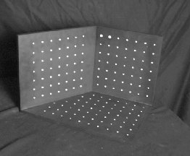
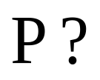
Camera calibration
Given n points with known 3D coordinates X_{i} and known image projections x_{i}, estimate the camera parameters
X_{i}
x_{i}

Slide 23
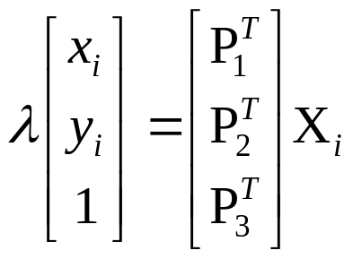

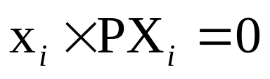
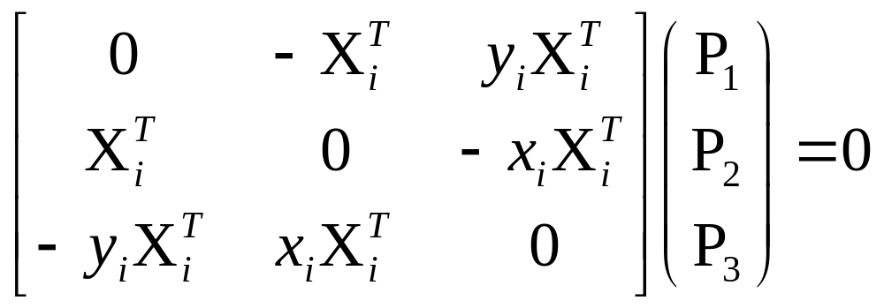
Camera calibration
Two linearly independent equations

Slide 24
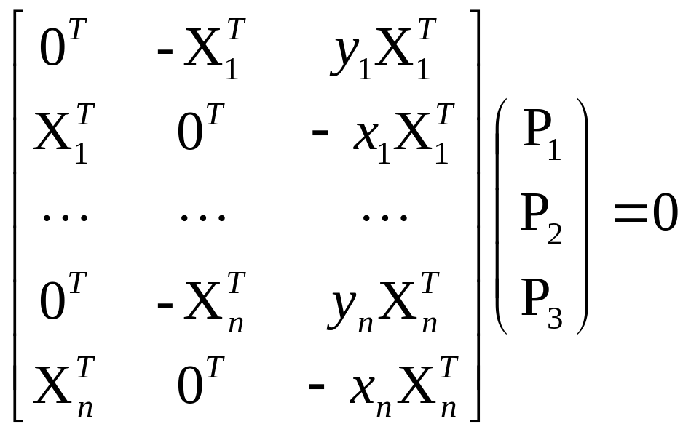
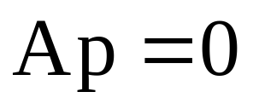
Camera calibration
P has 11 degrees of freedom (12 parameters, but scale is arbitrary)
One 2D/3D correspondence gives us two linearly independent equations
Homogeneous least squares
6 correspondences needed for a minimal solution

Slide 25
Camera calibration
Note: for coplanar points we will get degenerate solutions

Slide 26
Camera calibration
Once we’ve recovered the numerical form of the camera matrix, we still have to figure out the intrinsic and extrinsic parameters
This is a matrix decomposition problem, not an estimation problem

Slide 27
Two-view geometry
Scene geometry (structure): Given projections of the same 3D point in two or more images, how do we compute the 3D coordinates of that point?
Correspondence (stereo matching): Given a point in just one image, how does it constrain the position of the corresponding point in a second image?
Camera geometry (motion): Given a set of corresponding points in two images, what are the cameras for the two views?

Slide 28
Triangulation
Given projections of a 3D point in two or more images (with known camera matrices), find the coordinates of the point
X?
x₂
x₁
O₁
O₂

Slide 29
Triangulation
We want to intersect the two visual rays corresponding to x₁ and x₂, but because of noise and numerical errors, they don’t meet exactly
R₂
R₁
X?
x₂
x₁
O₁
O₂

Slide 30
Triangulation: Geometric approach
Find shortest segment connecting the two viewing rays and let X be the midpoint of that segment
X
x₂
x₁
O₁
O₂

Slide 31
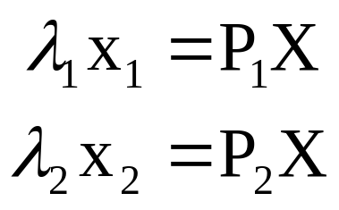
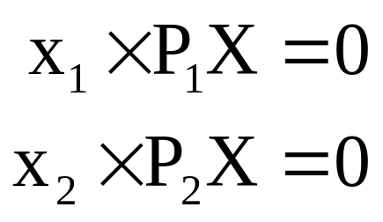
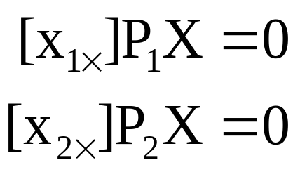
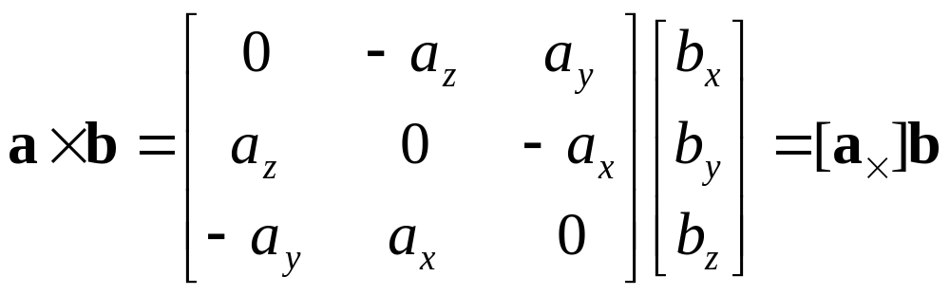
Triangulation: Linear approach
Cross product as matrix multiplication:

Slide 32
Triangulation: Linear approach
Two independent equations each in terms of
three unknown entries of X

Slide 33
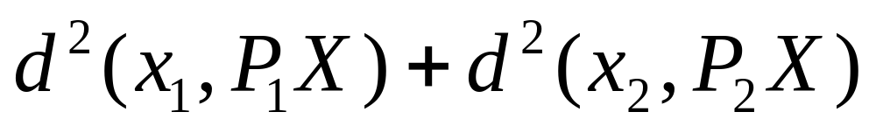
Triangulation: Nonlinear approach
Find X that minimizes
X?
x’₁
x₂
x₁
x’₂
O₁
O₂

