Slide 1
Automatic offline spike sorting using SpikeCluster
Minggui Chen, Ph.D.
minggui.chen@gmail.com

Slide 2
Offline sorting?
multi-electrode array
signal quality
manual sorting using Offline Sorter -- time-consuming
customized codes -- which algorithm?
isolation quality -- ‘well-isolated’ doesn’t work nowadays

Slide 3
Offline sorting?
multi-electrode array
signal quality
manual sorting using Offline Sorter -- time-consuming
customized codes -- which algorithm?
isolation quality -- ‘well-isolated’ doesn’t work nowadays
An integrated toolbox to
automatically sort action potentials,
quantify the isolation quality.

Slide 4
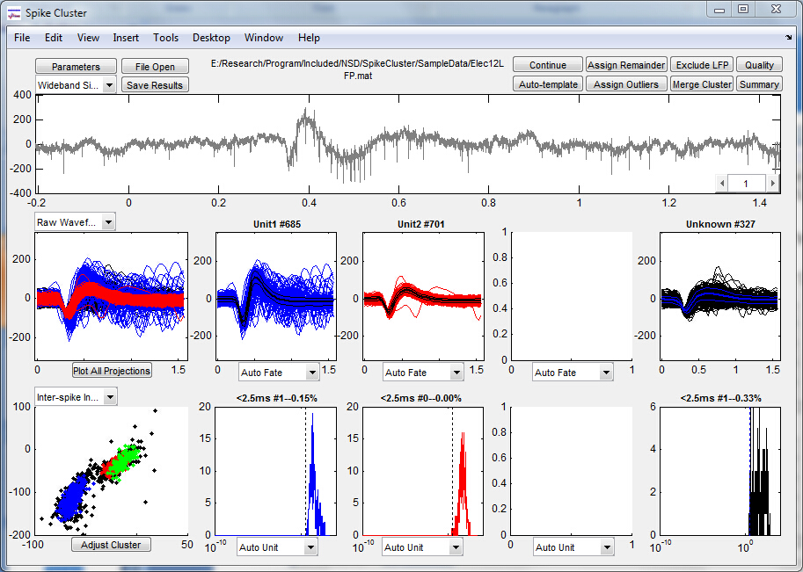
SpikeCluster
A similar GUI to WAVE_CLUS by Quiroga, R.Q.

Slide 5
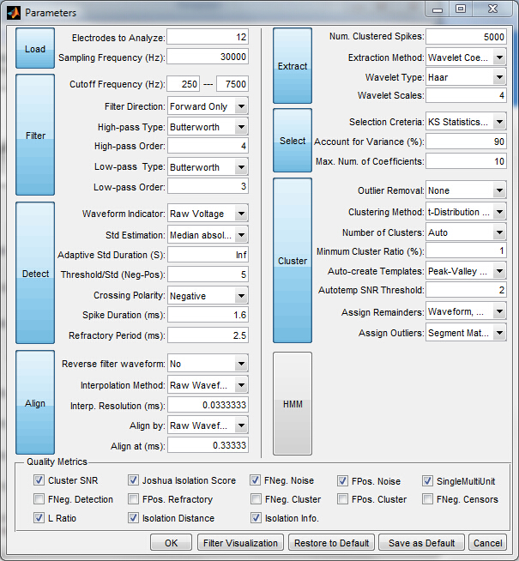
But SpikeCluster has…
Aims to automate spike sorting and qualification

Slide 6
Overall scheme of SpikeCluster
Raw signal
Filtering
Spike detection
Feature extraction
Clustering
Template matching
Segment matching
Isolation quality

Slide 7
Overall scheme of SpikeCluster
Raw signal
Filtering
Spike detection
Feature extraction
Clustering
≥ 2 clusters
Template matching
Segment matching
Isolation quality

Slide 8
Overall scheme of SpikeCluster
Raw signal
Filtering
Spike detection
Feature extraction
Clustering
Failed
(a single cluster with a low SNR)
Auto-template
≥ 2 clusters
Template matching
Segment matching
Isolation quality

Slide 9
Time for demos

Slide 10
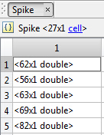
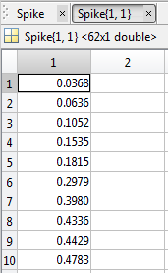
Data format for online spikes (*.mat)
Trial #
Spike times

Slide 11
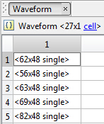
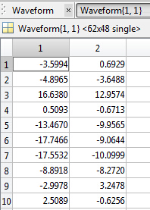
Data format for online spikes (*.mat)
Trial #
Trial #
Spike times
waveforms

Slide 12
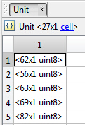
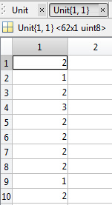
Data format for online spikes (*.mat)
Trial #
Trial #
Trial #
Spike times
waveforms
unit #

Slide 13
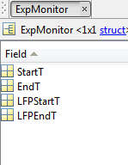
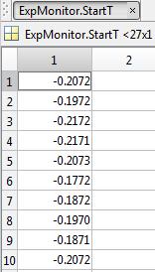
Data format for online spikes (*.mat)
Trial #
Trial #
Trial #
Spike times
waveforms
unit #
Trial #

Slide 14
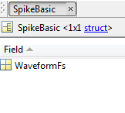
Data format for online spikes (*.mat)
Trial #
Trial #
Trial #
Spike times
waveforms
unit #
Trial #

Slide 15
Data format for unfiltered LFP (*.mat)
Trial #

Slide 16
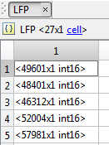
Data format for unfiltered LFP (*.mat)
Trial #
Trial #

Slide 17

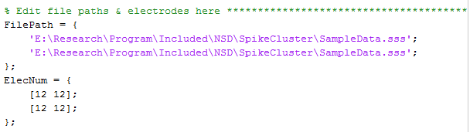
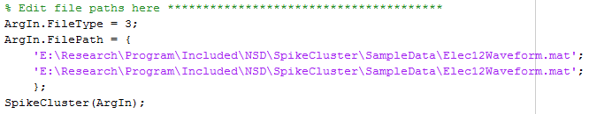
Automated analysis
individual *.mat file -- open the mat file directly
batch mat files -- open *Batch.m directly
batch all channels in multiple files -- open *FileBatch.m directly
called as a function

