Slide 1
SERIES 1 — LABORATORY EXERCISE
Convergence, Limits and the Number e
(1 + 1/n)^n · (a^h − 1)/h · Σ x^n / n!
Python + NumPy + Matplotlib | three exercises, three histograms, one answer: e = 2.718281828…

Slide 2
CONCEPT
One constant, three equivalent definitions
▪ Exercise 1 — sequence: e = lim_{n→∞} (1 + 1/n)^n (compound interest paid n times/year)
▪ Exercise 2 — difference quotient: lim_{h→0} (a^h − 1)/h = ln(a) (derivative of a^x at 0)
▪ Exercise 3 — power series: e^x = Σ_{n=0}^{∞} x^n / n! (with x = 1: e = Σ 1/n!)
▪ All three constructions converge to the SAME double-precision value 2.718281828459045
Take-away of the sheet:
A limit is a number — but the ALGORITHM used to compute it decides whether you actually see it (numerical stability, machine precision).

Slide 3
EXERCISE 1
Compound interest: (1 + 1/n)^n → e
Question: implement (1 + 1/n)^n for frequencies yearly, twice a year, quarterly, … up to every nanosecond, and draw a histogram in Matplotlib.
The mathematics
▪ n = number of interest-payment periods per year (1, 2, 4, 12, 365, 8 760, …, 3.1536×10^16)
▪ yearly: 2.000000 | 2×/year: 2.250000 | quarterly: 2.441406 | monthly: 2.613035 | daily: 2.714567
▪ Limit: lim (1 + 1/n)^n = e = 2.718281828…
▪ First-order error: e − A(n) ≈ e/(2n) — to halve the gap, double n
Numerical catch (up to the nanosecond):
for n ≥ 10^16 the literal float 1 + 1/n rounds to 1.0 → naive code returns 1.0. Stable form: exp(n * log(1 + 1/n)) with math.log1p.

Slide 4
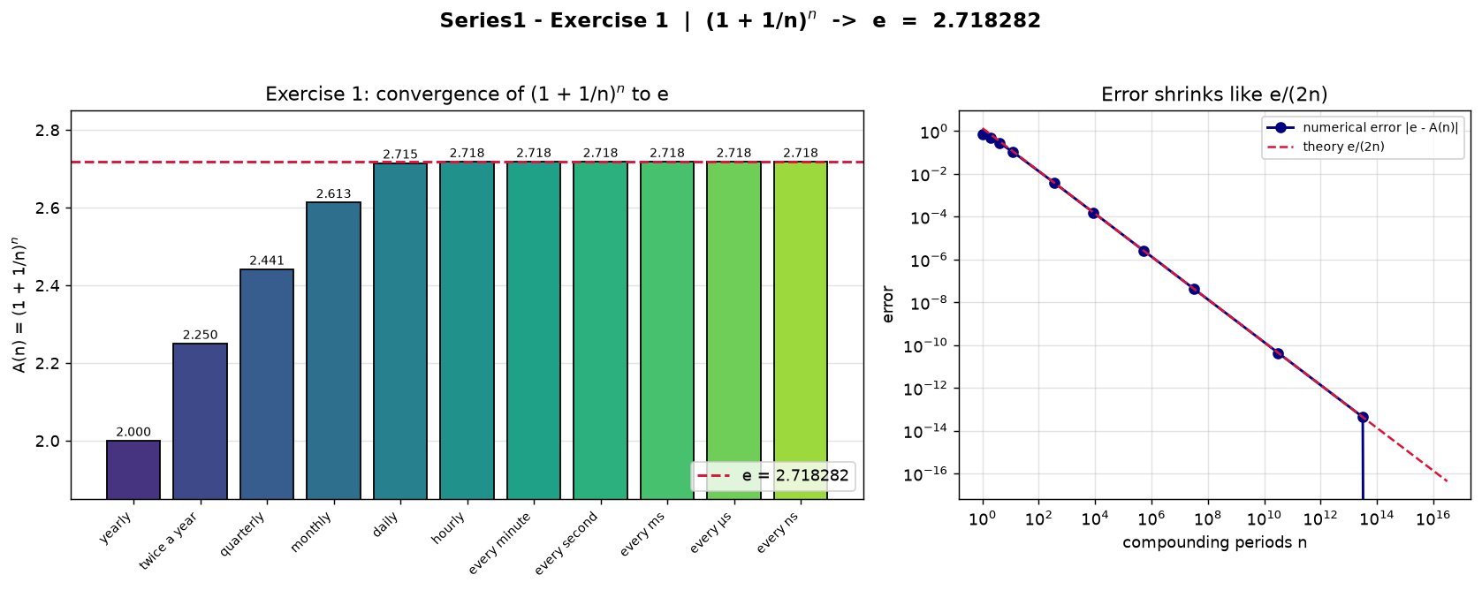
EXERCISE 1 — RESULTS
A(n) from yearly up to every nanosecond
Output table (stable computation)
yearly 2.000000 error 7.2e-01
twice a year 2.250000 error 4.7e-01
quarterly 2.441406 error 2.8e-01
monthly 2.613035 error 1.1e-01
daily 2.714567 error 3.7e-03
hourly 2.718127 error 1.6e-04
per minute 2.718279 error 2.6e-06
per second 2.718282 error 4.3e-08
per ms 2.718282 error 4.3e-11
per us 2.718282 error 4.4e-14
per ns 2.718282 error 0

Slide 5
EXERCISE 2
Difference quotient: (a^h − 1)/h → ln(a)
Question: implement the table of (a^h − 1)/h for three bases a = 2, e, 3 as h shrinks (tolerance ×10^−6) and draw a histogram.
The mathematics
▪ (a^h − 1)/h = slope of the SECANT of f(x) = a^x between 0 and h
▪ As h → 0 the secant becomes the TANGENT at x = 0
▪ Slope of the tangent = derivative f′(0) = ln(a)
▪ Limits: a=2 → 0.6931 a=e → 1.0000 a=3 → 1.0986
This is how the derivative of the exponential is defined from first principles — no derivative rules needed!

Slide 6
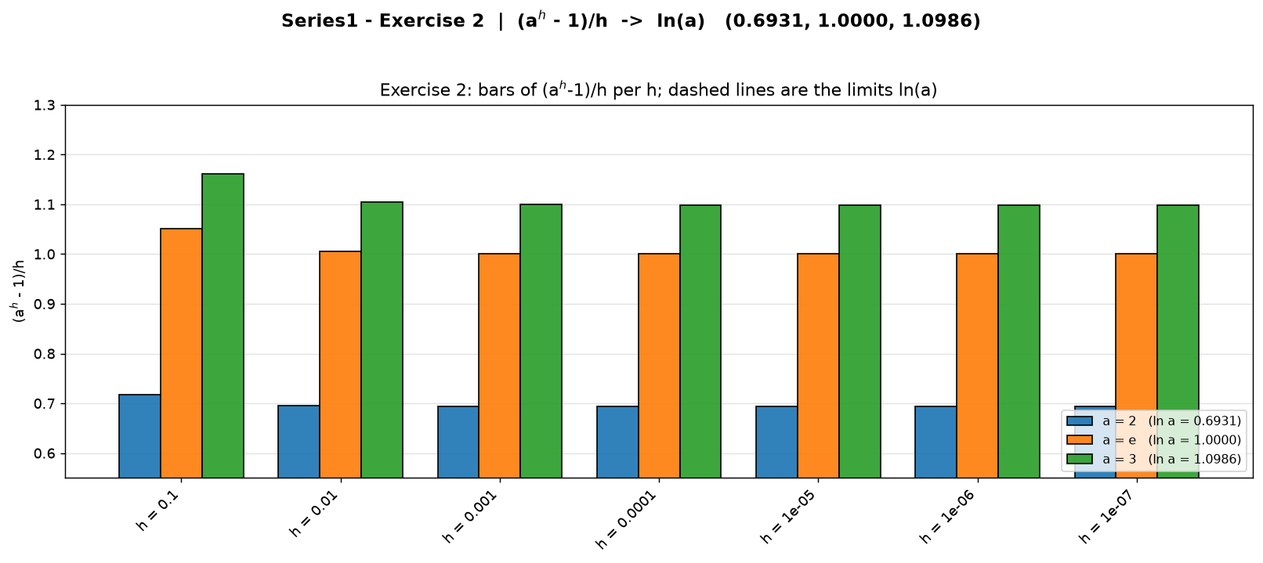
EXERCISE 2 — RESULTS
The table settles at ln(a) as h shrinks
Exact reproduction of the sheet’s table
h a=2 a=e a=3
h = 0.1 0.7177 1.0517 1.1612
h = 0.01 0.6956 1.0050 1.1047
h = 0.001 0.6934 1.0005 1.0992
h = 0.0001 0.6932 1.00005 1.0987
h = 1e-5 0.6931 1.00000 1.0986
h = 1e-6 0.6931 1.00000 1.0986
limit 0.6931 1.0000 1.0986
tolerance 1e-6 is reached at h = 1e-6 for all three bases

Slide 7
EXERCISE 3
Exponential series: e^x = Σ x^n / n! (x = 1)
Question: implement e^x = Σ_{n=0}^{∞} x^n / n! for x = 1, summing from n = 0 up to 10,000 terms; draw a histogram.
The mathematics
▪ Every term from the previous one: term(n) = term(n−1) · x / n, term(0) = 1 — no huge factorials
▪ For x = 1 the series reads e = 1 + 1 + 1/2! + 1/3! + … = Σ 1/n!
▪ Tail bound after N terms: |e − S_N| < 1/(N+1)! (factorial beats every polynomial)
▪ Partial sums: S_10 = 2.7182818011 | S_100 = 2.7182818285
By N ≈ 20 the terms are below 1/21! ≈ 5×10^−20: the sum saturates at the double-precision value of e — 10,000 terms run instantly.

Slide 8
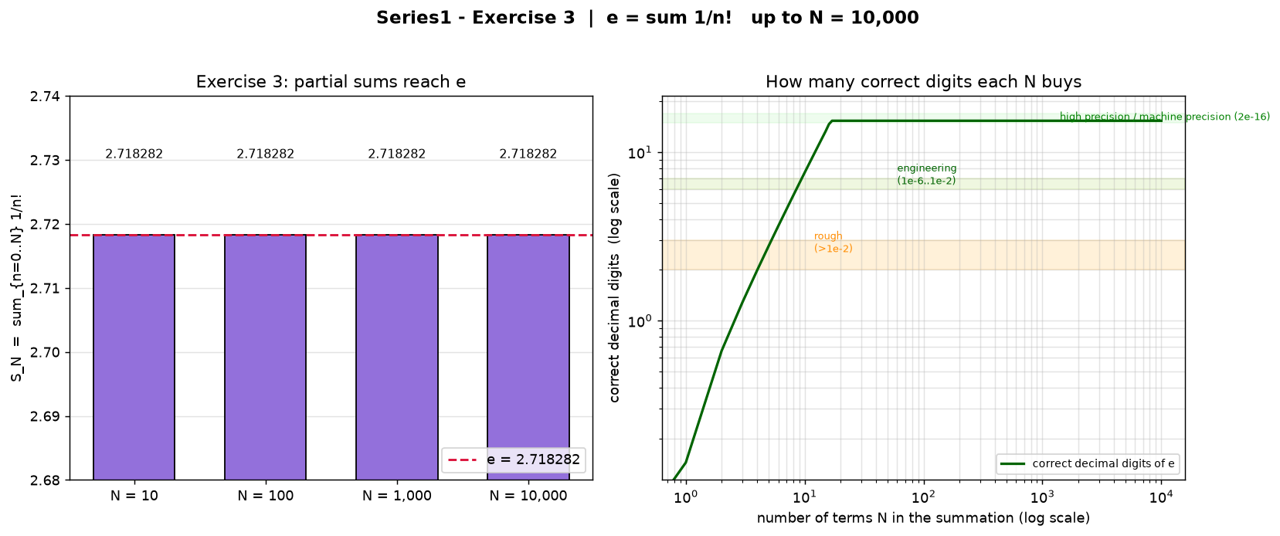
EXERCISE 3 — RESULTS
Partial sums up to N = 10,000 terms
Checkpoint table
N(terms) S_N |e−S_N| digits
10 2.7182818011 2.7e-08 8
100 2.7182818285 4.4e-16 16
1,000 2.7182818285 4.4e-16 16
10,000 2.7182818285 4.4e-16 16
machine precision ≈ 2.2e-16 reached at N = 100
Accuracy bands (right panel):
rough >1e-2 · engineering 1e-6..1e-2 · high precision <1e-6 · machine 2e-16

Slide 9
ANSWERS
Every road leads to e
Exercise 1 → A(ns) = 2.718282 = e (naive code says 1.0!)
Exercise 2 → (2^h−1)/h → 0.6931, (e^h−1)/h → 1.0000, (3^h−1)/h → 1.0986 = ln(a)
Exercise 3 → S_10000 = Σ 1/n! = 2.718281828459045 = e (double)
Key takeaways
▪ Sequences, quotients and series are three lenses on the same limit — match the tool to the definition.
▪ Numerical stability: log1p/exp rewrites keep nanosecond-scale answers honest.
▪ Machine precision caps accuracy at ~16 digits; bigger N buys nothing once the tail is below 2e-16.

Slide 10
THANK YOU — QUESTIONS?
Series1 · Laboratory Exercise — solved with Python, NumPy and Matplotlib
scripts: exercise1_compound_interest.py · exercise2_difference_quotient.py · exercise3_exponential_series.py

