Slide 1

Rockbuster Stealth
LAUNCHING THE STREAMING BUSINESS
Analysis by
Christine Dietzsch

Slide 2
The Why
Rockbuster Stealth LLC is a movie rental company that used to have stores around the world.
Facing stiff competition from streaming services such as Netflix and Amazon Prime, the Rockbuster Stealth management team is planning to use its existing movie licenses to launch an online video rental service in order to stay competitive.
This analysis provides insights for a strategy launch into online video service.

Slide 3
BASIC FACTS:
1,000 different movies
20 different movie categories in total
5 rating categories
Movie Length: 46min to 185 min, avg: 115
MOVIES
&
RENTALS
BASIC FACTS:
16.044 rentals
Rental Duration: 3 to 7 days, avg: 5 days
Rental Rate: 0,99 USD to 4,99 USD, avg: 2,98 USD
Replacement Costs: 9,99 USD to 29,99 USD, avg. 19,98 USD

Slide 4
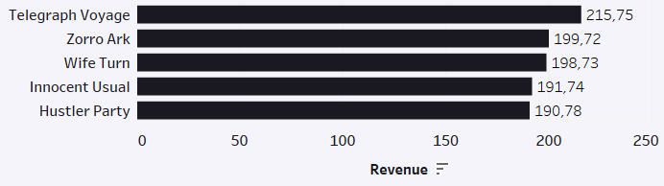
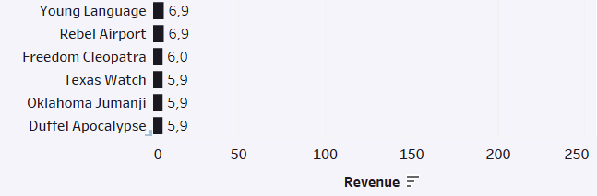
Most-revenue-movies: check licenses and copyrights
Most revenue:
„Telegrah Voyage“ had the highest impact in revenue with 215,75 USD.
With high-impact movies, check licences and copyrigths to make sure they are available,
Purchase or prolong licences if needed.
Least revenue:
„Duffel Apocalypse“ was the least successful movie with only 5,9 USD.
If licences expire: Take movies off the platform
If licences exist for the upcoming time or are very cheap: Prepare special offers for clients to increase rentals.

Slide 5
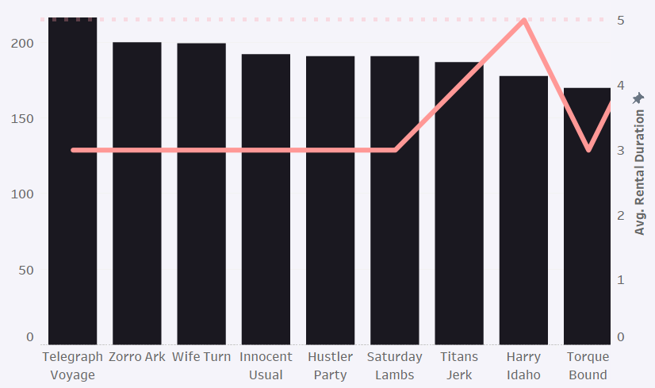

Most successful movies are not rented longest
The min-max rental duration is 3 – 7 days.
The overall average are 5 days (dotted line in the graph).
Most popular movies are not rented longer (but more frequent).
The least popular movies are rented between 5 to 7 days (not visualized here).

Slide 6
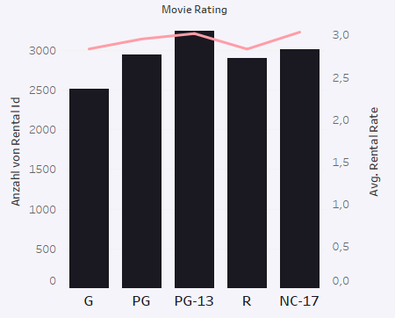
R-movies can be increased in rental rates + bulk up on PG-13 movies
There are five rating categories.
PG-13 is most popular, having the second highest average rental rate.
R-movies can be increased in rental-rates
As a plus: More licences of PG-13 rated movies can be purchased; to have more available.
The Motion Picture Association of America categorizes films based on their content and appropriateness for different age groups:
G = General Audience
PG = Parental Guidance Suggested
PG-13 = Parents Strongly Cautioned
R = Restricted
NC-17 = Adults Only

Slide 7
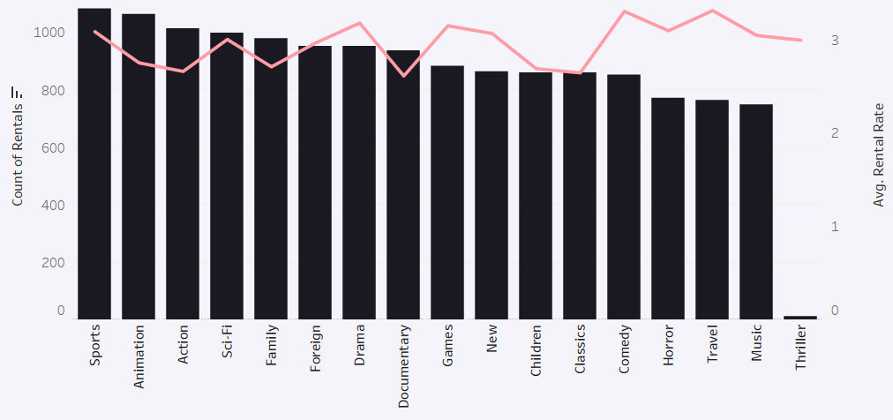
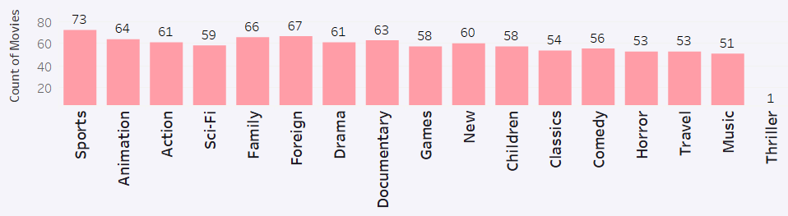
Sports, Animation and Action are most popular categories
There are 17 different movie categories
In terms of the count of rentals Sports, Animation and Action are the most popular; Thriller performs least.
The average rental rate is lowest for Documentary and highest for Travel.
The average rental rate is 2,98.
Categories of most popular (most rented) movies should dominate in numbers. At least in Animation and Action more movies can be purchased for the future streaming business.

Slide 8
BASIC FACTS:
61.312 USD generated revenue
General avg. revenue per rental is 4,2 USD
599 clients, from
108 different countries
SALES
&
CLIENTS

Slide 9
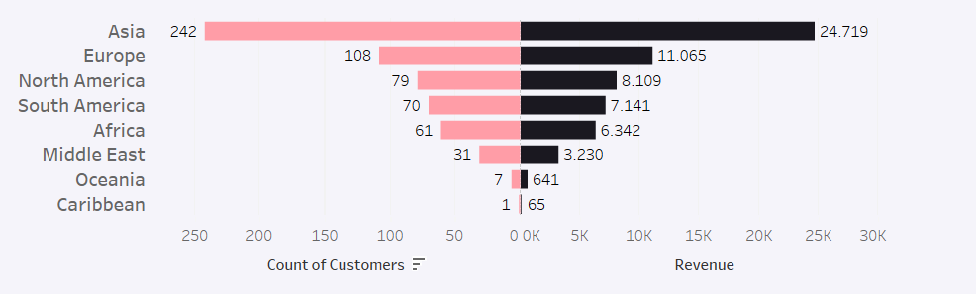
Sales and Client count: Asia leads, followed by Europe
Avg USD/rental:
Asia: 4,1 USD:
Europe: 4,3
North A.: 4,2
South A.: 4,3
Africa: 4,3
Middle East: 4,3
Oceania: 4,2
Caribbean: 3,6
Sales and numbers of clients are best in Asia (with distinction), followed by Europe.
In general, counts of rentals and sum of revenue are quite proportional
Average rates per rental are very similar overall.

Slide 10
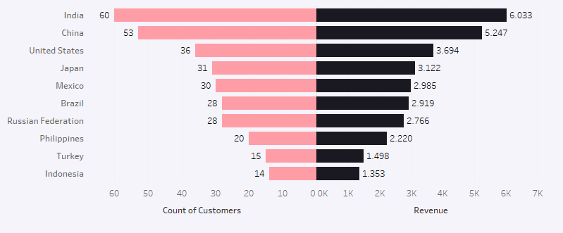
India and China dominate the Asian market
Avg USD/rental:
India: 3,0
China: 2,9
USA: 2,9
Japan: 3.0
Mexico: 3.0
Brazil: 3.0
Russ.Fed.: 3.0
Philippines: 2,9
Turkey: 3.0
Indonesia: 2,8
Most of the clients are located in India and China; in India almost twice as much as in the US and following countries.
India and China a very open to digital or online-based business. Online streaming will have great impact here und will be easily established among potential customers from a device-and-software-point of view, but we will face also high customer demands on user experience and profound competition from established companies.

Slide 11
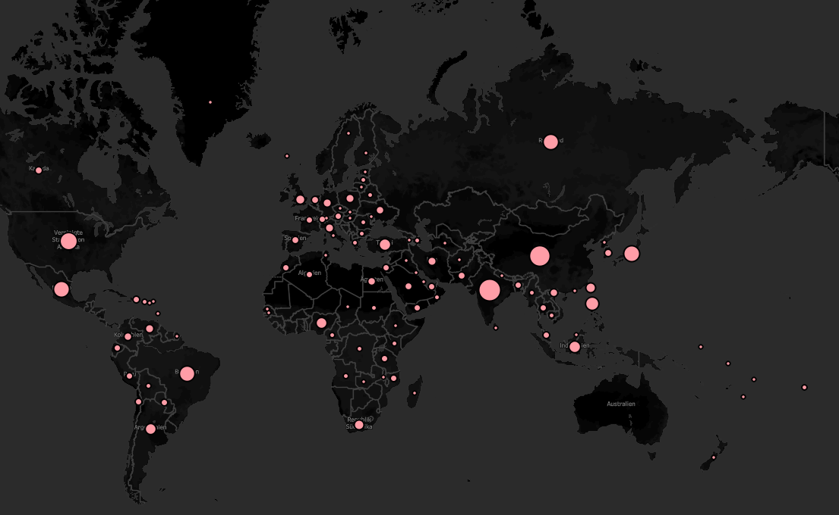
See in the map, where all the clients are located!
USA: 36
China: 53
India: 60
A heartfelt reward to our most valuable clients! This reward goes to:
Eleanor from Saint-Denis, Runion with total amount paid: 211.55 USD
Karl from Cape Coral, United States with total amount paid: 208.58 USD
Marion from Santa Brbara dOeste, Brazil with total amount paid: 194.61 USD
Rhonda from Apeldoorn, Netherlands with total amount paid: 191.62 USD
Clara from Molodetno, Belarus with total amount paid: 189.6 USD

Slide 12
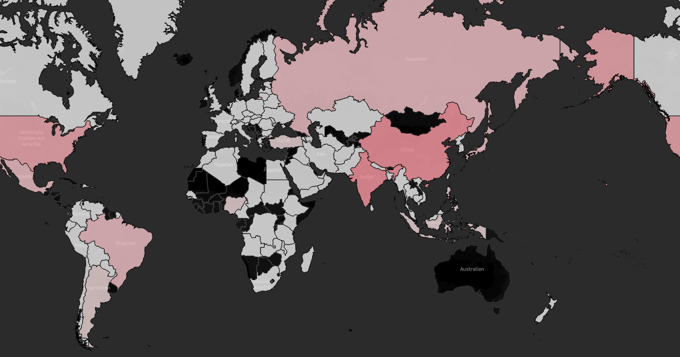

Global revenue per Country: India and China are best.

Slide 13
BTW: Remind due clients to pay…
There are 530 clients with in total 1452 rentals (9% of total count of rentals), worth about 4,300 USD of missing revenue, who have returned the movie, but don’t have matching payments in the database.
Those clients need to be reminded. They are to be found in the Excel file (Appendix).
For a smooth visualization with correct ratios, the visualization has it’s focus on complete rental procedures, that is with completed payments.

Slide 14
Recommendations to start the streaming business
Data related recommendations:
Check licences and copyrights for all movies, especially for most successful ones: Telegraph Voyage, Zorro Ark, Wife Turn, etc.
Purchase additional licences from most popular categories: Sports, Animation and Action
Purchase additional licences from most popular ratings: PG-13
Consider increasing rental rates for R-rated movies
Boost marketing activities in countries with high customer base (India and China)
Reward clients, who spent high amounts, like free rentals when first logging in in their streaming account, etc.
General recommendations and next steps:
Invest in stable and high-end software solutions. User Experience will be crucial.
Commit to a profound analysis of the competition to benchmark recommendations from this analysis, that is after all run on only 599 clients. The potential client base is much bigger and the company will have to adapt to different demands and preferences, than those from current regular customers.

Slide 15
THANK YOU!
This delivery includes:
PowerPoint Presentation
Data Dictionary
Excel file with all SQL codes and (additional) data outputs
Tableau Board with visualizations: https://public.tableau.com/app/profile/christine.dietzsch/viz/RockbusterStealthBoard/STORYBOARD?publish=yes
Find me on XING or LinkedIn
Credits: Picture from Unsplash (Artist: Dyllan Calluy)

