Slide 1

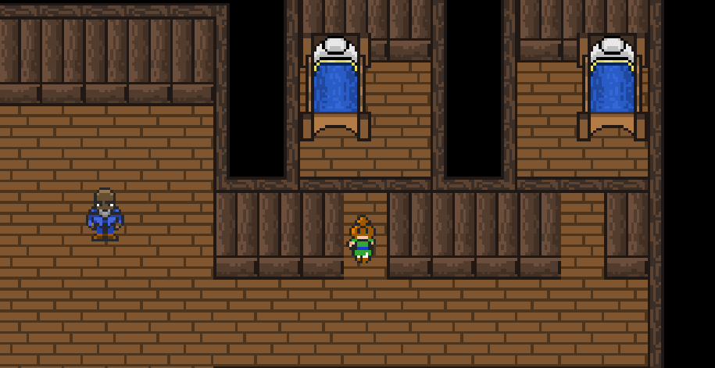
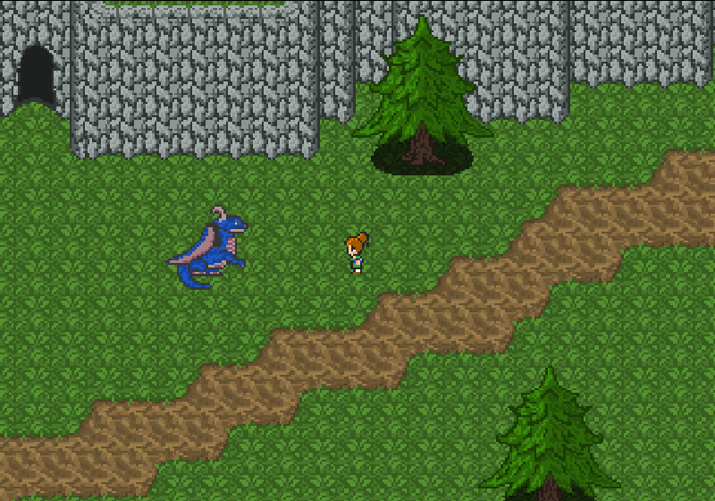
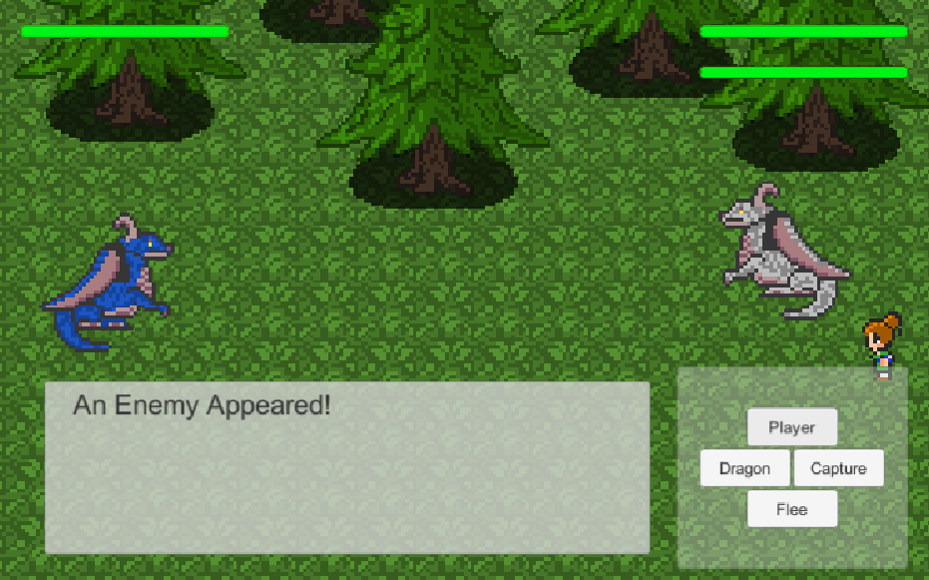
Dragonlord Chronicles
Sean Stevens, Jonathan Meade, Christine Vaughan, Ryan Lieu Department of Computer Science and Engineering, University of Nevada, Reno
Sergiu Dascalu, Devrin Lee
Eelke Folmer
CSE
Abstract
Features
Conclusions
Dragonlord Chronicles is an interactive Role-Playing Game (RPG) where the player assumes the role of a character training to become the Dragonlord. The gameplay involves exploring several different regions to discover new types of dragons and to capture them after a valiant battle. As the player grows in strength and experience, they will be prepared to confront their final challenge to become the Dragonlord. This game was inspired by several different RPGs, namely Pokemon, Final Fantasy, and Xenoblade Chronicles.
The application demonstrates the following systems:
Exploration. The player can transition to different sections of the world when they encounter a loading zone.
Dialogue System. The player may speak with different NPCs around town.
Inventory System. The player collects different items that may be helpful during their adventure.
Shopkeeper System. The player may buy, sell, and trade various items with the shopkeepers to get better potions, armor, and weapons.
Capture System. The player may capture different dragons over the course of their adventure.
The challenges we had when developing this game were overscoping and difference experience levels with Unity. We originally wanted to do a lot more with the game than what we had time for, so we had to scale the concept down to its core features: exploration, combat, and a minimal story.
Goals
We sought out to develop a fun and engaging RPG to provide people with entertainment and to allows players to unwind from stress.
Our team also wanted to obtain more experience with developing complex games both using the Unity game engine and more experience designing good games.
Future Work
Architecture
We plan to develop the game further by adding more regions to explore. Currently, there are three unique settings, and we would increase the number of towns and landscapes to explore.
In addition, we will expand upon the combat system by adding new dragon types, which would increase the complexity of combat.
Finally, we would develop a questing system to tell smaller side stores in addition to a grander main story.
This game uses the Unity game engine. Its features were programmed in C#. The artwork was created using PyxelEdit. This game was developed for Windows platforms using keyboard & mouse controls.
This project was developed in Spring 2019 as part of the course CS 426 Senior Projects in Computer Science
Notes:
Due: Friday April 12, 2018
For the CoEN Senior Projects Innovation Day that will be held on Friday, May 3, 2019 you have to prepare a poster describing your project. The poster should be a one-slide PowerPoint file with the following content:
Poster header:
Project title.
Team members’ names and affiliation (“Department of Computer Science and Engineering, University of Nevada, Reno” or “CSE Department, UNR”)
Instructors’ names
External advisor(s)’ names and their affiliation(s)
Poster body:
Project abstract (between 80 and 120 words) – use present tense
Project description: concise presentation of the project’s main goals, features, and architecture. This part should be structured in several sections of your choice. You can use text and diagrams from your project’s specification and design parts and it is strongly recommended that you also include snapshot(s) of your program’s user interface. Make sure you make references in text to the figures (snapshots) included, and that figures have captions.
Future work: at least three directions of further development
Conclusions (between 50 and 80 words)
[Optional] Acknowledgments
[Optional] Main references (if included, these should be used in text)
Poster footer:
Required coursework notice: “This project was developed in Spring 2019 as part of the course CS 426 Senior Projects in Computer Science”.
Notes: Except for the Future Work section, please avoid future tense in the text (“the system will do this and/or that …”). The posters will be presented on May 3, 2019, when the work is supposed to be done, so future tense in describing your present project will look strange at that time.
Name the file POSTER_T**.ppt (where ** is your team’s number) and by the due date submit your poster through Web Campus to the instructors who, with help from the CSE Department, will take care of printing all project posters.
Revision procedure: within few days after submission expect feedback from the instructors that you’ll need to incorporate in the revised version of the poster. After revision, you can increase your poster’s grade by up to 10 points (out of max 100).
Note also that your poster must be reasonably good to warrant printing and presentation to the public. For your reference, links to and samples of previous Senior Project posters are available in the lecture slides presented on March 26, 2019.
Make sure that you use the template from CoEN (with purple header) and that the dimensions of your poster are 48x36 inches.
1

