Slide 1
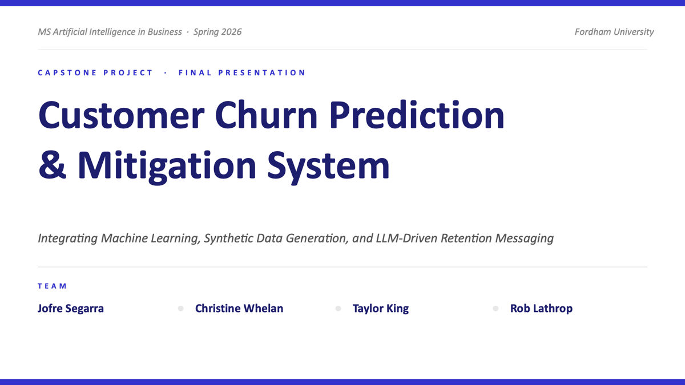

Slide 2
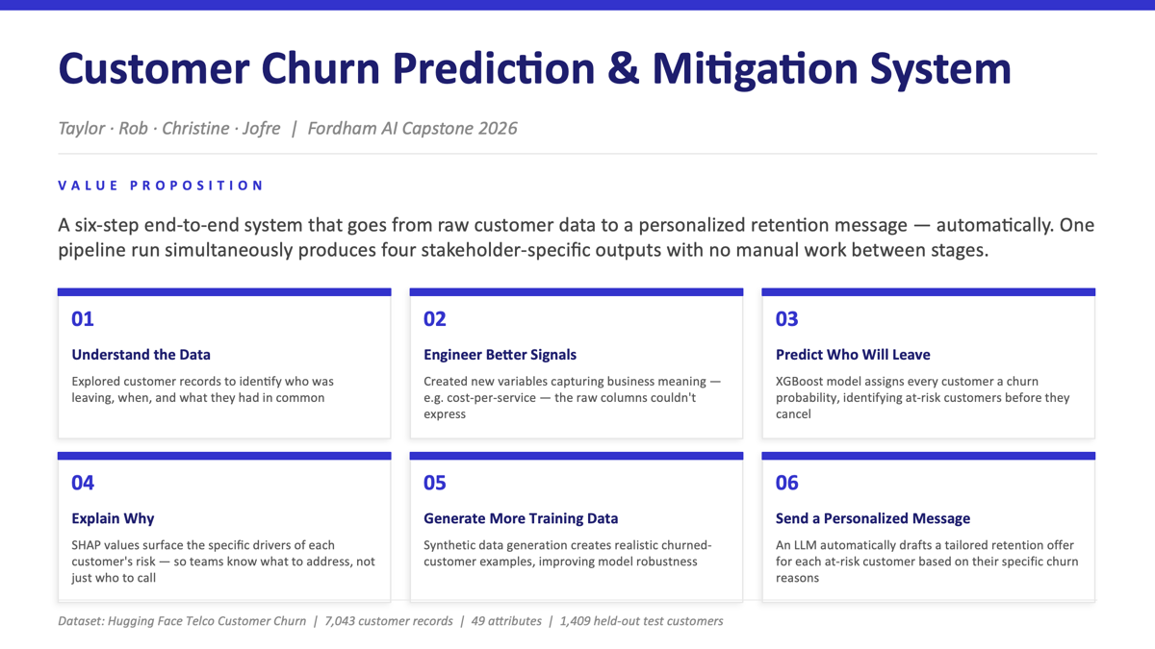

Slide 3
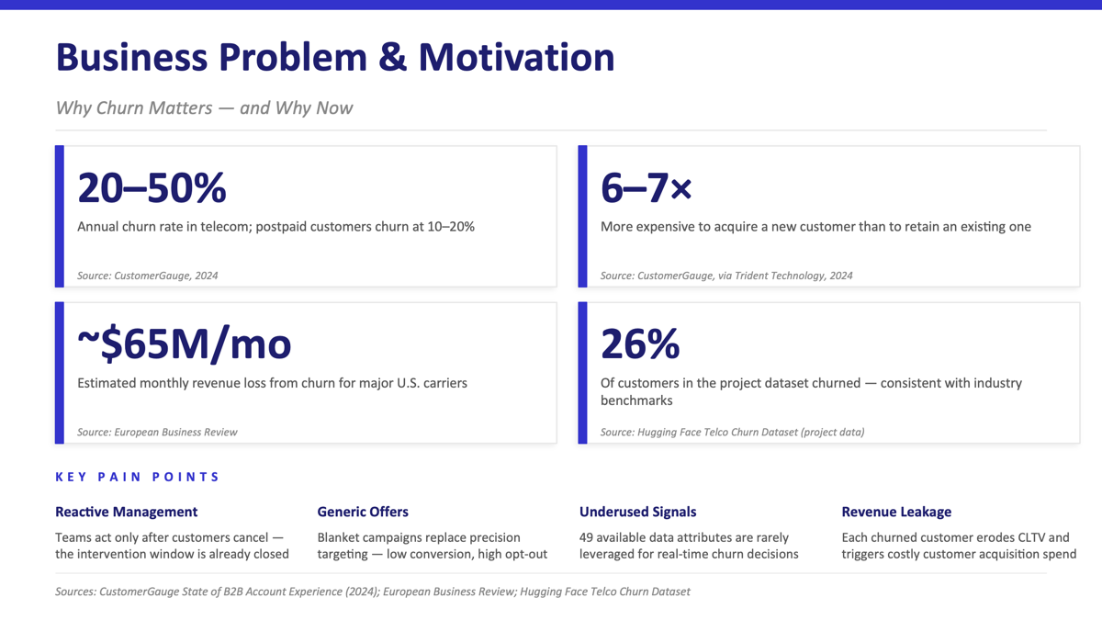

Slide 4
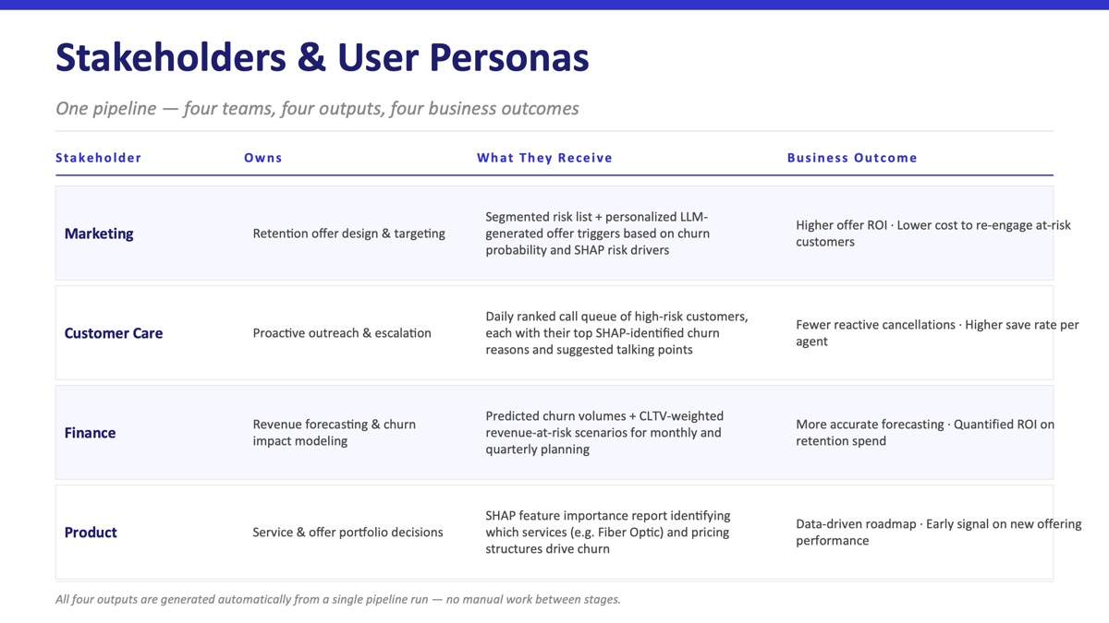

Slide 5
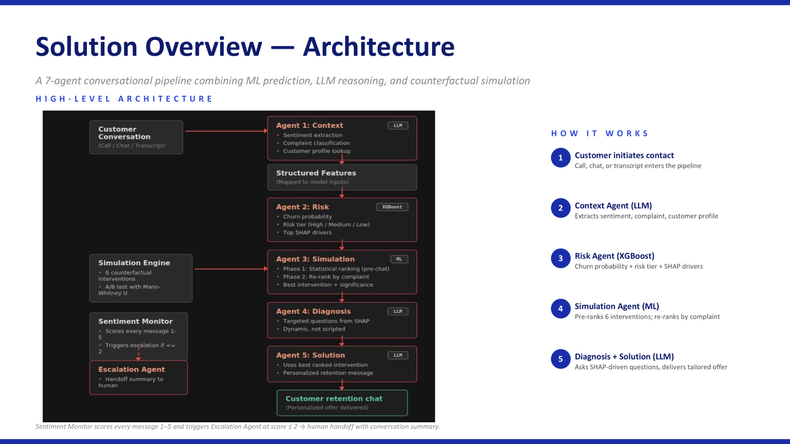

Slide 6
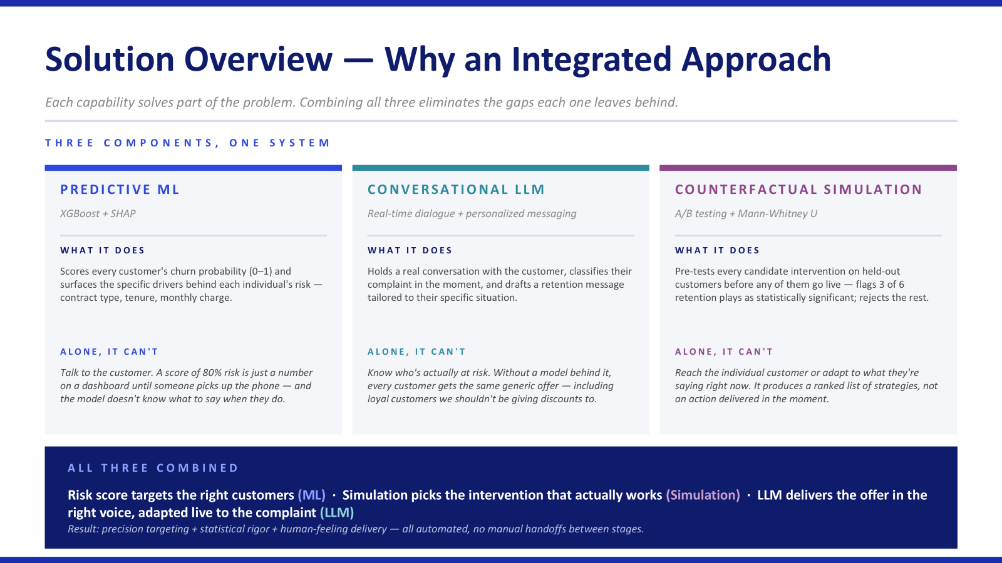

Slide 7
Data Sources
IBM Telco Customer Churn Dataset via HuggingFace
Dataset Overview
Structured Data Used
• 7,043 customer records across train/validation/test splits
• 33 original features covering demographics, services, billing, and account info
• Binary target: Churn (0 = Stayed, 1 = Churned)
• ~27% churn rate (class imbalance addressed with SDV + class weighting)
• Source: HuggingFace aai510-group1/telco-customer-churn
• Demographics: Age, Gender, Senior Citizen, Dependents
• Services: Phone, Internet, Online Security, Streaming, etc.
• Account: Contract type, Payment Method, Monthly Charge
• Tenure: Months with company
• Engineered: Total Services, Charge Per Service
12 Leakage Columns Removed
Satisfaction Score, Total Charges, Total Revenue, Total Refunds, Total Long Distance Charges, Total Extra Data Charges, CLTV, Customer Status, Churn Score, Churn Label, Churn Category, Churn Reason — all encode post-outcome information and cause 100% accuracy (data leakage).

Slide 8
Data Limitations
• California-only dataset — no geographic diversity, State column has minimal predictive value
• No unstructured data (call transcripts, chat logs, emails) — all features are tabular
• No actual revenue or cost data after leakage removal — cannot calculate true ROI
• Synthetic data quality: KS tests failed 3 of 4 continuous features — SDV distributions don't perfectly match originals
• No temporal dimension — dataset is a single snapshot, not a time series
• Churn is binary — no information on partial churn, service downgrades, or win-back events
• Interventions are simulated, not validated with real customer outcomes — causal assumptions untested
Mitigation: We compared SDV-augmented model against class-weighted-only control to isolate whether synthetic data actually helped. We used counterfactual simulations with statistical testing rather than unsourced industry benchmarks.

Slide 9
Modeling Approach
End-to-end pipeline from raw data to personalized retention offers
W2
W3
W4
W5
W6
W7
W8
EDA
Features
Baseline
Tuning
SDV
Insights
Pipeline
Leakage identification, target analysis, feature exploration
Total Services, Charge Per Service, encoding, leakage verification
LR, RF, XGBoost with class balancing + sanity check
RandomizedSearchCV (50 iter, 5-fold CV), SHAP analysis
Synthetic minority oversampling, 4-way model comparison
Risk tiers, SHAP profiles, LLM retention messaging
Counterfactual simulations, A/B testing, model export
Why XGBoost?
Key Decisions
• Best F1 and AUC-ROC across all baselines
• Handles non-linear feature interactions natively
• Built-in regularization prevents overfitting
• Pairs with SHAP for per-customer explainability
• Industry standard for tabular churn prediction
• Removed 12 leakage columns (fixed 100% accuracy)
• SDV on pre-encoded data (prevents fractional dummies)
• scale_pos_weight reset to 1 after SDV balancing
• Risk tiers instead of binary prediction (avoids threshold conflict)
• Counterfactual simulations replace unsourced benchmarks

Slide 10
Exploratory Data Analysis
Key patterns discovered before modeling
Contract Type
Tenure
Service Stacking
#1 Differentiator
< 12 Months = Danger Zone
More Services = Lower Risk
Month-to-month customers churn at 2-3x the rate of annual contract customers. This is the single strongest signal in the dataset.
New customers are most vulnerable. Churn rate drops significantly after the first year, suggesting onboarding and early engagement are critical.
Customers with 4+ services churn far less than single-service customers. Each additional service increases switching cost.
After removing leakage features, the model must rely on behavioral and contractual signals — not satisfaction scores that simply mirror the outcome.

Slide 11
What Actually Drives Churn
Top 10 global SHAP drivers from the final augmented model
Contract: Two Year
0.58
Key Takeaways
Number of Referrals
0.48
• Contract type dominates — long-term contracts are the strongest protective factor
• Referrals signal loyalty (but our A/B test shows forcing referrals backfires)
• Tenure confirms the first-year danger zone
• Monthly Charge matters — higher bills correlate with higher churn risk
Contract: One Year
0.42
Tenure in Months
0.38
Monthly Charge
0.30
Number of Dependents
0.22
Internet: Fiber Optic
0.20
Dependents
0.18
Avg Monthly GB Download
0.15
Referred a Friend
0.12

Slide 12
Model Performance & Validation
Four-way comparison isolates the contribution of each improvement
Metric | Baseline | Tuned | Tuned + Weighted | Augmented (SDV)
Accuracy | ~0.78 | ~0.80 | ~0.79 | ~0.81
Precision | ~0.60 | ~0.64 | ~0.62 | ~0.65
Recall | ~0.72 | ~0.76 | ~0.78 | ~0.80
F1 Score | ~0.65 | ~0.69 | ~0.69 | ~0.72
AUC-ROC | ~0.83 | ~0.86 | ~0.86 | ~0.87
Note: Replace these approximate values with your actual notebook output. The exact numbers will depend on your random seed and SDV generation.
Validation Approach
• RandomizedSearchCV: 50 iterations, 5-fold cross-validation
• CV F1 and test F1 reported side by side for generalization check
• Four-way comparison isolates SDV contribution vs class weighting alone
• Counterfactual simulations + Mann-Whitney U for intervention validation

Slide 13
Customer Journey — Live Demo
One customer, end to end
1
Customer enters chat
2
Risk scored
3
SHAP explains why
Customer ID loaded, profile retrieved from database
XGBoost predicts 72% churn probability → HIGH risk tier
Top drivers: month-to-month contract, low tenure, no online security
4
Simulation runs
5
Diagnosis asks questions
6
Best offer delivered
6 interventions tested — contract upgrade shows -28.7% churn reduction
Bot asks targeted questions based on SHAP drivers, not a script
"Switch to annual plan and save 25% — plus free Tech Support for 3 months"
Live chatbot: churn-chatbot.vercel.app

Slide 14
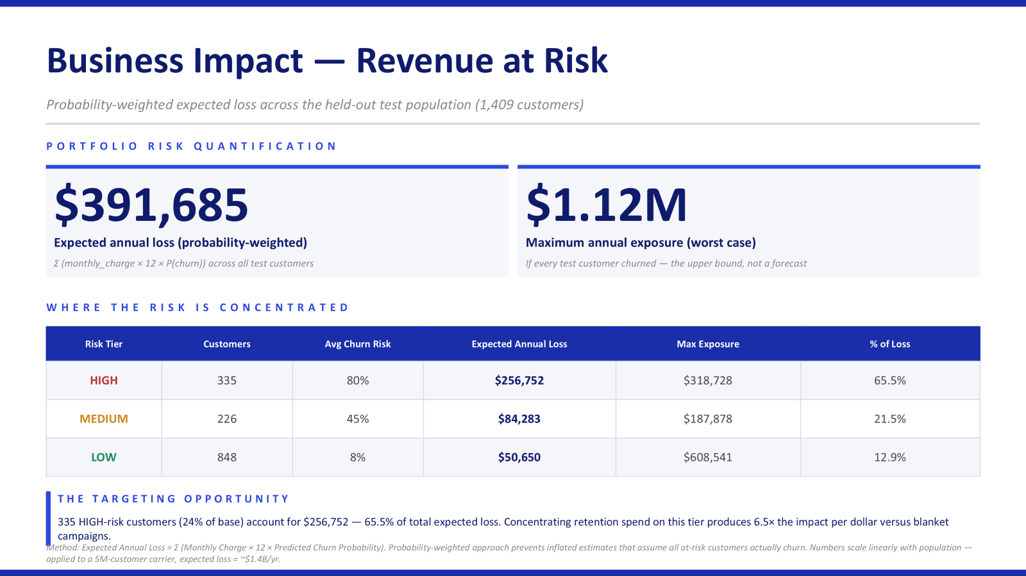

Slide 15
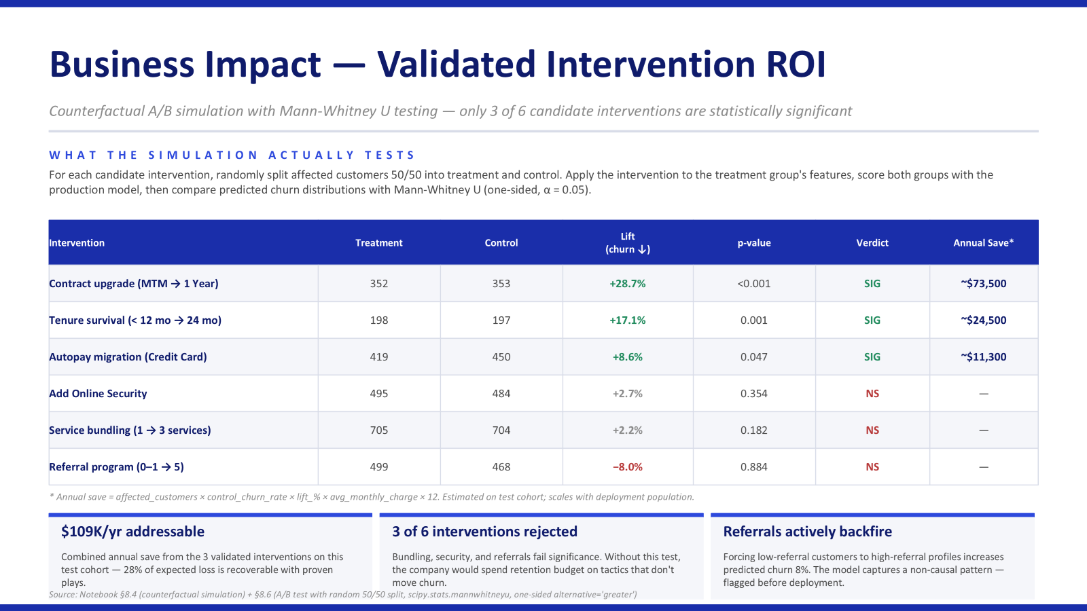

Slide 16
Limitations & Risks
Data Limitations
  There is no variation in geography. Dataset is California only.
  No unstructured data (calls, chats, complaints) → missing customer context.
  No true revenue/cost data → ROI is estimated, not actual.
  No time-series behavior —> cannot capture churn trends over time.
Modeling & Technical Risks
  Synthetic data (SDV) imperfect → distribution mismatch in some features
  Counterfactual simulations assume causality → requires A/B testing validation
  Encoding done pre-split → not production-ready pipeline
  Model performance depends on feature availability in real systems
Business & Adoption Risks
  Requires integration with CRM + customer data systems
  Risk of low adoption by call center agents if workflow is too complex
  Templated offers may not reflect real pricing/marketing constraints
Ethical & AI Risks
  Potential model bias across customer groups.
  Risk of over-targeting vulnerable users.
  LLM-generated responses may introduce hallucinations or misleading messaging.
  Need for human oversight in high-risk interventions

Slide 17
Future Enhancements & Roadmap
Production Integration
  Connect to CRM systems (Salesforce, HubSpot)
  Real-time scoring through API deployment
  Use fitted encoders + live data pipelines
Smarter Personalization
  Integrate actual retention offer catalog
  Dynamic pricing + promotion optimization
  LLM-powered conversation + negotiation flows
Expand Data Sources
  Add call center transcripts, chat logs, emails
  Use NLP for sentiment + intent detection
  Incorporate temporal behavior (customer lifecycle)
Validation & Experimentation
  Run A/B testing on retention strategies
  Validate causal impact of interventions
  Measure true ROI and revenue lift
Advanced AI Capabilities
  LLM critic loop to evaluate message effectiveness
  Simulate customer responses to offers
  Continous learning from real outcomes

Slide 18
Conclusions & Takeaways
The Problem:
Customer churn is costly, reactive, and poorly targeted
Businesses lack actionable, explainable insights.
Why it Matters:
Moves from precision → action
Enables targeted, data-driven retention strategies.
Prioritizzes high-risk customers with measurable impact.
Our Solution
End-to-end system combining:
  Predictive Modeling (XGBoost)
  Explainability (SHAP)
  Simulation (Counterfactual testing)
  AI-driven customer engagement.
What Makes This Different
No data leakage → realistic performance
Four-model comparison isolates true improvements
Probability-weighted revenue at risk (not inflated estimates)
Uses simulations instead of generic benchmarks
Combines ML + LLM into a decision system

