Slide 1





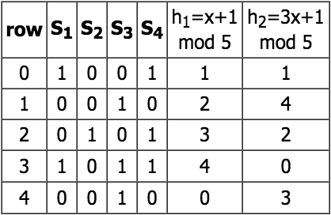
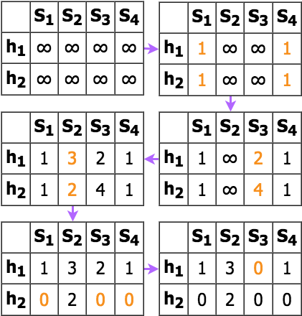

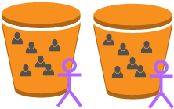
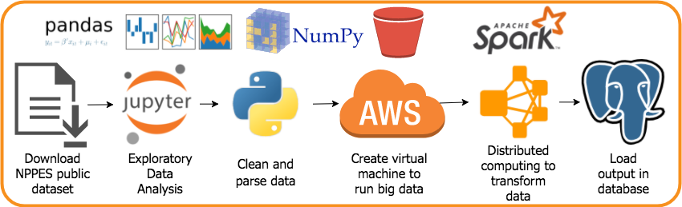
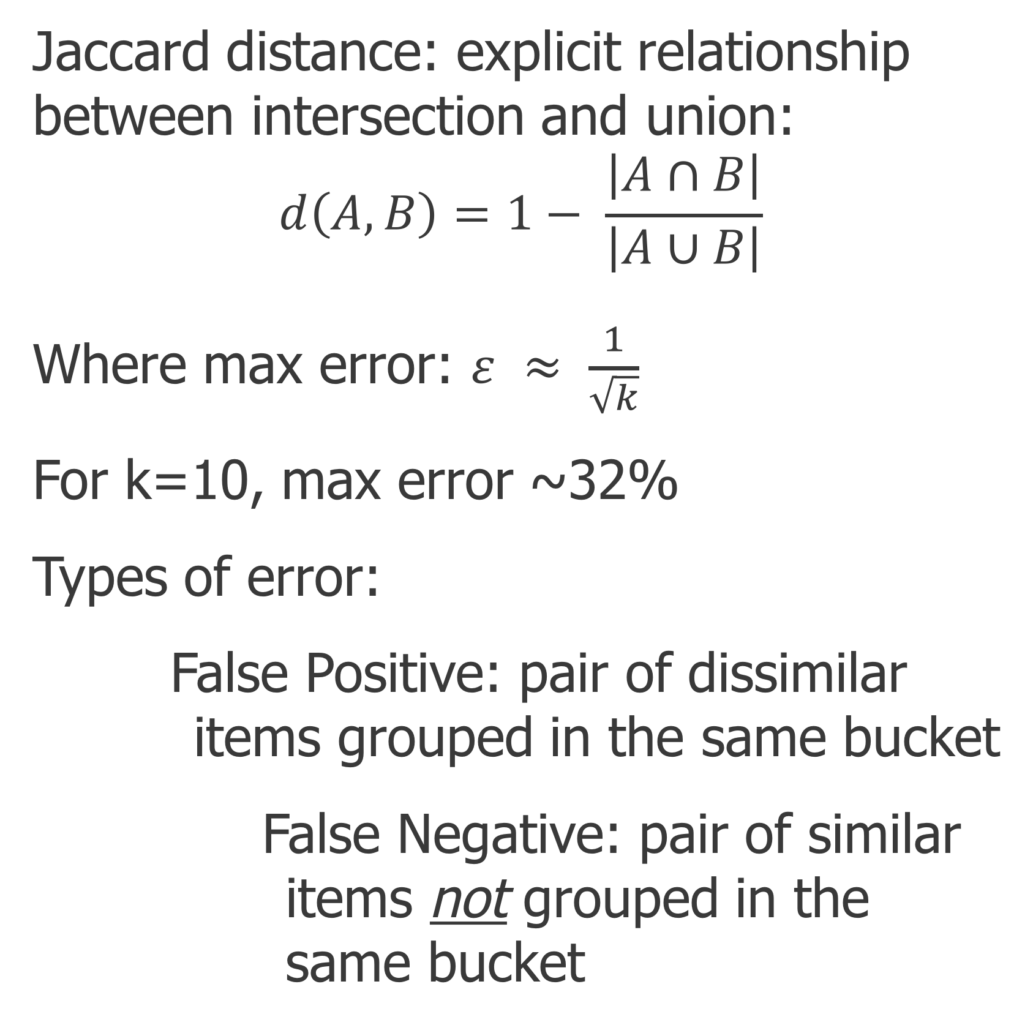
Provider Prescriber
Christine Buckler
Galvanize Denver Platte
christine.n.buckler@gmail.com
linkedin.com/in/christinebuckler
github.com/christinebuckler
Background
Model
Group items into buckets within a similarity threshold.
Calculate estimated distance between items in the same bucket.
Tune parameters.
Increasing the number of hashes increases accuracy but also increases computational cost and run time.
Increasing the similarity threshold increases the number of buckets.
Results
Objective:
Provide the top 10 most similar healthcare providers given a specific National Provider Identifier (NPI).
Use cases:
Patients that have changed insurance plans
Pharmaceutical representatives selling specialty products
The data:
Public NPPES dataset
5,315,800 entries
328 features
Features used in this study include: entity type, gender, state of business location, specialties, credentials, sole proprietor status, and organizational subpart status.
The MinHash LSH algorithm:
Transform data into binary vectors where non-zero values indicate presence of element.
Randomly permutate rows with k hash functions
Compute MinHash Signature Matrix
(these are the ”min hash” values)
Similarity distances were computed for a subset of the data (10,000 NPIs) and stored inside a database that can be queried for specific NPIs.
Next Steps
With more time, I would like to explore the following areas:
Improve virtual machine configuration to scale for more items
Expand input method to allow for updates without re-hashing existing data
Evaluate other features that add value to similarity measure such as standardized provider ratings
Integrate query with NPPES API to give context to the results
Add functionality to search for similar providers based on a list of NPIs
Cluster or graph items to visualize groupings
Measures
Jaccard distance: explicit relationship between intersection and union:
$$d\left(A, B\right)=1− \frac{\left|A∩B\right|}{\left|A∪B\right|}$$
Where max error: $ε ≈ \frac{1}{\sqrt{k}}$
For k=10, max error ~32%
Types of error:
False Positive: pair of dissimilar items grouped in the same bucket
False Negative: pair of similar items not grouped in the same bucket
References & Credits
Method
Stanford’s Mining of Massive Datasets Ch3
Pyspark Docs http://spark.apache.org/docs/2.2.0
https://en.wikipedia.org/wiki/MinHash
https://www.cs.utah.edu/~jeffp/teaching/cs5955/L5-Minhash.pdf
Getting Started on LSH by Vinicius Vielmo Cogo
Near Neighbor Search in High Dimensional Data (2) by Anand Rajaraman
Locality Sensitive Hashing at Uber Engineering https://databricks.com/blog/2017/05/09
Special thanks to the Galvanize instructors, DSRs, mentors, web dev, classmates and my family and friends for their support and encouragement during my immersive experience.
The brute force method compares each item to every other item which doubles the computation and memory storage with each addition to the input data set.
O(n²)
Instead, I used MinHash LSH (Locality Sensitive Hashing) as an efficient algorithm to find similar items using hashes. This technique allows for an approximate similarity solution.
Process Flow

