Slide 1
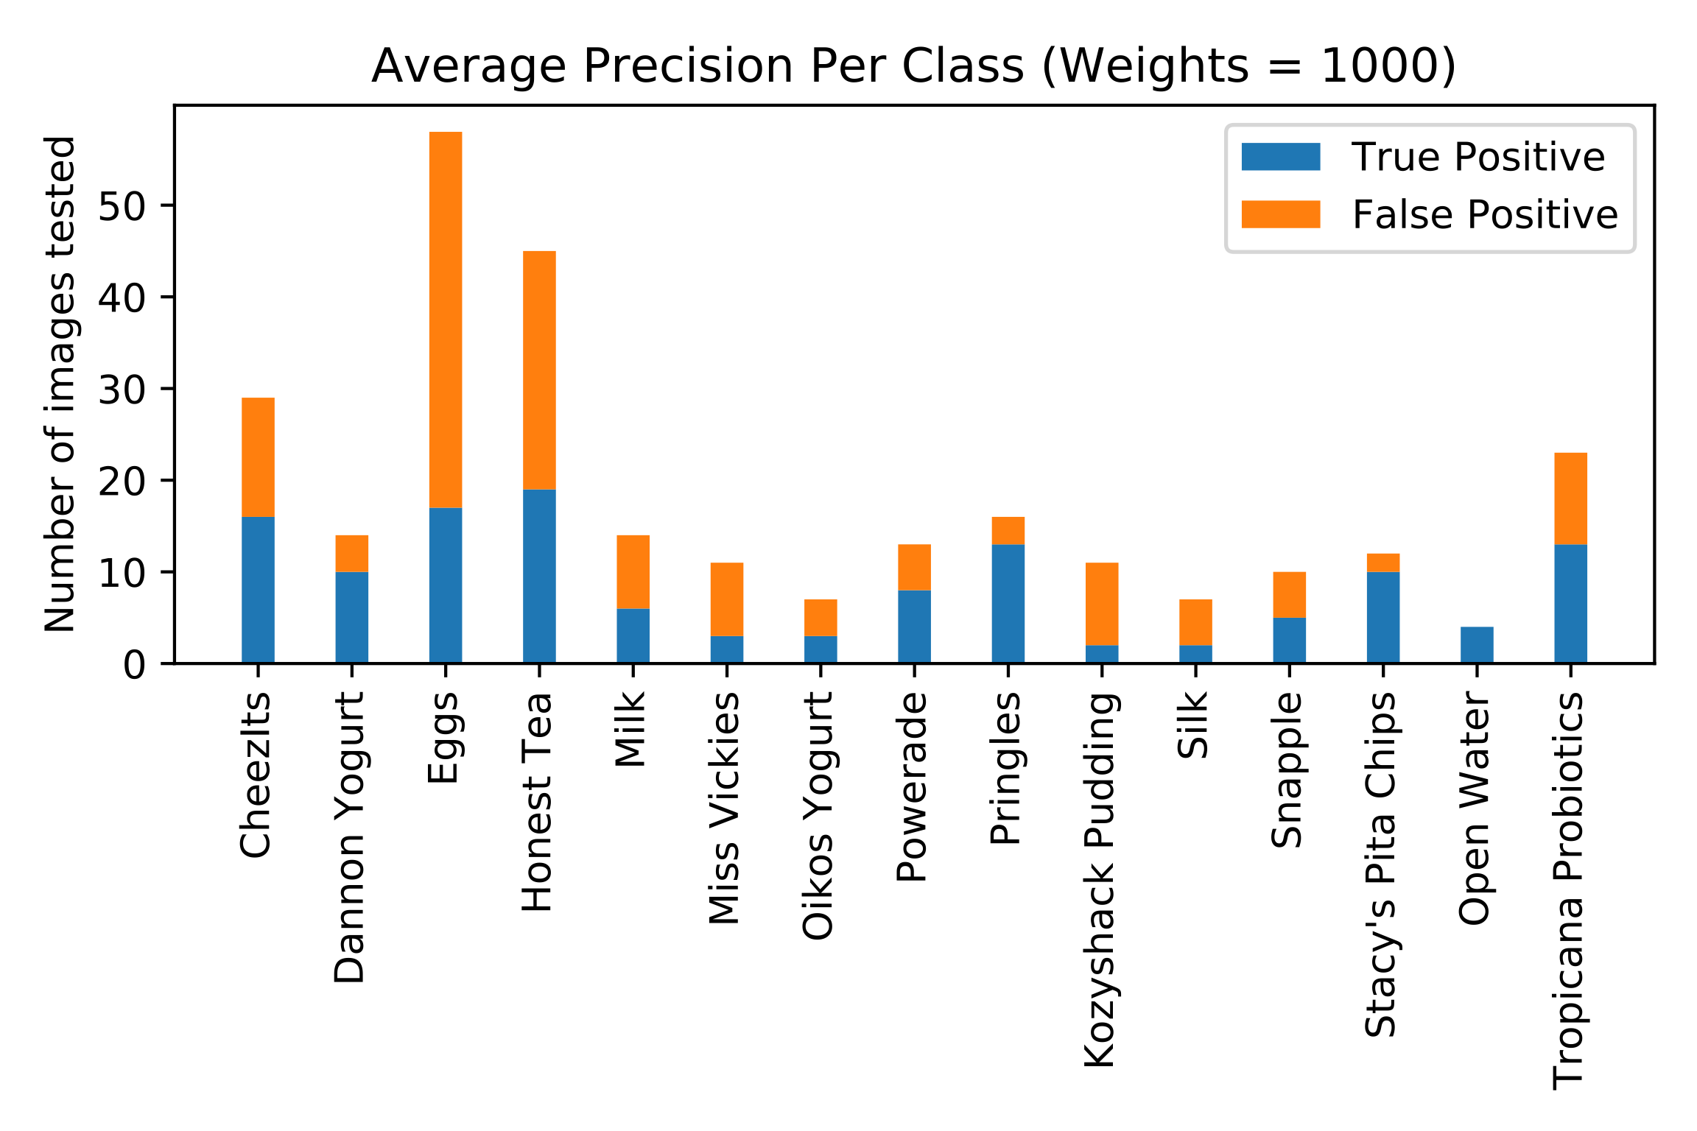
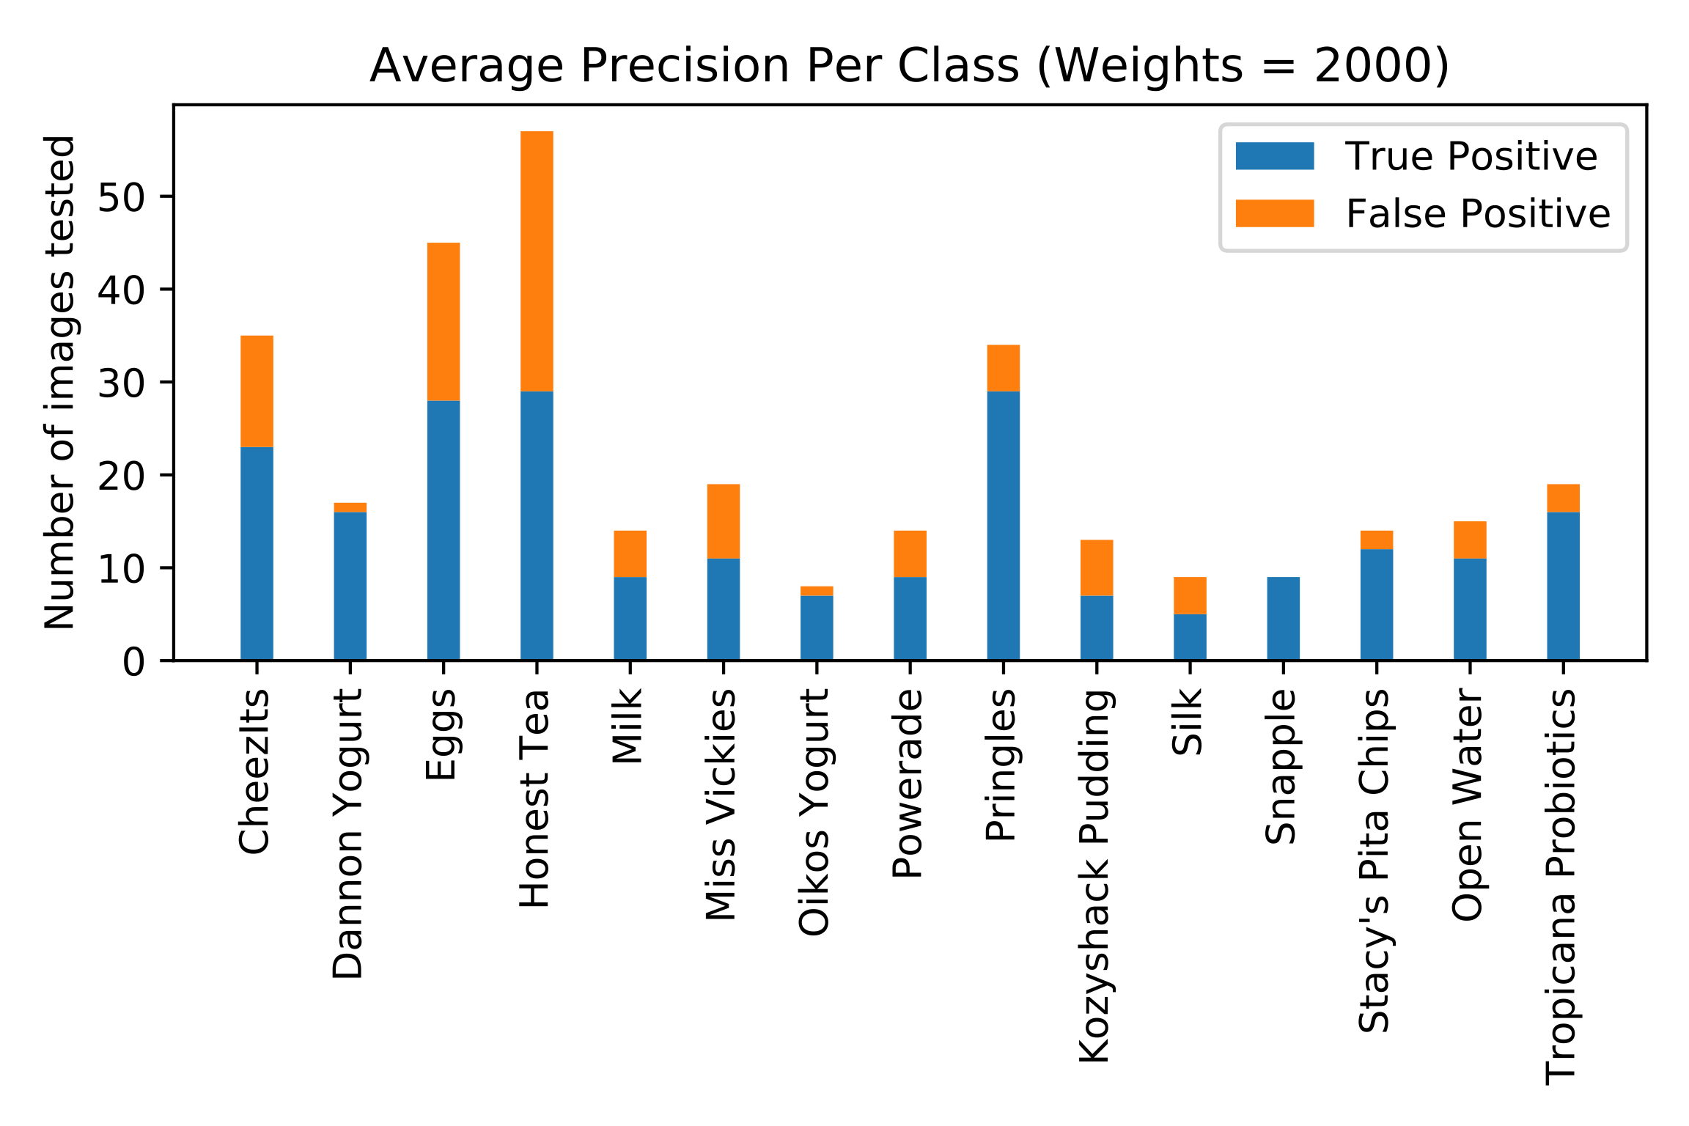
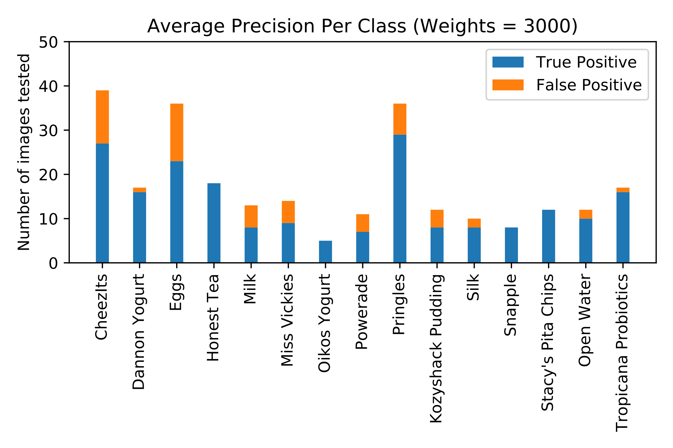
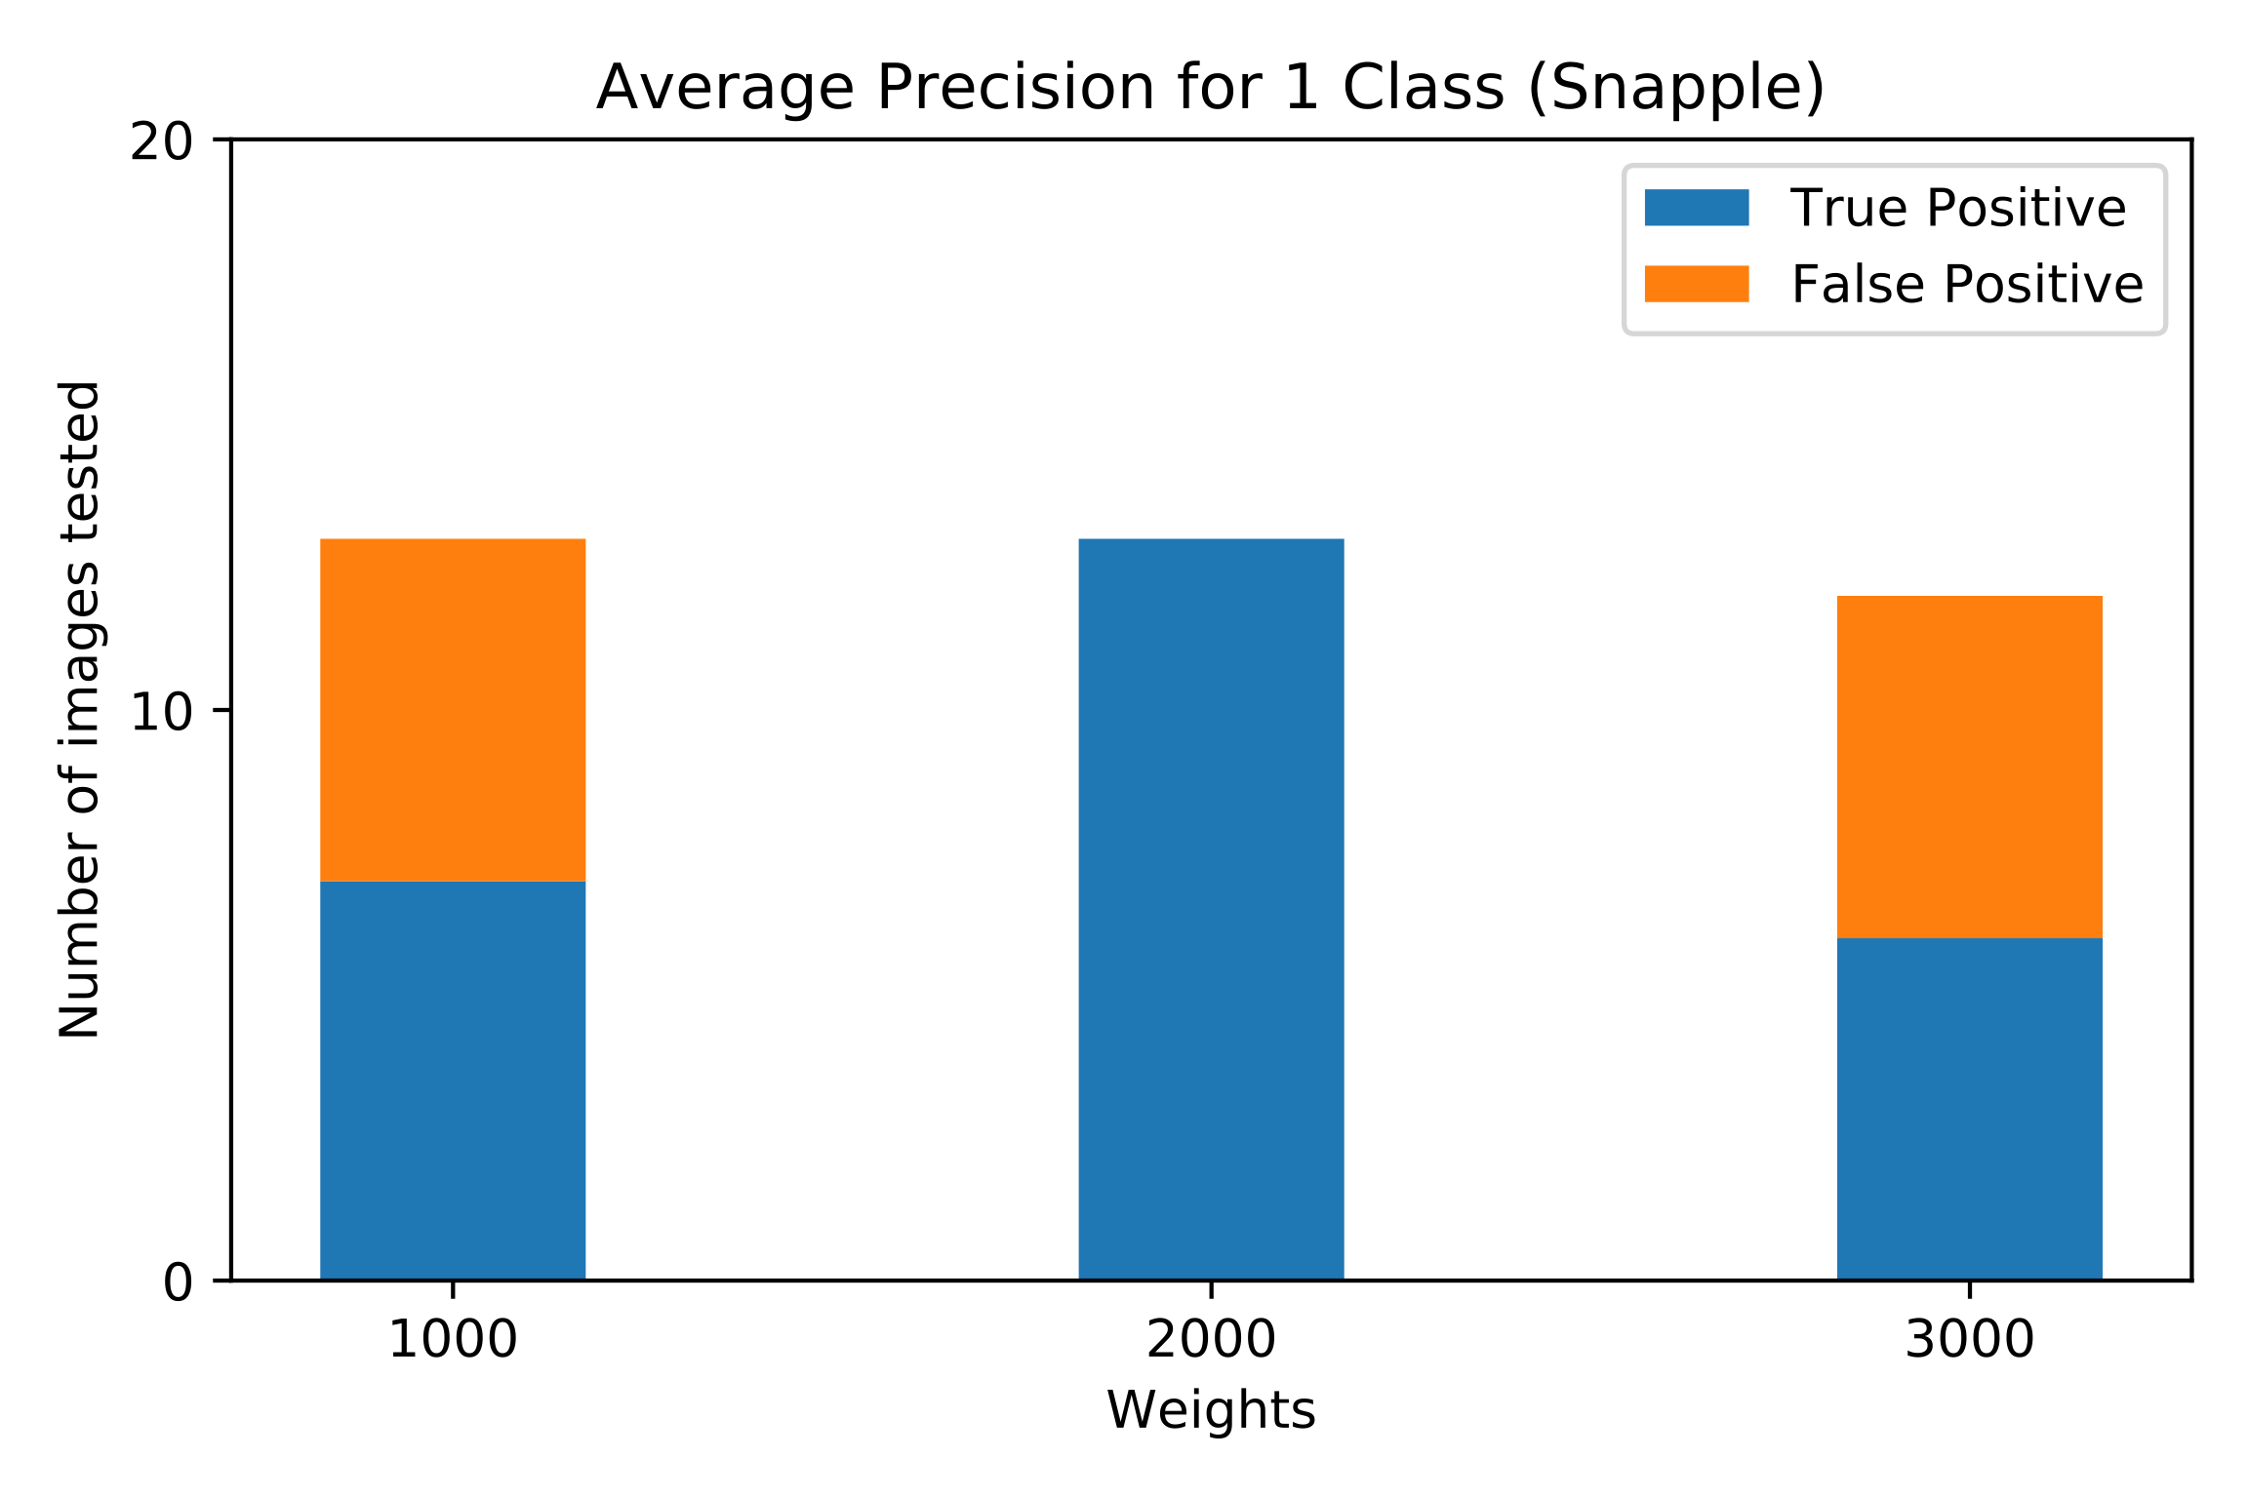
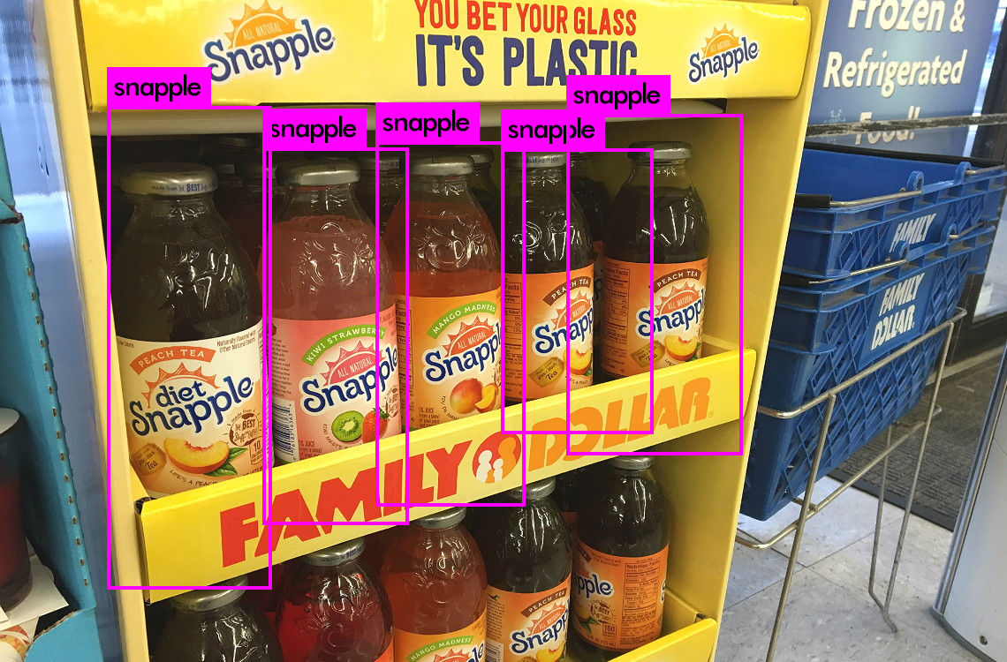
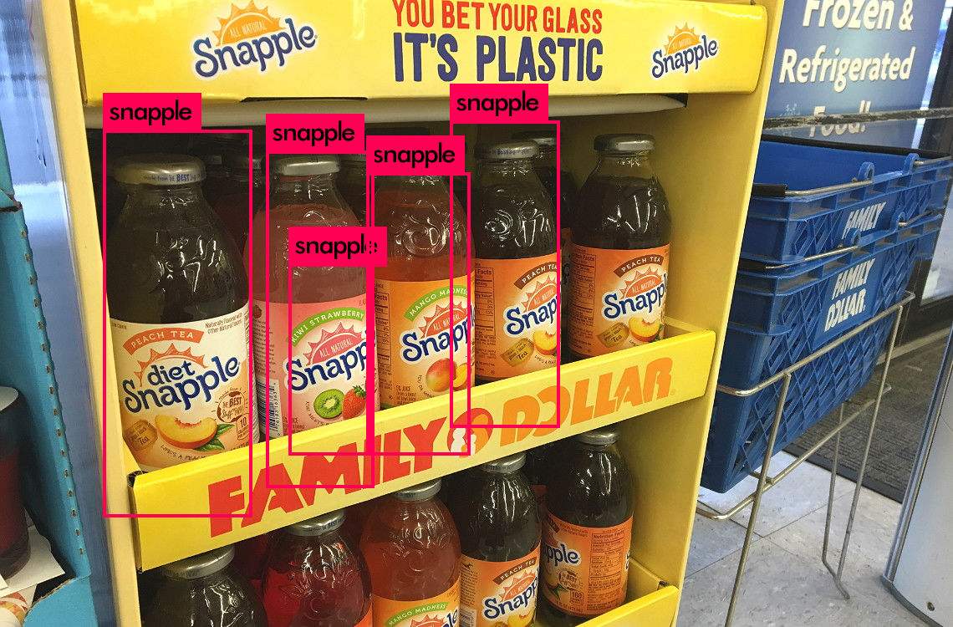
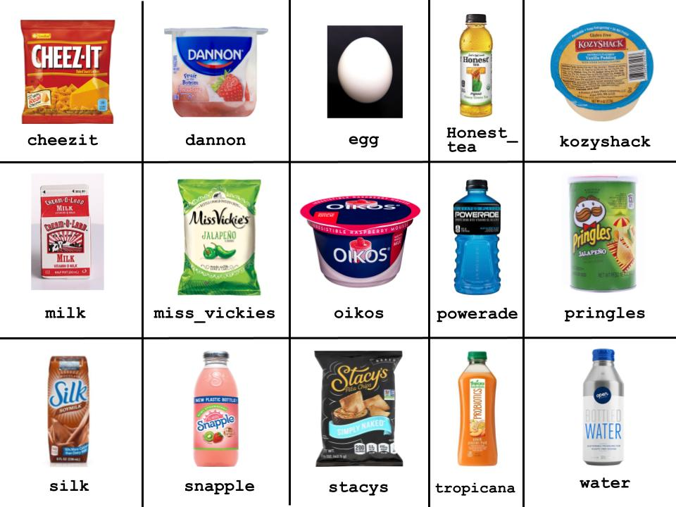
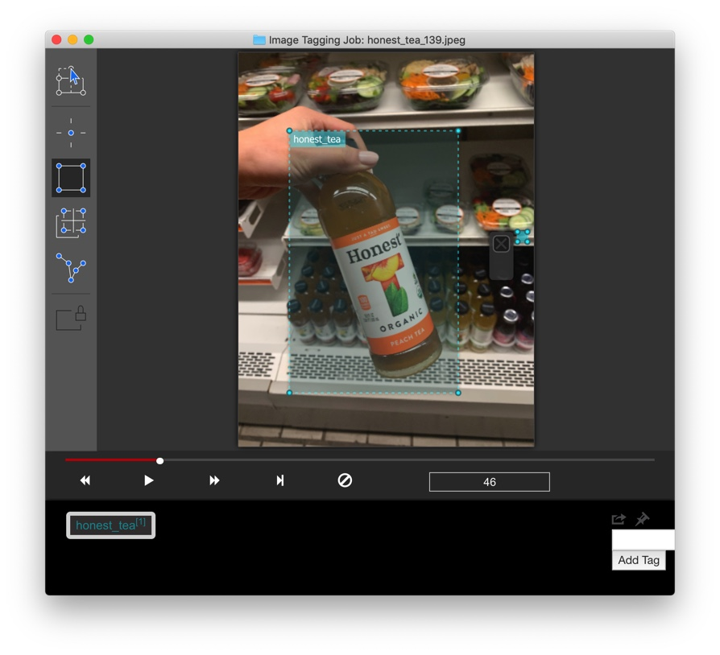
YOLO!
Anabelle Chang (anabelle), Christine Kwon (cmkwon), Christy Lee (christyl)
Advisors: Professor Olga Russokovsky, T.A. Fangyen Wei
INTRODUCTION
RESULTS
Goals
To create an object detector that detects Grab n' Go items from the Frist Gallery that can be expanded into a price calculation application which determines the total price of the items present in an image.
To analyze how YOLO’s algorithm responds to different numbers of classes, different weights generated in training, and various challenges of inconsistency which are common in everyday objects; this will allow optimization in both detection and classification in new datasets.
Related Works
Yi, Zhang, et al. “An Improved Tiny-yolov3 Pedestrian Detection Algorithm.” Optik, Urban & Fischer, 13 Feb. 2019.
Amazon Go
85ºC Bakery Autonomous Checkout
Challenges
Object Color Variation
Object Logo Distinction
Object Shape Distortion
Mean Average Precision (mAP) Analysis
Figure 1: The first 3 graphs show the average precision (AP) or a 15-class detector with weights after 1000, 2000, and 3000 epochs, respectively. The last graph shows the AP for a single-class detector with weights after 1000, 2000, and 3000 training epochs, respectively.
For the multi-class detector, the mAP for using the weights after 3000 epochs is highest at 73%. However, the mAP for the single-class detector was highest while using the weights after 2000 epochs at 85.71%
Multi-Class vs. Single-Class Detection
We wanted to compare the accuracy of a multi-class detector vs. a single-class detector trained on the same dataset for one singular label.
We expected a single-class detection to have more false positives, whereas a model trained on many classes would have more false negatives.
Figure 2: the items predicted by the single-class detector with objectness scores of 96%, 77%, 61%, 17%, and 65% under the label “snapple.”
Figure 3: the items predicted by the multi-class detector with objectness scores of 30%, 31%, 16%, 30%, and 12% under the label “snapple.”
METHODS
CONCLUSIONS
Overview
Our dataset was self-curated with Google image scraping and manual photography at Late Meal, then annotated using VoTT. This allowed us to train a tiny YOLO v3 detector that is customized to items found in the Frist Gallery and can be a practical application of computer vision for Princeton University students.
Dataset
Preparation: use of Fatkun batch download to mass download approximately 2,200 sample images total of varying dimensions, angles, and lighting across 15 distinct classes.
Annotation: the bounding boxes of each item were drawn with Vott v1.7.2 and exported into the YOLO dataset format.
Aggregation: each class was labeled separately, so a script was used to combine images and their corresponding annotations into one singular data folder.
Google Colaboratory
To speed up the process of training for our object detection, we used Google Colab for its GPU.
Tiny YOLO-v3
We used a smaller, quicker version of YOLOv3, the You Only Look Once object detect algorithm known for its speed and use of only a single convolutional neural network.
Strengths
Dd
Weaknesses
Dd
Future Work
Autonomous price checking application for Princeton University students to use at Late Meal.
Optimizing detection with more precise images and boundary box labeling for training.
Experimentation with training on images of the complete product versus logos.
REFERENCES
AlexeyAB. “AlexeyAB/Darknet.” GitHub, January 10, 2020. https://github.com/AlexeyAB/darknet/.
Redmon, Joseph. YOLO: Real-Time Object Detection. Accessed January 13, 2020. https://pjreddie.com/darknet/yolo/.
Figure 4: images and labels of the 15 classes our detector can identify.
Figure 5: VOTT software used for tagging images

