Slide 1
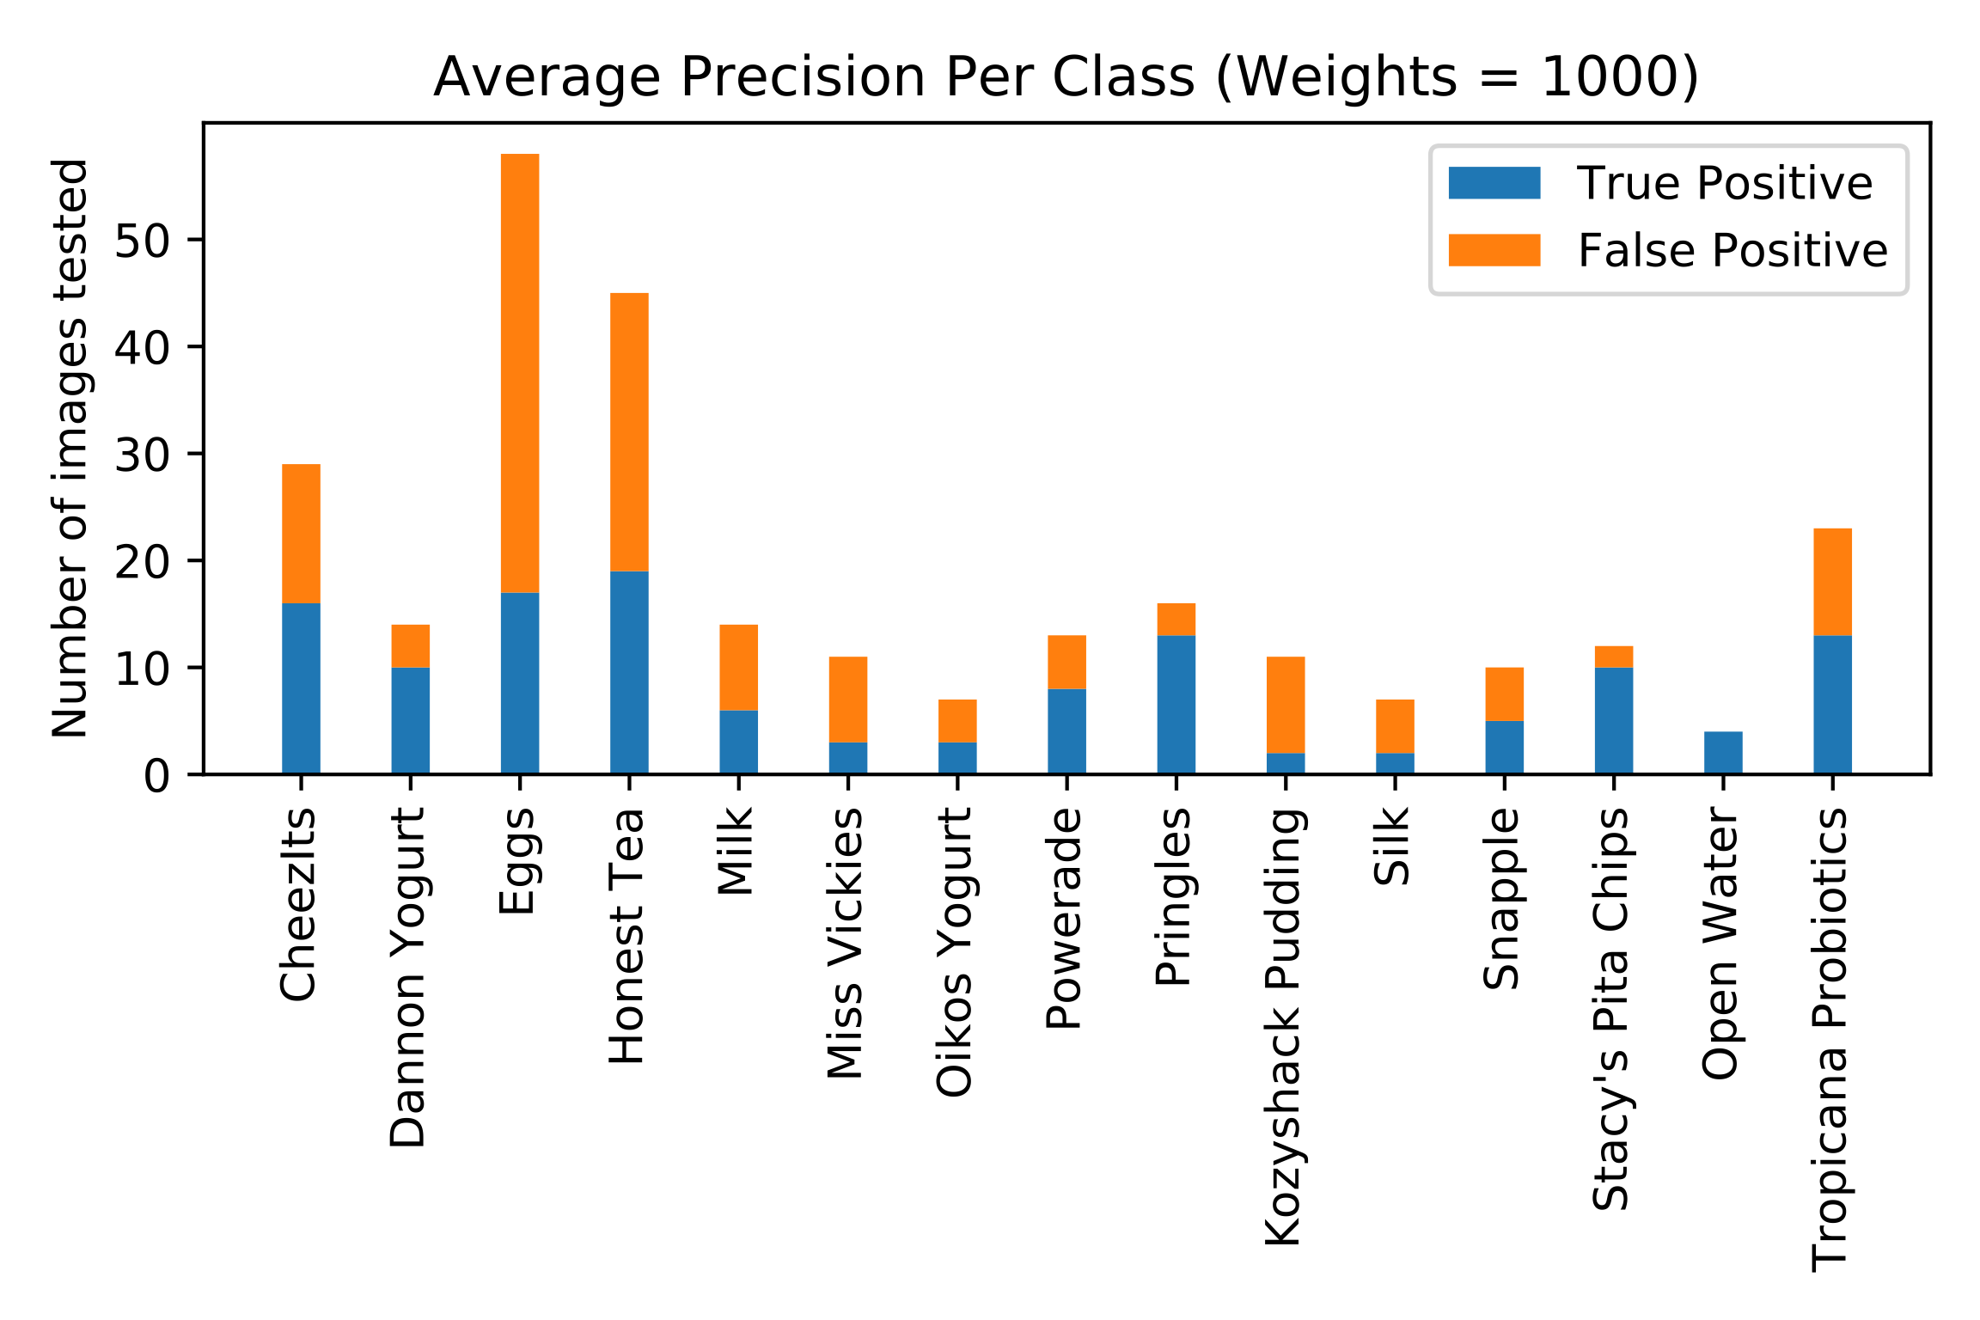
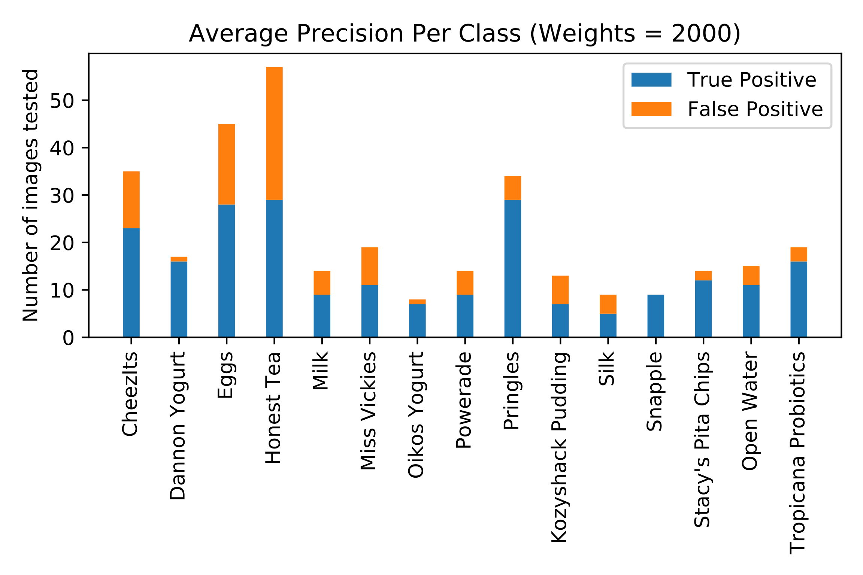
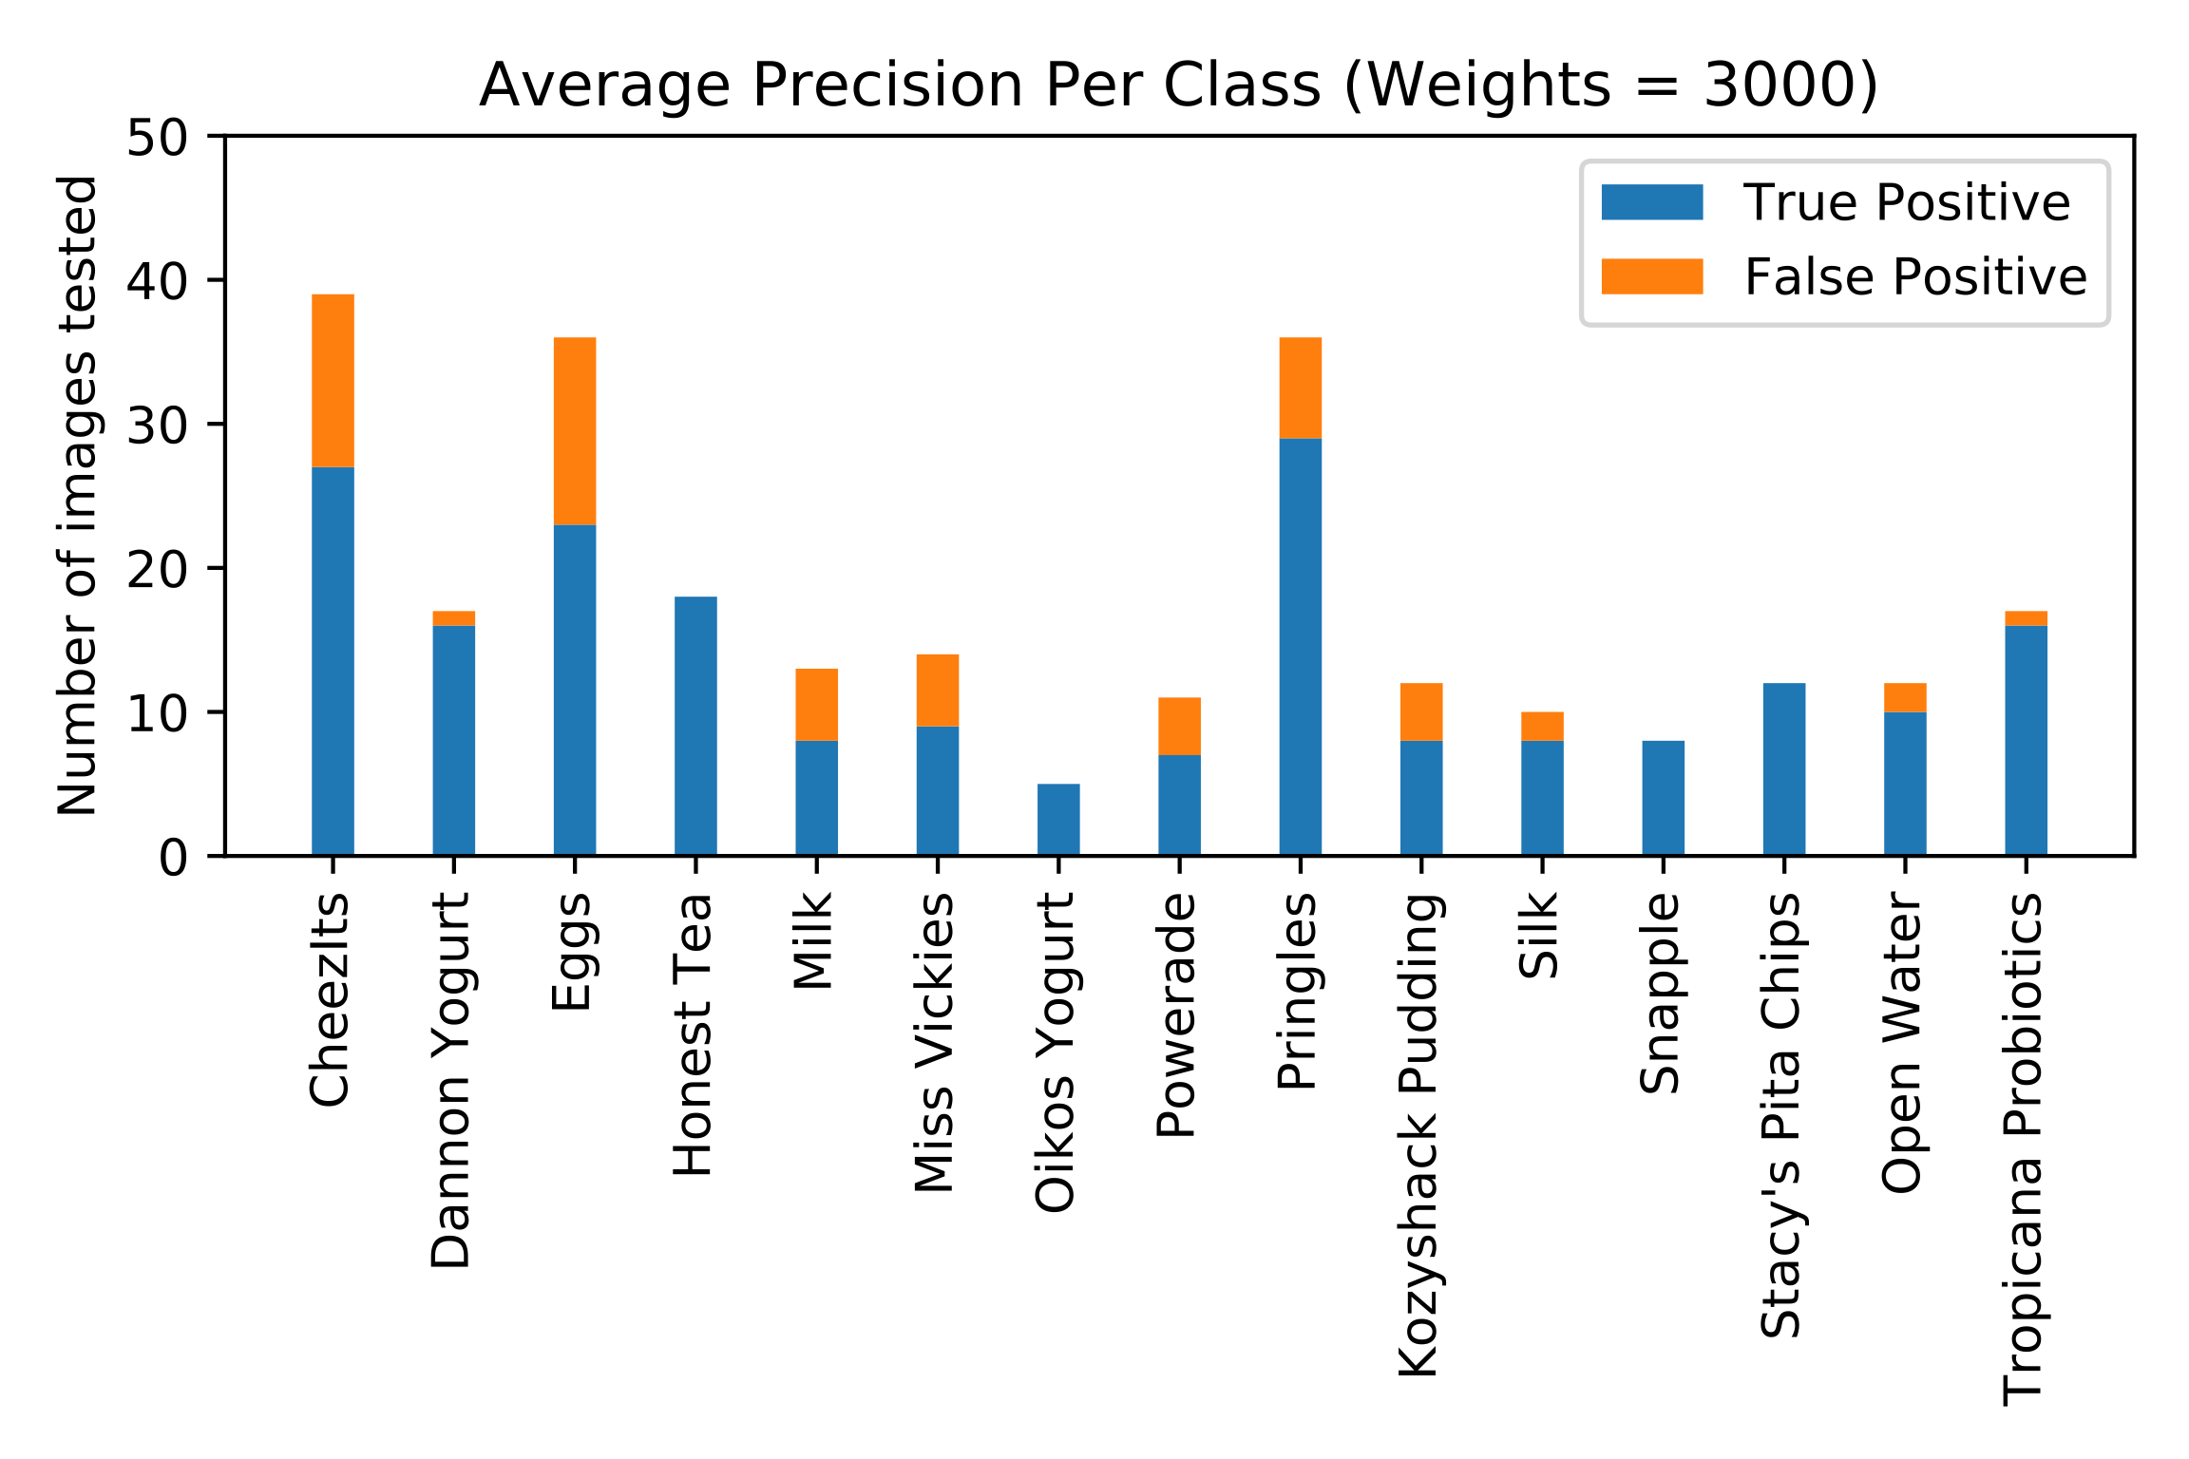
YOLO!
Anabelle Chang (anabelle), Christine Kwon (cmkwon), Christy Lee (christyl)
Advisors: Professor Olga Russokovsky, T.A. Fangyen Wei
INTRODUCTION AND ABSTRACT
RESULTS
CONCLUSIONS
Mean Average Precision (mAP) Analysis
3000 weights optimal, with __ mAP
Strengths
Dd
Weaknesses
Dd
Future Work
Dd
Multi-Class vs. Single-Class Detection
OBJECTIVES
REFERENCES
https://github.com/AlexeyAB/darknet/
MATERIALS AND METHODS
Dataset
Preparation: use of Fatkun batch download to mass download 2,178 sample images total of varying dimensions, angles, and lighting across 15 distinct classes.
Annotation: the bounding boxes of each item were drawn with Vott v1.7.2 and exported into the YOLO dataset format.
Aggregation: each class was labeled separately, so a script was used to combine images and their corresponding annotations into one singular data directory.
Tiny YOLO v3
ACKNOWLEDGEMENTS

