Slide 1
Brachistochrone Under Air Resistance
Christine Lind
2/26/05
SPCVC

Slide 2
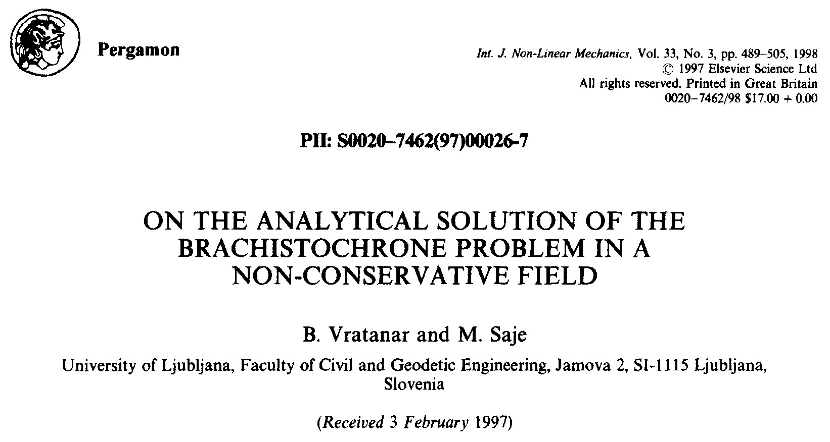
Source of Information:

Slide 3
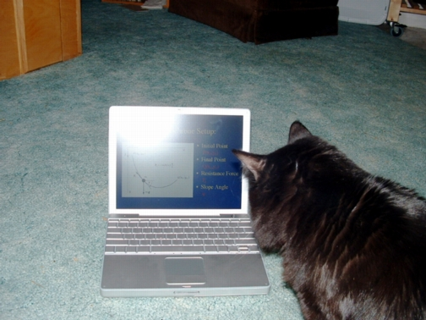
Collaborator:

Slide 4
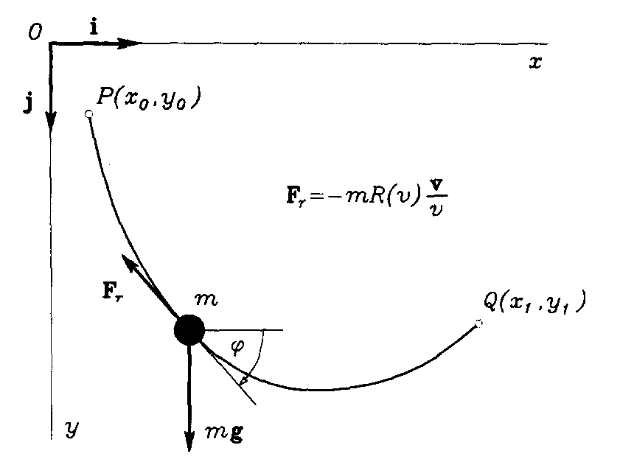
Brachistochrone Setup:
Initial Point
  P(x₀,y₀)
Final Point
  Q(x₁,y₁)
Resistance Force
  F_{r}
Slope Angle
  ϕ

Slide 5
Geometric Constraints
Parametric Approach:
  Start by using arclength
  (s) as the parameter
Parametrized by arclength:
    (curves parametrized by arclength have unit speed)

Slide 6
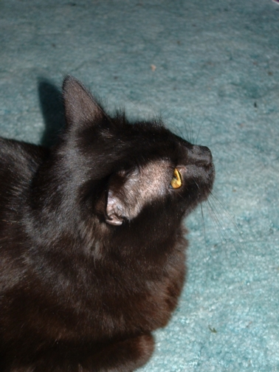
Energy Constraint?
Normally we use conservation of energy to solve for velocity in terms of the other variables
We have a Non-Conservative system, so what do we do?

Slide 7

Energy Constraint?
Energy is lost to work done by the resistance force:

Slide 8
Energy Constraint
Non-conservative system:
Constraint parametrized by time:
Constraint parametrized by arclength:

Slide 9
Problem Formulation:
Boundary & Initial Conditions:
Minimize the time integral:
Other constraints:
  How do we incorporate them?

Slide 10
Lagrange Multipliers
Introduce multipliers, vector:
Create modified functional:
  where

Slide 11
Euler-Lagrange Equations
System of E-L equations:
Additional boundary conditions:

Slide 12
7 Euler-Lagrange Equations:
Note:
Note:
Additional Constraints Appear as E-L equations!

Slide 13
Natural Boundary Conditions:
Note:
  v₁ is not necessarily zero, so:

Slide 14
Lagrange Multipliers - Solved!
Using:
Determine the Lagrange Multipliers:
Note:
κ(s),λ(s) constants
μ(s)=μ(ϕ(s))

Slide 15
First Integral
Recall:
  No explicit s-dependence!
First Integral:

Slide 16
Roadmap to Solving Problem:
Given the first integral, can solve for v(ϕ):
Then use E-L equation to solve for ϕ(s):
Then integrate E-L equations for x(s), y(s):
- still need l, v₁, ϕ₁... - maybe we could do better a different way...
Done?

Slide 17
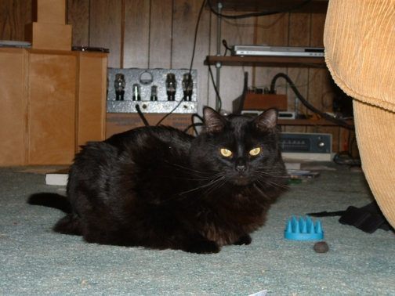
Parametrize by Slope Angle

Slide 18
Parametrize by Slope Angle
Define f(ϕ) to be the inverse function of ϕ(s):
f(ϕ) continuously differentiable, monotonic
Now we minimize:
Still need constraints...

Slide 19
Modified Functional
Transform modified problem in terms of ϕ:

Slide 20
7 Euler-Lagrange Equations
First Integral!
(Old Equations)

Slide 21
Same Natural B.C.’s
& Lagrange Multipliers

Slide 22
Solve for v(ϕ)
Using Lagrange Multipliers and First Integral:
Obtain:

Slide 23
Solve for Initial Angle ϕ₀
Evaluate at ϕ₀:
Obtain Implicit Equation for
initial slope angle:

Slide 24
Solving for f(ϕ)
Rearrange E-L equation:
Obtain ODE:
  ( Recall that we already have v(ϕ), ϕ₀, & initial condition f(ϕ₀) = 0 )

Slide 25
Solving for x(ϕ) and y(ϕ)
Integrate the E-L equations
Obtain

Slide 26
Seems like we are done...
What about parameters ϕ₁ & v₁?
  Appear everywhere, due to:
How can we solve for them?

Slide 27
Newton’s Method...
Use the equations for x(ϕ) and y(ϕ) and the corresponding boundary conditions:
Now we really are done!

Slide 28

Example: Air Resistance

Slide 29
Example: Air Resistance
Take R(v) = k v
  (k - coefficient
  of viscous friction)
  Newtonian fluid
  first order approx. for air resistance
Let x₀ = 0, y₀ = 0, v₀ = 0,
⇒ ϕ₀ = π/2

Slide 30
Solve for v(ϕ)
  Quadratic Formula:
( take the negative root to satisfy v(ϕ₀) = 0 )

Slide 31
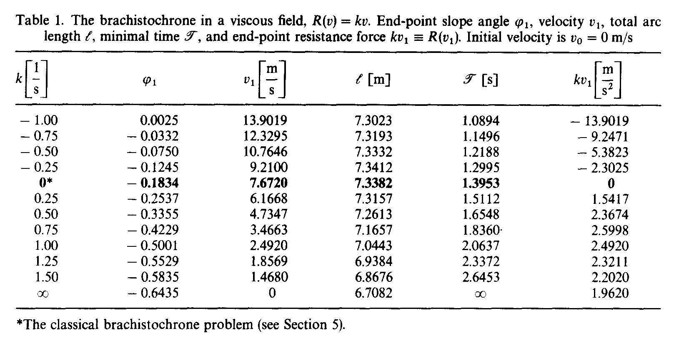
Many Calculations...

Slide 32
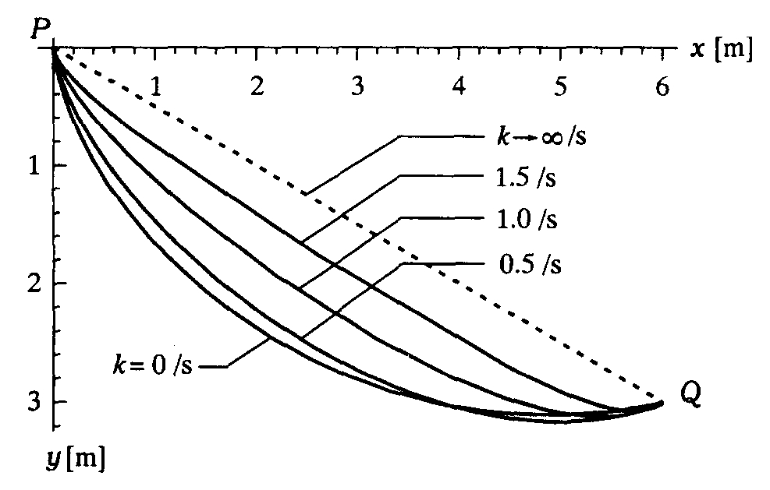
Results:
(Straight Line)
(Cycloid)

Slide 33
Conclusions
Different approach to the Brachistochrone
  parametrization by the slope angle ϕ
  use of Lagrange Multipliers
Gained:
  analytical solution for non-conservative velocity-dependent frictional force
Lost ( due to definition s = f(ϕ) ):
  ability to descibe free-fall and cyclic motion

Slide 34
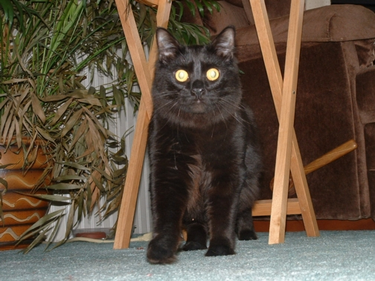
Questions ?

