Slide 1
Airbnb: consumer Helper for NYC Listings
October 1, 2019
Benedict, Mikey and Christine

Slide 2
The project assists the consumer in quickly scanning AirBNB listings in NYC based on most common criteria
Current Situation
Today there are more than 45,000 listings in the NYC Airbnb market, including more than 3,500 long term and hotel listings (30+ day rentals, traditional B&B's, and boutique hotels).
Project Objective
Our aim is to gain an understanding of the listing volume in NYC Airbnb and analyze the consumer review data to determine consumer preferences between the neighborhoods, pricing data by neighborhoods, amenities by neighborhood.
Comparative bar graphs
Heat maps of boroughs of NYC
Word cloud pulling review data from review text fields
Deliverables
Scope
NYC was chosen for the sheer volume (largest Airbnb market in the US) and diversity of Airbnb listings, taking into account all 5 boroughs.
NEXT STEP: Let’s Examine Airbnb listings in the Five Boroughs of NYC

Slide 3
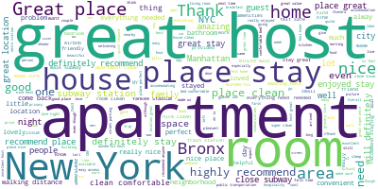
Looking at customer review data… we parsed the free text field
Which borough would you guess this word cloud represents?

Slide 4
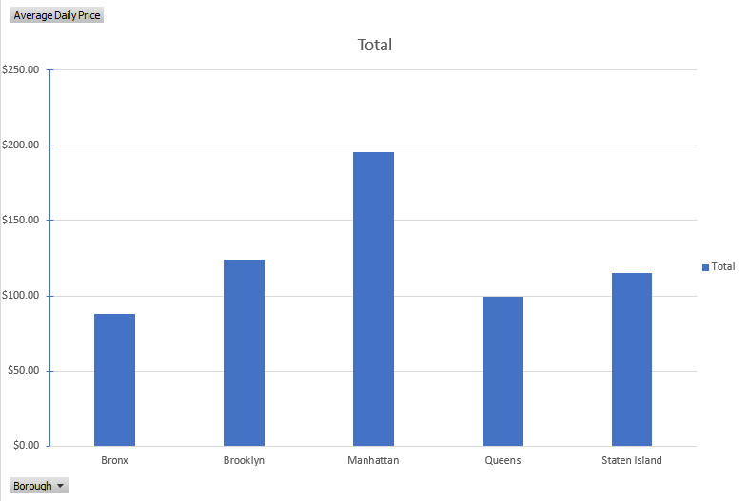

Average Price per day by Borough

Slide 5
Heat Maps

Slide 6
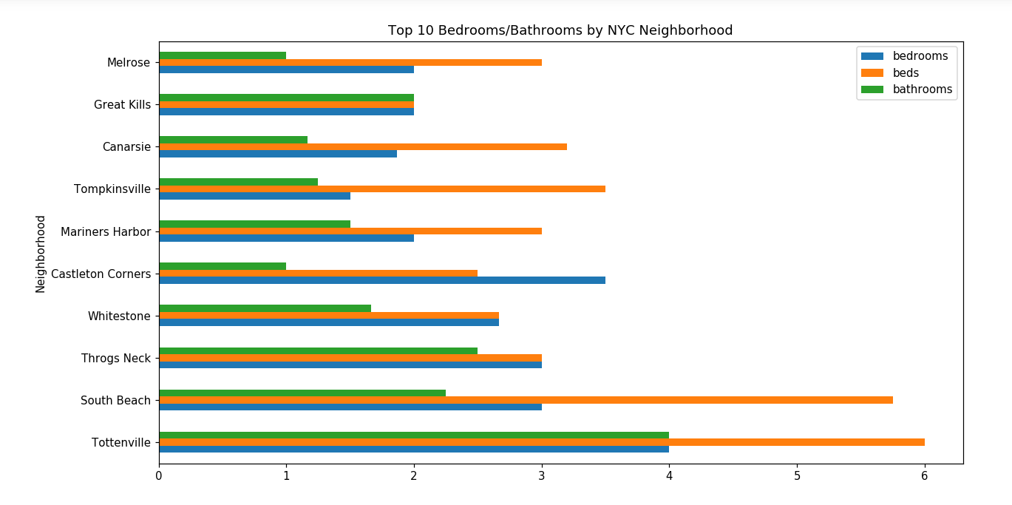
Families looking for large Number of Sleeping Quarters
4 of the 5 boroughs of NYC are represented here. Any idea which one is missing?
Notes:
Melrose – Bronx
Great kills – SI
Canarsie – Brooklyn
Tomp – SI
Mariners – SI
Castle – SI
Whitestone, Queens
Throgs neck, Bronx
South beach, SI
Tottenville, SI

Slide 7
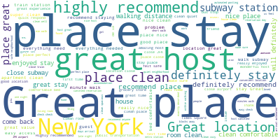
Time for word Clouds! Hmm, Manhattan? Queens? Brooklyn?
Notes:
How many reviews did you look through?

Slide 8
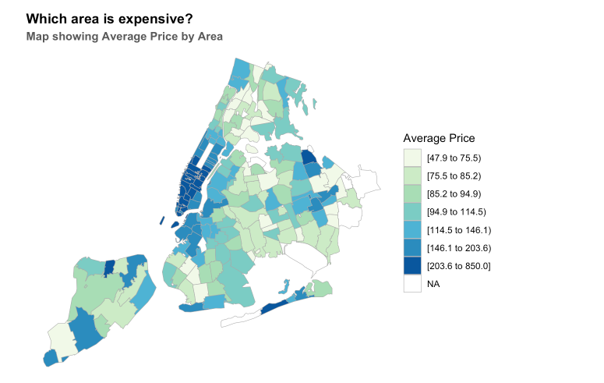
Heat Maps

Slide 9
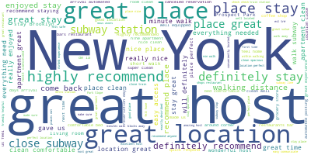
Its always sunny in... Brooklyn?

Slide 10
Mostly apartment listings in all 5 boroughs, except if you want a home check out Staten Island
Percentage

Slide 11
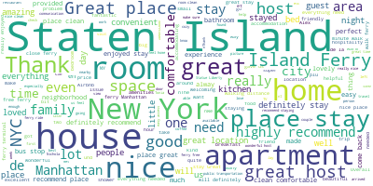
Ahh, more space in the cloud! Guess this homey place...

Slide 12
Heat Maps

Slide 13
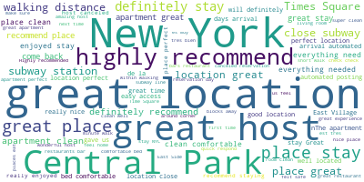
Aw c‘mon, where is expensive in this cloud?

Slide 14
Heat Maps

Slide 15
Conclusions

Slide 16
References and datasets
Airbnb data:
http://insideairbnb.com/index.html
http://insideairbnb.com/new-york-city/
http://insideairbnb.com/get-the-data.html
http://data.insideairbnb.com/united-states/ny/new-york-city/2019-08-06/visualisations/neighbourhoods.geojson
http://data.insideairbnb.com/united-states/ny/new-york-city/2019-08-06/visualisations/listings.csv
http://data.insideairbnb.com/united-states/ca/san-francisco/2019-08-06/visualisations/listings.csv
http://data.insideairbnb.com/united-states/ca/san-francisco/2019-08-06/visualisations/neighbourhoods.csv
http://data.insideairbnb.com/united-states/ca/san-francisco/2019-08-06/visualisations/neighbourhoods.geojson
Kaggle:
…

