Slide 1










































Slide 2
Welcome Page
MVP
This is the first page that a user sees when loading the app. It welcomes the user and provides two buttons to search for recipes or to locate a restaurant. Click the button navigates the user to a search page.
Potential add-on:
a third button that navigates to a user profile page
provides a funny greeting and/or random food fact
Find Your Craving
Welcome!
Find a recipe or restaurant that satisfies my craving.
Let’s Cook
Cook For Me
craving it!

Slide 3
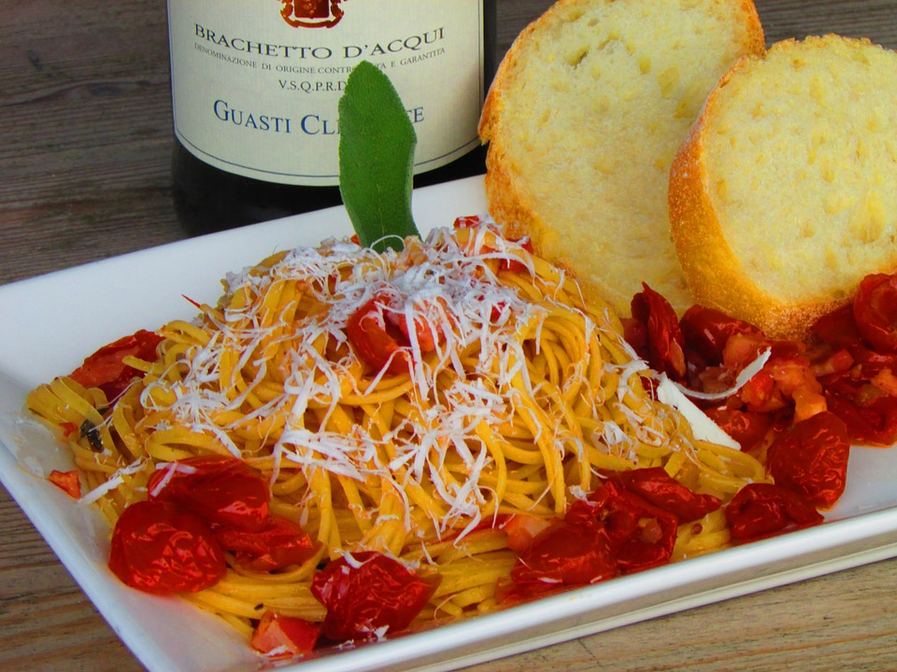
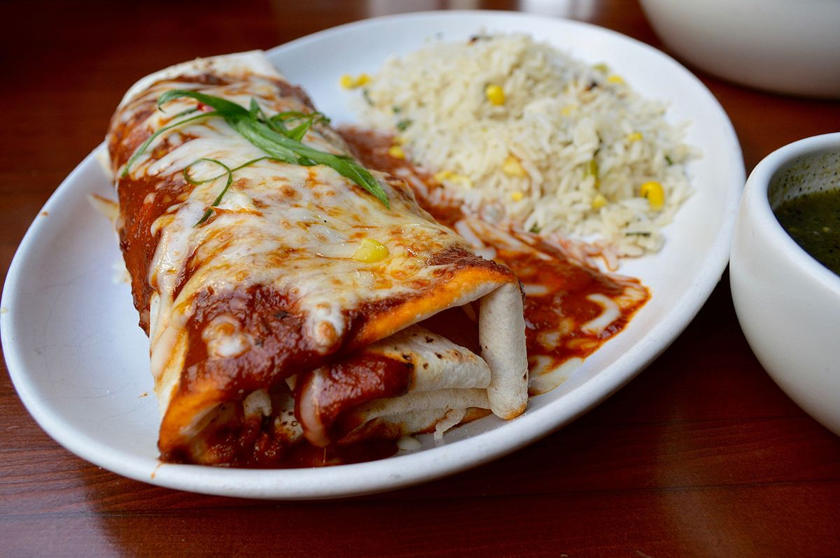
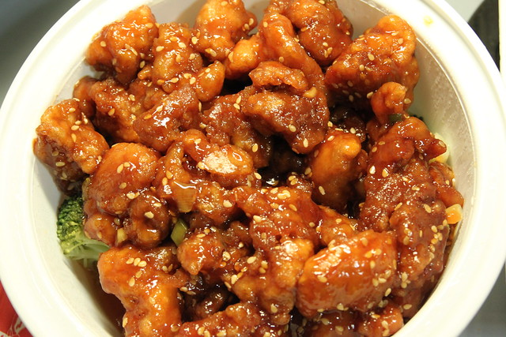
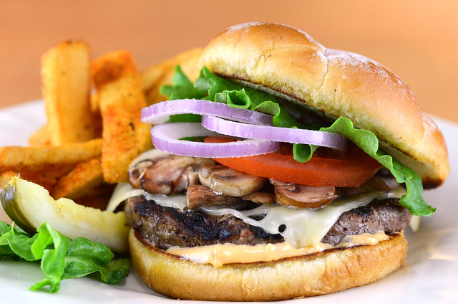
Search Page – Recipes
MVP
Navigation: Welcome > Find Recipe Button
A form that the user will complete in order to find specific recipes. User will be able to navigate back to the main welcome page.
MVP: button with a select number of “areas” (types of cuisine)
Potential add-on:
Change to search and have a “+” to additional search criteria
Navigation to Profile Page
Navigation to Restaurant Search
Additional Categories:
Japanese
Thai
Greek
Indian
French
Vietnamese
Find A Recipe
Italian
Mexican
Asian
America
Home
Restaurant
Profile
craving it!

Slide 4
Search Page – Restaurant
MVP
Navigation: Welcome > Find Restaurant Button
A form that the user will search for a restaurant depending on cuisine type in their area. User will be able to navigate back to the main welcome page.
MVP: area code field and button with a select number of “areas” (types of cuisine)
Potential add-on:
Change to search and have a “+” to additional search criteria
Navigation to Profile Page
Navigation to Restaurant Search
Select how many miles within their area code to expand the search
Additional Categories:
Japanese
Thai
Greek
Indian
French
Vietnamese
Find A Restaurant
Area Code*:
field
Italian
Mexican
Asian
America
Home
Recipes
Profile
craving it!

Slide 5
Search Result Page - Recipes
Navigation: Welcome > Find Recipe Button (future)
A page that provides a thumbnail picture of the dishes, the titles, link to recipe (navigates to recipe page).
MVP: list of recipe options
Potential add-on:
Favorite recipes that saves and can be viewed in the “saved” recipe page

Slide 6
Recipe Page
MVP
Navigation: Welcome > Find Restaurant Button > Cuisine Selected
A page that provides a picture of the dish, the list of ingredients needed with their quantities and instructions on how to cook it.
MVP: recipe with cooking instructions
Potential add-on:
Setting button in navigation that takes the user to the profile page
Navigation to Profile Page
Embedded YouTube video for how to cook the recipe
Title
Ingredient | Quantity
Ingredient | Quantity
Ingredient | Quantity
Ingredient | Quantity
Instructions:
---------------------------------------
---------------------------------------------------------------------------
---------------------------------------
YouTube Video
Home
Recipe Search
Profile
craving it!

Slide 7
Search Result Page – Restaurant
MVP
Navigation: Welcome > Find Restaurant Button > Search Restaurant
Lists of restaurant based on the cuisine type selected within their area code.
MVP: list of x number of results within x miles of their area code. Lists the restaurant name and URL to restaurant’s website or yelp page.
Potential add-on:
Navigation to Profile Page
Map showing locations of restaurants
List the address of each restaurants
Restaurants In Your Area
restaurant name
url
restaurant name
url
restaurant name
url
Home
Restaurant
search
Profile
craving it!

Slide 8
Saved Results Page - Recipes
Navigation: Welcome > x
A page that a list of recipes the users saved. The page provides a thumbnail picture of the dishes, the titles, link to recipe (navigates to recipe page).
MVP: list of recipe that were saved by the user
Potential add-on:
Button to remove the saved recipes

Slide 9
Profile Page

