Slide 1
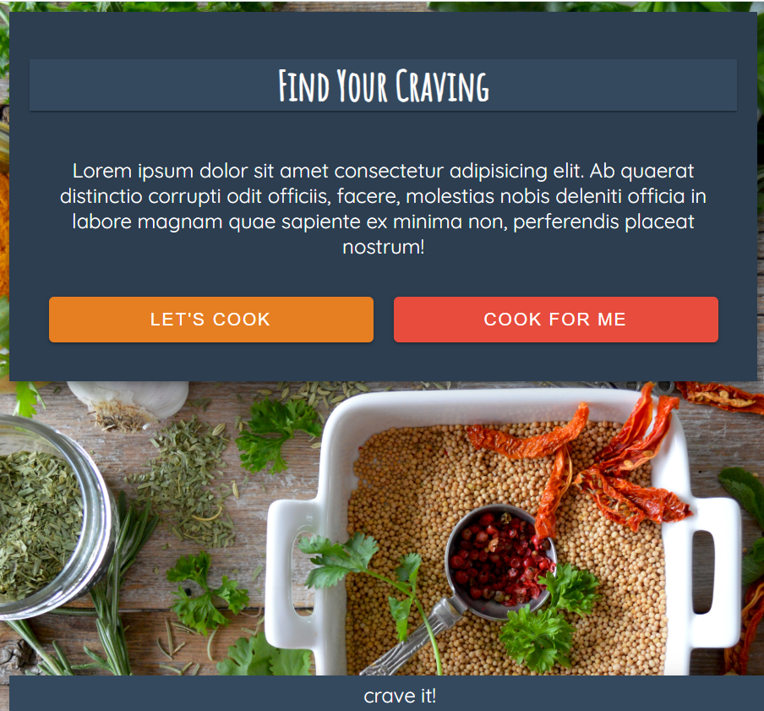
crave it!
Description

Slide 2

User Story
AS A hungry person I WANT TO find recipes or restaurants for a specific type of cuisine SO THAT I CAN make a decision on what and where to eat
This Photo by Unknown Author is licensed under CC BY-NC-ND

Slide 3

Held brainstorming session
Whiteboarded the design and page navigation
Determined MVP pages and features
Built ‘wireframes’ to use as reference during build for alignment and clarity
Decided overall site styling
Created tasks and assigned
As MVP tasks completed, referenced documented wireframes for ‘enhancement features’ on each page and created additional tasks for assignment
Each new idea discussed and decided on by group
Technologies & APIs Used
X
X
This Photo by Unknown Author is licensed under CC BY-SA

Slide 4

Challenges & Successes
Created pages that could be used for either restaurant or recipe search due to time constraints

Slide 5
Appendix

Slide 6










































Slide 7
Home Page
MVP
Navigation: Home
AS A hungry person I WANT TO select to find a recipe or restaurant SO THAT I CAN find something that I’m craving
This is the first page that a user sees when loading the app.
MVP: It welcomes the user and provides two buttons to search for recipes or to locate a restaurant. Click the button navigates the user to a search page.
Potential add-on:
a third button that navigates to a user profile page
provides a funny greeting and/or random food fact
Find Your Craving
Welcome!
Find a recipe or restaurant that satisfies my craving.
Let’s Cook
Cook For Me
craving it!

Slide 8
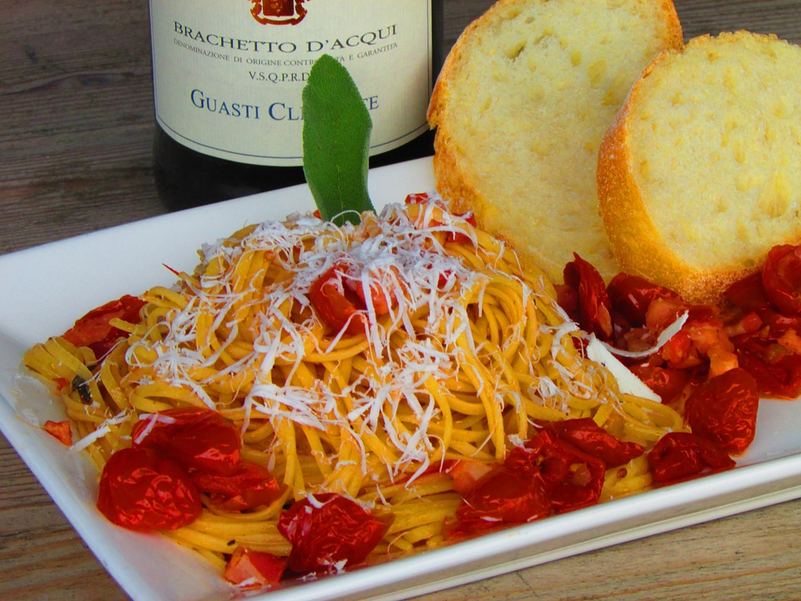
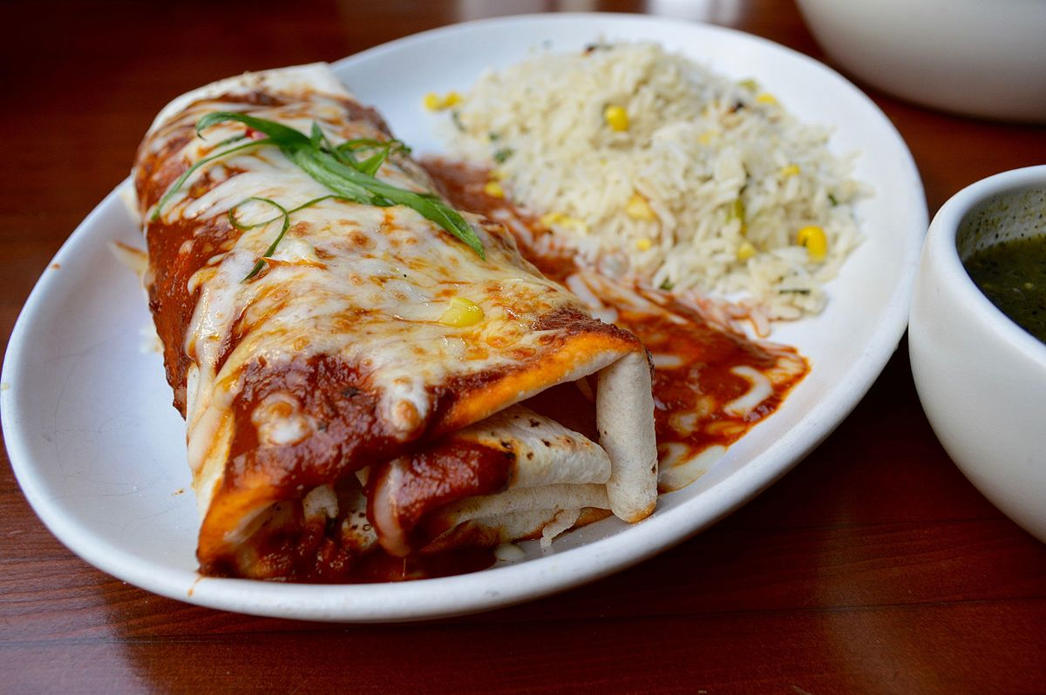
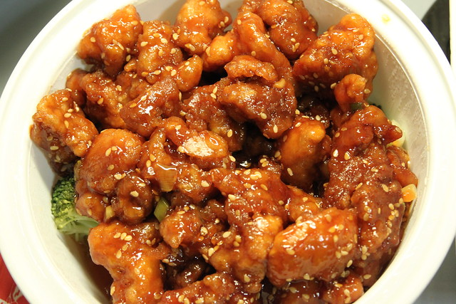
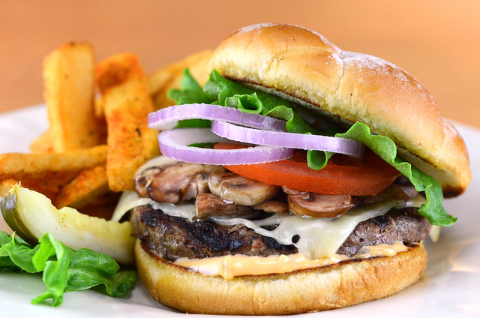
Search Page – Recipes
MVP
Navigation: Home > Find Recipe Button
AS A hungry person I WANT TO find out how I can make a specific dish SO THAT I CAN satisfy my craving
MVP: User can select a type of cuisine for a recipe. User can navigate back to the main welcome page.
Potential add-on:
Change to search and have a “+” to additional search criteria
Navigation to Profile Page
Navigation to Restaurant Search
Navigate to next recipe
Ability to go back to select another cuisine type
Additional Categories:
Japanese
Thai
Greek
Indian
French
Vietnamese
Find A Recipe
Italian
Mexican
Asian
America
Home
Restaurant
Profile
craving it!

Slide 9
Search Page – Restaurant
MVP
Navigation: Welcome > Find Restaurant Button
AS A hungry person I WANT TO find a restaurant that serves a specific dish SO THAT I CAN satisfy my craving
MVP: User can select a restaurant based on cuisine type (image) in their area (user’s geolocation). User will be able to navigate back to the main welcome page.
Potential add-on:
Add additional categories
Change to search and have a “+” to additional search criteria
Navigation to Profile Page
Navigation to Restaurant Search
Select how many miles within their area code to expand the search
Additional Categories:
Find A Restaurant
Italian
Mexican
Asian
America
Home
Recipes
Profile
craving it!
Japanese Thai Greek | Indian French Vietnamese

Slide 10
Search Result Page - Recipes
Navigation: Welcome > Find Recipe Button (future)
A page that provides a thumbnail picture of the dishes, the titles, link to recipe (navigates to recipe page).
MVP: list of recipe options
Potential add-on:
Favorite recipes that saves and can be viewed in the “saved” recipe page
[Type] Recipes
Dish name
recipe
Dish name
recipe
Dish name
recipe
Home
Profile
craving it!

Slide 11
Recipe Page
MVP
Navigation: Welcome > Find Restaurant Button > Cuisine Selected
AS someone who likes to cook I WANT TO see the ingredients and instructions of a specific dish SO THAT I CAN cook it
A page that provides a picture of the dish, the list of ingredients needed with their quantities and instructions on how to cook it.
MVP: recipe with cooking instructions
Potential add-on:
Setting button in navigation that takes the user to the profile page
Navigation to Profile Page
Embedded YouTube video for how to cook the recipe
Title
Ingredient | Quantity
Ingredient | Quantity
Ingredient | Quantity
Ingredient | Quantity
Instructions:
---------------------------------------
---------------------------------------------------------------------------
---------------------------------------
YouTube Video
Home
Recipe Search
Profile
craving it!

Slide 12
Search Result Page – Restaurant
MVP
Navigation: Welcome > Find Restaurant Button > Search Restaurant
AS A someone who is looking for something to eat I WANT TO see a list of restaurants in my area based on cuisine type I selected SO THAT I can decide on where to eat
MVP: Lists of 10 restaurant based on the cuisine type selected within 25 miles of their location (lat & lng).
Restaurant information:
Name
Address
Potential add-on:
URL to restaurant’s website or yelp page.
Navigation to Profile Page
Map showing locations of restaurants
Clicking address navigates user to Google map
Restaurants In Your Area
restaurant name
address
restaurant name
address
restaurant name
address
Home
Restaurant
search
Profile
craving it!

Slide 13
Saved Results Page - Recipes
Navigation: Welcome > Recipe Search > Recipe Results
AS A someone who likes to cook I WANT TO be able to save a recipe
SO THAT I CAN easily find and cook the recipe later
A page that a list of recipes the users saved. The page provides a thumbnail picture of the dishes, the titles, link to recipe (navigates to recipe page).
MVP: list of recipe that were saved by the user
Potential add-on:
Button to remove the saved recipes
Saved Recipes
name
recipe
name
recipe
name
recipe
Home
Profile
craving it!

