Slide 1






Email Spam Filtering Using Classification
Christine Joy Pugay

Slide 2
Introduction
Almost all business and personal transactions are communicated via email.
It also became a medium for many online frauds such as phishing to send spam email
Businesses losing billions of dollars each year
Project Objective:
Use machine learning to classify emails and spam emails

Slide 3
Data Collection and Variable Description
Obtained data from Kaggle
Dataset contains randomly picked email files
Columns: 3002, Rows: 5172
dropped column email id before analysis
Records represent:
Email No. (Object)
Count of words/characters in email (Integer)
Labels for prediction (Integer)
Variable Types
Independent: All character occurrence columns
Dependent: ‘Prediction’ column

Slide 4
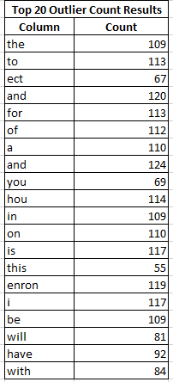
Descriptive Analysis- Outlier
Outlier Analysis
5172 records has an outlier >3
Dropping these will eliminate almost all records
Project Specific
Naturally high outlier result
Counts of words in an email will be inconsistent and varies depending on the length of an email itself
Conclusion:
keep the outliers in the dataset to prevent losing massive data

Slide 5
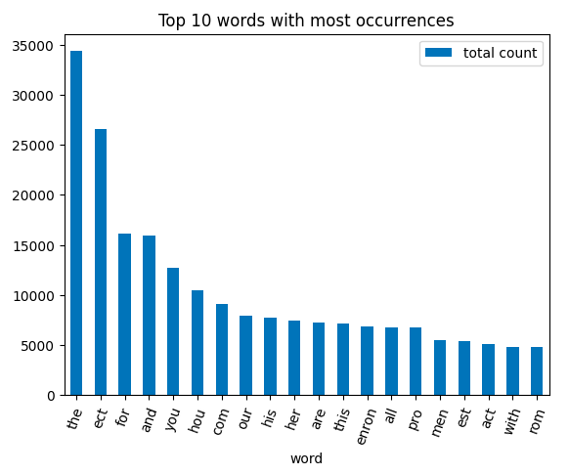
Descriptive Analysis- Word Count
Words “the” was the most used in these emails: used 34,345 times
Secondly, “ect” was used: used 26,604 times
misspelled “etc”?
misspelling is common in spam emails

Slide 6
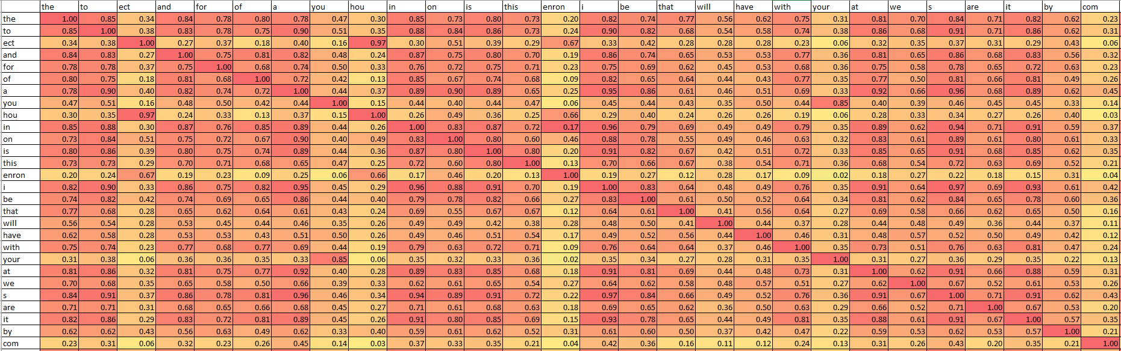
Descriptive Analysis- Correlation
First 29 Features and Their Correlations
Multicollinearity is heavily present in our dataset because words are naturally correlated with one another

Slide 7
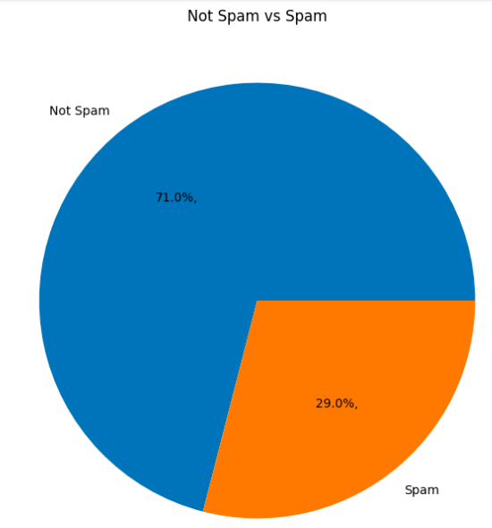
Data Analysis
Method of Analysis
Classification
Establish Naive Rule
Models we will be using:
Gaussian Naive Bayes
Multinomial Naive Bayes
Logistic Regression
Determine best performing model

Slide 8
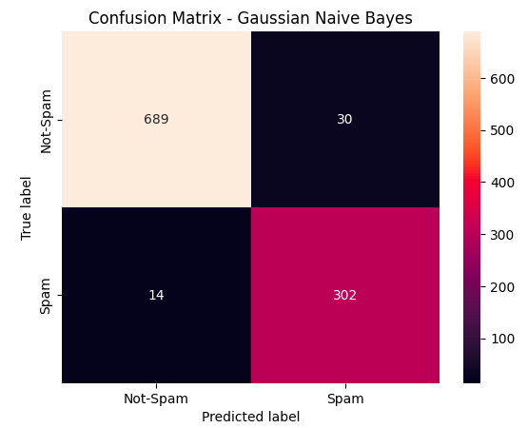
Data Analysis - Gaussian Naive Bayes
Performance Metrics
Accuracy Score | 95.75%
Precision | 90.96%
Sensitivity | 95.57%
Specificity | 95.83%
F-1 Score | 93.21%
Proportion Comparison
 | Original Proportion | GNB Accurate Proportion
Not-Spam | 71.00% | 66.57%
Spam | 29.00% | 29.18%

Slide 9
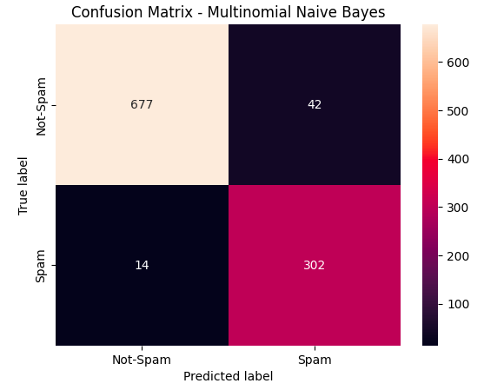
Data Analysis - Multinomial Naive Bayes
Performance Metrics
Accuracy Score | 94.40%
Precision | 87.72%
Sensitivity | 94.94%
Specificity | 94.16%
F-1 Score | 91.19%
Proportion Comparison
 | Original Proportion | MNB Accurate Proportion
Not-Spam | 71.00% | 65.41%
Spam | 29.00% | 29.18%

Slide 10
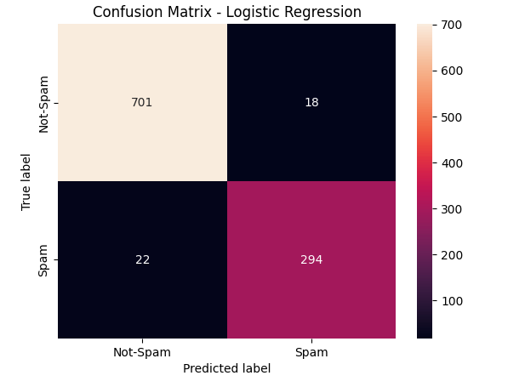
Data Analysis - Logistic Regression
Performance Metrics
Accuracy Score | 96.03%
Precision | 94.21.%
Sensitivity | 92.72%
Specificity | 97.49%
F-1 Score | 93.46%
Proportion Comparison
 | Original Proportion | MNB Accurate Proportion
Not-Spam | 71.00% | 67.72%
Spam | 29.00% | 28.41%

Slide 11
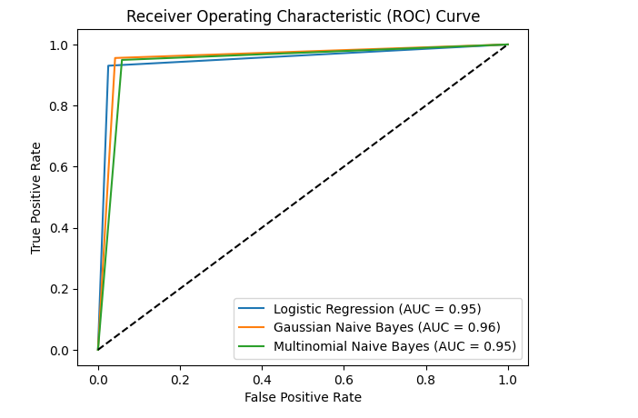
Summary of Findings
Gaussian Naive Bayes performed the best with AUC =0.96

Slide 12
Implications
Catch spam emails before they enter the inbox folder
Prevents employees from accidentally opening spam emails
Prevents employees from disclosing important company information
Decrease spam-related monetary losses for many businesses

Slide 13
Future steps
Improving Results:
Retrain Model using more data
Explore more models

