Slide 1
Finding the best city
in France

Slide 2
INTRODUCTION
- Background: The company ‘SUNSHINE’ is planning to start a consulting service to restaurants , providing new strategy to cope with COVID19.
-Objective: To find the best city in France where it has the most restaurants and hotels.

Slide 3
DATA ACQUISITION & CLEANING
Data Source: Internet( https://simplemaps.com/data/fr-cities) & Foursquare API
Contents of Data: Main 471 cities in France, Latitude, Longitude, Population and Venues
Data cleaning process through Python panda & numpy

Slide 4
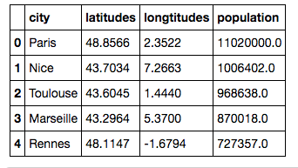
DATA ACQUISITION & CLEANING
Example of the table after the acquisition and cleaning

Slide 5
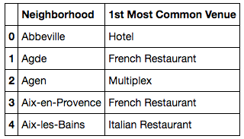
DATA ANALYSIS & METHODOLOGY
In total, there are 5545 venues with the search criteria of 100 limits on venues and the radius 500 meters for each city given latitude and longitude information.
There are 331 unique categories of venue and can look at the top 5 venue category and create a table of top venue by each each city as an example below

Slide 6
DATA ANALYSIS& METHODOLOGY
Identifying the fact that there is common venue category in several cities.
Hence, we use unsupervised learning K-means algorithm to cluster the cities.
For example, we run K-Means to cluster the cities into 5 clusters and merge table with cluster labels for each city

Slide 7
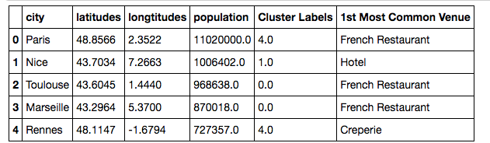
DATA ANALYSIS& METHODOLOGY
Example of clustering table

Slide 8
RESULTS
Based on the clustering algorithm, we find that cluster label 0 has French restaurant and cluster label1 has hotel as the most common venue.
It is also important that we look at the city that has the highest population since it is related to the volume of restaurant and hotel activity
We can see that Toulouse and the Nice have the highest in each label.

Slide 9
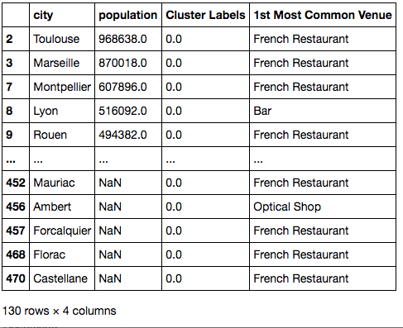
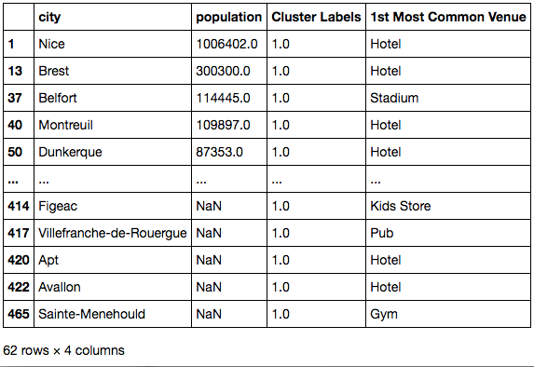
RESULTS
DSFDF

Slide 10
DISCUSSION
We can recommend the city, Toulouse to start the business. In terms of hotel industry -> Nice
Remarks: It is also possible to further explore restaurants and hotels of Toulouse and Nice in terms of ranking and visualise on the map. We also suggest to work with another data provider that has more local data in France.

Slide 11
CONCLUSION
The company ‘SUNSHINE’ should start with focusing on doing research about all the restaurants in Toulouse
Regarding the hotel industry, they should explore Nice since they have hotels as the most common venue.

Slide 12
