Slide 1
Oscar Nominations

Slide 2
Team Members/ Responsibilities
Jake Littman - Machine Learning Model
Oneil Anderson - Technologies /Presentation
Brieona Turner- Database
Elena Rivera - Presentation/ Dashboard
Christine Ibrahim Puri - Github Setup/Dashboard

Slide 3
Overview
Our project analyzed Oscar nominated movies throughout history. This topic was chosen for our analysis because of the large amount of data available and the common interest in movies between our team members. Using the datasets at our disposal, we identified variables that relate to Oscar performance of different movies
Questions to Address
Why do certain genres outperform others?
What features influence movie nominations?
What genres have the highest probability of being nominated for an Oscar at the next academy award?
Business Objective:
Our analysis could provide key investment decisions for production companies in financing and producing quality movies and retaining the top actresses, actors and directors in the movie industry

Slide 4
Database
Software used: Jupyter Notebook [Pandas], PostgreSQL
Cleansing the datasets: The database has come together from bringing in the movie_metadata.csv and oscars_movie.csv datasets.
The data in both were cleaned via regex processing and taking out null values. In addition, release_year and nominated columns were added to the movie_metadata.
Joining the datasets: From there, the data was exported into a Postgres database and then the datasets were combined into the combination_table.csv. The datasets were combined on the Oscar’s ‘film’ column with the Movie’s ‘title’ column.
The columns in the combined dataset are as follows: budget, release_year, revenue, runtime, title, genres, nominated, winner, category.
Kaggle Movie Dataset
Kaggle Oscar Movie Dataset

Slide 5
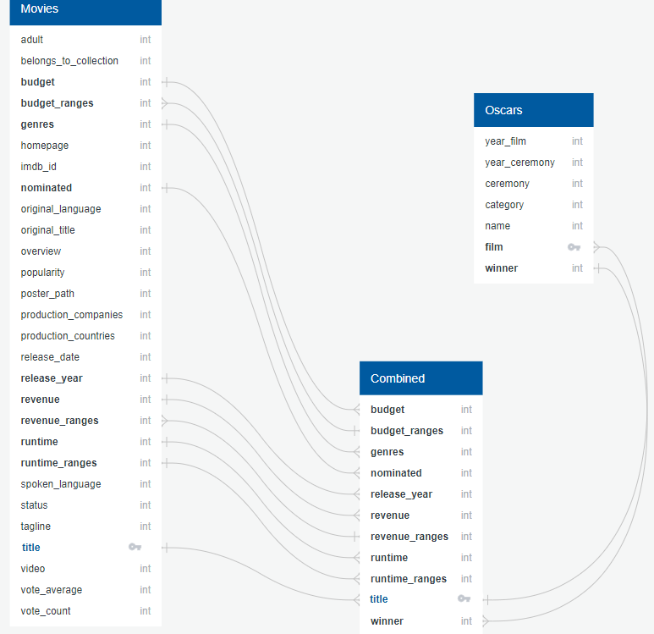
Entity Relationship Diagram (ERD) of tables

Slide 6
Machine Learning
Models: Logistic Regression and Random Forest
Observations: We imported the train_test_split model to split the dataset 50/50 by movie titles. There are 4,264 movie titles in the population that were used.
Feature Selection:
Independent Variables: Genre, Budget_Ranges, Revenue_Ranges, Runtime_Ranges (Dummy)
Dependent Variable: “Nominated”
0 = Was not nominated for an Oscar
1 = Was nominated for an Oscar
Notes:
We will use Logistic Regression and Random Forest Models. Random Forest Models are more likely to overfit the data, since they can split on multiple features whereas Logistic Regression handles better where the dimensionality is limited (single or limited variables).

Slide 7
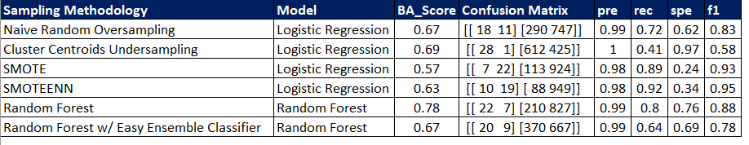
Models

Slide 8
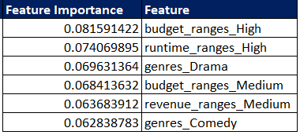
Feature Importance
Notes:
Top 5 Features

Slide 9
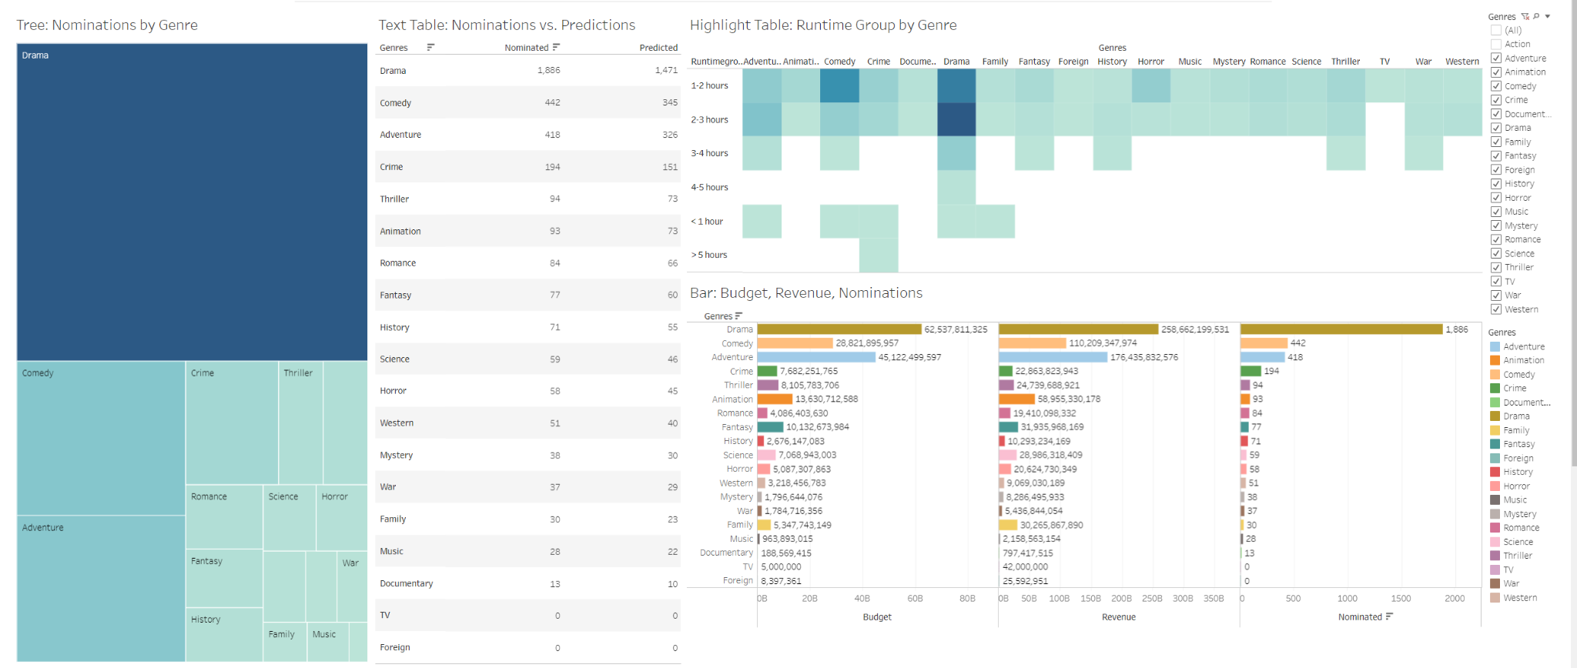
Dashboard Integration
https://public.tableau.com/app/profile/elena.rivera4127/viz/OscarNominationsDashboardStoryboard-Segment4v2/OscarNominationsDashboard?publish=yes

Slide 10
Proposal
Incorporating other factors such as other award shows to draw a stronger correlation between nominations and past performance
Building a more sophisticated model to account for any outliers
Genres/Budget with low feature importance, but high precision.

