Slide 1

Prevalence and rationale for covariate adjustment in cluster randomized trials: A scoping review
Christine Bui
Duke Global Health Institute / Research Design & Analysis Core
November 21, 2025
Notes:
Hi everyone! I’m Christine Bui and I’m a BCTIP intern interning with the Duke Global Health Institute, specifically within the Research Design & Analysis Core. Today, I’ll be presenting the project I’ve been working on discussing the prevalence and rationale for covariate adjustment in cluster randomized trials and this is a scoping review.

Slide 2
Overview
Introduction & Background
What are cluster randomized trials (cRCTs)?
What is covariate adjustment?
What is known in iRCTs vs cRCTs?
Inspiration for this study
Why LMICs?
Why are we doing this review?
Procedures & Methods
Data source
Data extraction form
Data extraction process
Results & Next Steps
Results
Next steps
Notes:
Regarding the overview and structure of the presentation, we’ll discuss the Introduction & Background such as some key terminology and the motivation for this review. Then we’ll go into the Procedures & Methods that will discuss everything about the data such as the data source and the data extraction process. And then we’ll go into Results & Next Steps that discusses the results thus far and planning for next steps.

Slide 3
Introduction & Background
Notes:
So starting off with the Introduction & Background…

Slide 4
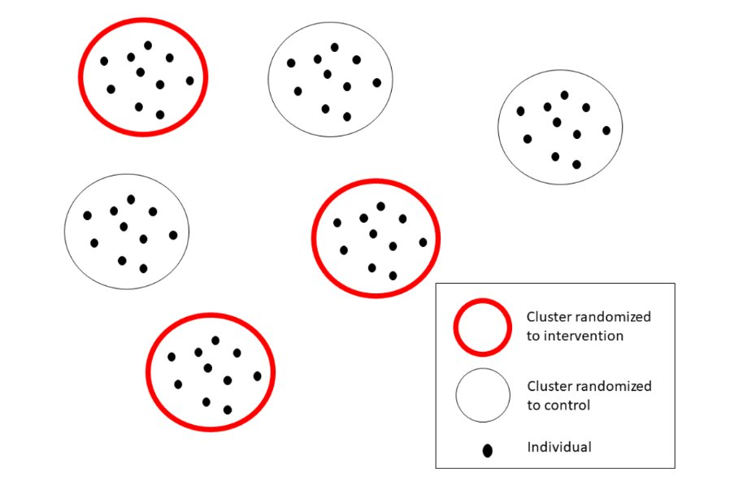
What are cluster randomized trials (cRCTs)?
Entire groups (clusters) randomized, not individuals
  Examples: schools, clinics, villages
Reduces contamination
Often used in public health settings
Fewer randomization units → covariate imbalance more likely
Notes:
I want to start off with introducing some terminology so in this project, we’ll be using cluster randomized trials where we randomize entire groups called clusters, So instead of assigning people to an intervention or control, we assign units such as schools, clinics, or villages.
And a benefit of randomizing whole groups is that it reduces contamination, and contamination is when people in the control group accidentally become exposed to the intervention so keeping everyone in the same group on the same arm helps prevent that.
But it’s also noted that cluster trials can come with a challenge and that’s the small number of clusters. So for example, we might have 20 clusters instead of 500 individuals. With fewer randomized units, the two groups can end up being different at baseline simply by chance. So because of this, covariate adjustment is important since it helps account for these chance imbalances.

Slide 5
What is covariate adjustment?
Adding baseline variables to statistical models estimating the treatment effect on outcomes
Why?
  Improves precision → increases statistical power
  Adjusts for design variables
  Handles chance covariate imbalances
Pocock et al. 2002
Notes:
Moving onto covariate adjustment, covariate adjustment is when we add baseline variables into the model that estimates the treatment effect. So instead of just comparing outcomes between the intervention and control groups, we’re also accounting for these baseline measures.
Several reasons as to why we do covariate adjustment is that it improves precision, which also increases the statistical power. This basically means if we include baseline variables that are strongly related to the outcome, the model can explain more of the variation in the data, and we can also get a clearer estimate of the treatment effect.
Adjusting for design variables is when trials stratify or balance on certain variables during randomization. And if a variable is used during randomization, it’s best to also adjust for it, which keeps the analysis aligned with the design of the trial.
And another reason is that it also handles covariate imbalances. So when you randomize on a small number of clusters, the two arms might differ at baseline by chance. So as a result, covariate adjustment helps correct for these random differences so that they don’t bias the treatment effect.
And these are also just several reasons as to why we use covariate adjustment among many other reasons.

Slide 6
What is known in iRCTs vs. cRCTs?
What We Know (From iRCTs) | What We Don’t Know (Gaps in cRCTs)
Existing guidance and literature on covariate adjustment | Less guidance specific to cRCTs
Explanations of when, why, and how to adjust for covariates | Limited systematic reviews examining covariate adjustment practices
Established best practices for choosing covariates and incorporating them into models | Lack of clarity of covariates being prespecified and adjusted for
Recommendations are frequently updated and adopted in the iRCT space | Last review was based on older trials
Notes:
I created a table summarizing what we know from individual randomized trials compared to what we don’t know for cluster randomized trials.
Regarding individual randomized trials, we have a lot of existing guidance with papers and tutorials explaining when and how you should adjust for covariates. There are also practices for doing this and recommendations are updated regularly and are widely followed.
However, for cluster randomized trials, there’s much less guidance. We don’t have many reviews telling us what researchers are actually doing in practice and information regarding covariate adjustment is often unclear. And importantly, the last major review of covariate adjustment in cluster randomized trials was published before 2010, which means that evidence is OUTDATED.

Slide 7
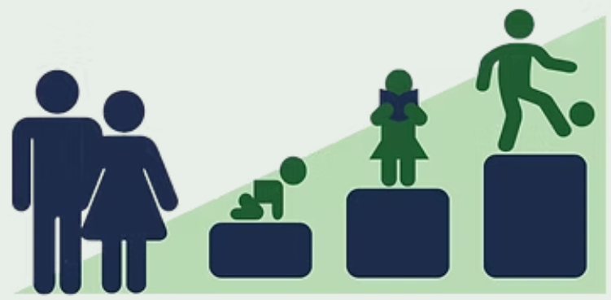
Inspiration for this study
The Bachpan Study
  Cluster randomized trial in Pakistan
  Mental health intervention for mothers
  Raised questions:
    What covariates are adjusted for in low- and middle-income country (LMIC) cluster trials?
    Do papers explain why they adjust?
Maselko et al. 2020
Notes:
The inspiration for our study comes from the Bachpan study, which was a cluster randomized trial conducted in rural Pakistan that discussed a peer-delivered psychosocial program delivered to mothers who were depressed during pregnancy and after birth.
A little bit about this study is that it followed these women and their children to see how both the mothers and kids were doing, especially seeing if depression symptoms rubbed off on their children.
Additionally, this study motivated our work on covariate adjustment because in a trial like this, many things measured at baseline could influence the outcome and if you don’t account for those, you risk misinterpreting the effect of the intervention. So for example, some clusters may have more risk factors just by chance and that could affect both how depressed mothers are and how their children develop.
And this raises questions around covariate adjustment such as like what covariates are adjusted for in cluster trials regarding low- and middle income countries and do papers explain why they adjust for covariates?

Slide 8
Why LMICs?
Many LMIC Trials | Variation in Methods | Gaps in Reporting
LMICs conduct a large number of community and public-health cRCTs | Methods and adjustment practices differ | Reporting on analysis decisions are inconsistent, making it unclear what was adjusted for
Goldstein et al. 2024
Notes:
We’re focusing on low- and middle-income countries for a few reasons. So first, low- and middle-income countries conduct a large number of community- and public-health based cluster randomized trials and these are places where interventions often happen at the community, school, or clinic level.
And across these low- and middle-income cluster trials, we see a lot of variation in the methods and how covariate adjustment is handled. So for instance, some trials could adjust for baseline variables, some don’t, and some don’t even explain their choices at all. So this raises the question of what are people actually doing in practice?
And lastly, previous reviews and papers don’t fully describe their analysis decisions so it’s often unclear which covariates were adjusted for and why they were included. So as a result, these gaps in reporting make it more difficult to evaluate the quality of the overall analyses that were done.

Slide 9
Why are we doing this review?
Last cRCT covariate adjustment review was 10+ years ago
  Used pre-2010 articles
  No clear understanding of current covariate adjustment practices in cluster randomized trials
Review of current practices can inform future work on guidance/recommendation documents
Wright et al. 2015
Notes:
Overall, we’re doing this review because the last covariate adjustment in cluster randomized trials review was done 10 or more so years ago and that review included articles published before 2010, specifically from 2000-2008, so it doesn’t reflect how modern trials are being analyzed today.
And by reviewing more recent trials, we can get an updated picture of how covariate adjustment is being used and these findings can also help inform future guidance or recommendations regarding covariate adjustment in cluster randomized trials.

Slide 10
Procedures & Methods
Notes:
Moving onto the Procedures & Methods, we’ll be going over anything regarding data and the data extraction process…

Slide 11
Data source
Using 300 papers from 2017-2022
All are parallel-arm cluster randomized trials conducted in LMICs
Based on:
  Ethics review of 800 cRCTs
  Randomization procedures review using a random subset of 300
Shaw et al. 2025
Goldstein et al. 2024
Notes:
So for this review, we’re using 300 papers published from 2017-2022 and all of these papers are parallel-arm cluster randomized trials conducted in low- and middle-income countries so this gives us a more up-to-date look at recent practices.
These papers were from previous reviews. The first review was an ethics review of 800 cluster randomized trials, and this review basically collected screening information about the trials such as basic study characteristics. So we essentially already have a well-organized pool of cluster trials to work with.
And then from those 800 papers, a random subset of 300 was used for a second review that looked at randomization procedures in cluster trials. And overall, we decided that it was just convenient to use the same 300 papers for the review we’re working on now.

Slide 12
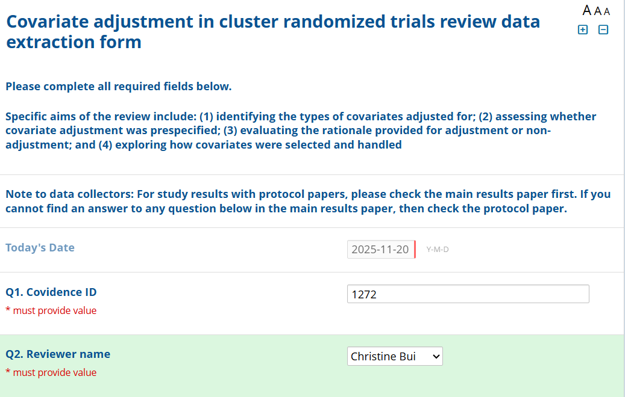
Data extraction form
REDCap
Standard questions:
  Total # of participants enrolled in the trial
  Type of study
  Primary outcome(s)
Analysis questions:
  How covariates were selected
  Distributional summaries of covariates
Notes:
The way we’re extracting data from these papers is through REDCap. For those of you who don’t know what REDCap is, REDCap is an online web-based application that’s meant for research study surveys.
The survey form includes standard basic questions such as the total # of participants enrolled in the trial, the type of study so think of study designs such as cohort, cross-sectional, repeated cross-sectional, etc. and what the primary outcomes were and how many there were. There were also more analysis-like questions in regards to covariate adjustment such as how covariates were selected and if there were any distributional summaries of the covariates.
I also provided a screenshot of how the form looks once you open it. So it starts with the article ID and a drop-down bar that signifies which reviewer is completing this data entry form.

Slide 13
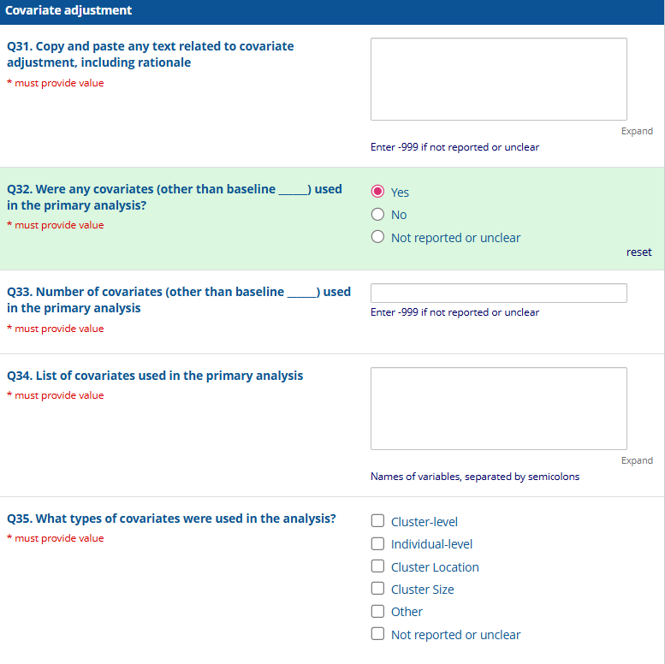
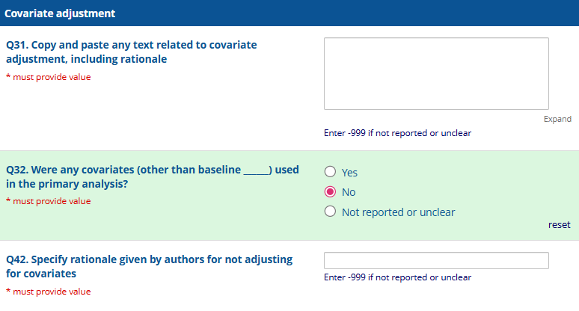
Data extraction form (cont.)
Notes:
The form does go through standard basic questions about the studies, but I did want to include screenshots of questions related to the covariate adjustment section of the form.
REDCap also follows a true/false logic so for instance, on the left, if you select ‘Yes’ for Question 32, it will bring up more specific follow-up questions related to those covariates that were used such as how many covariates were there and what type of covariates were used.
I also included a screenshot on the right that shows if you selected ‘No’ for Question 32, it skips through Questions 33-41 and automatically goes to Question 42, which states to specify the rationale for not adjusting for covariates.

Slide 14
Data extraction process
Two reviewers per article
  Senior reviewer and junior reviewer
Random assignment of reviewer pairs and articles
After individual article data extraction:
  Reconciliation meeting
  Resolve discrepancies
  Document final decisions
Notes:
Moving onto the data extraction process, there are 2 reviewers per article and there is a random assignment of reviewer pairs and articles. I do want to note that the assignment of reviewer pairs is technically not entirely randomly just because we wanted to make sure there was one senior reviewer and one junior reviewer per pair.
And to define what a senior reviewer is, it’s basically someone who has more senior-level experience working with cluster randomized trials whereas, a junior reviewer is someone who has little to no experience working with cluster randomized trials.
So after each person does their individual article data extraction, each pair will have a reconciliation meeting discussing and resolving any discrepancies based on the answers they put for a question from the data extraction form. And by the end of the meeting, the reviewers will come to a final decision for the specific questions that had discrepancies.

Slide 15
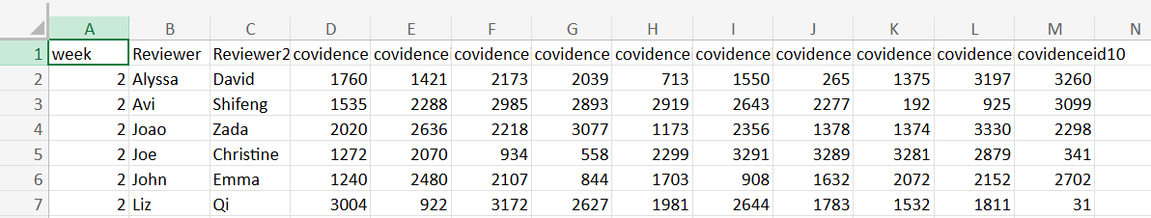
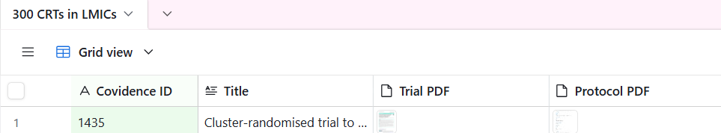
Data extraction process (cont.)
Notes:
I also wanted to provide screenshots of how we organized the articles per reviewer pair and where we organized the articles to download and extract data from.
So in the top screenshot, we basically had Excel spreadsheets for each week with the reviewer pair names. The first reviewer name is the senior reviewer and the second reviewer name is the junior reviewer and the 10 random articles assigned to each reviewer pair follows right after.
And all these numbers represent the article ID. In the bottom screenshot, we organized the 300 articles on a platform called AirTable. And for those of you who don’t know what AirTable is, it’s basically just an online organization and management tool.
So to walk you through the data extraction process, if you were assigned to the article with the ID of 1435, you would scroll to that article on AirTable and then download the main paper and protocol paper and as you go through the questions on the REDcap form from earlier, you fill out the form with the answers you find from the main paper and or protocol paper.

Slide 16
Results & Next Steps
Notes:
And lastly, we’ll be going over the results thus far as well as preparing for the next steps of this review…

Slide 17
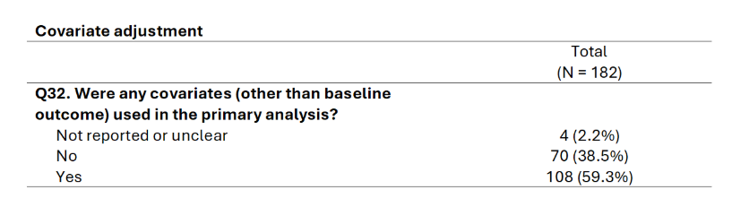
Results
Article data extraction and reconciliation ongoing
Notes:
So for results, I want to note that we’re towards the end of article data extraction and reconciliation so the process is still ongoing. I don’t have access to the data yet but my supervisor, John, had a good idea of including a screenshot of what the final Table 1 could look like just to get a general idea.
With the results so far, we’ve finished extracting data from 182 out of 300 articles, which is more than half the articles. And to get a somewhat general idea of what the final Table 1 could look like, we included a random question, which in this case is Question 32. And we can see that about 59% of articles extracted so far used covariates in their primary analyses and about 39% of articles extracted so far did not use any covariates.
And I would say that it’s good that a big percentage of articles extracted so far included covariates in their primary analysis because as mentioned in previous slides, if we enter ‘Yes’ to Question 32, it will give us several follow-up questions and specifics on how covariate adjustment was handled in the trials.

Slide 18
Next steps
Finish article data extraction and reconciliation
Merge and clean data
Create summary tables
Identify patterns:
  Which covariates are most common?
  How often do authors give a rationale?
Draft manuscript and think about how to frame main findings
Notes:
Regarding the next steps, we’re finishing up the article data extraction and reconciliation process. Once the extraction and reconciliation is finished, merging and cleaning the data is the next step, then creating summary tables. And with this, we can identify patterns or trends so for example, like which covariates are most common and how often the authors gave a rationale for covariate adjustment. And then the final step will be drafting a manuscript. So once we have a sense of the major findings, we’ll be thinking carefully about how to frame them in writing.

Slide 19
References
Goldstein, C. E., Marouf, Y., Johri, M., Shaw, J. F., Sergeant, A., Nicholls, S. G., Althabe, F.,Ferrand, R. A., van der Graaf, R., Hemming, K., Mbuagbaw, L., Treweek, S., Welch, V. A.,Weijer, C., & Taljaard, M. (2024). Systematic scoping review of cluster randomised trialsconducted exclusively in low-income and middle-income countries between 2017 and2022. BMJ Open, 14(9), e087724. https://doi.org/10.1136/bmjopen-2024-087724
Maselko, J., Sikander, S., Turner, E. L., Bates, L. M., Ahmad, I., Atif, N., Baranov, V., Bhalotra, S., Bibi, A., Bibi, T., Bilal, S., Biroli, P., Chung, E., Gallis, J. A., Hagaman, A., Jamil, A., LeMasters, K., O’Donnell, K., Scherer, E., Sharif, M., Waqas, A., Zaidi, A., Zulfiqar, S., & Rahman, A. (2020). Effectiveness of a peer-delivered, psychosocial intervention on maternal depression and child development at 3 years of age: A cluster randomised trial in Pakistan. The Lancet Psychiatry, 7(9), 727–737. https://doi.org/10.1016/S2215-0366(20)30230-3
Pocock, S. J., Assmann, S. E., Enos, L. E., & Kasten, L. E. (2002). Subgroup analysis, covariate adjustment and baseline comparisons in clinical trial reporting: Current practice and problems. Statistics in Medicine, 21(19), 2917–2930. https://doi.org/10.1002/sim.1296
Shaw, J. F., Goldstein, C. E., Mazzetti, T., Armond, A., Marouf, Y., Lamprecht, K., Tran, E., Abdul,S., London, A. J., & Weijer, C. (2025). Randomization procedures in parallel-arm clusterrandomized trials in low-and middle-income countries: a review of 300 trials publishedbetween 2017-2022. Journal of Clinical Epidemiology, 111825.
Wright, N., Ivers, N., Eldridge, S., Taljaard, M., & Bremner, S. (2015). A review of the use ofcovariates in cluster randomized trials uncovers marked discrepancies between guidanceand practice. Journal of Clinical Epidemiology, 68(6), 603-609.

Slide 20
Thank you! Questions?
Special Thanks: John Gallis
Notes:
So this concludes the end to my presentation. I also want to give a special thanks to my supervisor, John, who has helped guide me throughout this project.
And thank you everyone for listening! If you have any questions, I’d be happy to answer them now.

