Slide 1
Feature Selection-FS12
Team Presentation
ELEC8900-76-R-2021F AML
Christino Jacob-110060886
Kishore Selvaraju-110032345

Slide 2
Feature Selection
Unsupervised Feature Selection with Ordinal Locality (UFSOL)
Adaptive Structural Learning (ASL)
Dependence Guided Unsupervised Feature Selection (DGUFS)

Slide 3
Unsupervised Feature Selection with Ordinal Locality (UFSOL)

Slide 4
Triplet-based loss function is introduced to enforce the selected features group to preserve the ordinal locality of original data which contribute to distance-based clustering tasks.
Simplify the orthogonal basis clustering by imposing an orthogonal constant on a feature projection matrix
An alternative minimization algorithm is employed to efficiently optimize the proposed model together with rapid convergence.

Slide 5
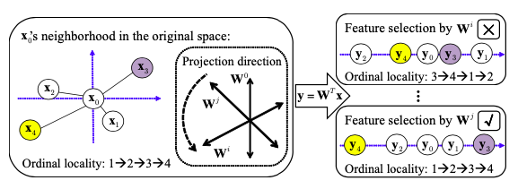

Slide 6
Adaptive Structural Learning (ASL)

Slide 7
ASL is based on a unified learning framework that performs structural learning and feature selection simultaneously.
Traditional unsupervised methods try to select the features by preserving intrinsic structure of the data but the structure may contain noise and redundancies which are non desirable.
The key idea is to learn the true structure of data during feature selection and thus avoiding undesirable outcomes caused due to noise and replication.
In ASL, the structure is adaptively learned from each iteration of feature selection which results in selecting the most informative features from the learned structure.

Slide 8
For instance, sparse structural regression try to characterize the structure and then generating a graph initially. Then it uses the same graphical data for feature selection.
Analogous to the cat and dog example, ASL considers the differentiating features of a cat from a dog instead of taking the whole features set!
ASL propose to jointly perform unsupervised feature selection and data structure learning simultaneously, where both global and local structure are adaptively updated using the result of current feature selection.

Slide 9
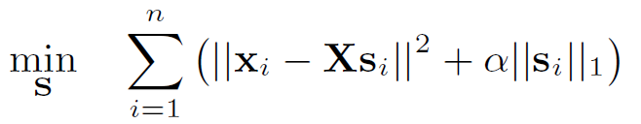
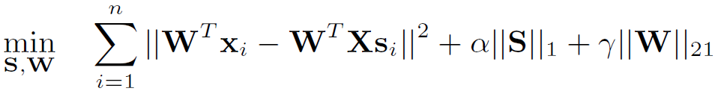
i. Adaptive Global Structural Learning
ASL uses sparse regression coefficients to extract global structure of data.
In sparse representation, each data sample x_{i} can be approximated as a linear combination of all the other samples.
The sparse matrix S obtained by the below expression can be used to guide the search of relevant features and to eliminate noisy features.
S =

Slide 10


ii. Adaptive Local Structural Learning
Local structural learning in ASL is achieved from Euclidian distance induced probabilistic neighborhood model rather than Laplacian model which can induce noise.
The probabilistic model P obtained by the following expression is used to model the local structural learning.
P =

Slide 11
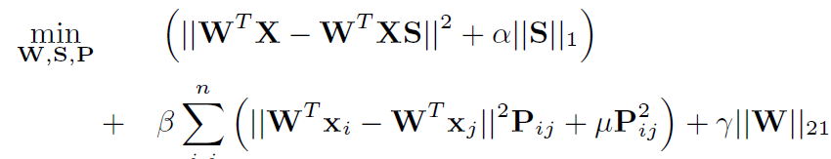
iii. Unsupervised Feature Selection with ASL
Combining both global and local structural learning models, ASL can model feature selection by the solution of
where alpha, beta and gamma are regularization parameters balancing the fitting error of global and local structure learning in the first term and second term, and the sparsity of the feature selection matrix in the third group.

Slide 12
Dependence Guided Unsupervised Feature Selection (DGUFS)

Slide 13
Existing unsupervised methods adopts a two-step strategy for feature selection. i.e., selecting the top-m features according to a calculated descending order and then performing K-means clustering, resulting in a group of sub-optimal features.
DGUFS performs both the selection of features and partitioning data in a joint manner.
This method enhances interdependence among the original data, cluster labels and selected features and thus the feature selection will be performed from the original data w.r.t the learned cluster labels to minimize the noise.

Slide 14
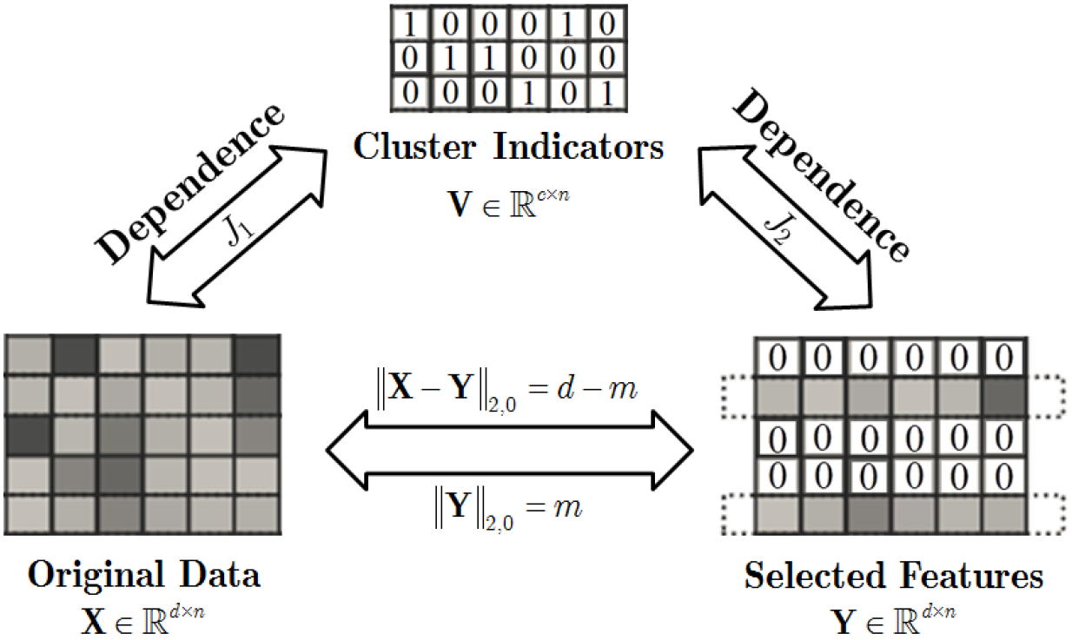

DGUFS is performed based on the following steps
I_{2.0} based model for clustering
Directly select exact m features from all d features in the learning phase.

Slide 15

ii. Designing 2 dependence guided terms
Enhance the inter-dependence among original data, learned cluster labels, and selected features.
S is the similarity matrix of X
H=I-11^{T}/n is the centering matrix

Slide 16







Dependence Guided term J₁
Consider S as the correlation matrix of input dataset X
Consider L as a linear kernel matrix of V such that
Then J₁ can be calculated as
Dependence Guided term J₂
The calculation of J₂ is based on Hilbert-Schmidt Independence Criterion (HSIC)
then
Where K is the kernel function, H is the centering matrix for HSIC and n is the dimension of K
Here,
,
and
Then

Slide 17


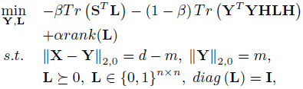

Reformulation

Slide 18
References
[1] L. Du and Y.-D. Shen, “Unsupervised feature selection with adaptive structure learning,” in Proceedings of the 21th ACM SIGKDD International Conference on Knowledge Discovery and Data Mining, 2015.
[2] F. Bach, R. Jenatton, J. Mairal, and G. Obozinski. Optimization with sparsity-inducing penalties. Foundations and Trends R in Machine Learning, 4(1):1{106, 2012.
[3] Y. Yang, H. Shen, Z. Ma, Z. Huang, and X. Zhou.`21-norm regularized discriminative feature selectio for unsupervised learning. In IJCAI, pages 1589{1594, 2011.
[4] F. Nie, S. Xiang, Y. Jia, C. Zhang, and S. Yan. Trace ratio criterion for feature selection. In IJCAI, volume 2, pages 671{676, 2008.
[5] D. Cai, X. He, and J. Han. Spectral regression: A unified approach for sparse subspace learning. In ICDM, pages 73{82, 2007.

Slide 19
[6] Z. Zhao, L. Wang, and H. Liu. Efficient spectral feature selection with minimum redundancy. In AAAI, pages 673{678, 2010.
[7] Z. Zhao, L. Wang, H. Liu, and J. Ye. On similarity preserving feature selection. TKDE, 25(3):619{632, 2013.
[8] Y. Yang, H. T. Shen, F. Nie, R. Ji, and X. Zhou. Nonnegative spectral clustering with discriminative regularization. In AAAI, 2011.
[9] H. Zeng and Y. Cheung. Feature selection and kernel learning for local learning-based clustering. PAMI, 33(8):1532{1547, 2011.
[10] F. Nie, X. Wang, and H. Huang. Clustering and projected clustering with adaptive neighbors. In SIGKDD, pages 977{986, 2014.

Slide 20
[11] R. He, T. Tan, L. Wang, and W. Zheng, “l2,1 regularized correntropy for robust feature selection,” in CVPR, 2012, pp. 2504–2511.
[12] S. Wang, X. Chang, X. Li, Q. Z. Sheng, and W. Chen, “Multitask support vector machines for feature selection with shared knowledge discovery,” Signal Processing, vol. 120, pp. 746–753, Mar. 2016.
[13] L. Jian, J. Li, K. Shu, and H. Liu, “Multi-label informed feature selection,” in IJCAI, 2016, pp. 1627–1633.
[14] J. Guo, Y. Guo, X. Kong, and R. He, “Unsupervised feature selection with ordinal locality,” in 2017 IEEE International Conference on Multimedia and Expo (ICME), 2017, pp. 1213–1218
[15] J. Guo and W. Zhu, “Dependence Guided Unsupervised Feature Selection,” in Thirty-Second AAAI Conference on Artificial Intelligence, 2018

Slide 21
Thank You

