Slide 1

Dependence Guided Unsupervised Feature Selection
Jun Guo¹ and Wenwu Zhu¹²
¹Tsinghua-Berkeley Shenzhen Institute (TBSI), Tsinghua University, China
²Department of Computer Science and Technology, Tsinghua University, China
eeguojun@outlook.com
AAAI 2018 - Presentation

Slide 2
Outline
Introduction
The proposed method
Experiments and analysis
Summary and future work
AAAI 2018 - Presentation

Slide 3
Outline
Introduction
The proposed method
Experiments and analysis
Summary and future work
AAAI 2018 - Presentation

Slide 4
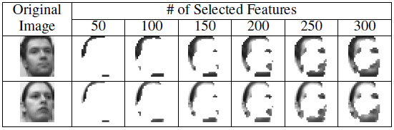
Unsupervised Feature Selection
In unsupervised scenarios:
  Remove correlated, redundant, and noisy features.
  Select more discriminative features.
  Contribute to clustering.
AAAI 2018 - Presentation

Slide 5
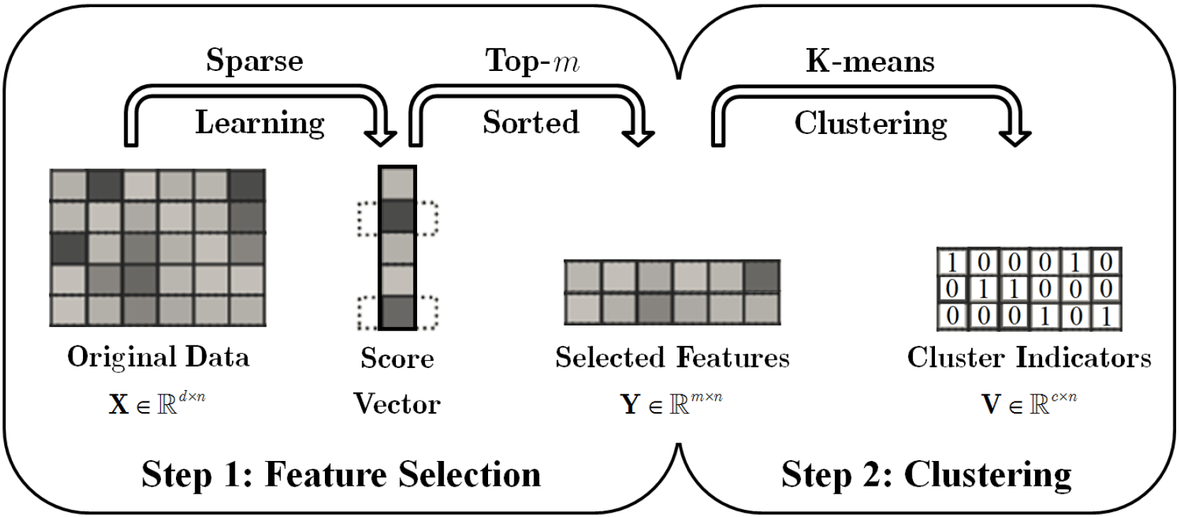
Sparse Learning Based Unsupervised Feature Selection
  Explicit score: Laplacian score [NIPS’05].
  Implicit score: column-wise l_{2,1}-norm of a learned matrix [AAAI’12, IJCAI’13, AAAI’15].
AAAI 2018 - Presentation
Notes:
[1] X. He, et al., “Laplacian score for feature selection,” NIPS 2005.
[2] Z. Li, et al., “Unsupervised feature selection using nonnegative spectral analysis,” AAAI 2012.
[3] M. Qian and C. Zhai, “Robust unsupervised feature selection,” IJCAI 2013.
[4] S. Wang, et al., “Embedded unsupervised feature selection,” AAAI 2015.

Slide 6
Sparse Learning Based Unsupervised Feature Selection
  However, such a two-step strategy cannot prevent selecting sub-optimal features.
  The m top-sorted features ≠ the desired top-m features.
AAAI 2018 - Presentation

Slide 7
Sparse Learning Based Unsupervised Feature Selection
Drawback 1:
  Select m features without removing the information of other d-m features in the learning phase.
AAAI 2018 - Presentation

Slide 8
Sparse Learning Based Unsupervised Feature Selection
Drawback 2:
  Suppress the inter-dependence among original data, cluster labels, and selected features.
AAAI 2018 - Presentation

Slide 9
Outline
Introduction
The proposed method
Experiments and analysis
Summary and future work
AAAI 2018 - Presentation

Slide 10
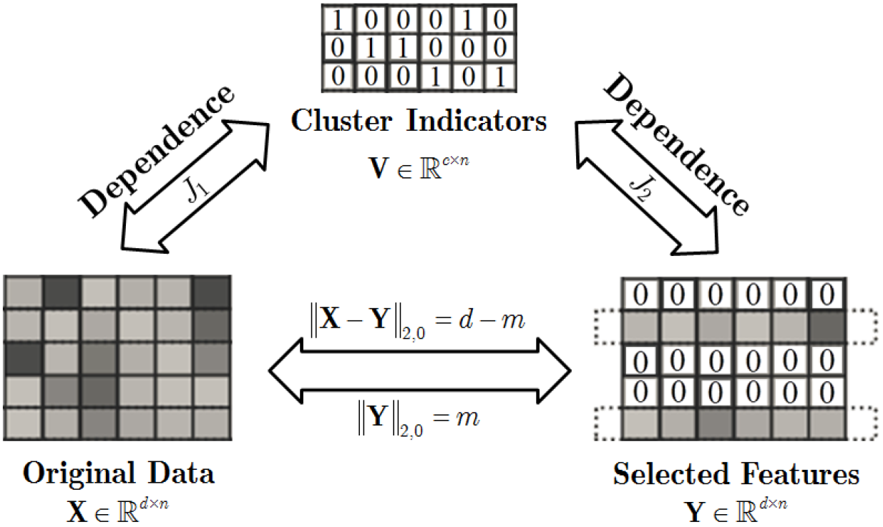
The Proposed DGUFS Method
Framework of our proposed Dependence Guided Unsupervised Feature Selection:
AAAI 2018 - Presentation

Slide 11
The Proposed DGUFS Method
l_{2,0}-norm based projection-free model:
  Directly select exact m features from all d features in the learning phase.
AAAI 2018 - Presentation
Notes:
Overcome Drawback 1.

Slide 12

The Proposed DGUFS Method
Two dependence guided terms:
S is the similarity matrix of X
H=I-11^{T}/n is the centering matrix
  Enhance the inter-dependence among original data, learned cluster labels, and selected features.
AAAI 2018 - Presentation
Notes:
Overcome Drawback 2.
J1 is based on the geometrical structure and discriminative information of data. It is well-known that samples within the same cluster are close to each other while samples from different clusters are far away.
J2 is based on Hilbert-Schmidt Independence Criterion (HSIC), which is a kernel-based dependence metric for random variables.

Slide 13


Overall Objective Function
AAAI 2018 - Presentation
Notes:
β∈(0,1) is a regularization parameter.
Ω is the candidate set of cluster label matrices that can exactly partition data into c groups.

Slide 14
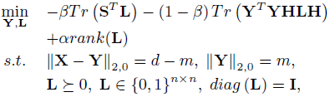

Reformulation
DGUFS:
  Properties of matrix L:
  The rank of L is exactly the number of clusters.
  L is symmetric and positive semi-definite.
  Each element of L is binary.
  diag(L)=I: a sample can’t be split into different clusters.
AAAI 2018 - Presentation
Notes:
A basic example of V, where n = 6, c = 3. Samples x1 and x5 are from cluster 1, x2 and x3 are from cluster 2, x4 and x6 are from cluster 3.

Slide 15
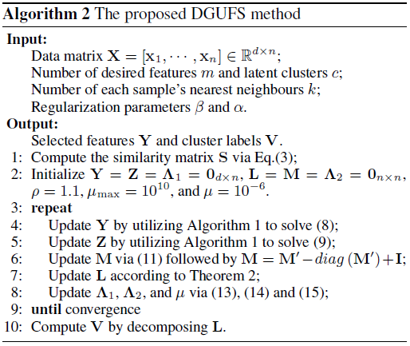
Optimization
Optimization by Alternating Direction Method of Multipliers (ADMM):
  Introduce two auxiliary variables Z and M for Y and L.
  Alternatively minimized until convergence.
AAAI 2018 - Presentation
Notes:
It is worth noting that there is no established theory in literature for the global convergence of ADMM applied to non-convex problems as the one solved in this paper. In practice, we set a maximum iteration number.
As for V, we can adopt some classical algorithms to decompose L at the end of optimization.

Slide 16
Outline
Introduction
The proposed method
Experiments and analysis
Summary and future work
AAAI 2018 - Presentation

Slide 17
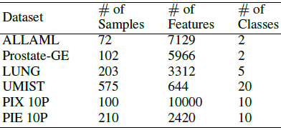
Experimental Setup
Datasets description
Comparing algorithms
  the baseline using all feature dimensions (All Features)
  the classical Laplacian Score (LS) [NIPS’05]
  other famous methods: MCFS [KDD’10], UDFS [IJCAI’11], NDFS [AAAI’12], RUFS [IJCAI’13], EUFS [AAAI’15]
mass spectrometry dataset
microarray dataset
cancer dataset
face image dataset
face image dataset
face image dataset
AAAI 2018 - Presentation
Notes:
[1] X. He, et al., “Laplacian score for feature selection,” NIPS 2005.
[2] D. Cai, et al., “Unsupervised feature selection for multi-cluster data,” KDD 2010.
[3] Y. Yang, et al., “l2;1-norm regularized discriminative feature selection for unsupervised learning,” IJCAI 2011.
[4] Z. Li, et al., “Unsupervised feature selection using nonnegative spectral analysis,” AAAI 2012.
[5] M. Qian and C. Zhai, “Robust unsupervised feature selection,” IJCAI 2013.
[6] S. Wang, et al., “Embedded unsupervised feature selection,” AAAI 2015.

Slide 18
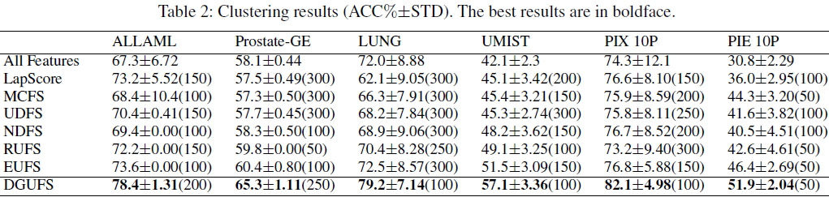
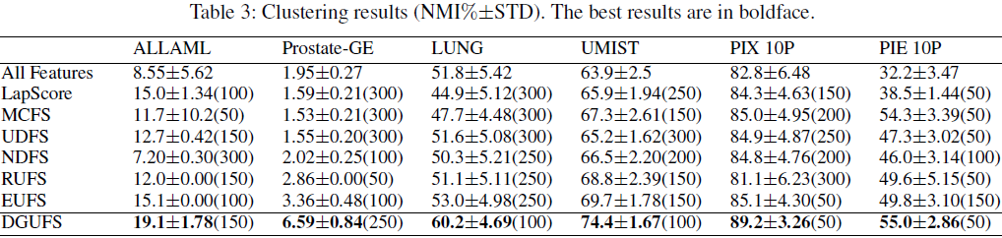
Results and Analysis
  Our proposed method outperforms state-of-the-art methods at acceptable feature dimensions.
AAAI 2018 - Presentation

Slide 19
Outline
Introduction
The proposed method
Experiments and analysis
Summary and future work
AAAI 2018 - Presentation

Slide 20
Summary and Future Work
In this paper,
  A projection-free framework for joint feature selection and clustering is proposed.
  Two dependence guided terms are designed to make the original data, cluster labels, and selected features intimately intertwined.
  An alternating minimization algorithm is developed to for the optimization process.
In the future,
  Reduce the time complexity (cubic w.r.t. n).
  A sample-level hierarchical strategy.
  ……
AAAI 2018 - Presentation
Notes:
n is the total number of samples.

Slide 21
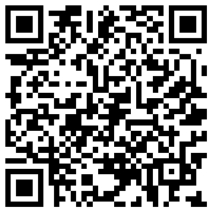
Thank you! (Q&A)
Jun Guo¹ and Wenwu Zhu¹²
¹Tsinghua-Berkeley Shenzhen Institute (TBSI), Tsinghua University, China
²Department of Computer Science and Technology, Tsinghua University, China
Email: eeguojun@outlook.com
Source code released at https://sites.google.com/site/eeguojun
QR code for Homepage
AAAI 2018 - Presentation

