Slide 1

MSc in Artificial Intelligence
Course Machine Learning
“Game Result prediction”
Toliopoulou Christianna

Slide 2
3-step process
Data Collection
Data are derived from nba-api which includes 30000 games derived from specific endpoints
Data pre-processing- Feature Engineering
Performed initial data cleaning as well as constructed features that could potentially be good predictors. The output of this process concludes in the construction of the final dataset
Model Design
Binary classification problem (win/loss) where SVM and Decision Trees and Random Forest classifiers were used

Slide 3
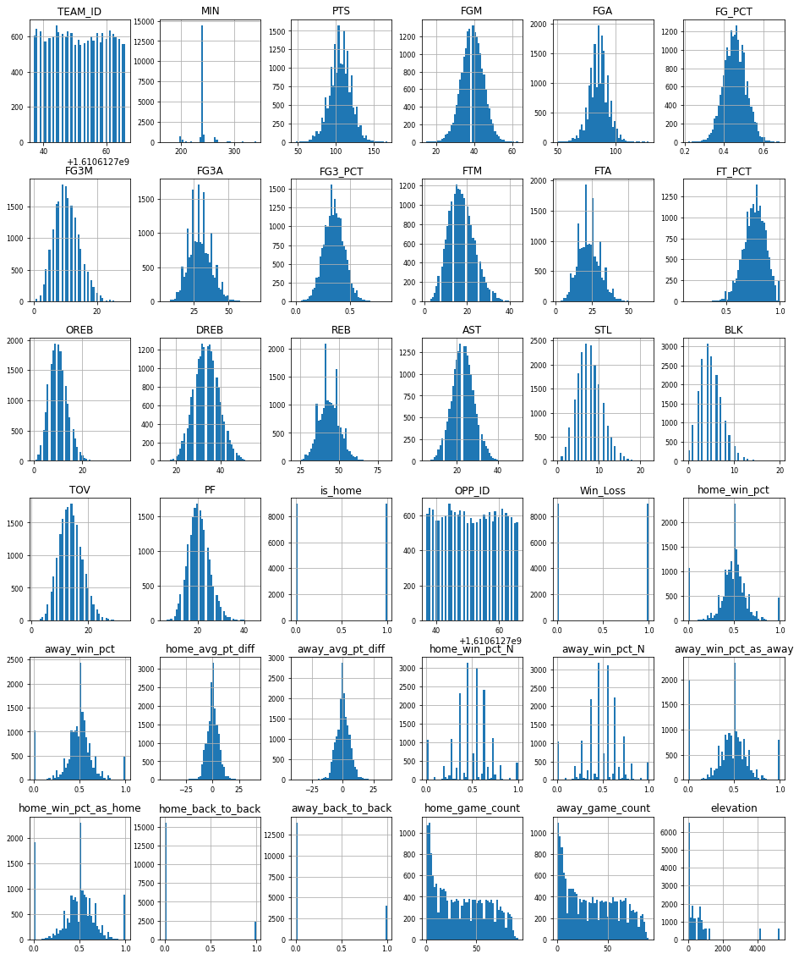
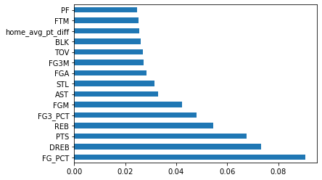
Data Pre-processing/ Feature Engineering
STEPS
Removed games referring to WNBA, G league, All Star games, Fantasy games
Transformed needed variables to categorical
Created static features (e.g home/ away, win/loss, altitude, travel distance)
Created time dependent features (e.g home_win_pct, home_game_count, home_back_to_back) -> lookback parameter
Finalized top 15 features by using feature importance plot

Slide 4
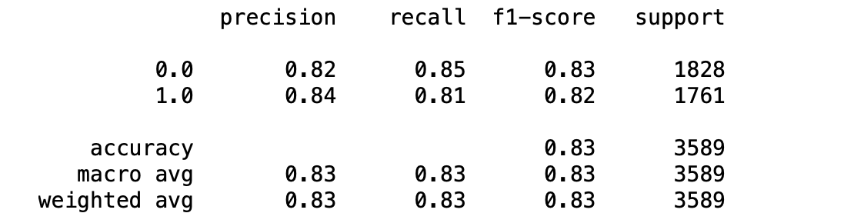
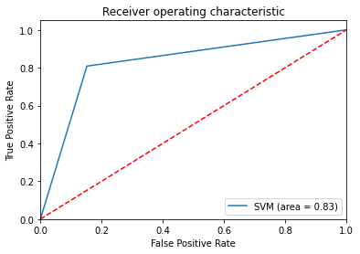
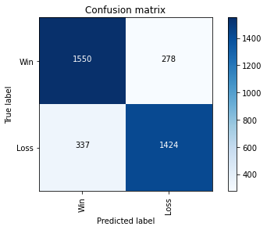
1st Model : SVM
Best parameters derived from grid search
C = 0.9
Degree = 3
Gamma = 0.05
Kernel = poly
APPROACH
Standardizing of features
80% train - 20% test
Experienced with different hyperparameters and kernels
Performed grid search in order to find the best combination
10-fold cross validation

Slide 5
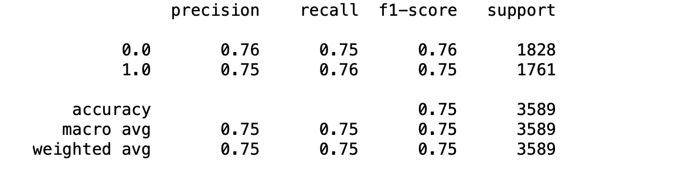
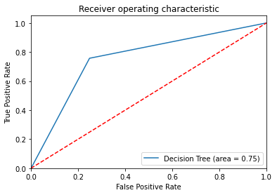
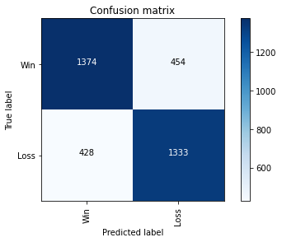
2nd Model : Decision Trees
Best parameters derived from grid search
Criterion = entropy
Max depth = 10
Min_samples_leaf = 20
APPROACH
80% train - 20% test
Performed grid search in order to find the best combination
4 fold cross validation

Slide 6
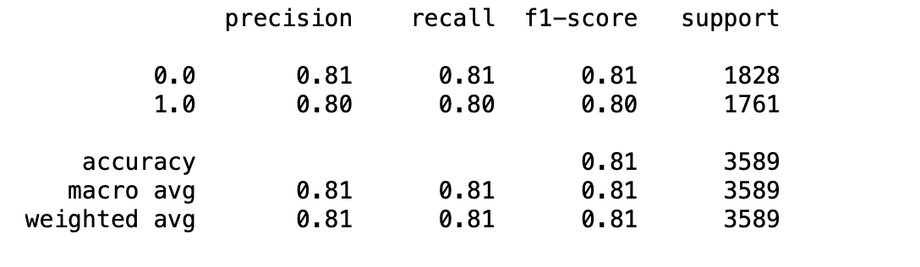
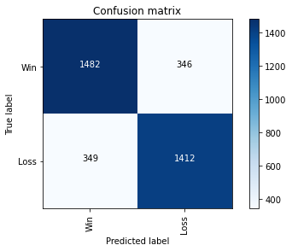

3rd Model : Random Forest
Best parameters derived from randomized search cv
N_estimators = 1600
Min_samples_split = 5
Min_samples_leaf = 1
Max_features = sqrt
Max_depth = 80
Bootstrap = false
APPROACH
80% train - 20% test
Performed grid search in order to find the best combination
4 fold cross validation

Slide 7
Results/ Future work
Include Player characteristics
It may be interesting to add also player characteristics as features in the analysis
Performance
From the classifiers it seems that SVM model has the best accuracy 83%. Random forest follows with 81% and finally decision trees
NN or CNN approach
Current bibliography suggests using Neural Networks to solve such problem

Slide 8


