Slide 1

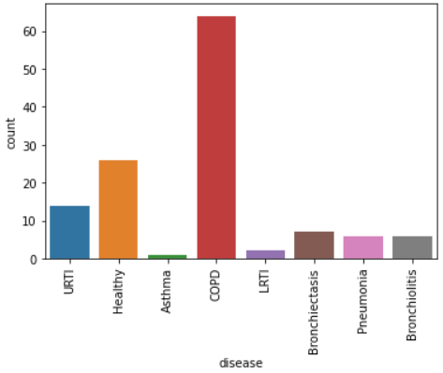
Application of ML and AI to the medical field, classification of patients with lung diseases
C.D. Nguyen, L Pisano
Motivation
Conclusions
The goal of this project is to explore the possibilities of detecting pulmonary diseases, using ML, by analysing a respiratory sound database provided on Kaggle.
We have realized that high accuracy does not necessarily mean good results when it comes to a heavily imbalanced dataset.
Classification | Overall accuracy
Binary | 96.32%
Multi | 86.90%
50 | 7 | 1 | 1 | 4 | 1
10 | 39 | 0 | 0 | 0 | 0
0 | 0 | 115 | 3 | 2 | 0
2 | 1 | 0 | 16 | 1 | 1
1 | 0 | 1 | 0 | 54 | 1
3 | 5 | 0 | 0 | 0 | 24
Figure 1. Spread of diseases in our dataset.
Our approach
Table 1. Different classification accuracy
In order to do that, we divide our problem into two tasks:
Binary classification diagnostic based on demographic information.
Random tree forest.
Multi classification diagnostic analyzing sound representing the respiratory cycles of the patient.
Voting Classifier with SVM, RF and K-NN.
Pre-processing
Imbalanced dataset
Subslice audio
Downsample majority class
Upsample others (SMOTE)
Feature extraction (MFCC, MelSpec)
Feature selection (Kfold, Kbest)
Figure 2. Confusion matrix of multi classification.
Notes:
Approach:
For multi-class classification:
Using testing and validation dataset to

