Slide 1
ARTI 6001: Computer Vision and Multimodal Machine Leraning
Assignment 1 Christo Joshy a1962973

Slide 2
Content: -Problem: Motion blur degrades detection performance - Dataset: GoPro official split — 1111 test, 2103 train - No data leakage between train and test
Image Restoration and Object Detection
Blur
MPRnet
Deblurred
YOLOv8
Results

Slide 3
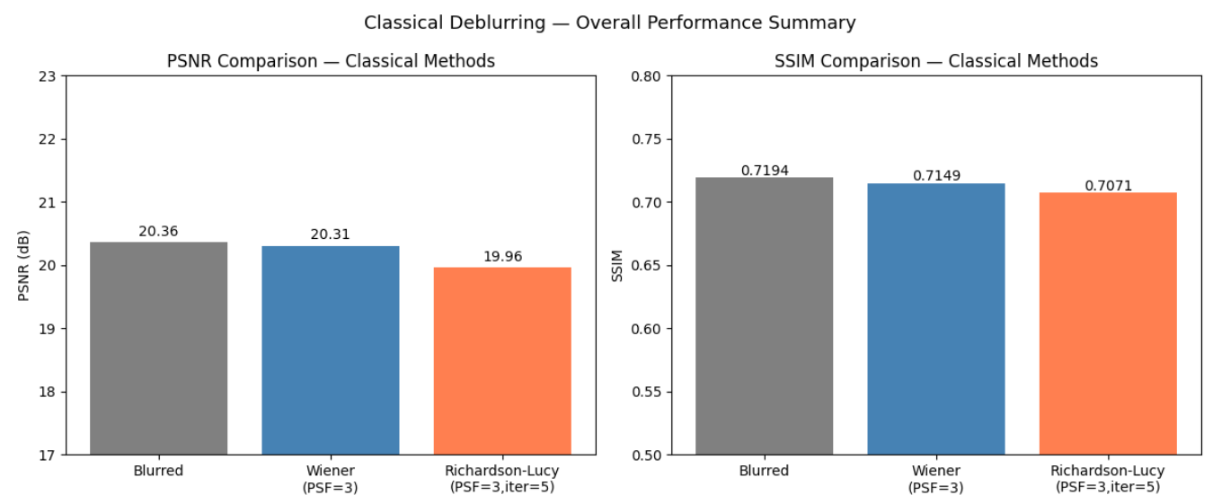
Introduction and Pipeline
Method | PSNR | SSIM
Blurred | 25.11 | 0.7717
Wiener | 20.31 | 0.7149
Richardson Lucy | 19.96 | 0.7071
Content:
- Wiener filter — PSF sizes 3-15 tested –
Richardson-Lucy — iterations 5-20 tested - Both failed due to spatially varying blur assumption

Slide 4
MPRNet Results (Quantitative)
Motion | Blurred PSNR | MPRnet PSNR | SSIM
horizontal | 20.36 | 24.72 | 0.8961
complex | 23.65 | 28.56 | 0.9338
diagonal | 19.69 | 25.55 | 0.8865
Tier | Blurred PSNR | MPRnet PSNR | SSIM
heavy | 20.75 | 26.12 | 0.8305
medium | 22.73 | 27.75 | 0.8879
mild | 23.98 | 29.96 | 0.9365
MPRNet consistently improves PSNR by +4 to +5 dB across all motion types and blur intensity tiers,confirming robustness to real-world camera motion patterns
Heavy blur benefits most from restoration — features completely destroyed by motion are successfully recovered by the learned model, while mild blur achieves the highest restored PSNR of 29.96 dB
Classical methods failed on all these same conditions due to their uniform PSF assumption confirming deep learning is essential for spatially varying real-world motion deblurring

Slide 5
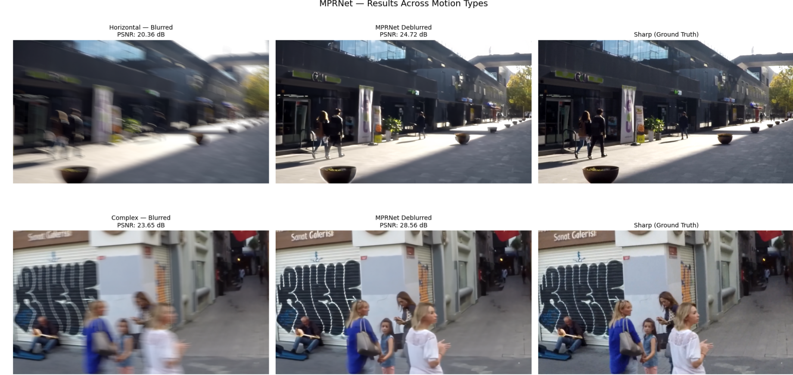
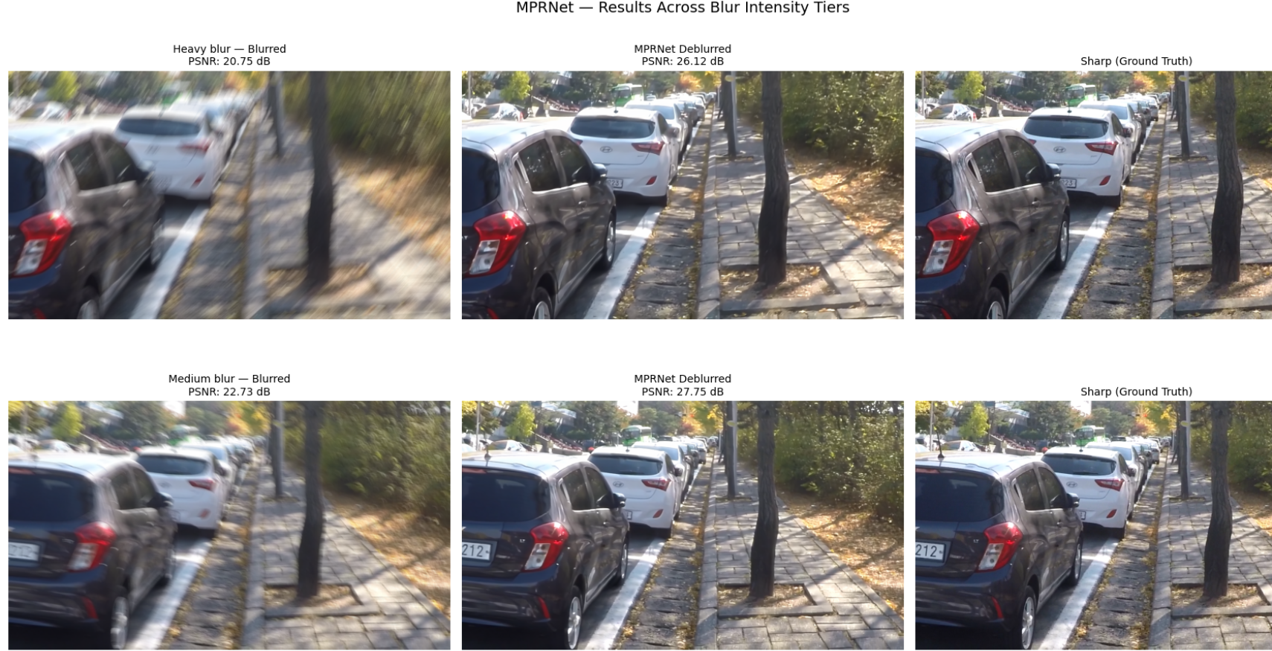
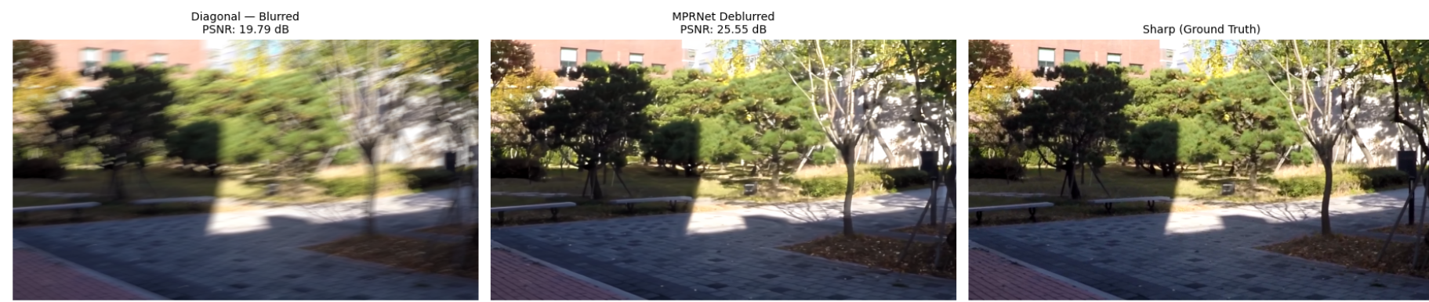
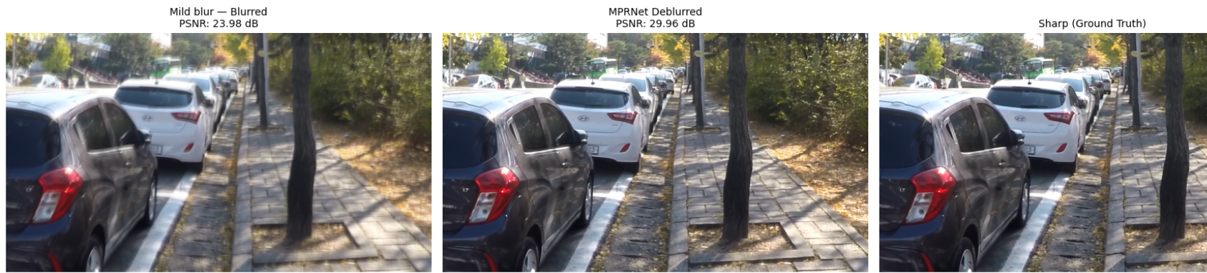
MPRNet Results (Visual)
Visual improvement is clear across all conditions

Slide 6
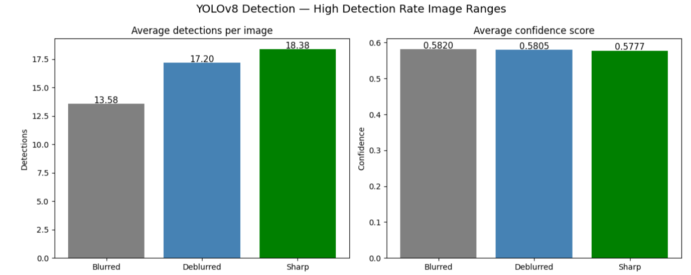
Task 3: Detection Results and Boundary Visualisation
Condition | AVG Det | AVG Conf | Zero Det
Blurred | 13.58 | 0.5820 | 0/50
Deblurred | 17.20 | 0.5805 | 0/50
Sharp | 18.38 | 0.5777 | 0/50
Key findings
Deblurring improved detections by +26.7% -
Car: +40%
Bus: +240 latency%
Person: +13%
Inference identical: ~24ms
Avg detections:
Blurred 13.58
Deblurred 17.20
Sharp 18.38 –
Avg confidence: 0.582
0.581
0.578

Slide 7
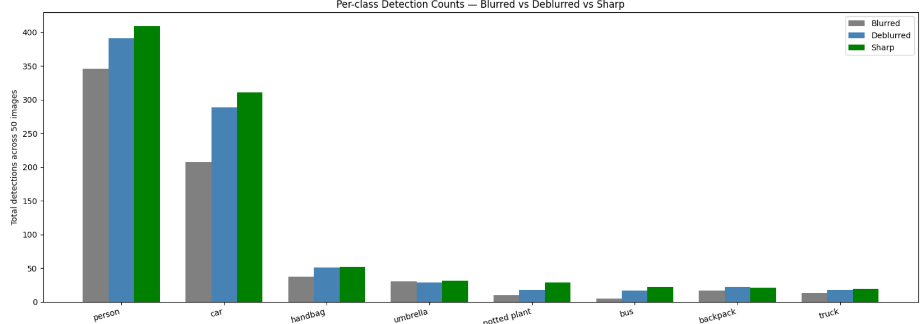
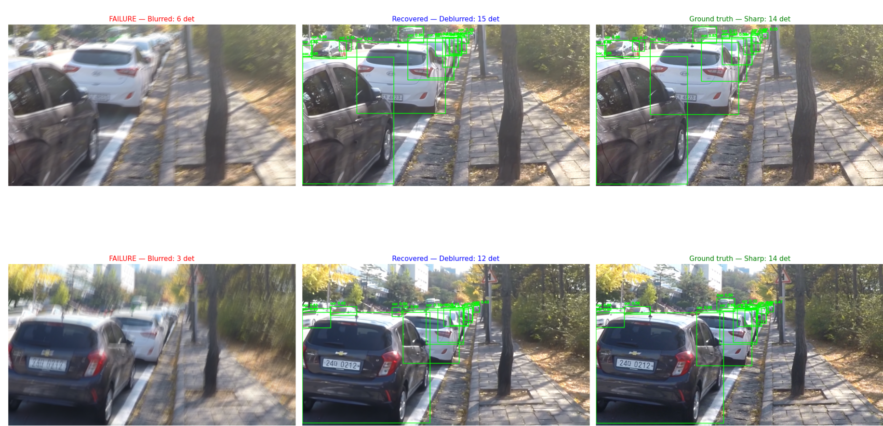
Per-class Analysis and Failure Cases
This bar graph shows the per class distribution the highest being person and the lowest being truck
13/50 images (26%) showed significant detection failure under blur — deblurring recovered all cases

Slide 8
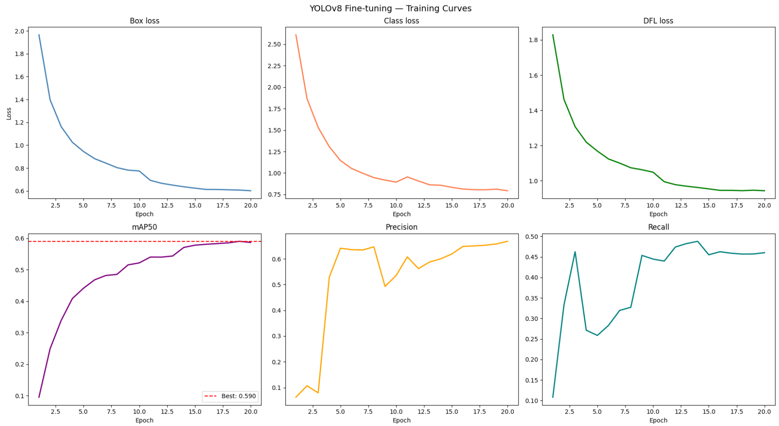
Task 4: Dataset Preparation and Training
Dataset Construction: - Source GoPro train split (2103 pairs)
No overlap with test split
zero data leakage - 600 images stratified across blur tiers
Heavy: 200
Medium: 200
Mild: 200
Auto-annotated using YOLOv8m on deblurred images
Augmented: brightness jitter + horizontal flip
Final: 1191 training images
Split: 420 train / 81 val / 86 test
Results Best mAP50 (val): 0.590
mAP50 (test): 0.581
Precision: 0.743 Recall: 0.403

Slide 9
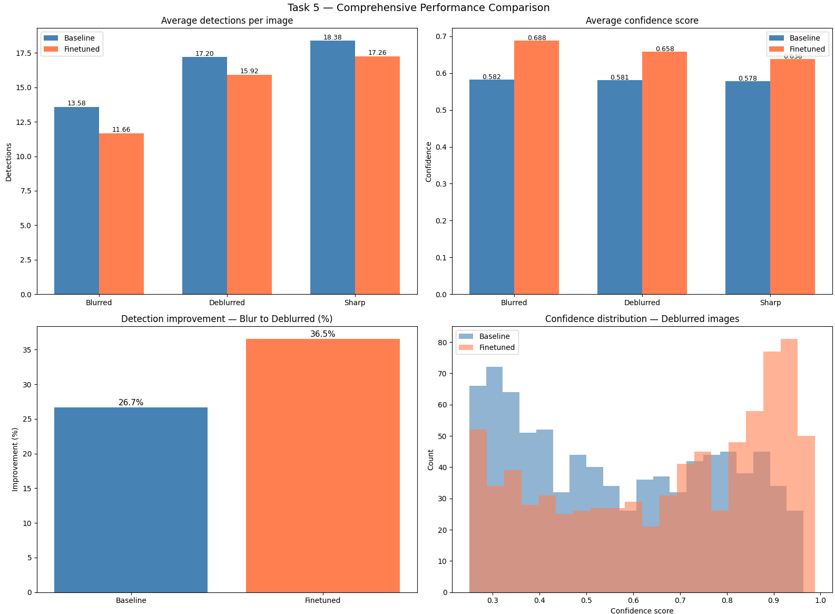
Task 5: Comprehensive Comparison
Condition | AVG Det | AVG Conf
Baseline- Blurred | 13.58 | 0.582
Baseline- Deblurred | 17.20 | 0.581
Baseline- Sharp | 18.38 | 0.578
Finetuned- Blurred | 11.74 | 0.676
Finetuned- Blurred | 16.08 | 0.658
Finetuned- Blurred | 17.32 | 0.642
Key insights:
Deblurring: +26.7% baseline
+37% finetuned
Finetuned model: higher confidence +0.09
Statistical significance: p=0.039

Slide 10
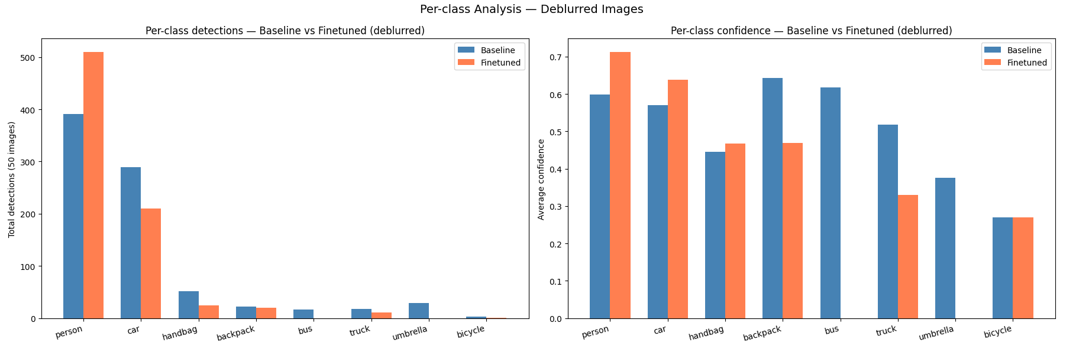
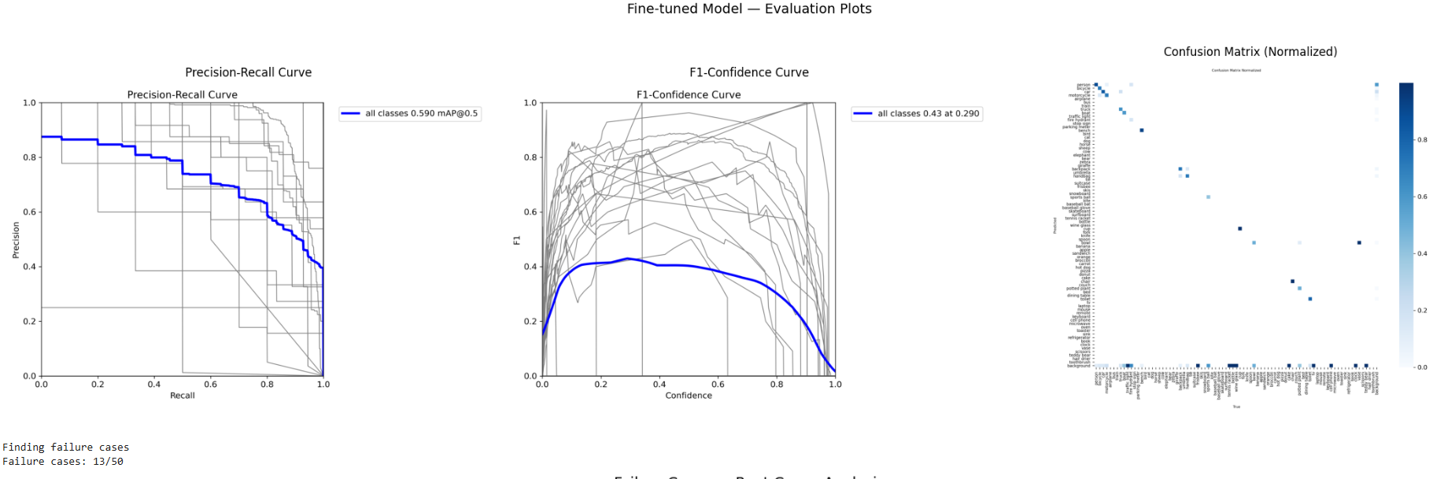
PR Curves and Per-class Comparison
Per-class analysis: Fine-tuned model detects significantly more persons (+32%)
but baseline detects more cars — evidence of class imbalance in training data
PR Curve: mAP50 = 0.590 | F1 Peak: 0.43 at confidence 0.290 | Failure cases: 13/50 (26%)
Statistical significance: -
Blurred vs Deblurred:
p = 0.000 — highly significant improvement
Baseline vs Finetuned:
p = 0.039 — statistically significant difference

Slide 11
Critical Analysis and Conclusion
Limitations
GoPro specific — limited generalisation
Auto-annotation introduces label noise
Class imbalance: person/car dominate
MPRNet adds ~5s per image Not suitable for real-time use
Advantages
Detection improved by +26.7%
Statistically confirmed p=0.039
No additional inference latency
Consistent across all blur types
Fine-tuning adds confidence +0.09
Key Takeaways:
Classical deblurring fails
deep learning essential
MPRNet: +4.27 dB PSNR across 1111 test images
Deblurring improves detection by up to +37%
Fine-tuned model statistically significant p=0.039
Complete end-to-end pipeline demonstrated
Future Improvements:
Manual annotation
Multiple camera types
End-to-end joint training
All 2103 training pairs
Lightweight deblurring model

Slide 12
Thank You

