Slide 1
WebbStore
A journey through React and API

Slide 2


Slide 3
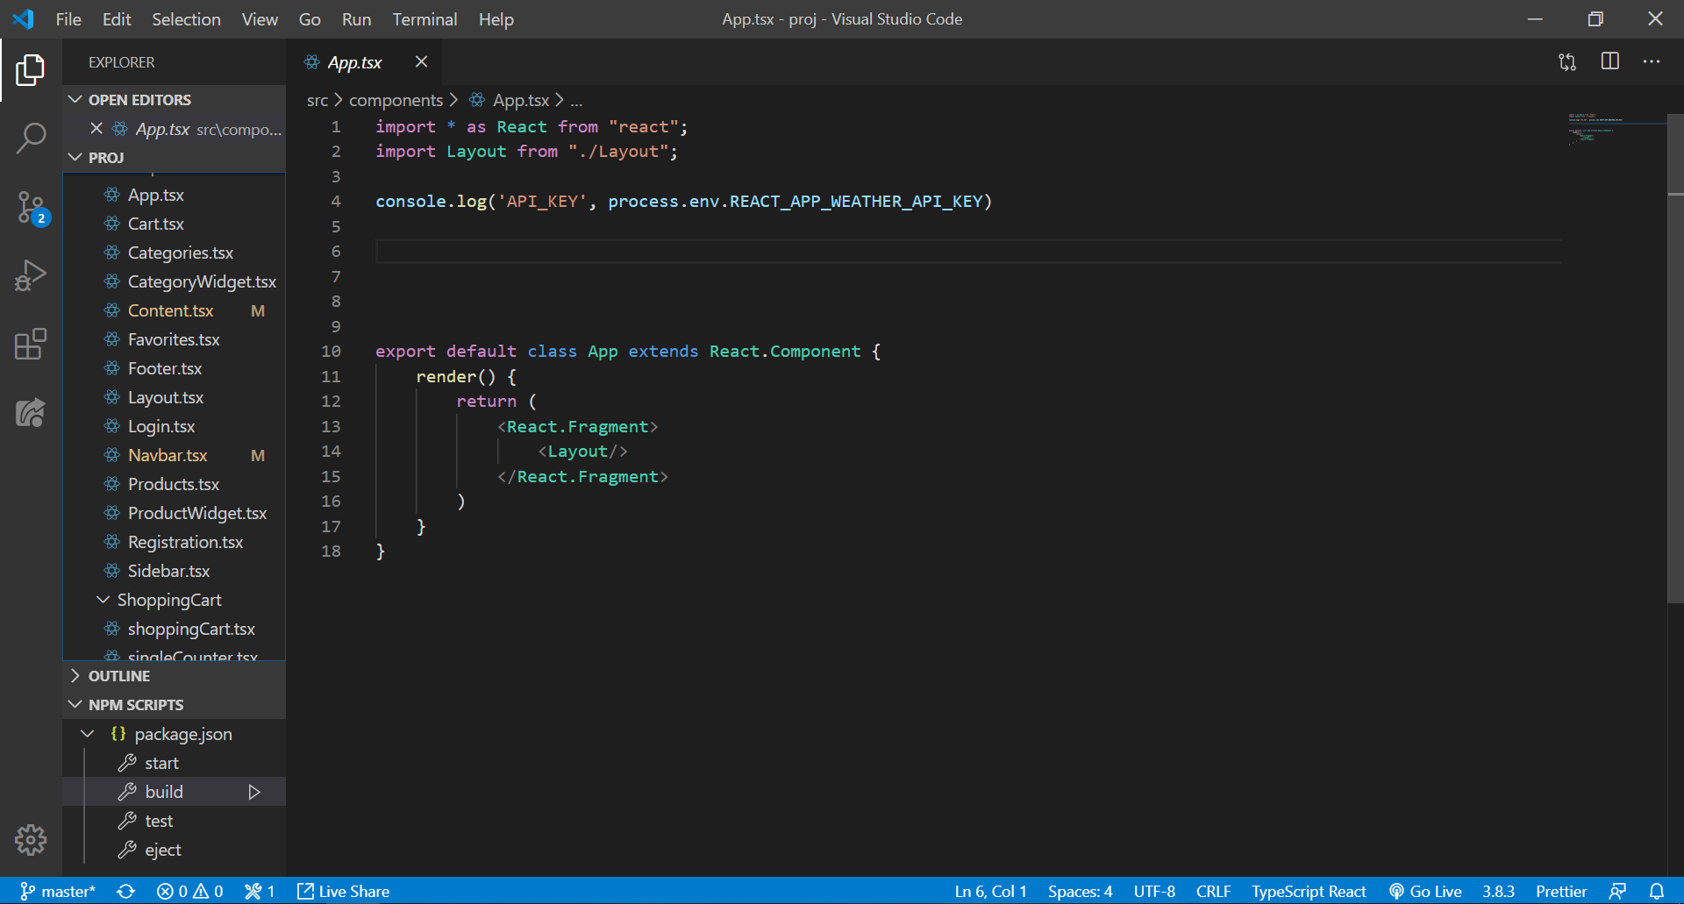


Slide 4
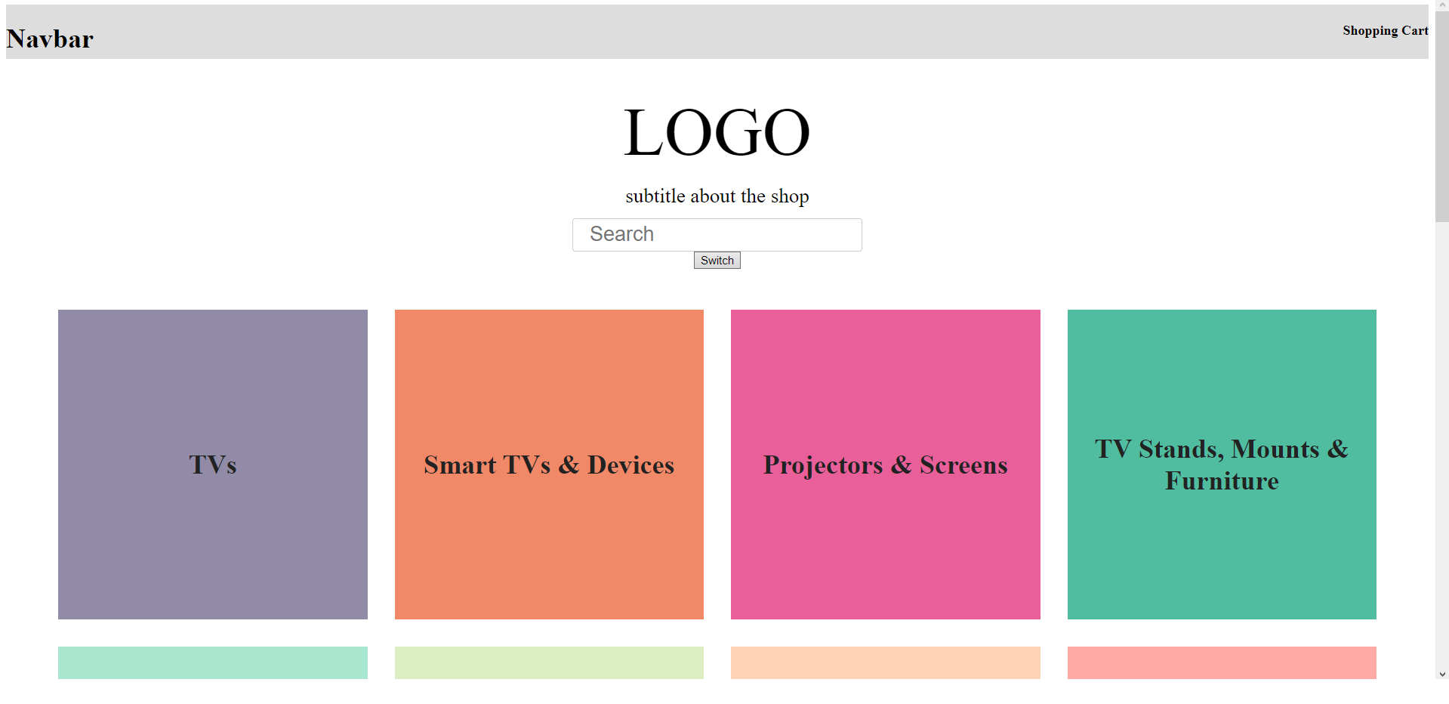

Slide 5
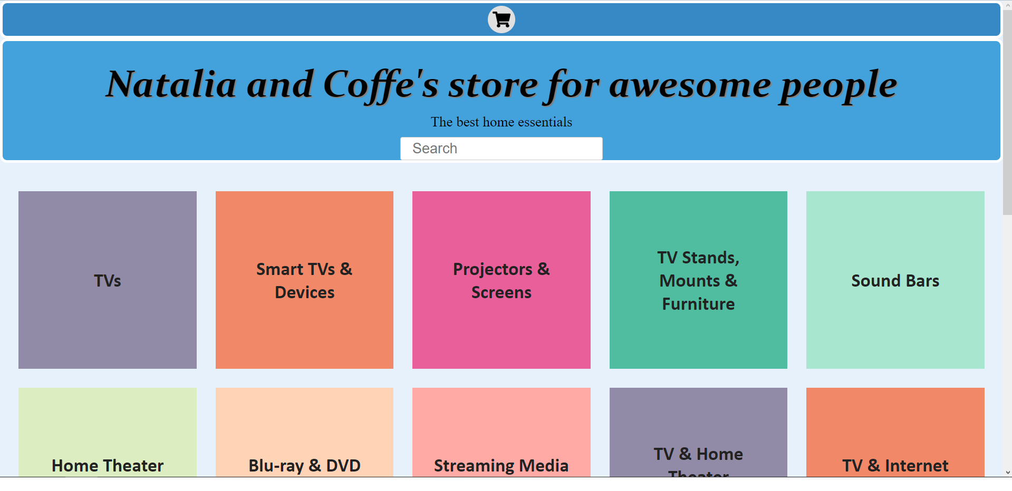

Slide 6


Slide 7

licensed by CC BY 3.0

Slide 8
Rundturs dags!

