Slide 1
Bank Loan Default Prediction
Christofer bryan Natanael komala

Slide 2
Problem Statement
Bank loans is one of the major source revenues for banks. The interest charged to the loan applicants is what drives the daily operation of banks. However, bank loans are often associated with risks such as borrowers defaulting on their loans. Banks have collected past data on loan borrowers which include detailed information of each borrower, and they would like to develop a machine learning model to predict if a new borrower is likely to default on their loans or not.

Slide 3
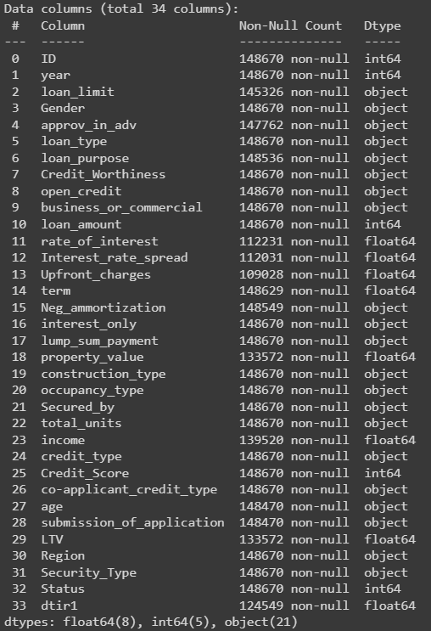
Data Understanding
148,670 rows
34 columns (33 features + 1 target variable)
Status is the target variable (0 or 1)
1 for defaulting applicants and 0 for non-defaulting applicants

Slide 4
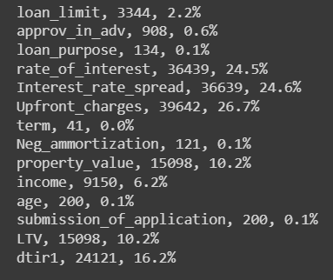
Data Understanding
Some columns contain missing values.
There are not duplicated records in this data.

Slide 5
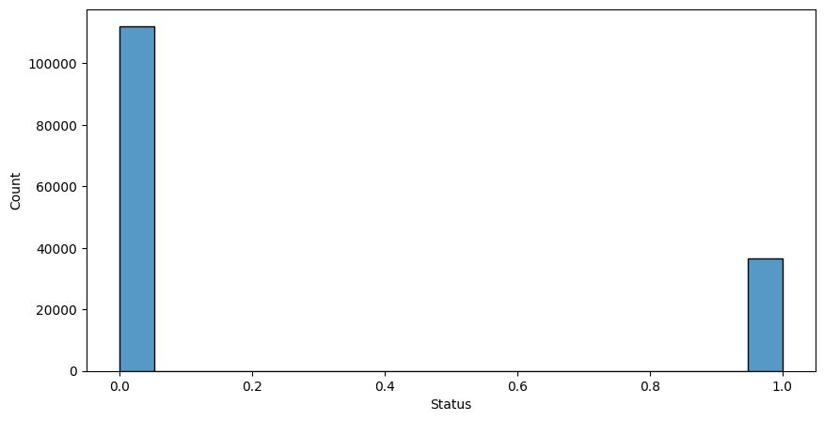
The Status target column is imbalanced.
Requires imbalanced data handling.

Slide 6
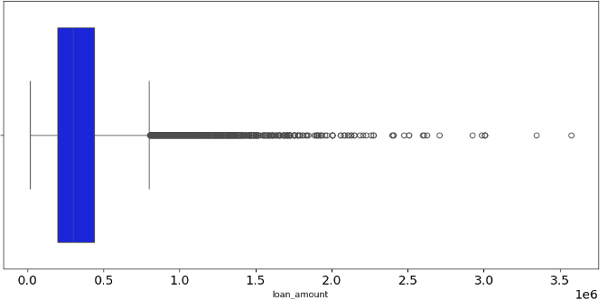
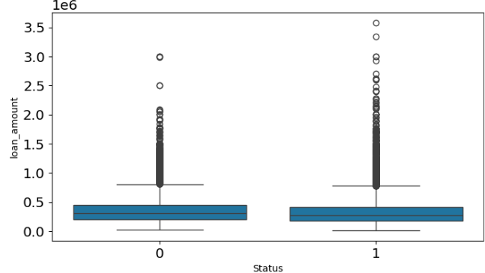
Exploratory Data Analysis
Loan amount is heavily right skewed. Majority of the applicants applied a loan amount between $0 and $796,500.
It does not appear to be a determining factor of loan defaults.

Slide 7
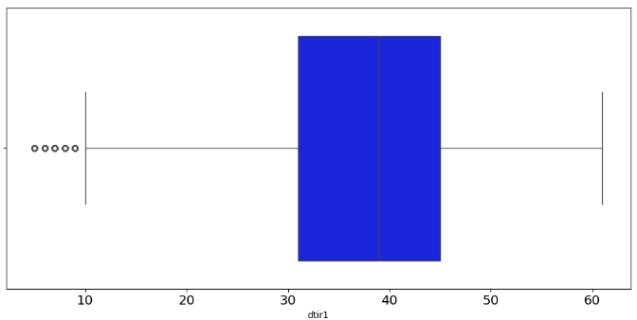
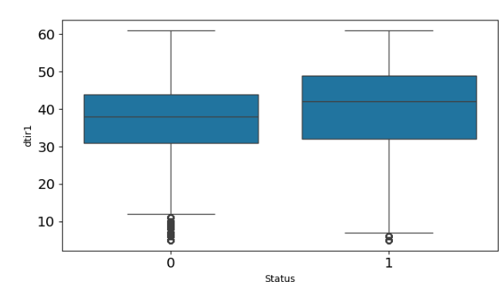
Exploratory Data Analysis
The debt-to-income ratio is about symmetrical. 50% of the applicants have a ratio of between 31 to 45.
It appears that applicants with higher debt-to-income ratio have a higher tendency to default on their loans.

Slide 8
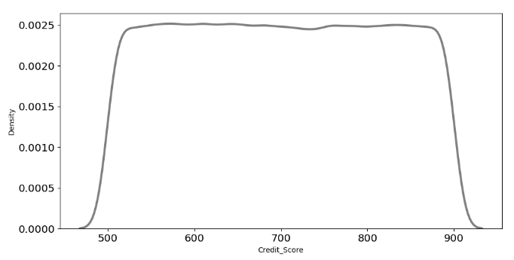
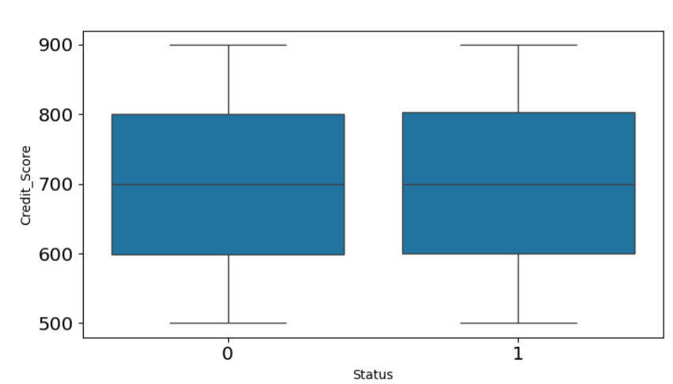
Exploratory Data Analysis
The credit score has a relatively uniform distribution from 500 to 900.
Credit scores do not appear to determine whether a loan applicant would default.

Slide 9
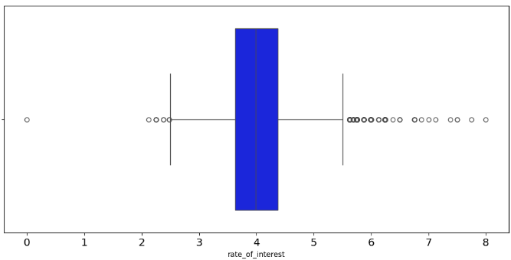
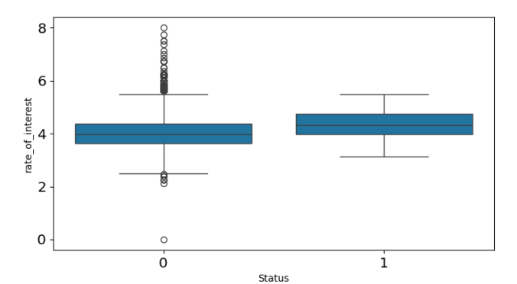
Exploratory Data Analysis
Applicants charged with higher interest rate are more likely to default on their loans.

Slide 10
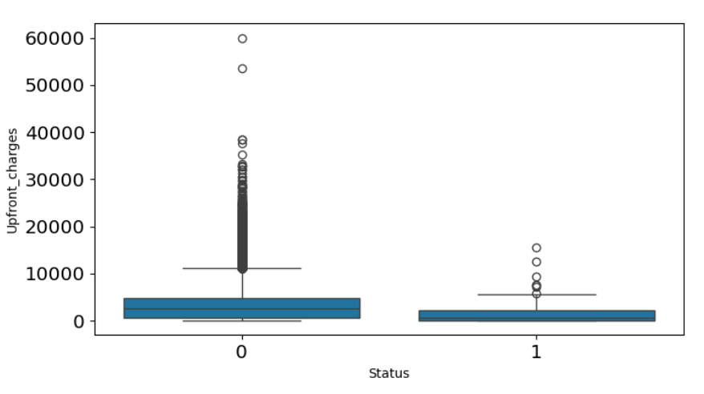
Exploratory Data Analysis
Applicants charged with higher initial loan charges are more likely to not default on their loans.

Slide 11
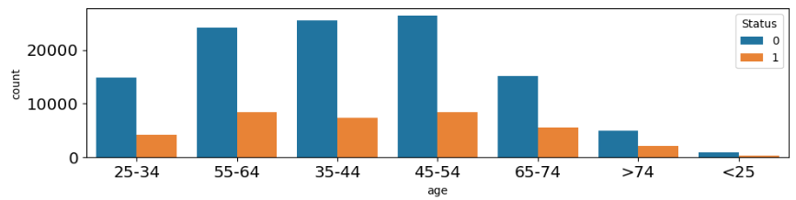
Exploratory Data Analysis
Majority of the applicants are of ages 45-54.
Looking at the applicants of ages 35-44 and 45-54, there is a lower proportion of defaulting applicants.

Slide 12
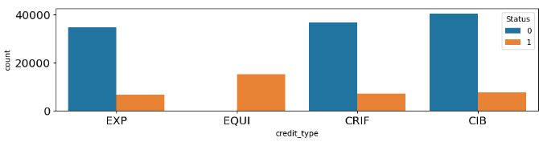
Exploratory Data Analysis
All applicants with EQUI credit type default on their loans and there is also a higher number of defaulting applicants who use EQUI compared to other credit types.

Slide 13
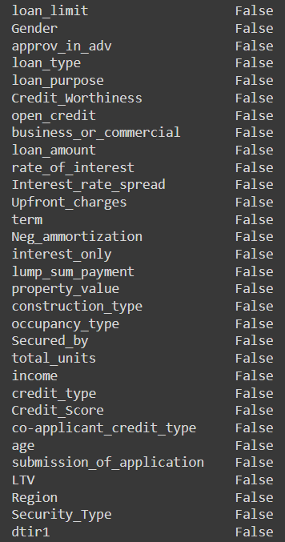
Imputing missing values
Before imputing
After imputing

Slide 14
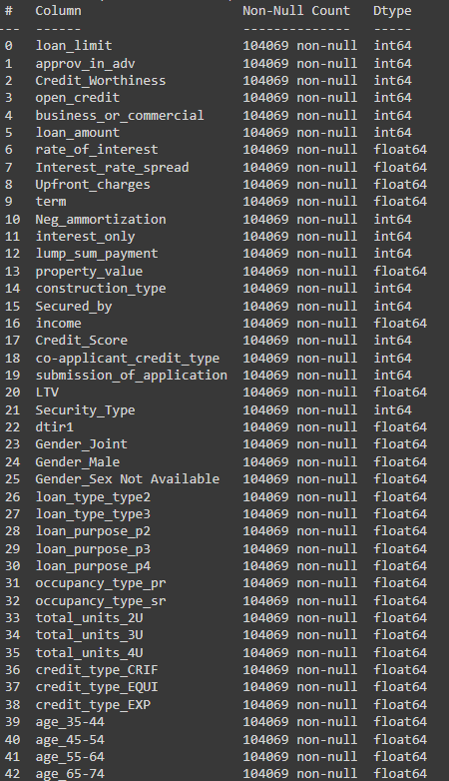
Feature Encoding
Convert non-integer categorical columns to integer type by performing label encoding and one hot encoding.

Slide 15
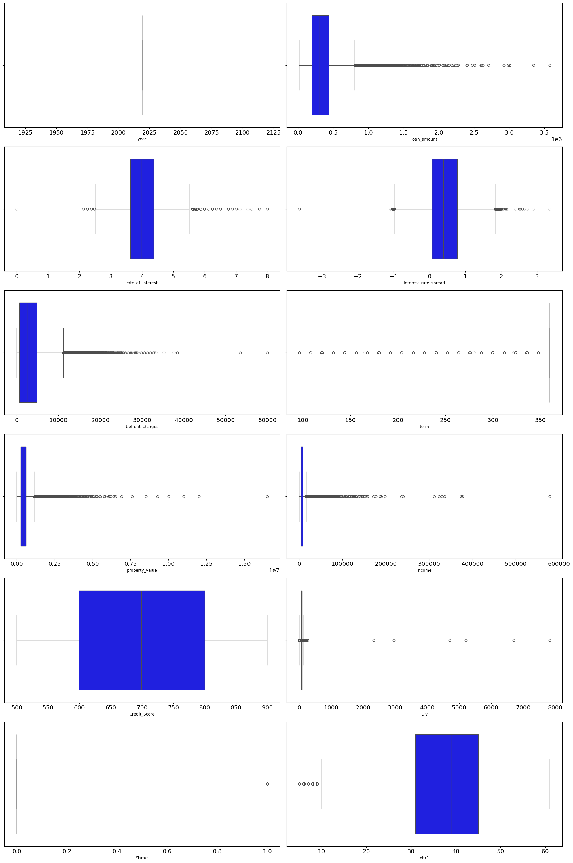
Outlier Handling

Slide 16
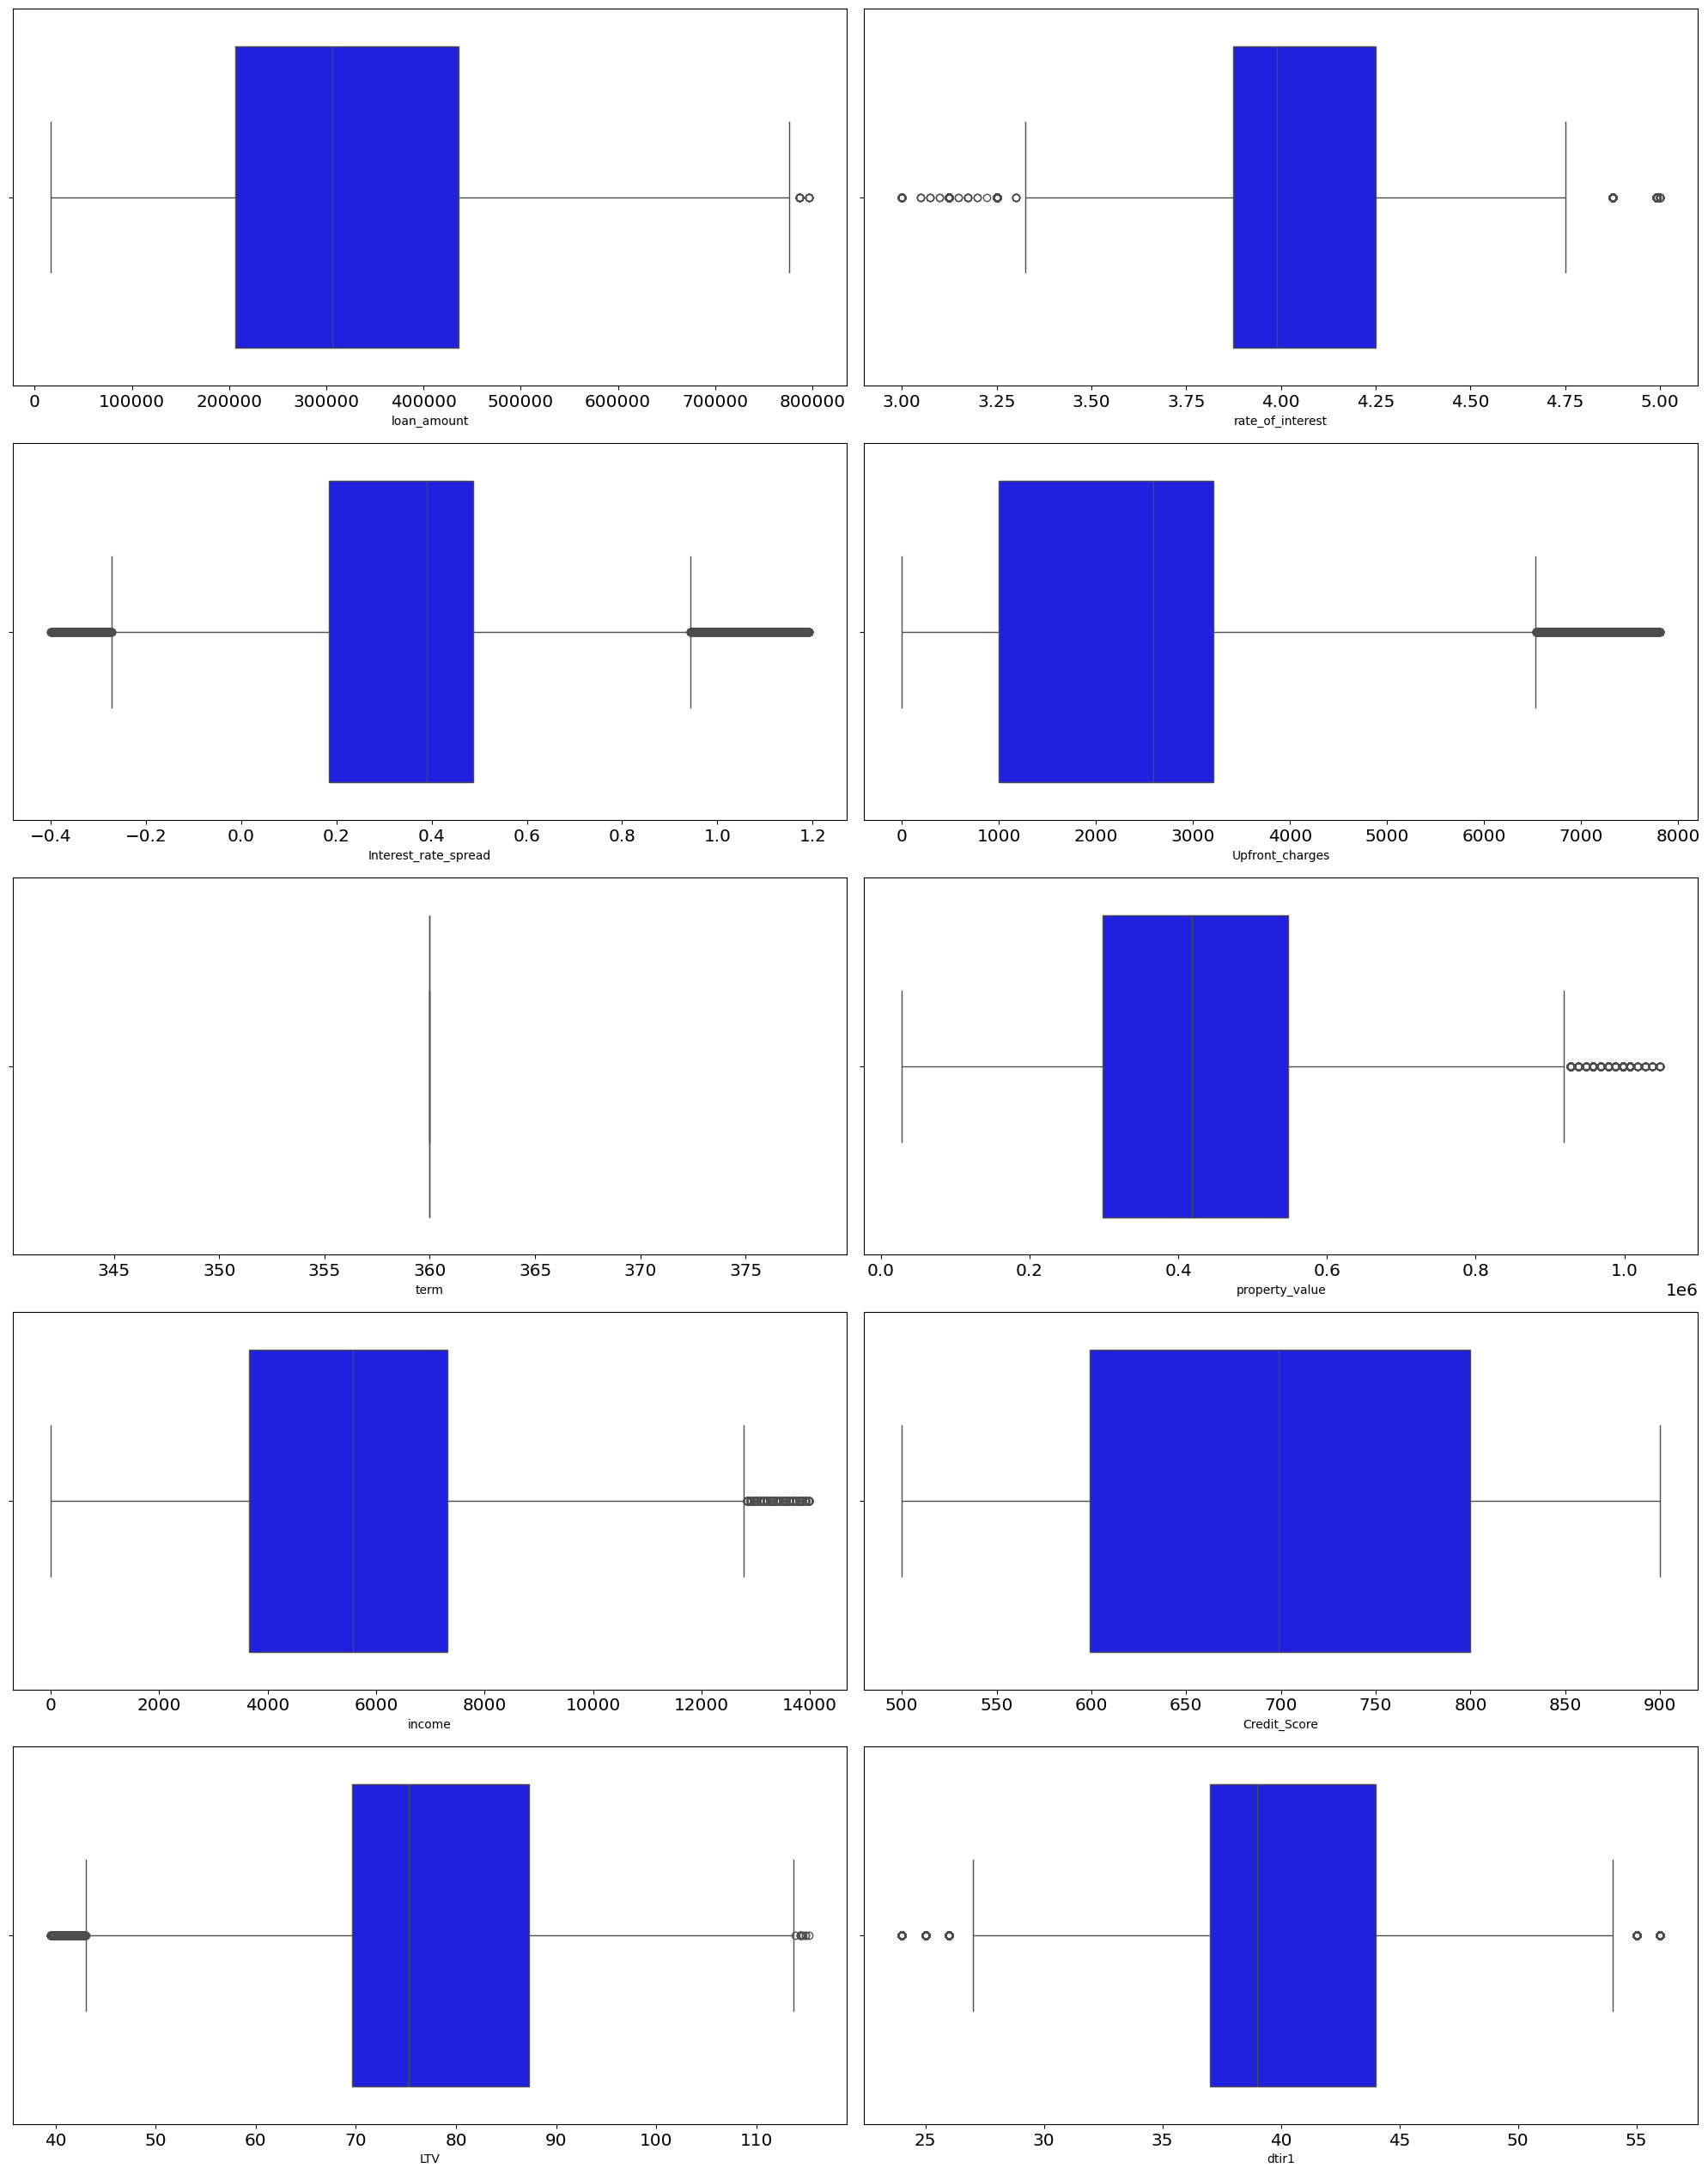
Outlier Handling

Slide 17
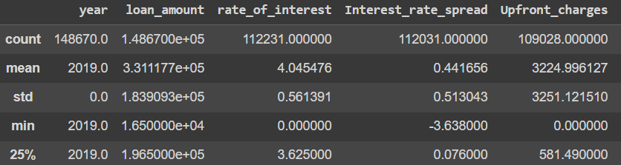
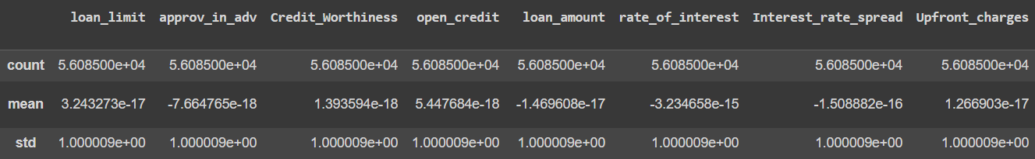
Feature Scaling
Before standardizing
After standardizing

Slide 18
Feature Selection
Dropped features:
1. “business_or_commercial”
2. “property_value”
3. “term”
4. “construction_type”
5. “Secured_by”
6. “Security_type”
7. “loan_type_type2”
Select features using VIF (variance inflation factor). Features with high VIF imply strong multicollinearity between them and are dropped.

Slide 19
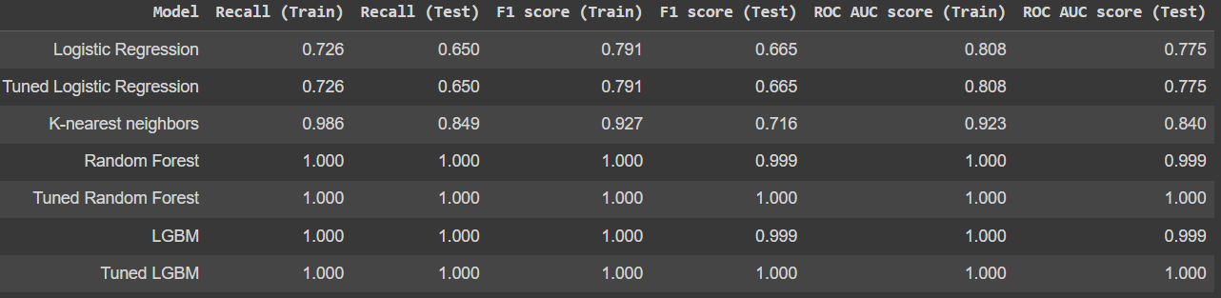
Modelling
The dataset is split into 70% training data and 30% testing data before data preprocessing to ensure no testing data leakage.
In the end, we select K-nearest neighbors as our model as it does not appear to be overfitting unlike random forest and LGBM. It also performs better (higher recall) than logistic regressions which appears to be underfitting.

Slide 20
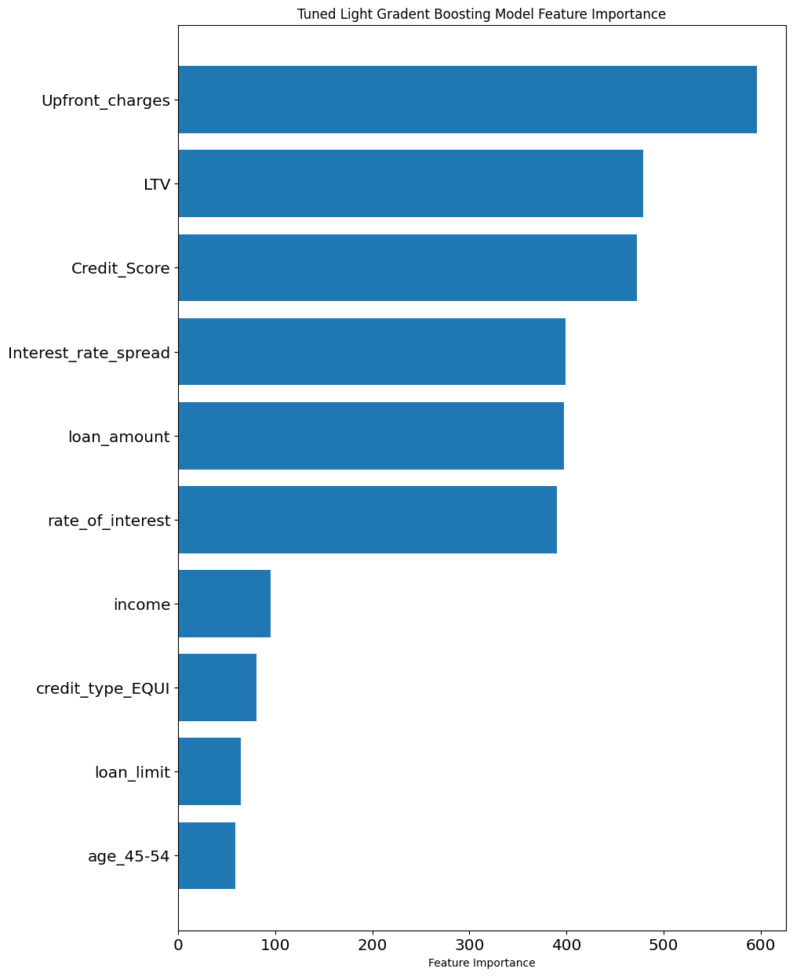
Feature Importance

Slide 21
Recommendations
Focus more on applicants with a lower debt-to-income ratio as they are more likely to repay their loans (not default).
Lower the interest rate for loan borrowers as higher interest rates tend to make applicants to default more.
Focus more on the two age groups 35-44 and 45-54 years old as they comprise majority of the total applicants and have lower proportion of defaulting applicants.
Avoid approving loans for applicants using credit type of EQUI.
Increase upfront charges so that only people who can really afford to repay their loans are approved to borrow from the bank. These people are more likely to successfully repay their loans.

