Slide 1
Benchmarking Incremental Dynamic Attribute Evaluation
RACR/JastAdd Performance Case Study in the Domain of Invasive Software Composition
Marta Tasić
Supervisor: Dipl.-Inf. Christoff Bürger

Slide 2
Table of Contents
Introduction
  Incremental vs. non-incremental attribute evaluation
  Task objective
Component and composition language design
  CJava programming language
  Composition language
Implementation
  RACR realization of CJava
  JastAdd realization of CJava
  Source code preview
Test suite
  Input: class boxes and composition recipe
  Exploiting attribute caching
Performance benchmarking
  Test setup
  Results
Conclusion

Slide 3
Introduction
Incremental vs. non-incremental attribute evaluation
Case study scenario:
  transformations of abstract syntax trees (AST) throughout invasive software composition (ISC)
  composition invalidates attributes
Two attribute evaluation strategies:
  entire tree reevaluation (non-incremental),
  reevaluation of invalidated attributes only (incremental)

Slide 4
Introduction
Incremental vs. non-incremental attribute evaluation
RACR: Attribute evaluator minimizes reevaluations using dynamic dependency analyses (incremental).
JastAdd: Attribute evaluator maintains attribute consistency using full flush approach (non-incremental).

Slide 5
Introduction
Task objective
Comparative case study to investigate performance impact of the two different attribute evaluation approaches by developing simple component and composition language using RACR and JastAdd.

Slide 6
Table of Contents
Introduction
  Incremental vs. non-incremental attribute evaluation
  Task objective
Component and composition language design
  CJava programming language
  Composition language
Implementation
  RACR realization of CJava
  JastAdd realization of CJava
  Source code preview
Test suite
  Input: class boxes and composition recipe
  Exploiting attribute caching
Performance benchmarking
  Test setup
  Results
Conclusion

Slide 7
Component and composition language design
CJava programming language
Subset of Java: static inner classes, static integer fields, static void methods with integer parameters, assignment of fields using qualified names.
<classsDecl> ::= public class <Id> { {<declaration>} }
<declaration> ::=
public static class <Id> { {<declaration>} }
| public static void <Id> ( {<parameter>} ) { {<bodyDecl>} }
| public static int <Id> ;
| [[ <Id> ]]
<parameter> ::= int <Id>
<bodyDecl> ::= int <Id> ; | <qId> = <qId> ;

Slide 8
Component and composition language design
CJava programming language
Well-formedness semantics:
  only fields can be referenced in assignments
  fields must be declared before they can be referenced in assignments
  re-declarations within a scope are not permitted

Slide 9
Component and composition language design
Composition language
Supported ISC operator: bind.
Syntax:
  hooks specified in dot notation with simple, arbitrary depth and limited depth wild-card support (*, **, *n)
Semantics:
  a class box is extended at it's declared hook
  a hook corresponds to any class member
<composer> ::= bind hook fragment ;

Slide 10
Table of Contents
Introduction
  Incremental vs. non-incremental attribute evaluation
  Task objective
Component and composition language design
  CJava programming language
  Composition language
Implementation
  RACR realization of CJava
  JastAdd realization of CJava
  Source code preview
Test suite
  Input: class boxes and composition recipe
  Exploiting attribute caching
Performance benchmarking
  Test setup
  Results
Conclusion

Slide 11
Implementation
RACR realization of CJava
Implemented in R6RS Scheme programming language.
Project structure:
  scanning and parsing
  abstract syntax
  static semantics
  composition API
  user interface
LexerCL
construct-lexer
Lexer
construct-lexer
ParserCL
construct-parser
Parser
construct-parser
AST
specify-ast
NameAnalysis
lookup
WellFormedness
correct?
Compositions
next-composition composer-exhausted?
UserAPI
parse do-compositions pretty-print

Slide 12
Implementation
JastAdd realization of CJava
Scanning and parsing implemented using Flex and Beaver.
User interface is implemented in Java.
Static semantics and composition API implemented using JastAdd.
Attribution and attribute equations as in the RACR realization.

Slide 13
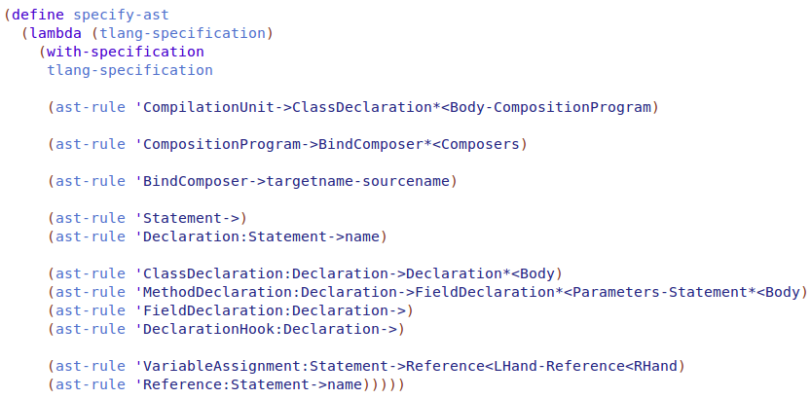
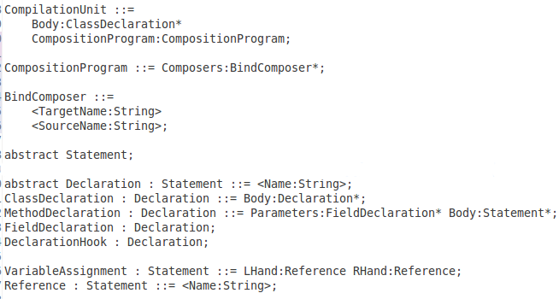
Implementation
Source code preview - AST specification

Slide 14
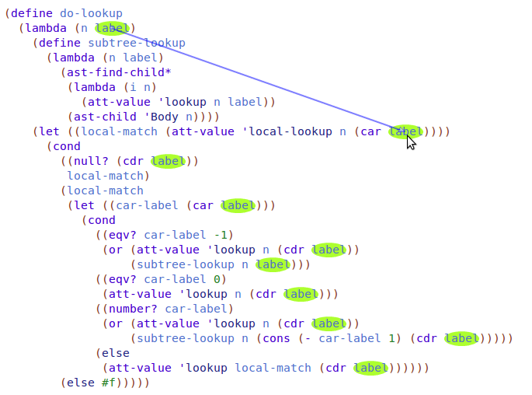
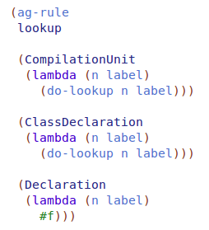
Implementation
Source code preview - Hook lookup
ClassA.Inner.hookA
ClassB.*.hookB
ClassC.**.hookC
ClassD.*3.hookD

Slide 15
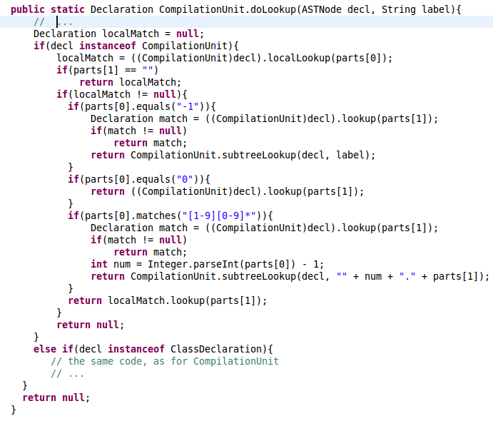
Implementation
Source code preview - Hook lookup

Slide 16
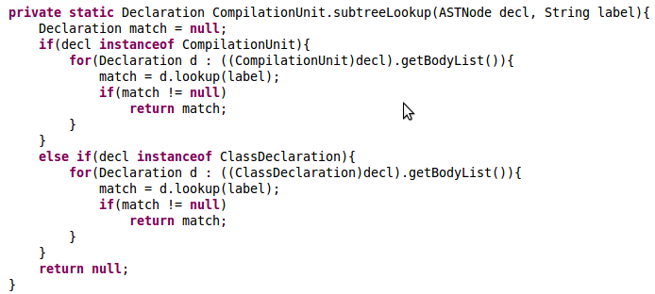
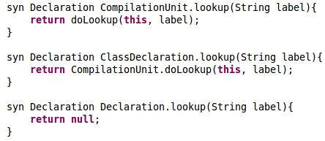
Implementation
Source code preview - Hook lookup

Slide 17
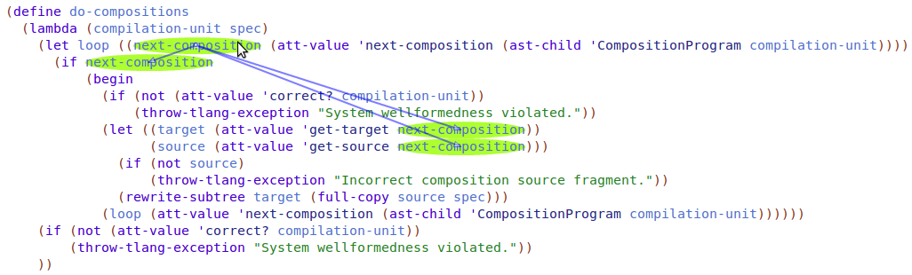
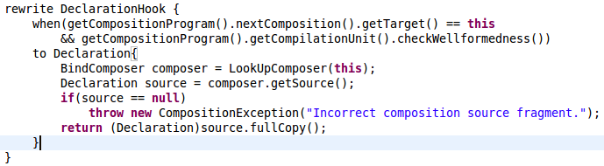
Implementation
Source code preview - Execution of compositions

Slide 18
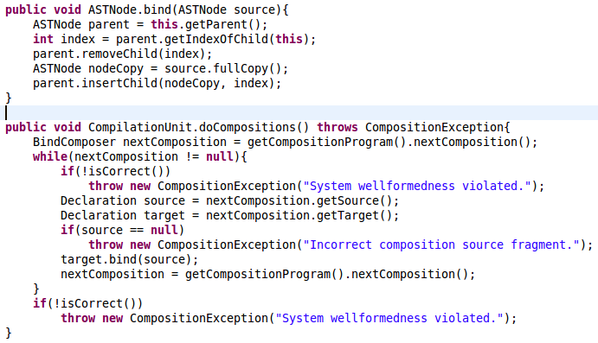
Implementation
Source code preview - Execution of compositions

Slide 19
Table of Contents
Introduction
  Incremental vs. non-incremental attribute evaluation
  Task objective
Component and composition language design
  CJava programming language
  Composition language
Implementation
  RACR realization of CJava
  JastAdd realization of CJava
  Source code preview
Test suite
  Input: class boxes and composition recipe
  Exploiting attribute caching
Performance benchmarking
  Test setup
  Results
Conclusion

Slide 20
Test suite
Input: class boxes and composition recipe
Class boxes and composition recipes are generated.
Parameters:
  total number of rewrites
  hook count

Slide 21
Test suite
Input: class boxes and composition recipe
public class Targets{
public static class InnerClassA{
public static int field1;
public static int field2;
public static void method(int param){
int localVar;
localVar = param;
}
public static class InnerClassB{
public static int field1;
public static int field2;
}
}
[[classhook01]]
[[classhook02]]
[[classhook03]]
. . .
}
Depends on given parameter: hook count

Slide 22
Test suite
Input: class boxes and composition recipe
public class Sources{
public static class Source01{
public static void method(int aa, int bb){
Targets.InnerClassA.InnerClassB.field1 = aa;
Targets.InnerClassA.InnerClassB.field2 = bb;
}
[[classhook01]]
}
public static class Source02{
public static void method(int aa, int bb){
Targets.InnerClassA.InnerClassB.field1 = aa;
Targets.InnerClassA.InnerClassB.field2 = bb;
}
[[classhook02]]
}
. . .
}
Depends on given parameter: hook count

Slide 23
Test suite
Input: class boxes and composition recipe
Targets.classhook01
Targets.Source01.classhook01
Targets.Source01.Source01.classhook01
. . .
bind Targets.*9.classhook01 Sources.**.Source01;
bind Targets.*9.classhook02 Sources.**.Source02;
bind Targets.*9.classhook03 Sources.**.Source03;
bind Targets.*9.classhook04 Sources.**.Source04;
bind Targets.*4.classhook05 Sources.**.Source05;
rewrite count: 45
hook count: 5

Slide 24
Test suite
Input: class boxes and composition recipe
C
X
X
H
H
. . .
. . .
x C
x C
M
H
M
H
x C
x C
A
A
M
H
A
A
M
H
. . .
x C
. . .
x C
A
A
M
H
A
A
M
H
. . .
x C
. . .
x C
A
. . .
A
M
H
A
. . .
A
M
H
A
. . .
A
A
. . .
A
. . .
. . .

Slide 25
Test suite
Exploiting attribute caching
lookup(classhook02)
correct?
lookup(classhook03)
correct?
C
X
. . .
X
C
C
. . .
Not influenced by rewrite - in particular stable subtree: attribute caching benefits.
M
C
M
C
A
. . .
A
M
C
A
. . .
A
M
C
A
. . .
A
M
C
A
. . .
A
M
C
A
. . .
A
M
H
A
. . .
A
M
H
A
. . .
A
A
. . .
A
. . .
. . .

Slide 26
Test suite
Exploiting attribute caching
Hook count
C
Challenge: inferring relation between AST dimensions and potential benefits of attribute caching.
X
X
H
H
H
H
. . .
x C
. . .
M
C
A
. . .
A
M
C
Composition depth
A
. . .
A
M
C
A
. . .
A
M
H
A
. . .
A
. . .

Slide 27
Table of Contents
Introduction
  Incremental vs. non-incremental attribute evaluation
  Task objective
Component and composition language design
  CJava programming language
  Composition language
Implementation
  RACR realization of CJava
  JastAdd realization of CJava
  Source code preview
Test suite
  Input: class boxes and composition recipe
  Exploiting attribute caching
Performance benchmarking
  Test setup
  Results
Conclusion

Slide 28
Performance benchmarking
Test setup
CPU, RAM and motherboard specification:
OS:
  Ubuntu 14.04 LTS
Memory Device
Array Handle: 0x0041
Error Information Handle: Not Provided
Total Width: 64 bits
Data Width: 64 bits
Size: 4096 MB
Form Factor: DIMM
Set: None
Locator: ChannelA-DIMM0
Bank Locator: BANK 0
Type: DDR3
Type Detail: Synchronous
Speed: 1600 MHz
Manufacturer: Micron
Serial Number: 316C5783
Asset Tag: 9876543210
Part Number: 16KTF51264AZ-1G6M1
Rank: 2
Configured Clock Speed: 1600 MHz
Architecture: x86_64
CPU op-mode(s): 32-bit, 64-bit
Byte Order: Little Endian
CPU(s): 4
On-line CPU(s) list: 0-3
Thread(s) per core: 1
Core(s) per socket: 4
Socket(s): 1
NUMA node(s): 1
Vendor ID: GenuineIntel
CPU family: 6
Model: 58
Stepping: 9
CPU MHz: 1600.000
BogoMIPS: 6186.10
Virtualisation: VT-x
L1d cache: 32K
L1i cache: 32K
L2 cache: 256K
L3 cache: 6144K
NUMA node0 CPU(s): 0-3
Base Board Information
Manufacturer: LENOVO
Product Name: MAHOBAY
Version: Win8 STD MM DPK IPG
Serial Number: ES11110462
Asset Tag:
Features:
Board is a hosting board
Board is replaceable
Location In Chassis: To be filled by O.E.M.
Chassis Handle: 0x0003
Type: Motherboard
Contained Object Handles: 0

Slide 29
Performance benchmarking
Test setup
Scheme R6RS VMs (RACR solutions):
  Larceny (native x86 compiler)
  Petite Chez Scheme (threaded interpreter)
  Racket (byte-code compiler)
Open JDK Java VM (JastAdd solutions):
  With specified rewrite rules (declarative composition)
  Without specified rewrite rules (iterative composition)

Slide 30
Performance benchmarking
Test setup
Three implementation versions:
  Well-formedness checked after all compositions
  Well-formedness checked before each composition
  No well-formedness check

Slide 31
Performance benchmarking
Results – hook count: 10

Slide 32
Performance benchmarking
Results – hook count: 10

Slide 33
Performance benchmarking
Results – hook count: 10

Slide 34
Performance benchmarking
Results – hook count: 20

Slide 35
Performance benchmarking
Results – hook count: 20

Slide 36
Performance benchmarking
Results – closer look on the hook count

Slide 37
Performance benchmarking
Results – closer look on the hook count

Slide 38
Performance benchmarking
Results – closer look on the hook count

Slide 39
Performance benchmarking
Results – JastAdd declarative composition

Slide 40
Performance benchmarking
Results – all together

Slide 41
Performance benchmarking
Results – all together

Slide 42
Performance benchmarking
Results – all together

Slide 43
Table of Contents
Introduction
  Incremental vs. non-incremental attribute evaluation
  Task objective
Component and composition language design
  CJava programming language
  Composition language
Implementation
  RACR realization of CJava
  JastAdd realization of CJava
  Source code preview
Test suite
  Input: class boxes and composition recipe
  Exploiting attribute caching
Performance benchmarking
  Test setup
  Results
Conclusion

Slide 44
Conclusion
Incremental attribute evaluation is advantageous in case of costly to evaluate but frequently queried attributes.
Real world programming languages have complex semantics.
Semantic evaluation in face of composition results in considerable attribute reevaluations ⇒ performance critical.

Slide 45
Conclusion
Semantic evaluation in face of composition results in considerable attribute reevaluations:
  Well-formed ISC introduces compilation cross-cutting semantics (i.e., many, huge reevaluations)
  Composition = Non-monotonic compilation (think of typedef problem in C++)
!!! PERFORMANCE MATTERS !!!

Slide 46
Thank you for your attention.

Slide 47
Performance benchmarking
Results – closer look on the hook count

Slide 48
Performance benchmarking
Results – closer look on the hook count

