Slide 1
HOTEL BOOKING (back end mini project: many to many)
Christofora Diana Yuliawati

Slide 2
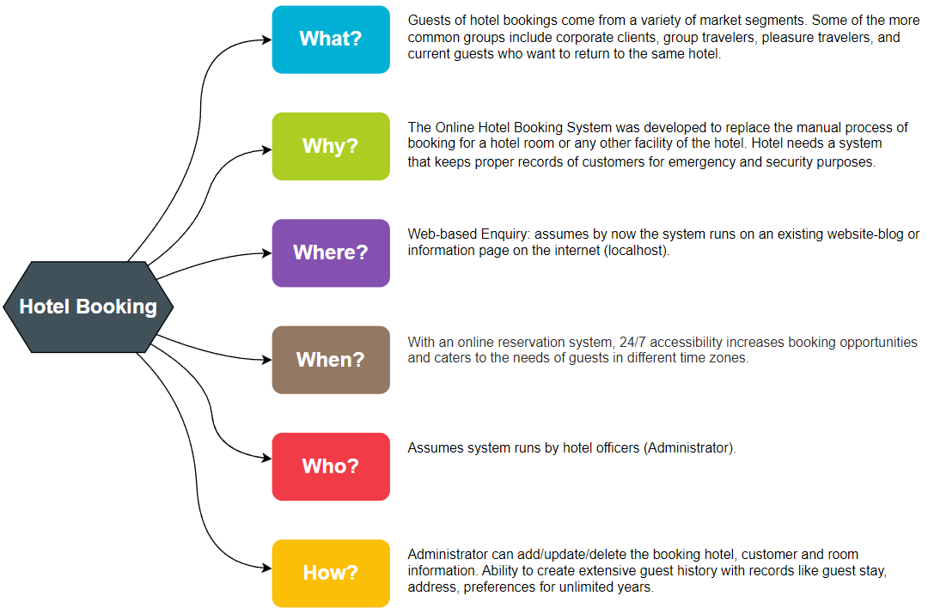
5w1h

Slide 3
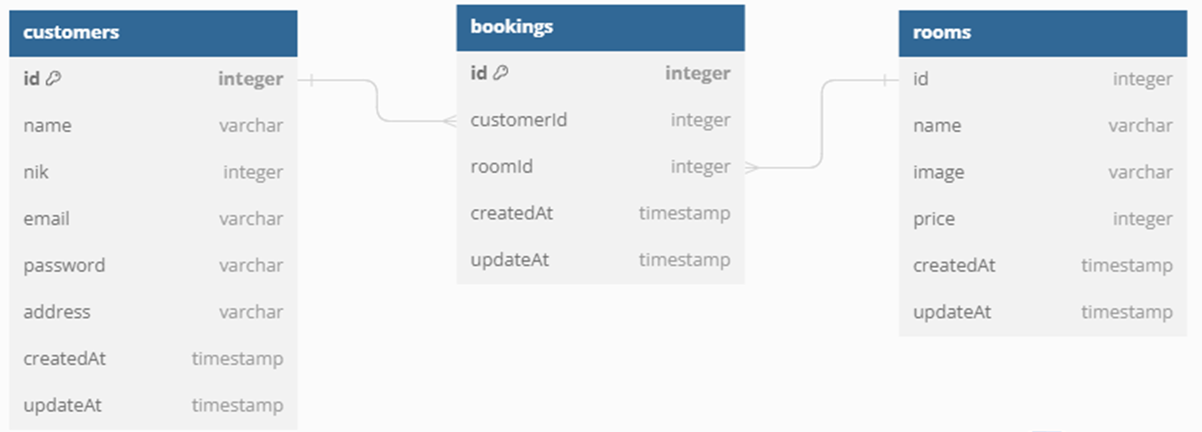
erd

Slide 4
Technology Stack
Node.js
Express
Postgres (DBMS): Many To Many
Sequelize (ORM): Basic Query / CRUD, Validations, Hooks
EJS (Template Engine) : CSS framework Bootstrap
Server Side: Booking Hotel
API Documentation : Swagger UI

Slide 5
THANK YOU

