Slide 1
Untitled

Slide 2

Quarto
Quarto enables you to weave together content and executable code into a finished presentation. To learn more about Quarto presentations see https://quarto.org/docs/presentations/.
Test figure

Slide 3
Bullets
When you click the Render button a document will be generated that includes:
Content authored with markdown
Output from executable code

Slide 4
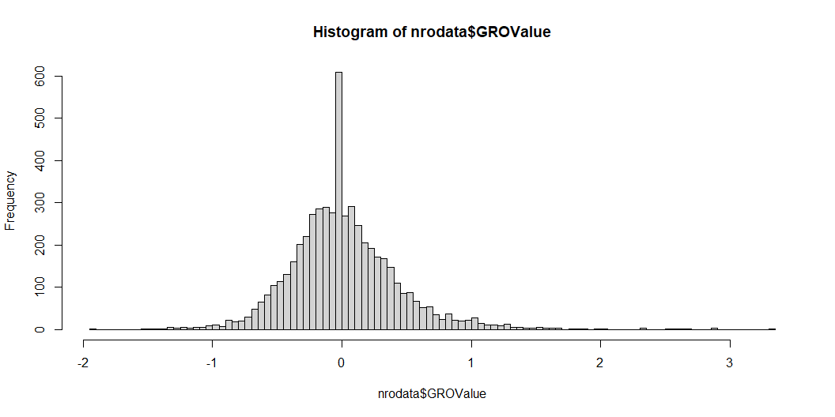
Code
When you click the Render button a presentation will be generated that includes both content and the output of embedded code. You can embed code like this:

Slide 5
[1] 0.5077577

